Slide 1
Auction it yourself
-Presented by
Amey Kelekar

Slide 2
What is Auction It Yourself?
Auction is yourself is also known as Reverse Auction.
A reverse auction is a type of auction in which the roles of buyer and seller are reversed.
In a reverse auction, the sellers compete to obtain business from the buyer and prices will typically decrease as the sellers undercut each other.

Slide 3
Project Details
Project aims at creating a website that is user friendly and caters to the various software needs of our customers.
My portal will enable the customers to create a profile of his/her own that will mention his/her specifications that he/she requires.
Then upload the profile in a matter of minutes on my portal.
The seller who are capable enough to provide the services and meet the buyer’s demands within the budget will bid for it.
The aim in making the bidding process completely transparent and also the bidders will be able to track their competition and what is their status.
Finally we are also providing a provision wherein the website without the interference of the administrator will decide and shortlist the best deal for the buyer which will help the buyer to make a wise decision.

Slide 4
Steps in Reverse Auction
Step 1: You (The Buyer) Post an Order
Step 2: Sellers Compete In Live Reverse Auction
Step 3: The Lowest Bidder Wins
Step 4: Buyer Contacts The Seller
Step 5: Buyer-To-Seller Funds Transfer
Step 6: Seller Sends The Product To The Buyer
Step 7: Buyer Receives The Package

Slide 5
Benefits
Reverse Auctioning drives the price to go down.
Buyer is able to view to compare the profiles of the various sellers.
The time between creating the request by the buyer and choosing the seller is considerably reduced.

Slide 6
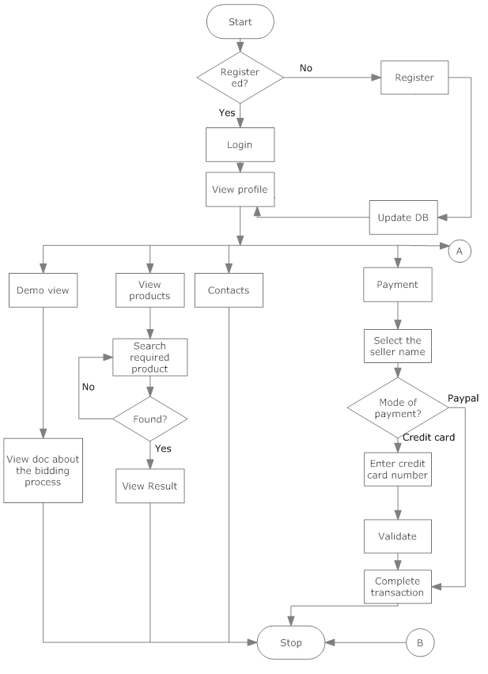
Flowchart/Block Diagram

Slide 7
Flowchart/Block Diagram(Continued)

Slide 8
Activity Diagram

Slide 9
THANK YOU!

