Slide 1

Basic Details of the Team and Problem Statement
Ministry/Organization Name/Student Innovation: Ministry of Law and Justice
PS Code: SIH1286
Problem Statement Title: Incentives based Design for onboarding Legal Service Providers such as Advocates, Arbitrators, Mediators, Notaries, Document Writers, etc on eMarket Place for extending Legal Services to Citizens in India
Team Name: Shadow Programmers
Team Leader Name: Amey Vijay Kurade
Institute Code (AISHE):
Institute Name: D.Y.Patil School of Engineering & Management
Theme Name: Miscellaneous

Slide 2
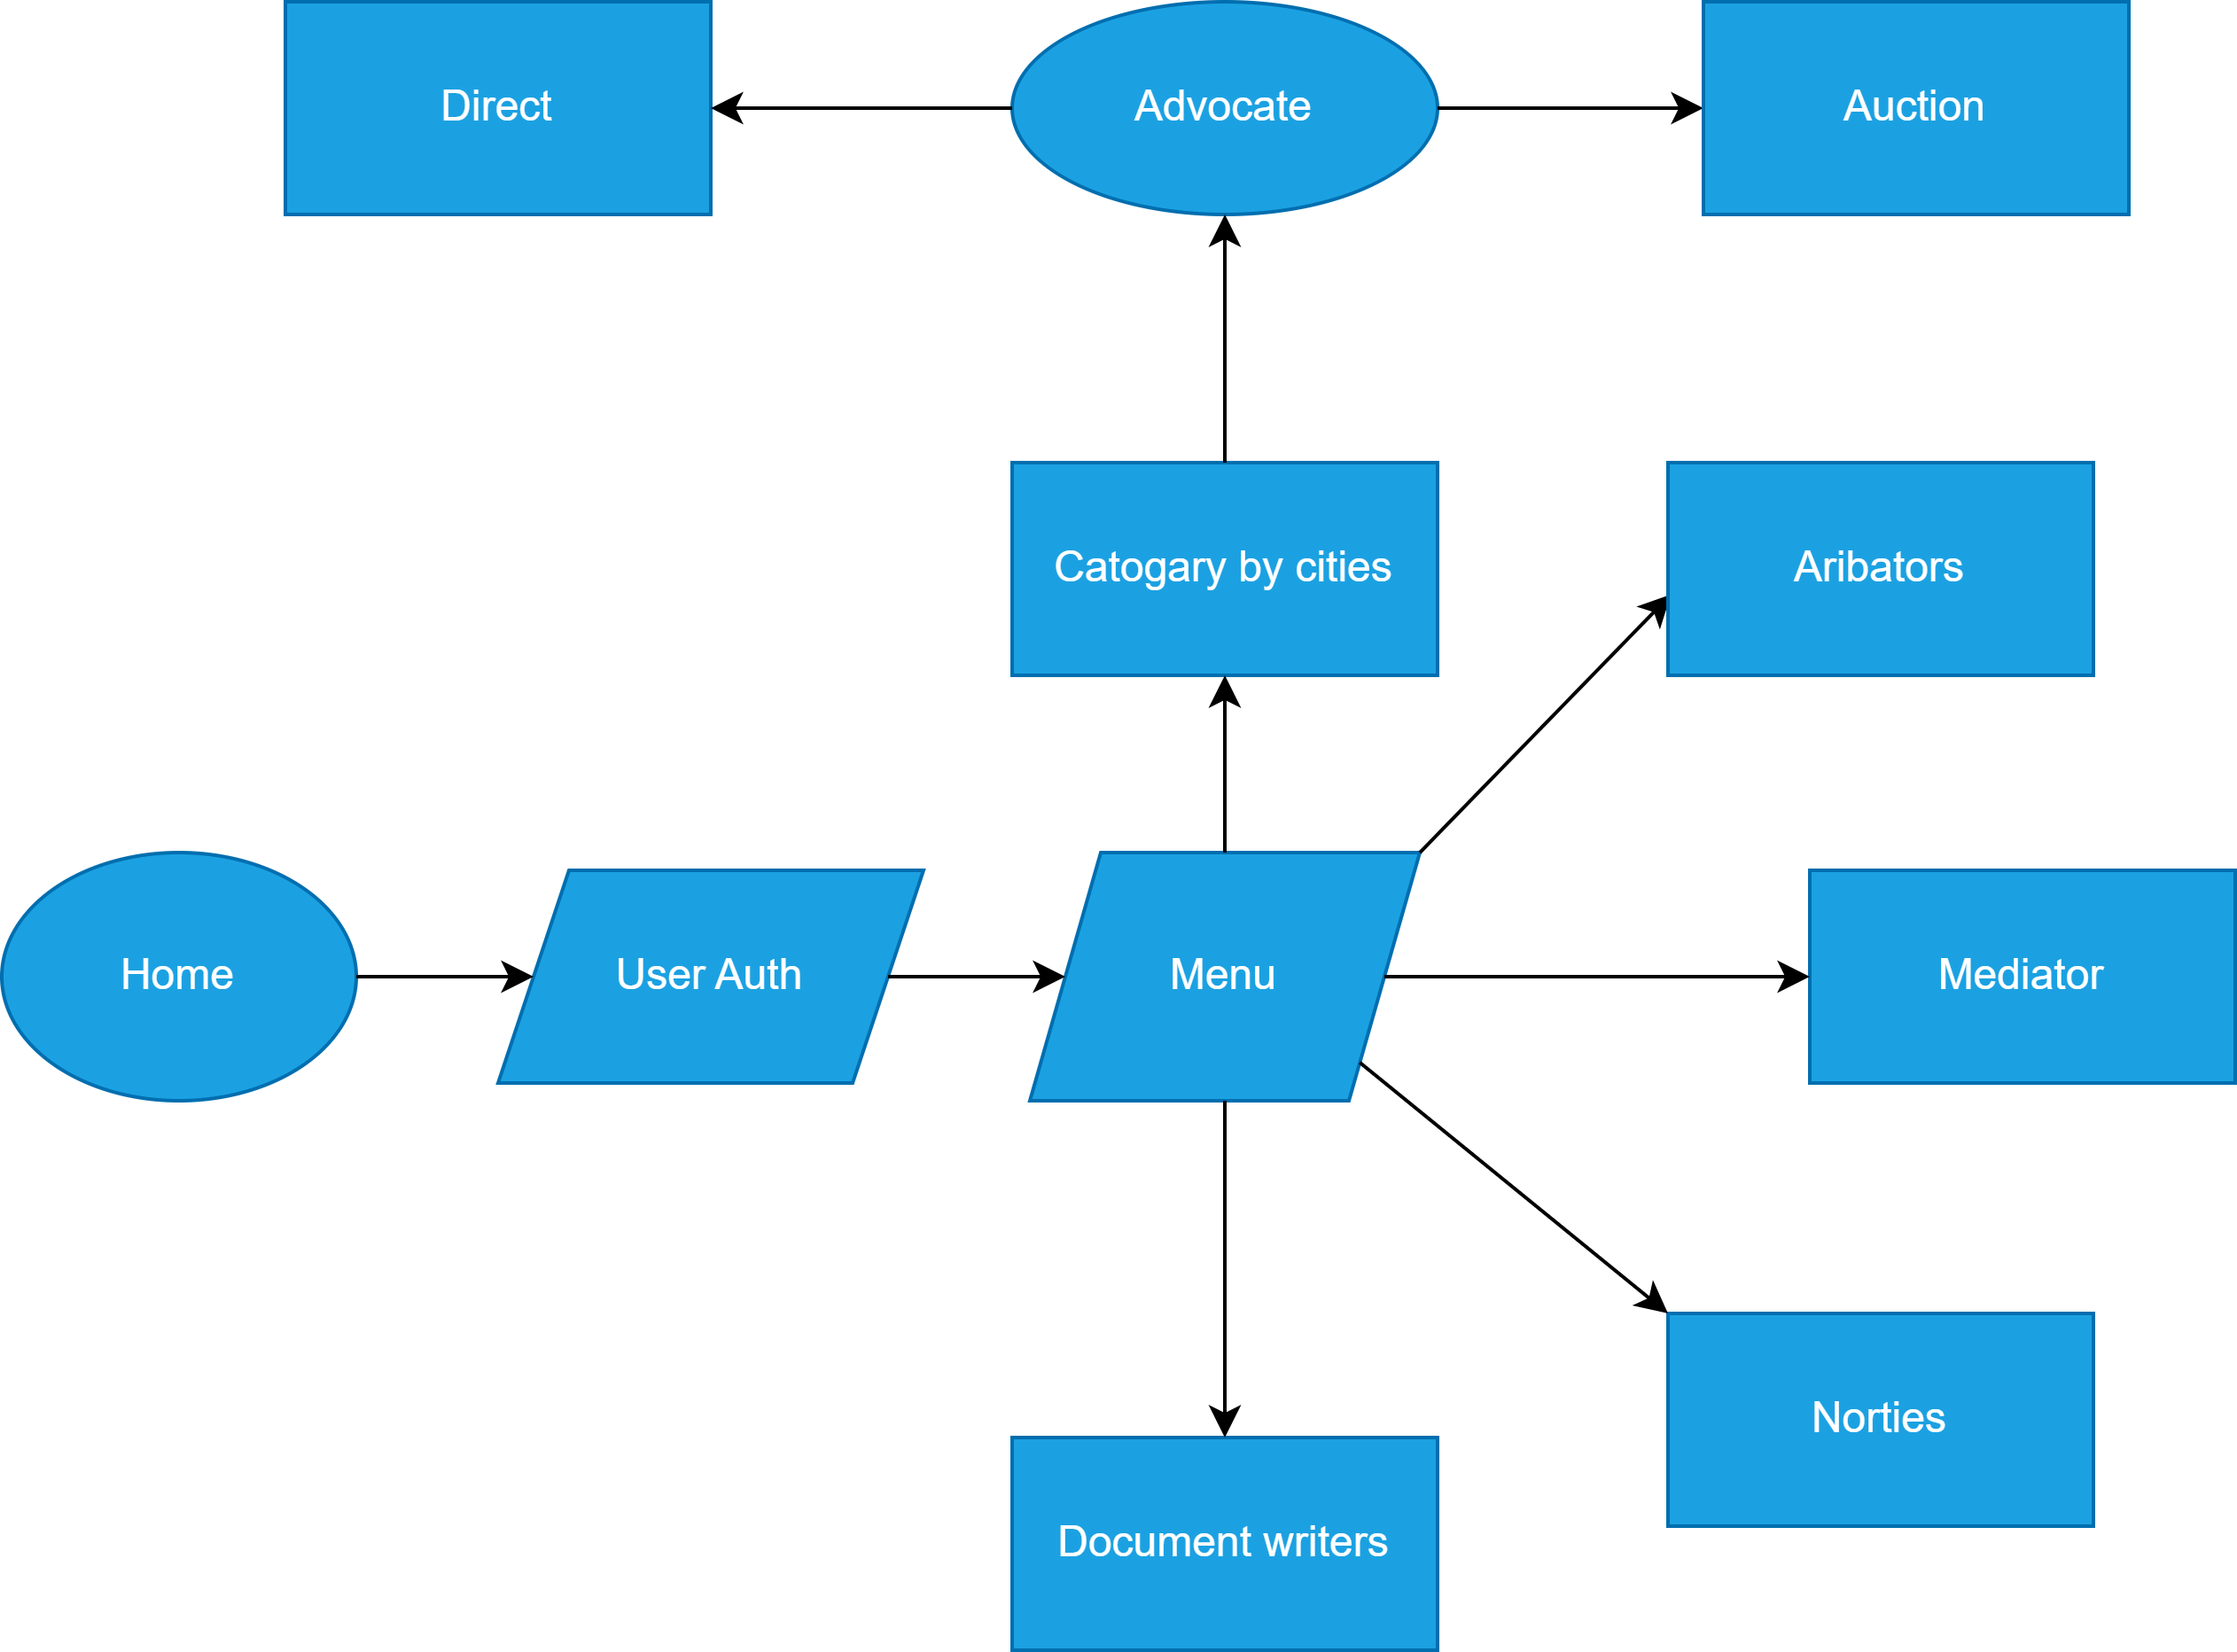











Idea/Approach Details
Describe your idea/Solution/Prototype here:
🚀Welcome to our Legal Services Hub—an all-in-one platform connecting you with legal experts like advocates, arbitrators, mediators, notaries, and document writers.
🔍Browse, choose, and connect: Explore various legal categories, read reviews, and connect directly with the expert of your choice.
🌟 Introducing Case Auctions: Have a legal case? Auction it! Set a starting price, let advocates bid, and choose the best offer.
💼 Your Legal Bid, Your Choice: Review bids, Advocate profiles, and negotiate terms directly to find the perfect match for your case.
📱Accessible Anytime, Anywhere: With a mobile-friendly platform, legal help is just a tap away, be it on the web or through our app.
Describe your Technology stack here:
Java / React Native (for app development).
HTML, CSS, JS / MERN Stack (for web development).
AWS / Azure (for Server).

Slide 3
Idea/Approach Details
Describe your Use Cases here
Describe your Dependencies / Show stopper here
Citizens can apply for, renew, and manage government documents such as passports, driver’s licenses, and ID cards. This eliminates the need to visit government offices and wait in long queues.
Users can file their taxes, make payments, and track their tax status. This simplifies the often complex and time-consuming process of tax management.
Users can access land records, pay property taxes, and apply for building permissions.
Students can apply for government scholarships, check exam schedules, download study materials, and even take online classes.
Dependencies :-
The success of this platform heavily depends on the support and cooperation from various government departments and agencies. They need to provide accurate and up-to-date information and services.
The platform must comply with all relevant laws and regulations. This includes data protection laws, e-commerce regulations, and digital signature laws.
Cons & Solutions:-
Any compromise in data security could lead to a loss of public trust and legal issues but It can be rectified through user authentications and OTP services.
Some people may resist the shift from traditional methods to digital platforms. This can be socialized through many campaigns.

Slide 4
Team Member Details
Team Leader Name: Amey Vijay Kurade
Branch: B.Tech Stream: CSE Year: I
Team Member 1 Name: Sanket Bhalchandra Patil
Branch: B.Tech Stream: CSE Year: I
Team Member 2 Name: Kadambari Krushnat Shinde
Branch: B.Tech Stream: CSE Year: I
Team Member 3 Name: Jeet Sachin Desai
Branch: B.tech Stream: CSE Year: I
Team Member 4 Name: Aditi Shivaji Patil
Branch: B.tech Stream: CSE (DS) Year: I
Team Member 5 Name: Vedant Shivgonda Chougule
Branch: B.tech Stream: CSE Year: I
Team Mentor 1 Name: Nihar Prasanna Mahajan
Category: Academic Expertise : Student Domain Experience: 0

