Slide 1
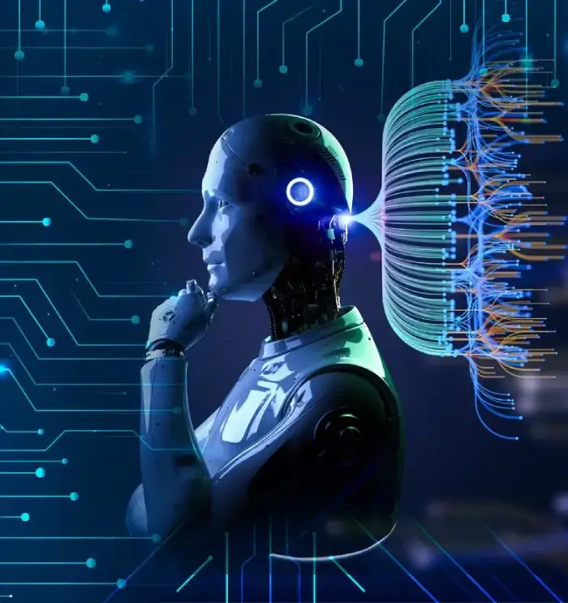
AI
Informative Presentation
Author: Amey G M
Date: October 26, 2023
Understanding the Future of Technology

Slide 2
What is Artificial Intelligence?
Defining AI: Artificial Intelligence refers to the simulation of human intelligence processes by machines, especially computer systems.
Core Goal: The primary objective of AI is to enable machines to perform tasks that typically require human intelligence, such as learning, problem-solving, decision-making, and perception.
Key Components: Modern AI encompasses various sub-fields including Machine Learning, Deep Learning, Natural Language Processing (NLP), and Computer Vision.

Slide 3
Key Branches and How AI Works
Machine Learning (ML): A fundamental branch where AI systems learn from data without explicit programming, identifying patterns and making predictions or decisions.
Deep Learning (DL): A more advanced subset of ML that utilizes neural networks with many layers (deep neural networks) to process complex data like images, sound, and text, mimicking the human brain's structure.
Data-Driven Approach: The effectiveness of AI heavily relies on vast amounts of data for training, allowing systems to continuously learn, recognize intricate patterns, and improve their performance over time.

Slide 4
Everyday Applications of AI
Personal Assistants: Voice-activated systems like Siri, Alexa, and Google Assistant leverage AI for natural language understanding, voice recognition, and executing commands.
Recommendation Engines: Platforms such as Netflix, Amazon, and Spotify use AI algorithms to suggest products, movies, or music tailored to individual user preferences and past behavior.
Autonomous Systems: AI powers technologies from self-driving cars and drones to robotic vacuum cleaners, enabling them to perceive their environment, navigate, and make decisions independently.
Healthcare & Finance: AI assists in critical areas like disease diagnosis, drug discovery, fraud detection, and providing personalized financial advice.

Slide 5
The Impact and Future of AI
Transformative Potential: AI is rapidly reshaping industries globally, enhancing efficiency, automating repetitive tasks, and creating entirely new possibilities across sectors like manufacturing, education, and entertainment.
Ethical Considerations: Addressing crucial concerns around data privacy, algorithmic bias, potential job displacement, and ensuring the responsible development and deployment of AI technologies is paramount.
Continuous Evolution: The field of AI is characterized by rapid advancements, promising increasingly sophisticated capabilities and deeper integration into various aspects of daily life in the coming years.

Slide 6
Summary / Key Takeaways
Summary Points:
AI is the simulation of human intelligence by machines, designed to learn, reason, and solve complex problems.
Machine Learning and Deep Learning are foundational technologies enabling modern AI systems to learn from vast datasets.
AI is already pervasive, powering essential functions from voice assistants and personalized recommendations to medical diagnostics and autonomous vehicles.
Responsible development and ethical considerations are crucial for harnessing AI's benefits while mitigating potential risks as it continues to evolve.

Slide 7
Timeline of AI Milestones
1950s:
  Alan Turing proposes the Turing Test; the term "Artificial Intelligence" is coined, marking the birth of the field.
1997:
  IBM's Deep Blue chess computer defeats reigning world champion Garry Kasparov, a significant achievement in symbolic AI.
2012:
  AlexNet wins the ImageNet Large Scale Visual Recognition Challenge, revolutionizing image recognition through deep learning.
2016:
  Google DeepMind's AlphaGo defeats Go world champion Lee Sedol, demonstrating AI's mastery over a highly intuitive game.
2022:
  OpenAI's ChatGPT launches, bringing advanced conversational AI and natural language generation capabilities to mainstream public awareness.

Slide 8
Thank You
We appreciate your time and attention

