Slide 1
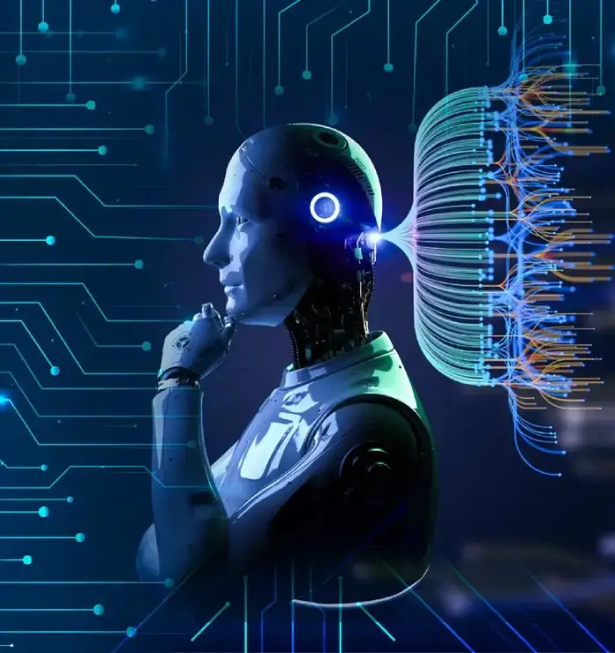
GenAI
Understanding Generative Artificial Intelligence for University Students
Author: Amey G M
Date: July 26, 2024
Shaping the Future of Innovation and Learning

Slide 2
Understanding Generative AI
What is Generative AI (GenAI)?: A cutting-edge subset of artificial intelligence focused on creating new, original content rather than just analyzing or classifying existing data.
Beyond Traditional AI: Unlike discriminative AI which predicts or categorizes (e.g., spam detection, image recognition), GenAI *generates* novel outputs that did not exist before.
Core Function: It learns patterns and structures from vast datasets to produce text, images, audio, code, and more that resemble the training data but are entirely new and unique.
Empowering Creativity: GenAI opens new avenues for human-computer collaboration, automating content creation, and exploring innovative solutions across various academic and professional fields.

Slide 3
Key Models and Capabilities
Foundation Models: Often built on large neural networks, these models are trained on massive, diverse datasets and can be adapted for numerous tasks, forming the backbone of many GenAI applications.
Generative Adversarial Networks (GANs): Comprise two competing neural networks (a generator and a discriminator) that learn to create highly realistic synthetic data, frequently used for generating images and videos.
Transformer Architecture: A powerful neural network design, particularly effective for sequential data like text, enabling models like GPT (Generative Pre-trained Transformer) to understand context and generate coherent, human-like language.
Diverse Outputs: Capable of generating a wide array of content, including natural language text, realistic images and art, synthesized audio, video clips, and even functional code snippets.

Slide 4
Applications & Impact for Students
Academic Enhancement: Utilize GenAI tools for research assistance, summarizing complex texts, brainstorming ideas for essays, and generating code examples to aid learning and problem-solving.
Creative Expression: Explore new forms of digital art, music composition, storytelling, and design concepts by leveraging GenAI as a creative partner, pushing the boundaries of traditional media.
Skill Development: Gain hands-on experience with cutting-edge technology, developing critical skills in prompt engineering, data analysis, and ethical AI application, which are highly valued in future careers.
Career Readiness: Understand how GenAI is transforming industries from marketing to engineering, preparing for roles that involve AI development, content creation, data science, and strategic innovation.

Slide 5
Summary / Key Takeaways
Summary Points:
GenAI is a Transformative Technology: It creates new, original content, moving beyond traditional AI's analytical focus.
Powered by Advanced Models: Key architectures like GANs and Transformers enable its diverse generative capabilities.
Vast Applications: From academic support and creative endeavors to industry innovation, GenAI is reshaping how we work and learn.
Empowers Students: Offers powerful tools for learning, research, and skill development, preparing for future challenges.
Requires Responsible Engagement: Understanding its potential, limitations, and ethical implications is crucial for effective and beneficial use.

Slide 6
Comparison: Traditional AI vs. Generative AI
Primary Goal:
Traditional AI:
  Analyze, classify, and predict based on existing data.
Generative AI:
  Create new, original data or content that did not previously exist.
Output Type:
Traditional AI:
  Labels, scores, classifications, predictions (e.g., "cat" or "not spam").
Generative AI:
  Text, images, audio, code, designs (e.g., a new poem or a unique image).
Learning Focus:
Traditional AI:
  Identify patterns and relationships within given data to make decisions.
Generative AI:
  Learn the underlying data distributions to produce novel, plausible samples.
Example Tasks:
Traditional AI:
  Spam detection, facial recognition, medical diagnosis support.
Generative AI:
  Writing articles, creating realistic deepfakes, composing original music.
Innovation Driver:
Traditional AI:
  Automation, efficiency, informed decision-making, problem-solving.
Generative AI:
  Creativity, content scalability, exploration of new possibilities, innovation.

Slide 7
Thank You
We appreciate your time and attention

