Slide 1
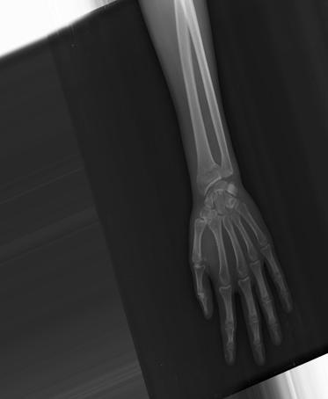
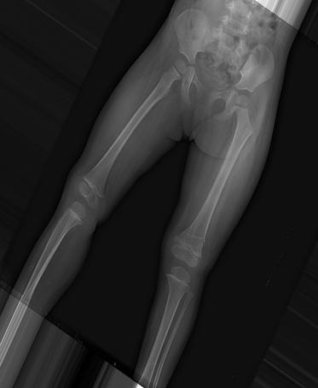
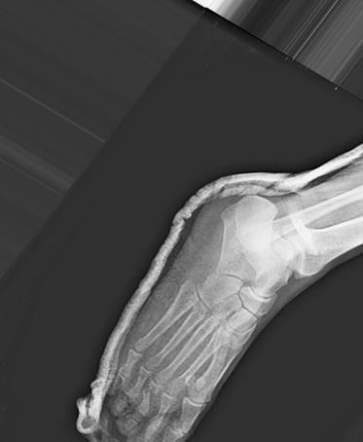
Logits1
T1
Logits2
∑
SoftMax
T=t
Soft Targets
T2
Logits3
T3
Distillation Loss
Pre trained models
Distillation
Model to be trained
Student Model
Logits
SoftMax
T=t
Soft targets
Ltask_w
Ltotal_w
∑
Ldistill_w
Evaluate
Combined Inputs
Trained Student Model

Slide 2
Classification Module
Fusion
Head 1
Dense(5, relu)
Dense(1, softmax)
∑
Flatten
Dropout(0.4)
Fracture Detection
TimeDistributedLSTM
Head 2
128 x 128
Image
Spatial Attention Module
Convolution Head Architecture
Head 1
Head 2
Spatial Attention Module
Conv Layer
Spatial Attention
XS
Conv2D(16,(3,3))
Spatial Attention(2)
Conv2D(16,(5,5))
Spatial Attention(2)
Channel-refined Feature(F’)
~
Output Feature Map
MaxPool (2,2)
Conv2D(8,(3,3))
MaxPool (2,2)
MaxPool (2,2)
Conv2D(8,(5,5))
MaxPool (2,2)
X
F”
[AvgPool, MaxPool]
X Element-wise-multiplication ~ Sigmoid Function

Slide 3
Head
Classification Module
Dense(3 , relu)
Dense(1, softmax)
Conv2D(16,(3,3))
Flatten
Dropout(0.4)
Fracture Detection
MaxPool (2,2)
Spatial Attention(2)
TimeDistributedLSTM
Conv2D(8,(3,3))
MaxPool (2,2)
128 x 128
Image

