Slide 1
UG Program – TE Information Technology
Hope Foundation’s
Finolex Academy of Management and Technology
(Affiliated to University of Mumbai)
P- 60¸ P- 60/1, MIDC, Mirjole Block, Ratnagiri – 415639
Mini/Minor/Major Project Presentation Semester – VI
18th March 2025

Slide 2
Deepfake Image-Audio Detection System
AY 2025-2026
Group No.- 02 | Registration No | PRN
Kadam Paras | T-23-
Kadam Soham Shridhar | T-23-
Nivalkar Sahil Ramdas | T-23-
Pandit Amey Ravindra | T-23-
Under the Guidance of | Affiliation and Designation
Guide | Prof. Rashmi More
Industry Mentor
Primary SDG-
Secondary SDG -

Slide 3
Vision and Mission Statements
Institute’s Vision
The academy aspires to nurture students as leaders who are in tune with global trends, equipped with engineering knowledge and practical skills, to excel in creativity and innovation in order to play their part in technological advancement of the nation.
Institute’s Mission
To become foremost seat of advanced technical learning as a center of excellence in the region.
To offer state of the art facilities and quality education at affordable cost
To inculcate in students the culture of ‘Play Hard and Play Fair’.
To advance sustainable development in the region through opportunities for entrepreneurship and industry-institute interaction.
To create a generation of young professionals who appreciate in all its aspects the necessity of balance between technological advances and traditional values.
Department’s Mission
M1-To Enrich students by rigorously implementing quality education (Knowledge)
M2-To empower the students with the required skills to solve the complex problems of modern society by following collaborative, multidisciplinary and sustainable activities (Skills)
M3-To imbibe professional ethics and social values in the students and make them responsible citizens (Attitude)
Department’s Vision
To provide excellent Information Technology education and aspire to nurture students as leaders who are in tune with global IT Trends

Slide 4
Program Educational Objectives (PEOs)
PEO1
01
PEO 2
02
To provide learners with Core Competence in mathematical, scientific and basic engineering fundamentals necessary to formulate, analyse and solve hardware/software engineering problems.
To prepare learners to solve business-centered problems by identifying, analyzing, developing, and implementing information system-based solutions with modern programming tools. To encourage learners to use best practices and implement technologies to enhance information security and enable compliance, ensuring confidentiality, information integrity, and availability.
PEO 3
03
PEO 4
To prepare learners for successful career in Indian and Multinational Organizations, Identify and evaluate current and emerging technologies. To provide our graduates with learning environment awareness of the life-long learning. To motivate students to pursue it throughout their career and higher studies. To encourage and motivate learners for Research & Development and entrepreneurship.
04
To introduce learners to ethical codes and guidelines including professional, ethical, legal and public policy issues to perform excellence, show leadership skills and demonstrate good citizenship
PEO 5
05
To develop effective written and oral communication skills to interact with clients, users, co-workers and managers. To enable learners to work as part of teams on multidisciplinary projects and diverse professional environments to accomplish a common goal by integrating personal initiative and group cooperation.
Notes:
© Copyright PresentationGO.com – The free PowerPoint and Google Slides template library

Slide 5
Presentation Overview
Project Overview and Background
Problem Statement
Project objectives and scope
Proposed System Architecture
Requirement Specification
Methodology
Results and Discussions
References
Literature Review
SDG Alignment
Industry Mentor - Communication Details

Slide 6
Project Overview and Background
Need: Unified detection for multi-modal (Image + Audio) forgeries to prevent financial fraud and identity theft.
Context: Deepfakes emerged in 2017; current AI now generates hyper-realistic content that bypasses traditional security.
Impact: Escalating threats to biometric authentication (Face/Voice ID) and the spread of high-stakes misinformation.
Gaps: Existing systems are "Single-Mode" (Audio or Video) and look for outdated artifacts like blinking patterns.
Our Solution: A robust, dual-analysis system designed to detect modern deepfakes that "single-mode" systems miss.

Slide 7
Problem Statement
The rapid evolution of Generative AI has moved beyond simple digital editing to create hyper-realistic deepfakes that seamlessly integrate manipulated imagery with cloned audio, making them indistinguishable to human observation and traditional security systems. Existing detection methods are largely "single-mode," focusing on isolated visual or auditory artifacts that modern AI has already learned to correct, leaving a critical gap in our digital defenses. This technological lag creates significant risks for financial fraud, identity theft, and the compromise of biometric authentication. Consequently, there is an urgent need for a unified, dual-analysis detection system capable of identifying cross-modal inconsistencies to provide a robust defense against the next generation of multi-modal AI forgeries.

Slide 8
Project objectives and scope
To develop a lightweight, efficient platform that allows users to upload and verify audio and image files independently.
To implement an Ensemble-based Framework (CNNs + ResNet) to stay ahead of rapidly advancing deepfake generation models.
To integrate specialized Audio Forensic capabilities using MFCC feature extraction and Random Forest classification.
To create a comprehensive Flask-based web dashboard that serves as a one-stop platform for investigators to upload and receive instant results.

Slide 9
Literature Review
Authors & Year | Paper Title | Domain | Methodology / Algorithms | Key Findings & Results
Shah & Parekh (2024) | Detecting Deepfake: Audio, Video & Image using DL | Audio, Video, Image | Mel-spectrograms + ML/DL training | High trade-off between complexity and precision.
Mcuba et al. (2023) | Effect of DL Methods on Deepfake Audio Detection | Audio | MFCC, Chromagram, Spectrograms; VGG-16 vs. Custom | Custom Architecture excelled with Spectrograms.
Huang et al. (2023) | Implicit Identity Driven Deepfake Face Swapping | Image (Face Swap) | Implicit Identity Framework (EIC/IIE loss) + CosFace | Identity differences are strong forgery indicators.
Rana et al. (2022) | Deepfake Detection: A Systematic Literature Review | Multi-modal | SLR of 112 articles (DL, ML, Blockchain) | DL methods (CNN, LSTM) make up 77% of research.
Dang et al. (2020) | On the Detection of Digital Face Manipulation | Image & Video | Attention Mechanism to localize manipulation | Attention maps accurately highlight fake regions.

Slide 10
Base Papers (Journal/ Conference)
This project is built upon the foundational methodologies and research findings of the following key papers:
Detecting Deepfake: Audio, Video & Image using Deep Learning Technique
Authors: Nirav K. Shah, Arpit B. Parekh (2024)
Relevance: Provides the framework for unified multi-modal detection (Audio/Video/Image) which is the core of our project.
The Effect of Deep Learning Methods on Deepfake Audio Detection
Authors: Mvelo Mcuba et al. (2023)
Relevance: Established the use of MFCC and Spectrograms for audio forensics, which we use for our "Auditory" module.
Implicit Identity Driven Deepfake Face Swapping Detection
Authors: Baojin Huang et al. (2023)
Relevance: A top-tier CVPR conference paper that provides the logic for detecting pixel-level facial inconsistencies.
Deepfake Detection: A Systematic Literature Review
Authors: Md Shohel Rana et al. (2022)
Relevance: A comprehensive review that justifies our choice of CNN and LSTM architectures as the most effective current standards.

Slide 11
Proposed System Architecture
System Architecture Diagram: A block or layered diagram showing main components (e.g., user interface, database, application logic, external systems, sensors, cloud, etc.) and their interactions.
Brief Description: 2-3 lines summarizing how the system operates, the roles of major modules, and the flow of data between components.
Key Modules/Blocks: Label and briefly describe each major module (e.g., Data Acquisition, Processing, Storage, Analytics, Communication, Security).
Data Flow: Indicate the direction and nature of data (input, output, feedback, etc.) through arrows or lines in the diagram.
Technology Stack (optional): Mention core technologies (e.g., languages, platforms, communication protocols) if relevant.
Assumptions/Constraints (optional): List any important constraints, like network dependency, hardware limitations, scalability targets.

Slide 12
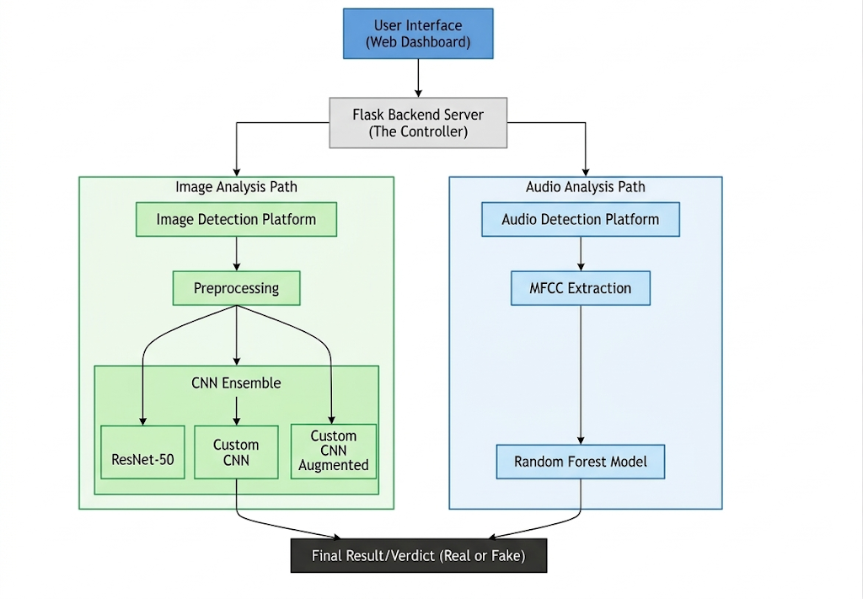
Proposed System Architecture

Slide 13
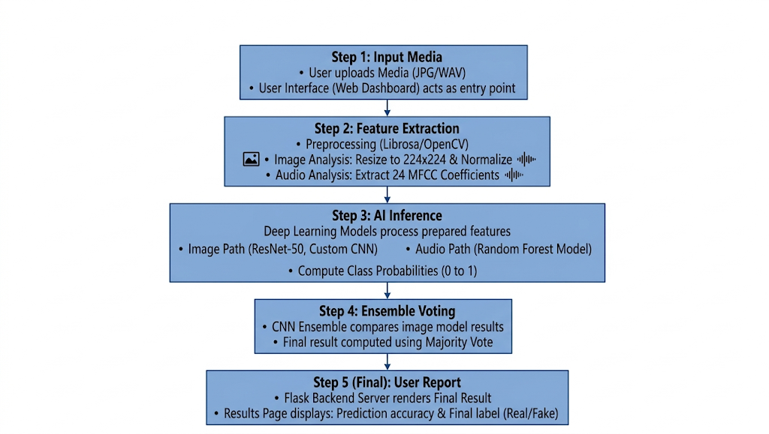
Methodology

Slide 14
Methodology
Media Handling: Specialized upload zones for Image and Audio media types, with format-specific validation.
Feature Extraction: Face localization/alignment for images; MFCC statistical extraction (mean/std) for audio signals.
Dedicated Pipelines:
Image Pipeline: Inference via an Ensemble of Custom CNN (Keras) and ResNet-50 (PyTorch) with accuracy up to 89%.
Audio Pipeline: Inference using a Random Forest classifier trained on 48 MFCC-derived features with 82% accuracy.
Platform Integration: Integrated inference engines for Keras, PyTorch, and Scikit-Learn into a cohesive Flask backend.
Deployment: Containerized via Docker and hosted on Hugging Face Spaces for real-time accessibility.

Slide 15
Dataset Description
Image Datasets: Trained on 140k Real/Fake Face and FaceForensics++ datasets, capturing the "new wave" of GAN-generated artifacts.
Audio Datasets: Trained on ASVspoof and custom synthetic samples to identify modern voice cloning signatures.

Slide 16
Machine Learning Algorithms
ResNet-50 (PyTorch): Fine-tuned for deep spatial feature extraction (89% accuracy).
Custom CNN: 3× Conv Blocks specifically designed for pixel-level artifact detection (86% accuracy).
Random Forest: Trained on MFCC features for lightweight yet reliable audio forensics (82% accuracy).
PCA & SVM: Used for dimensionality reduction and visualization of complex feature representations

Slide 17
Tools and Technologies
Backend Framework: Python 3.10+, Flask, Gunicorn.
Deep Learning Library: PyTorch, TensorFlow, Keras, Torchvision.
Analysis Tools: Librosa (Audio), OpenCV (Images), Scikit-Learn.
Cloud & DevOps: Docker, Hugging Face Spaces.

Slide 18
References- (Use IEEE Reference Styling)
Shah, N. K., & Parekh, A. B. (2024). "Detecting Deepfake: Audio, Video & Image using Deep Learning Technique." TIJER.
Mcuba, M., et al. (2023). "The Effect of Deep Learning Methods on Deepfake Audio Detection for Digital Investigation." Procedia Computer Science.
Rana, M. S., et al. (2022). "Deepfake Detection: A Systematic Literature Review." IEEE Access.
Hugging Face Spaces & Docker Documentation (2025-2026).

Slide 19
Conclusion
Summary of the Proposed Project: The project delivers a multi-modal forensic platform that provides users with independent, high-performance tools for image and audio verification. It bridges the gap between outdated detection methods and the rapidly advancing threats of modern Generative AI.
Importance of Machine Learning Solution: With deepfake technology evolving daily, standalone and legacy detection systems are failing. An adaptive, ensemble-based Machine Learning solution that analyzes separate media types with the latest architectures is the only way to safeguard digital trust and prevent identity-related fraud.

Slide 20
Thank You..

Slide 21
Requirement Specification
Functional Requirements
List the main user and system functionalities (e.g., user authentication, data processing, alert generation).
Brief statements of what the system should do (inputs, operations, outputs).
Non-Functional Requirements
State required qualities of the system, such as performance, security, reliability, scalability, usability, maintainability.
Interface Requirements
Specify interfaces required with hardware, software, databases, users, or other systems.
Performance Requirements
Indicate response time, throughput, resource usage, and other operational characteristics.

Slide 22
Results and Discussions

Slide 23
SDG Alignment
Brief Introduction: 1-2 lines summarizing the importance of SDG alignment.
Relevant SDG(s):
List the specific SDGs (by name and number) your project supports (e.g., SDG 3: Good Health and Well-Being, SDG 9: Industry, Innovation and Infrastructure).
Display official SDG icons or use color coding for clarity and engagement.
Mapping of Project Aims to SDGs:
For each relevant SDG, cite how specific components, objectives, or expected outcomes of your project contribute (directly or indirectly) to selected SDG targets.
Use concise bullet points or a simple table/infographic for clear mapping.
Potential Impact:
Briefly describe expected measurable impacts or contributions towards chosen SDGs, if possible.
Optional (for further detail):
Indicators or metrics that will be used to measure SDG impact.
Partnerships or external stakeholders involved in SDG-relevant activities.

Slide 24
Requirement Specification
Design Constraints
List any design limitations (hardware, software, compliance, technology stack, budget or deadlines).
Assumptions and Dependencies (optional)
Mention basic assumptions and external dependencies, such as third-party APIs or hardware.
Acceptance Criteria (optional)
Define how success will be measured for meeting each requirement.

Slide 25
Mapping of Project Outcomes (POs) to Program Outcomes (POs)/Program Specific Outcomes (PSOs)
CO/PO | PO1 | PO2 | PO3 | PO4 | PO5 | PO6 | PO7 | PO8 | PO9 | P10 | PO11 | PO12 | PSO1 | PSO2
PRO1 | 2 |  |  |  | 1 | 1 |  |  | 1 | 2
PRO2 |  | 1 |  |  |  |  |  | 1 | 1
PRO3 | 2 | 2 |  |  | 3 | 1 |  |  | 1 |  | 1 | 3 | 3
PRO4 |  |  |  | 3 | 3 |  |  | 2 | 1 |  |  | 3 | 3
Sample Mapping – Finalize the PRO PO mapping by discussing the same with your Guide and industry mentor

Slide 26
Literature Review
S. N. | Title of the paper | Key Finding | Gap Finding | Research Objective
1 | A Survey on Biometric Authentication: Towards Secure and Privacy-Preserving Identification [123], IEEE, 2018 | It has pointed out potential risks and proposed evaluation criteria for measuring the performance of classifiers. | Classification is performed by using solely shallow classifiers, fails to leverage deep learning techniques. | RO1: Transfer Learning using Pretrained architectures VGG16, VGG19, GoogLeNet, ResNet50 and MobileNet.
2 | Unsupervised feature learning and automatic modulation classification using deep learning model [124], IEEE, 2017 | The proposed network with autoencoders extracts two features separately and then stacks to the final DNN to get high accuracy. | A minimum to a maximum number of hidden layers is not specified, so complexity and learning time are unknown.
3 | Data augmentation for improving deep learning in image classification problem[22], IEEE 2018 | Introduced an error mechanism to make the classifier more robust to improve the classifier's accuracy over a test data set. | It overheads the performance of system due to additional data.
Repeat the same for all Research Objectives

