Slide 1

INTERNSHIP FINAL PRESENTATION · DATA ANALYTICS
HR Attrition Analysis
Amey Kishor Sawatkar · SkillinfyTech Solutions Pvt. Ltd.
Internship Domain: Data Analytics

Slide 2


Project Introduction
Employee attrition — the voluntary or involuntary exit of employees — is one of the most critical challenges in workforce management. High attrition drives up recruitment costs, disrupts team productivity, and signals deeper organizational issues.
What Is HR Attrition Analysis?
A data-driven approach to understanding why employees leave, identifying at-risk segments, and supporting retention strategies through structured analytics.
Project Scope
This project analyzes the IBM HR Attrition Dataset using Python, MySQL, and Power BI to uncover workforce trends, salary patterns, and demographic factors influencing attrition.

Slide 3
Problem Statement & Objectives
The Problem
Project Objectives
Organizations lose valuable talent without clear visibility into the drivers of attrition. Without structured data analysis, HR teams struggle to identify at-risk employees, understand departmental patterns, or make evidence-based retention decisions.
Clean and preprocess the IBM HR Attrition Dataset for analysis
Build a MySQL database and execute 50+ business-oriented SQL queries
Identify attrition patterns by department, job role, age, and income
Develop a 3-page interactive Power BI dashboard for HR stakeholders
Surface actionable insights to support workforce retention strategies

Slide 4





Tools & Technologies Used
A modern data analytics stack was leveraged end-to-end — from data cleaning and statistical analysis to database management and interactive visualization.
Python
Pandas & NumPy
Matplotlib & Seaborn
Core language for data cleaning, transformation, and exploratory analysis
Data manipulation, aggregation, and numerical computation
Statistical plotting and visual exploration of HR data
MySQL & SQL
Power BI
Relational database creation and 50+ structured business queries
Interactive 3-page dashboard for HR stakeholders and decision-makers

Slide 5

Dataset Overview
IBM HR Attrition Dataset
A widely used benchmark dataset containing employee records with demographic, job-related, and satisfaction attributes — ideal for attrition modeling and workforce analytics.
Key Attributes Analyzed
Age, Gender, Marital Status, Education Field
Department, Job Role, Job Level, Years at Company
Monthly Income, Overtime, Work-Life Balance
Attrition (Target Variable: Yes / No)
1,470
32
Total employee records
Cleaned columns

Slide 6

Project Methodology
A structured five-phase workflow was followed to ensure data quality, analytical rigor, and stakeholder-ready outputs at every stage.
Data Cleaning
Data Collection
Database Creation
SQL Analysis
Dashboard Development
Python with Pandas and NumPy
50+ business-focused queries executed
IBM HR Attrition Dataset gathered
MySQL schema design and import
Power BI visuals and stakeholder reports
Each phase built upon the previous — cleaned data fed into MySQL, query outputs informed dashboard design, and visualizations translated findings into actionable HR insights.

Slide 7



SQL & Database Work
Database Setup
1
Created a dedicated MySQL database and structured table schema. Imported the cleaned 1,470-record dataset for persistent, query-ready storage.
50+ Business Queries
2
Executed structured SQL queries across five analytical domains: attrition rates, department breakdowns, job role patterns, salary distributions, and demographic insights.
Analysis Coverage
Attrition by Department & Job Role
Salary vs. Attrition correlation
Age group and tenure-based patterns
Overtime and work-life balance impact
3

Slide 8
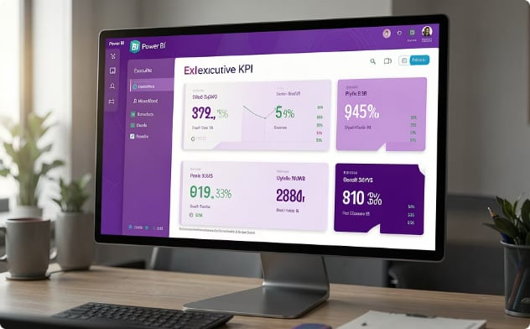
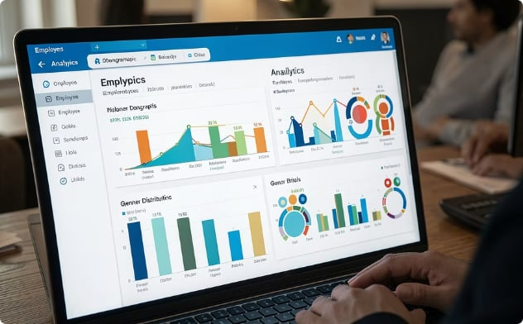
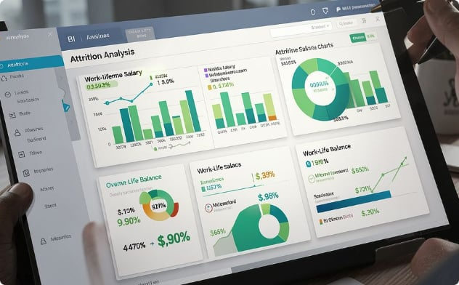

Power BI Dashboard Overview
A 3-page interactive dashboard was developed in Power BI to translate analytical findings into a visual, stakeholder-friendly format. Each page serves a distinct analytical purpose.
Page 1 — Executive Dashboard
Page 2 — Employee Insights
Page 3 — Attrition Analysis
Gender distribution, Age group breakdown, Marital Status, and Education Field — workforce demographic overview.
Deep-dive visuals: Attrition by Age Group, Overtime impact, Monthly Income bands, and Work-Life Balance ratings.
KPI cards (Total Employees, Attrition Rate, Avg. Income, Avg. Age) + Attrition by Department and Job Role visualizations.
📌 Placeholder: Insert Power BI dashboard screenshots here for viva demonstration.

Slide 9

Key Insights & Findings
What the Data Revealed
Department Trends: Sales, R&D, and HR recorded the highest concentration of attrition events
Overtime Impact: Employees working overtime showed a markedly higher likelihood of leaving
Income Correlation: Lower monthly income bands were associated with elevated attrition rates
Work-Life Balance: Poor work-life balance ratings emerged as a strong predictor of employee exit
Demographics: Younger employees (25–35) and single employees showed higher mobility patterns

Slide 10

Conclusion
Project Outcomes
Skills Developed
Successfully delivered a complete analytics pipeline — from raw data to a polished, interactive Power BI dashboard — using industry-standard tools.
Hands-on experience with Python data wrangling, SQL querying, database design, and Power BI visualization in a real-world HR analytics context.
Business Value
Demonstrated how data analytics empowers HR teams to move from reactive to proactive workforce management and evidence-based retention planning.
Thank you for your time and attention. This presentation was prepared as part of the Data Analytics Internship at SkillinfyTech Solutions Pvt. Ltd. — Amey Kishor Sawatkar

