Slide 1
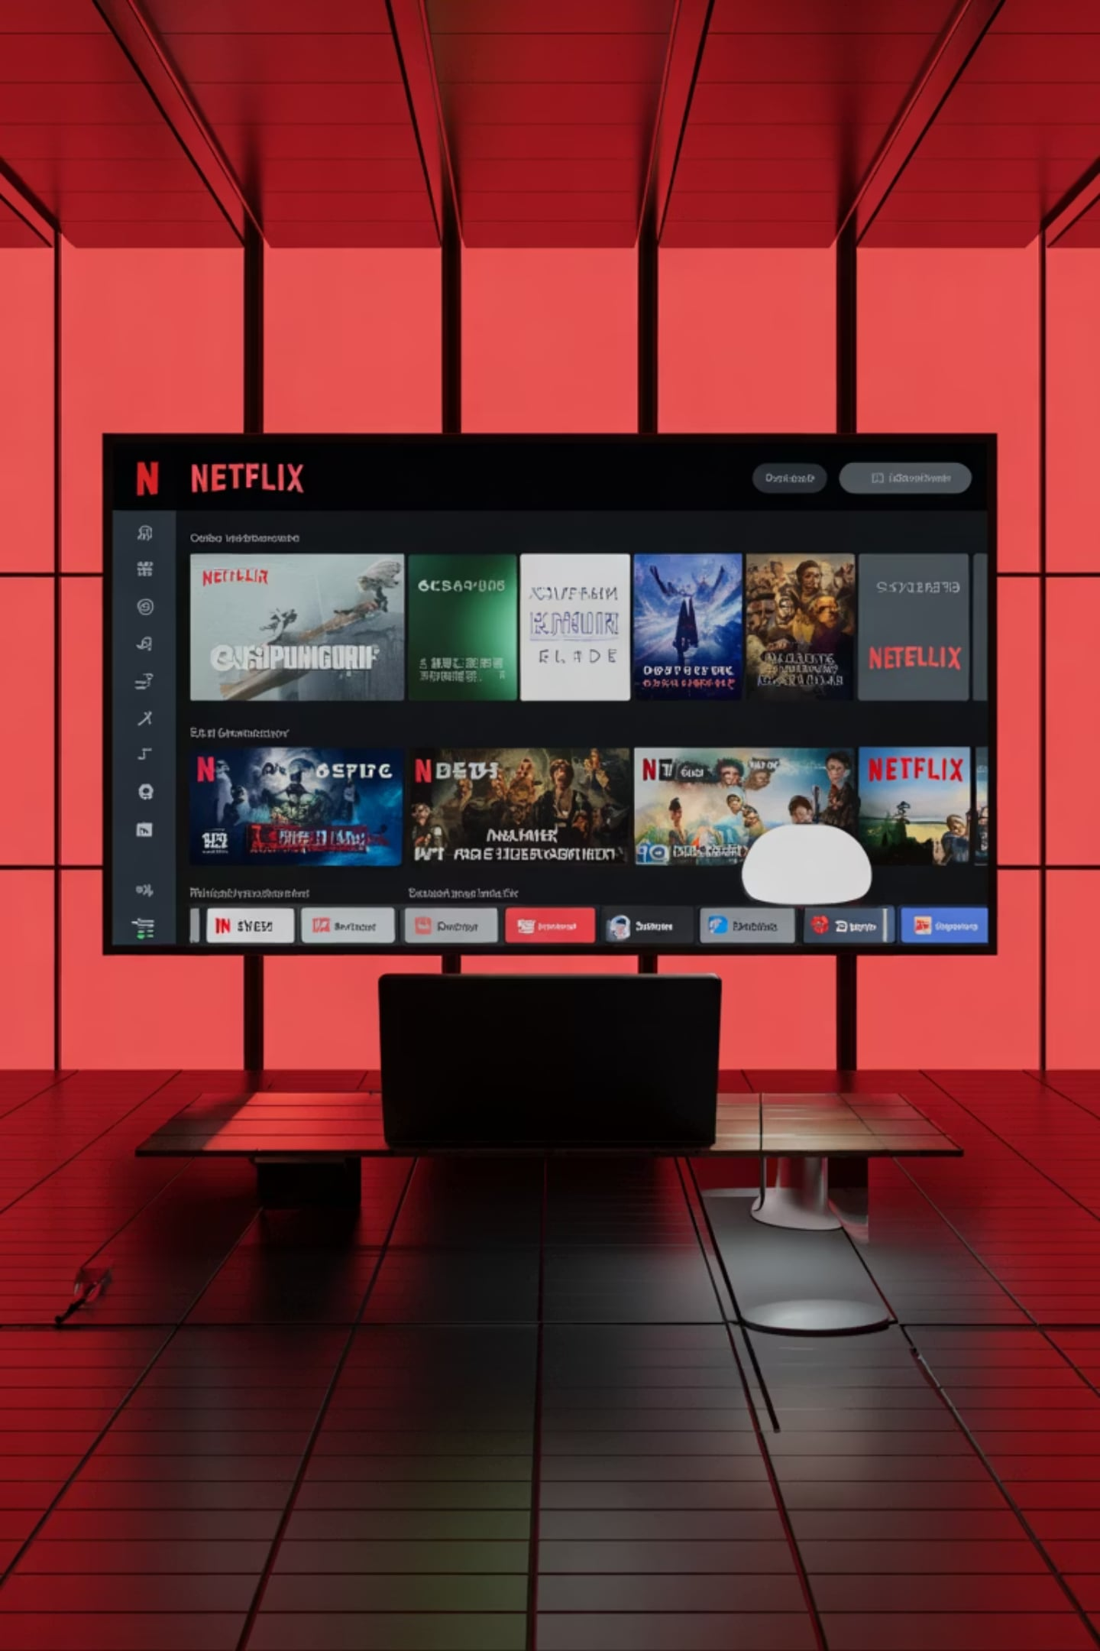
SKILLINFYTECH IT SOLUTIONS PVT. LTD.
Netflix Content Performance Analysis
A Data Analytics Internship Project · Amey Kishor Sawatkar
DATA ANALYTICS
PYTHON · SQL · POWER BI

Slide 2

PROJECT OVERVIEW
What This Project Is About
Introduction
This project applies end-to-end data analytics techniques to Netflix's content library — uncovering trends, patterns, and performance insights from a comprehensive dataset spanning movies and TV shows up to 2025.
Objectives
Clean and structure raw Netflix data using Python
Build a relational database for structured querying
Derive actionable business insights through SQL analysis
Visualize findings in an interactive Power BI dashboard
Problem Statement
Netflix's vast content catalog lacks a unified analytical framework. This project bridges that gap by transforming raw data into structured, insight-driven intelligence.

Slide 3
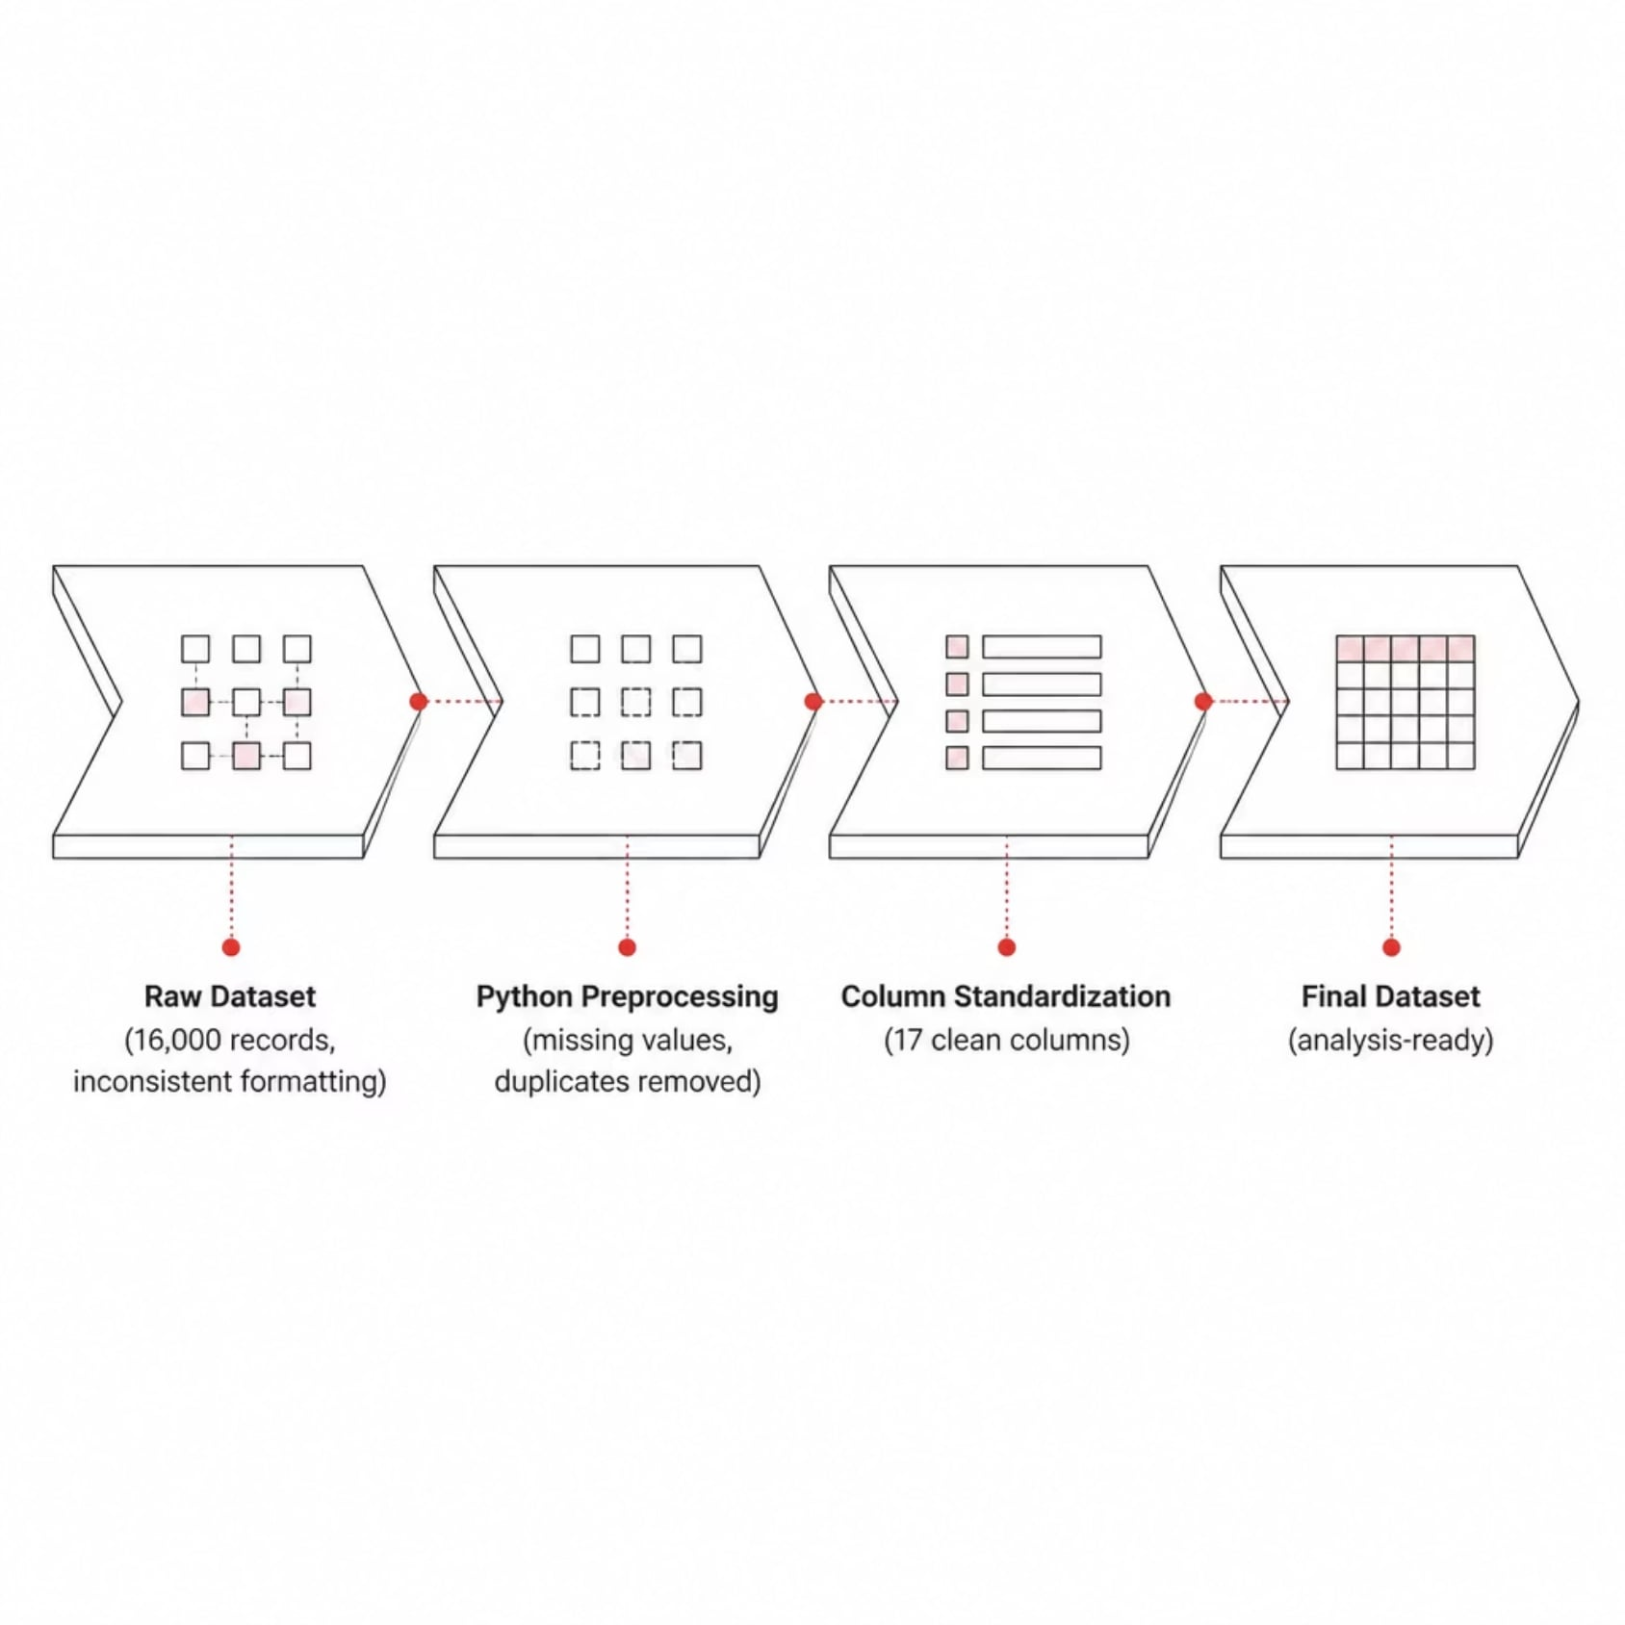
DATASET OVERVIEW
The Data Behind the Analysis
Dataset: Netflix Movies Detailed up to 2025
A rich, real-world dataset capturing Netflix's global content catalog — including titles, genres, release years, cast, directors, ratings, and durations. The dataset was cleaned and refined to ensure analytical accuracy.
16,000
17
Total Records
Final Columns

Slide 4






TOOLS & TECHNOLOGIES
The Analytics Stack
This project leverages a modern, industry-standard toolkit — from data wrangling to visualization — ensuring reproducible and scalable analysis.
Python
Pandas & NumPy
Core language for data cleaning, transformation, and preprocessing workflows.
Data manipulation, statistical operations, and numerical computing.
Matplotlib
MySQL
Exploratory data visualization and chart generation during analysis.
Relational database for structured storage and complex SQL querying.
SQL
Power BI
50+ business queries for trend extraction and content analysis.
Interactive executive dashboard for visual storytelling and reporting.

Slide 5
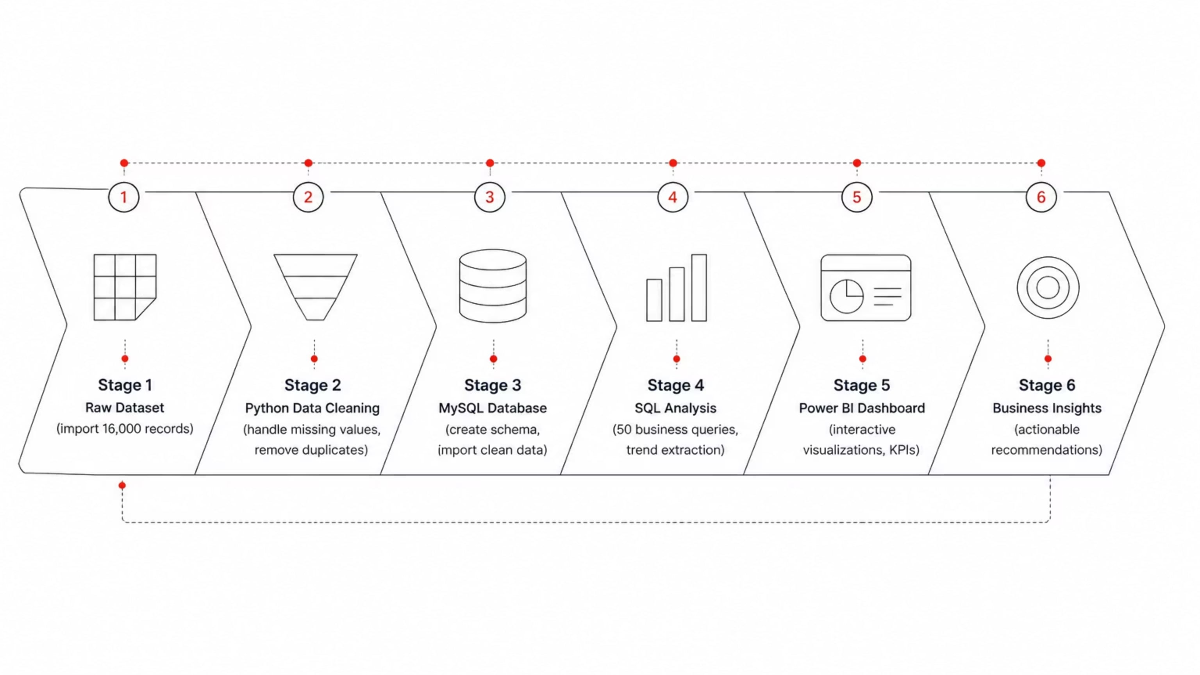
PROJECT METHODOLOGY
End-to-End Analytics Workflow
A structured six-stage pipeline transforms raw Netflix data into executive-ready business intelligence — each stage building on the last to ensure data integrity and analytical rigor.
Each stage was executed sequentially to maintain data integrity — from raw ingestion through Python preprocessing, structured storage in MySQL, analytical querying with SQL, and finally visualization in Power BI — culminating in actionable business insights.

Slide 6


IMPLEMENTATION
Python & MySQL Under the Hood
Python Data Cleaning
Handled missing values across key columns using imputation and selective removal
Removed duplicates and standardized text fields (titles, genres, cast)
Converted data types and formatted dates for analytical consistency
MySQL Database Setup
Designed a normalized schema with 17 structured columns
Imported cleaned dataset via bulk insert operations
Optimized indexes for fast query execution

Slide 7
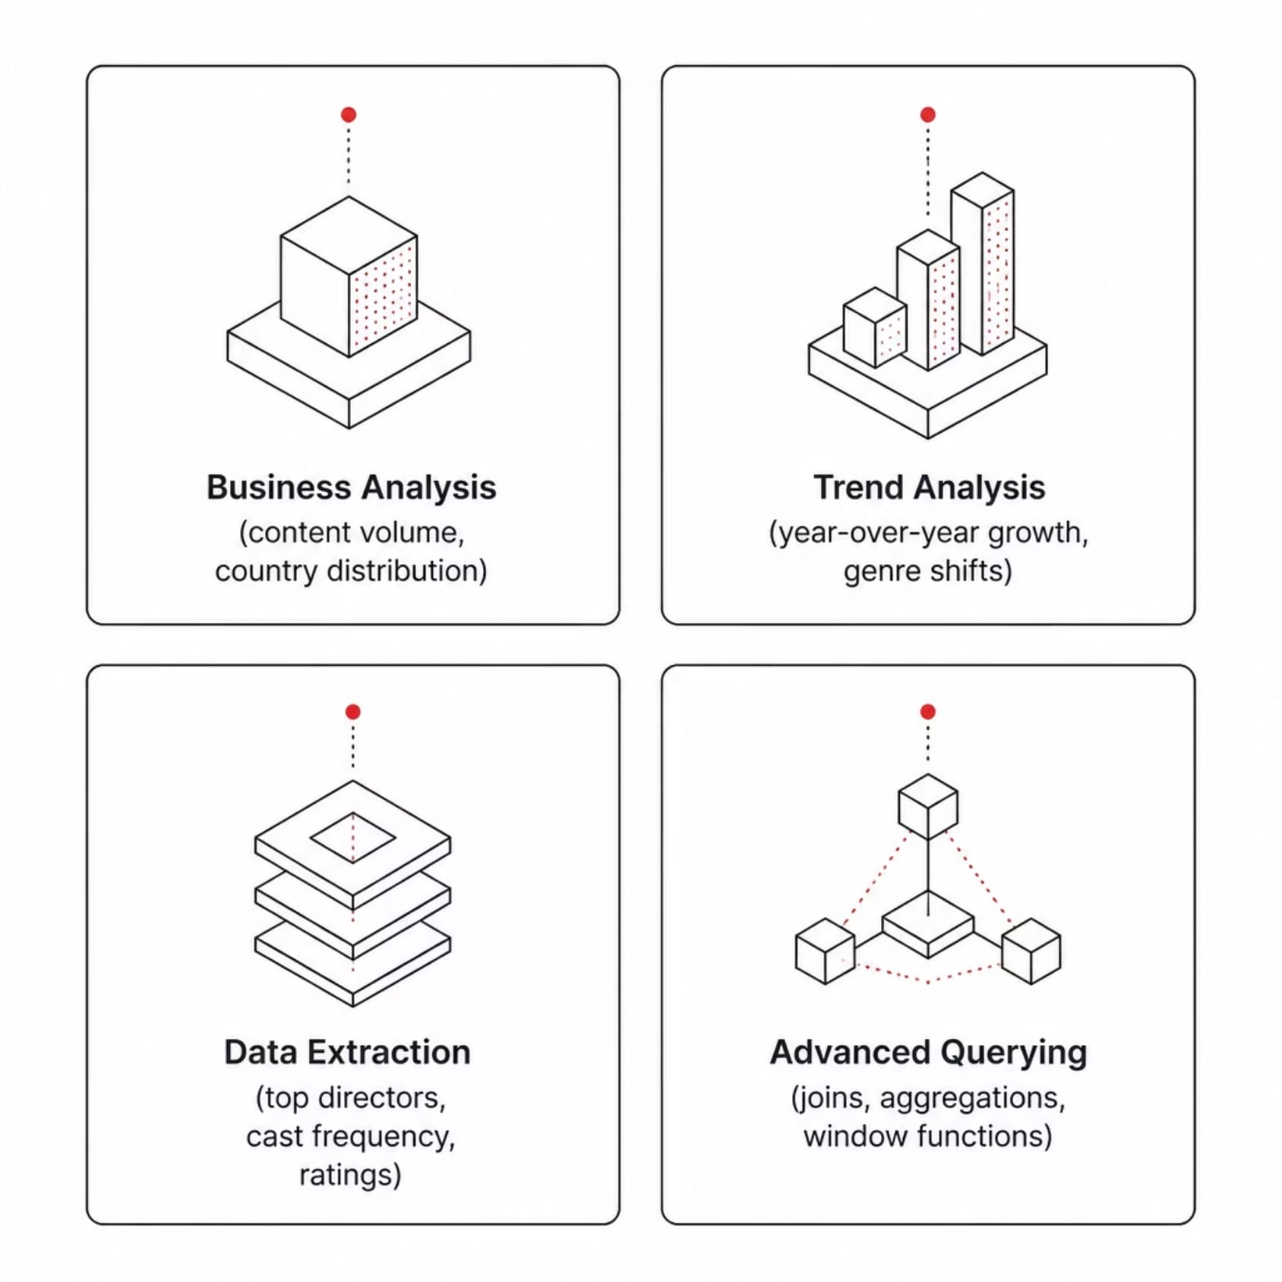

SQL ANALYSIS
50 Business Queries. Real Insights.
What We Queried
A comprehensive suite of SQL queries was developed to extract meaningful patterns from the Netflix dataset — covering content distribution, genre trends, release patterns, and audience ratings.
Business Analysis
Trend Analysis
Data Extraction
Database Querying
Content volume by country, type, and year
Year-over-year release growth and genre shifts
Top directors, cast frequency, rating breakdowns
Joins, aggregations, subqueries, and window functions

Slide 8
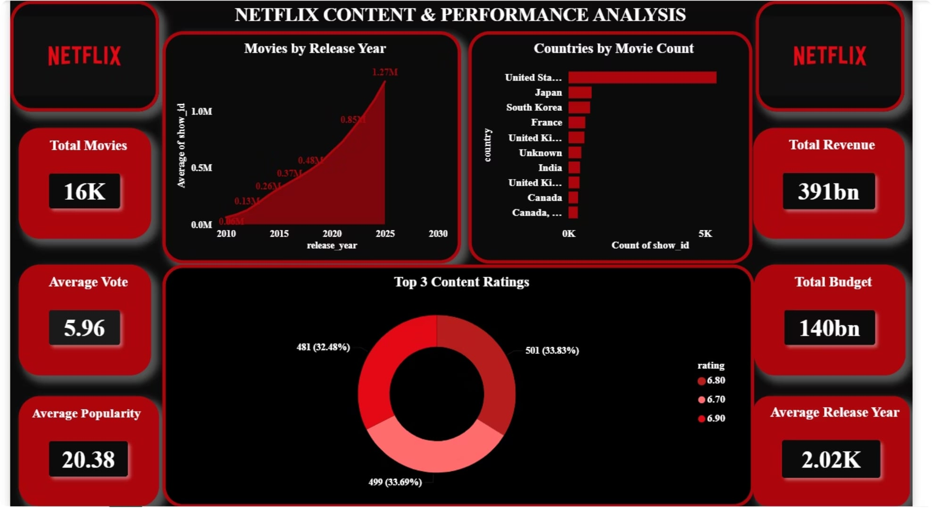
POWER BI DASHBOARD
Executive Dashboard
An interactive Power BI dashboard consolidates all analytical findings into a single, executive-ready view — enabling stakeholders to explore Netflix content performance at a glance.
Dashboard Features
Content volume by country and type
Release year trend visualizations
Genre and rating distribution charts
Interactive slicers and filters
Executive KPI summary cards

Slide 9






KEY BUSINESS INSIGHTS
What the Data Revealed
United States Dominates Content Production
Movies Outnumber TV Shows 3:1
Movies represent approximately 70% of the catalog, with TV shows growing steadily in recent years.
The U.S. accounts for the largest share of Netflix titles, reflecting its role as the primary content hub.
Content Growth Peaked Around 2018–2020
TV-14 and TV-MA Are the Dominant Ratings
Netflix's most aggressive content expansion occurred during this period, coinciding with global streaming wars.
Mature and teen-oriented content drives the majority of Netflix's library, targeting adult audiences.
Drama and Comedy Lead by Genre
Most Movies Run 90–120 Minutes
These two genres consistently appear across the highest number of titles globally.
The standard feature-length format remains the dominant duration across the movie catalog.

Slide 10


CONCLUSION
Project Summary & Takeaways
Project Delivered
Skills Demonstrated
A complete analytics pipeline — from raw data to executive dashboard — analyzing 16,000 Netflix records across 17 dimensions.
Python data engineering, MySQL database design, advanced SQL querying, and Power BI visualization — end to end.
Business Value
Actionable insights on content trends, genre distribution, and regional patterns — ready to inform content strategy decisions.
Thank you for your time and attention. This project was completed as part of a Data Analytics internship at SkillinfyTech IT Solutions Pvt. Ltd. · Amey Kishor Sawatkar

