Slide 1
AI Checkers Game
Informed & Uninformed Search • BFS • Minimax

Slide 2
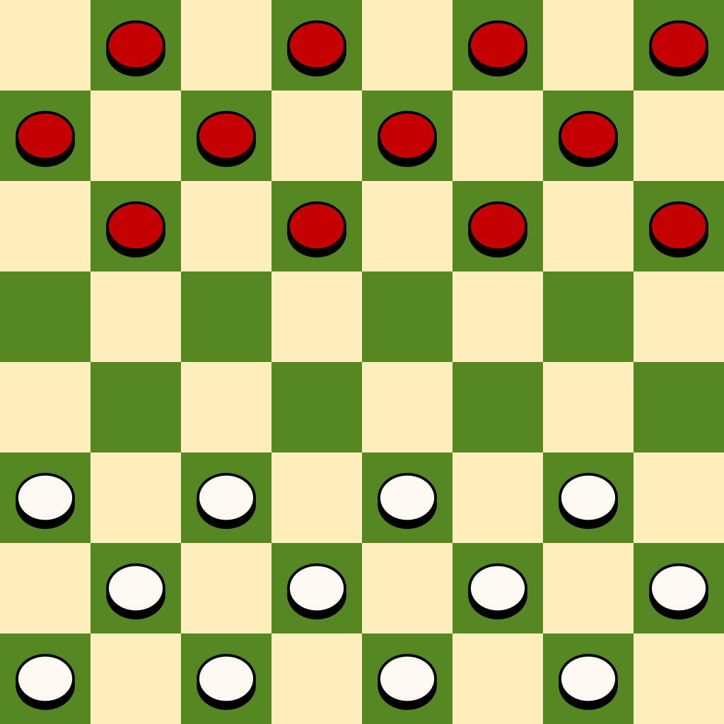
RULES AND REGULATIONS
Board: 8×8 grid, dark squares used for play.
Players: Two sides — Black and White
Starting Setup: Each player places 12 pieces on the dark squares of the first 3 rows on their side.
Objective: Capture all opponent’s pieces or block them so they can’t move.
Moves:
Pieces move diagonally forward one square to an empty square.
Capturing is done by jumping over an adjacent opponent piece to an empty square immediately beyond it.
Multiple jumps in a single turn are allowed if possible.
Captures are mandatory (must take if available).
Kings:
A piece reaching the opponent’s back row is kinged (crowned).
Kings can move diagonally forward and backward.
Winning: Opponent has no legal moves (all pieces captured or blocked).

Slide 3
Overview
Simplified Checkers implementation.
Two modes:
- Uninformed Search (BFS)
- Informed Search (Minimax + Alpha-Beta)
Player (Black) vs Computer (White).
Depth limit: 4.

Slide 4
Uninformed Search (BFS)
Breadth-First Search explores moves level-by-level.
No evaluation of board quality — just legality.
Selects first valid move at depth.
Heuristic_uninformed: piece count (+1 normal, +2 king).
Pros: Simple. Cons: Weak gameplay.

Slide 5
Informed Search (Minimax)
Simulates moves ahead up to depth 4.
Alternates maximizing (computer) and minimizing (player).
Uses Alpha-Beta pruning to cut irrelevant branches.
Heuristic_informed:
- Piece weights + king bonus
- Center control
- Mobility advantage.

Slide 6
Heuristic Functions
heuristic_uninformed(board, side):
- Counts pieces: +1 normal, +2 king.
heuristic_informed(board, side):
- +1 per piece, +2 per king.
- Bonus for central control.
- Bonus for mobility advantage.

Slide 7
Code: Minimax (Alpha-Beta)
def minimax(board, depth, alpha, beta, maximizing, side):
if depth == 0 or game_over(board):
return heuristic(board, side), None
if maximizing:
maxEval = -inf; best_move = None
for move in get_moves(board, side):
new_board = deepcopy(board)
apply_move(new_board, move)
eval, _ = minimax(new_board, depth-1, alpha, beta, False, opp)
if eval > maxEval:
maxEval = eval; best_move = move
alpha = max(alpha, eval)
if beta <= alpha: break
return maxEval, best_move
else:
minEval = inf; best_move = None
for move in get_moves(board, side):
new_board = deepcopy(board)
apply_move(new_board, move)
eval, _ = minimax(new_board, depth-1, alpha, beta, True, opp)
if eval < minEval:
minEval = eval; best_move = move
beta = min(beta, eval)
if beta <= alpha: break
return minEval, best_move

Slide 8
Game Tree Analysis
Minimax tree:
- Nodes = board states
- Max nodes = AI turn
- Min nodes = Player turn
Depth 4: ~b^4 nodes (b = branching factor).
Alpha-Beta pruning reduces explored nodes.
BFS explores all nodes level-by-level, no pruning.

Slide 9
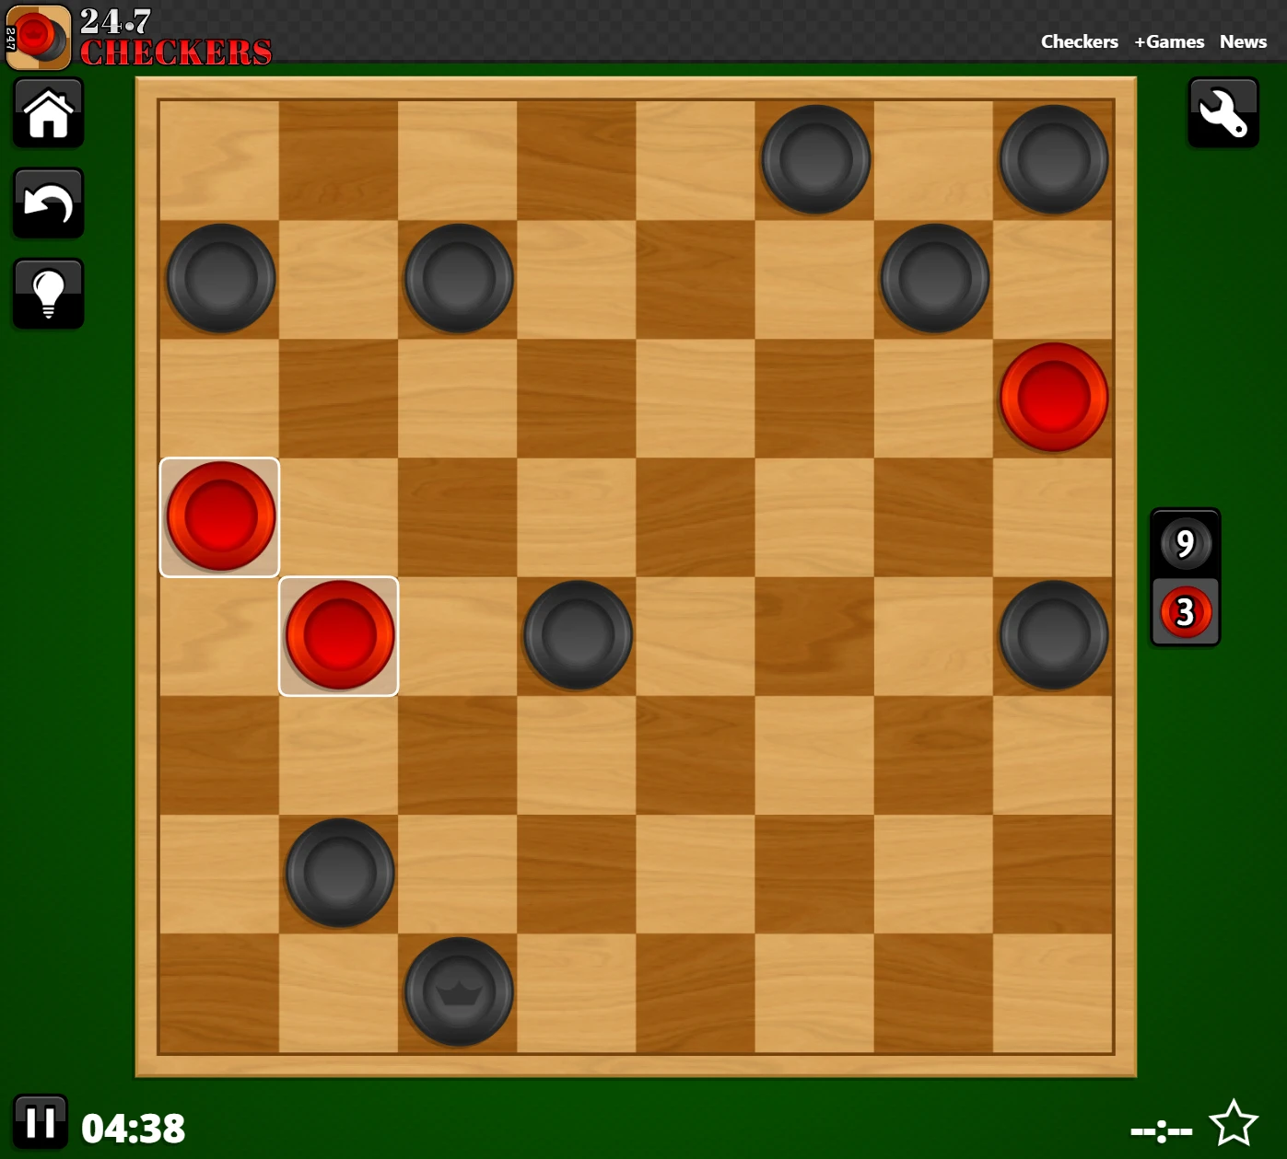
Example scenario

Slide 10
Advantages of alpha-beta pruning
.
If branching factor b = 4:
Nodes without pruning: 341
Best-case with alpha–beta: 21
Nodes saved ≈ 341 − 21 = 320 → ~93.8% pruned.
Faster decision-making
Reduces number of nodes evaluated compared to plain Minimax.
Same optimal result
Guarantees the same move as Minimax (if evaluation function is same), just faster.
Deeper lookahead
Time saved can be used to search deeper within the same time budget.
No extra memory cost
Uses same O(depth) memory as depth-first Minimax.
Improves with move ordering
Sorting moves by heuristic priority gives maximum pruning benefit.

Slide 11
Learnings
Understood Minimax Algorithm
Learned how AI evaluates moves using alternating maximizing and minimizing layers.
Applied Alpha–Beta Pruning
Experienced how pruning reduces search space without affecting the final result.
Explored Uninformed Search (BFS)
Implemented BFS to explore possible moves without heuristics.
Explored Informed Search (Heuristic-based)
Applied custom heuristic evaluation to guide AI’s search for better efficiency.
Analyzed Game Trees
Built and interpreted game trees up to a given depth.
Evaluated Heuristics
Compared simple (piece count) vs advanced (position, kings, mobility) heuristics.
Observed Impact of Depth
Learned how increasing depth changes AI’s foresight and computation time.
Experienced Game Logic
Understood rules of checkers including movement, capturing, and king promotion.
Practical AI Integration
Combined game mechanics with AI algorithms into a playable application.

