Slide 1
On Quantum Annealing without a Physical Quantum Annealer
Authors :
Dr. Ajinkya Borle (Lecturer, University of Maryland, Baltimore County)
Ameya Bhave (Grad Student M.S. in CS)

Slide 2
Presentation Outline
Short intro to Simulated Annealing
Short intro to Quantum Annealing
Aim of our work
Background and notations in this work.
Experimental Setup for DiQA
Results and Discussion for DiQA
Quantum Accelerated Simulated Annealing
Experimental Setup : QASA
Results and Discussion (QASA Cont)
Feasibility
Future Work
Conclusion

Slide 3
Simulated Annealing (SA)
Method for solving unconstrained and bound-constrained optimization problems.
Models the physical process of annealing in metallurgy.^{[1]}
Start at random point.
Choose another random point
Decide whether to jump to random point by a probability that takes into account the energy and a temperature parameter.
The figure shows how Simulated annealing is finding the point that gives the best output to the cost Hamiltonian function.
[1] . https://www.mathworks.com/help/gads/what-is-simulated-annealing.html
[2].https://upload.wikimedia.org/wikipedia/commons/d/d5/Hill_Climbing_with_Simulated_Annealing.gif

Slide 4
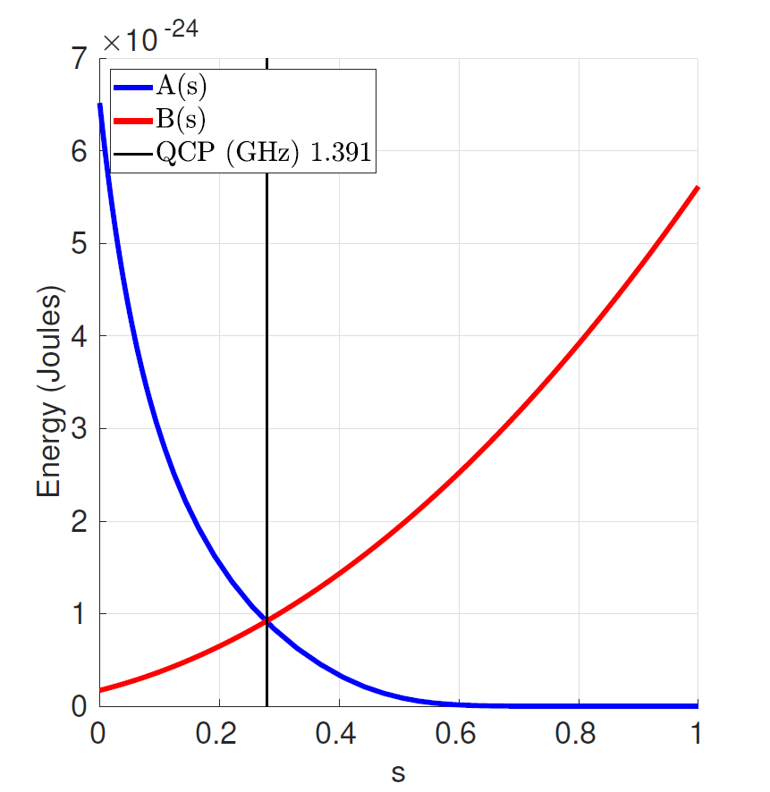
Quantum Annealing (QA)
Optimization process for finding global minimum of a given objective function.
Typically using the Ising Model
Most popular implementation with rf Superconducting qubits.
One of the most popular and mature quantum metaheuristics for solving combinatorial optimisation problems
[1]
[1].https://docs.dwavesys.com/docs/latest/c_qpu_annealing.html#annealing-functions

Slide 5
Quantum Annealing as a physical process at hardware level
D-Wave only vendor to successfully implement this metaheuristic whose physical quantum annealers are analogue computers that implement QA as a physical process.
Simulations of Quantum Annealing in the form of classical Monte-Carlo processes is well studied.
One of the possible alternatives ?
:- Implement Quantum Annealing on Gate-Model Quantum Computers (Discretized Quantum Annealing, DiQA)

Slide 6
Aim of our work
Exploration of DiQA
Focus is on using relatively low depth circuits.
Contributions :
Preliminary experiments comparing DiQA and simulated annealing for randomly generated Ising problems for variable sizes ranging from N = 10 to N = 22.
Proposed the QASA : Quantum Accelerated Simulated Annealing
Preliminary evaluation of QASA and compared it to SA

Slide 7
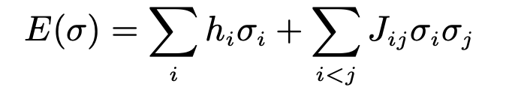
Background and notations in this work.
1. Classical Ising Model:
: Computationally an NP-Hard problem and in the recent years, the objective function associated with it has been used to represent hard problems from other domains. In the two-dimensional case, the energy or objective function of the classical Ising model can be described as follows.
Where σ is a set of N bipolar variables and σ_{i} ∈{−1,+1},i= 1, 2, . . . N . The primary goal here is to encode a combinatorial optimisation problem of interest as a minimisation or maximisation problem of the Ising objective function

Slide 8
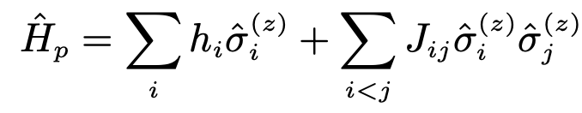
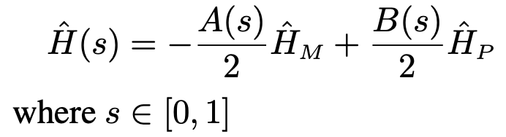
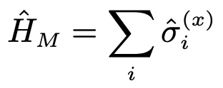
Background and notations in this work. (cont)
2. Quantum Annealing:
: Attempts to reach the ground-state for the problem Hamiltonian Ĥ_{P}. The most well known problem Hamiltonian is the one for two-dimensional classical Ising Hamiltonian.
The process of quantum annealing at any given time s can best be described by the following Hamiltonian.
Ĥ_{M} is the starting Hamiltonian for which we can easily prepare the ground state.

Slide 9
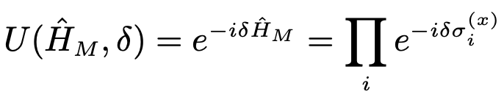
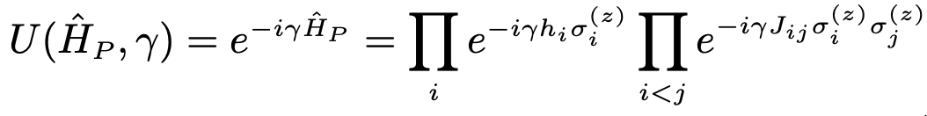

Background and notations in this work. (cont)
3. Quantum Approximate Optimization Algorithm (QAOA)
: Involves the Hamiltonian simulations of Ĥ_{M} and Ĥ_{P} as
where δ ∈ [0, π] and γ ∈ [0, 2π] are angles.
A set of p pairs of alternating Unitary operators are applied for angles ∆ = (δ1,δ2,...,δp) and Γ = (γ1, γ2, ..., γp)
This parameterised circuit is known as the QAOA-ansatz and p is known as QAOA-depth

Slide 10
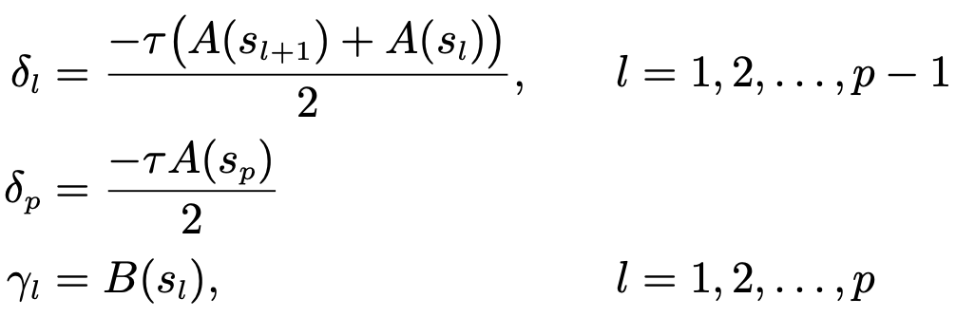
Background and notations in this work. (cont)
4. Discretized Quantum Annealing
Our implementation of DiQA uses the second- order Suzuki-Trotter decomposition.
Given A(s) and B(s), discretise the QA process into p steps of the QAOA-ansatz by:
s discretized into p steps.
τ represents the amount of time taken per step
We use τ = 0.8 ns
Annealing schedule is from the dwave_2000Q_6 machine.

Slide 11
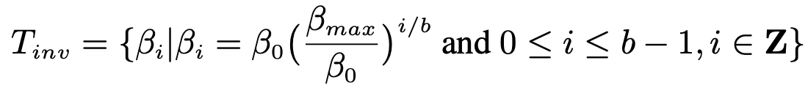
Background and notations in this work. (cont)
5. Simulated Annealing
Just like with QA, objective is to minimise the classical Ising cost function.
Start with β=β∼0
End with β = βmax ≫ 0
For all our experiments, we use β₀ = 0.01 and β_{max} = 100 with an exponential schedule given by the set T_{inv} .
b is the number of steps for the schedule.
At each step of the annealing, a number of sweeps can be taken.

Slide 12
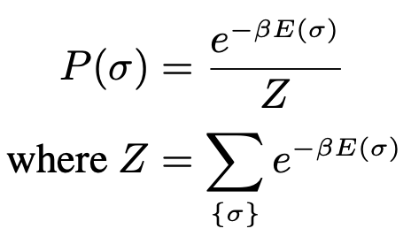
Background and notations in this work. (cont)
6. Gibbs distribution:
: A Gibbs or Boltzmann distribution is a probability distribution that is defined using an energy function and the inverse temperature parameter β.
In our case, the variables are bipolar and the energy function is defined by the Classical Ising Model.

Slide 13
Experimental Setup for DiQA (Part 1)
Generated 100 random Ising problems for sizes 10,12,14,16,18,20,22.
Problems have a 6-regular graph interactivity between the variables
Coefficients are uniformly sampled in the range h_{i} ∈[−2,2]andJ_{ij} ∈[−1,1] rounded to one decimal place.
Founded the ground state(s) for each problem by brute-force
Probability of successfully measuring (or reaching) a ground state P is a key output metric. (aka the success probability)

Slide 14
Experimental Setup for DiQA (Part 2)
Ran DiQA simulations with a QAOA-ansatz depth of p = 100 and p = 200
Ran SA with the same number of steps b = p.
For our SA runs, we also ran them for two settings (for b = 100 and b=200)
One sweep per β
N sweeps per β
For DiQA the success probability P was calculated with the help of state vectors.
For SA however we need to approximate the success probability. We do this by
Running each problem 2000 times
Counting the number of times we attain a ground state at the end .
Dividing it by 2000.

Slide 15
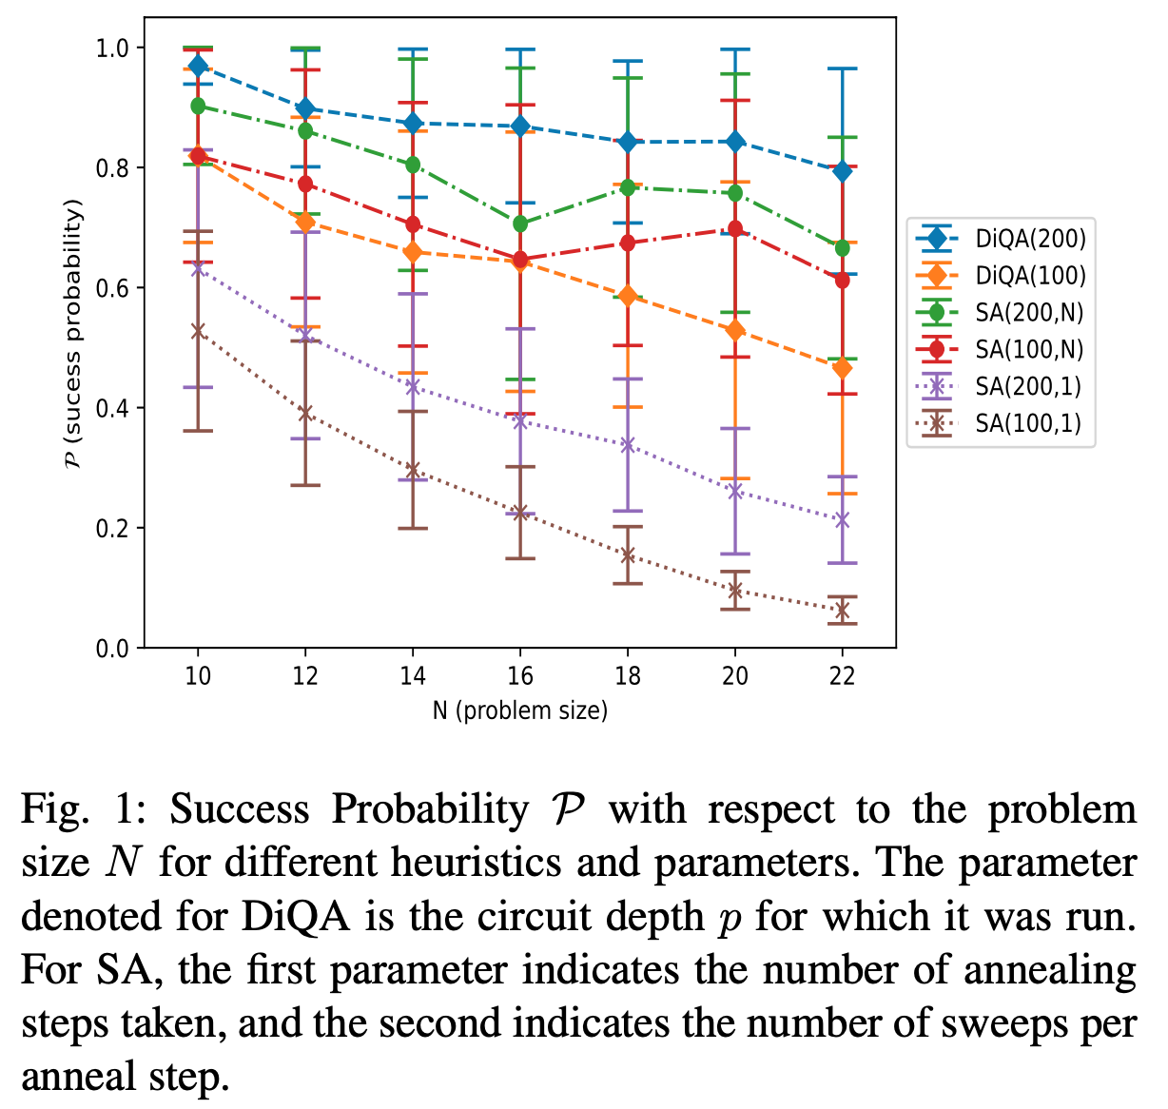
Results and Discussion for DiQA
P reduces as problem size N increases
Worst performing: SA when its allowed to only take one sweep per β
When sweeps are increased to N per β, we can see SA with 100 steps perform better than DiQA with p = 100.
However, we see DiQA with p = 200 marginally outperforming SA with b = 200 steps (and N sweeps).

Slide 16
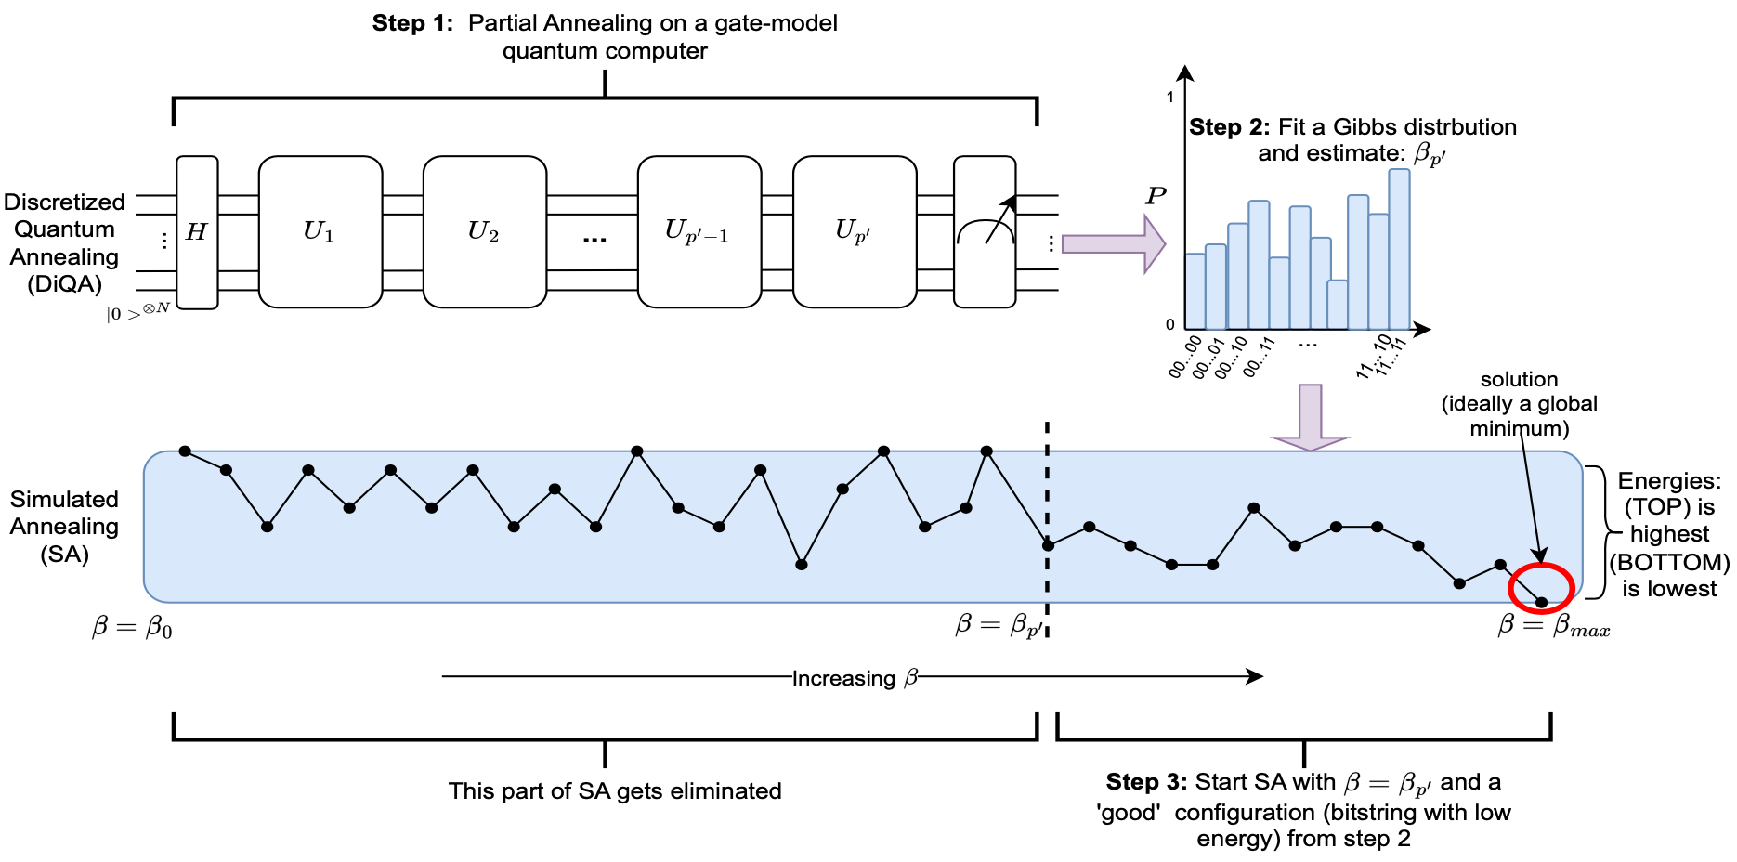
Quantum Accelerated Simulated Annealing
Aimed at leveraging a lower depth quantum circuit (relative to the depth of a standard DiQA run). Steps of the process as below
Partial annealing with DiQA
Calculate the inverse temperature β_{p′}
Run (shortened) simulated annealing

Slide 17
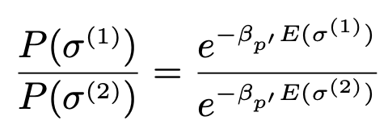
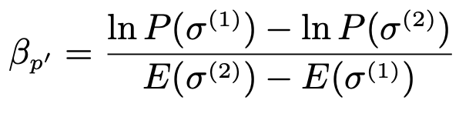
Calculate the inverse temperature β_{p′}
Calculate β_{p′} value by fitting the probabilities from step 1 as a Gibbs distribution.
The partition function Z is intractable to calculate
We can eliminate it from the equation by dividing for two Ising configuration
Taking log on both sides we get β_{p′}

Slide 18
Experimental Setup : QASA
The 700 Ising problems were used again.
The annealing schedule of dwave_2000Q_6 was discretized for p = 200 steps.
Ran DiQA circuits for the first p′ = 50 and p′ = 100 steps.
Calculate β_{p′} use an approximation method. Calculate m = 50 bit strings with the largest probabilities.
Pick the second-largest probability bitstring as σ⁽¹⁾ and pair with all m − 1 bit strings
Calculate the β_{p} value for each tuple and take the median value to represent the β_{p}
The SA schedule T_{inv} for b = 200 steps is used here. Based on the closest value on the SA annealing schedule to β_{p′} , we calculate the starting step number b′ in the schedule.
Use N sweeps per step in this truncated SA procedure.

Slide 19
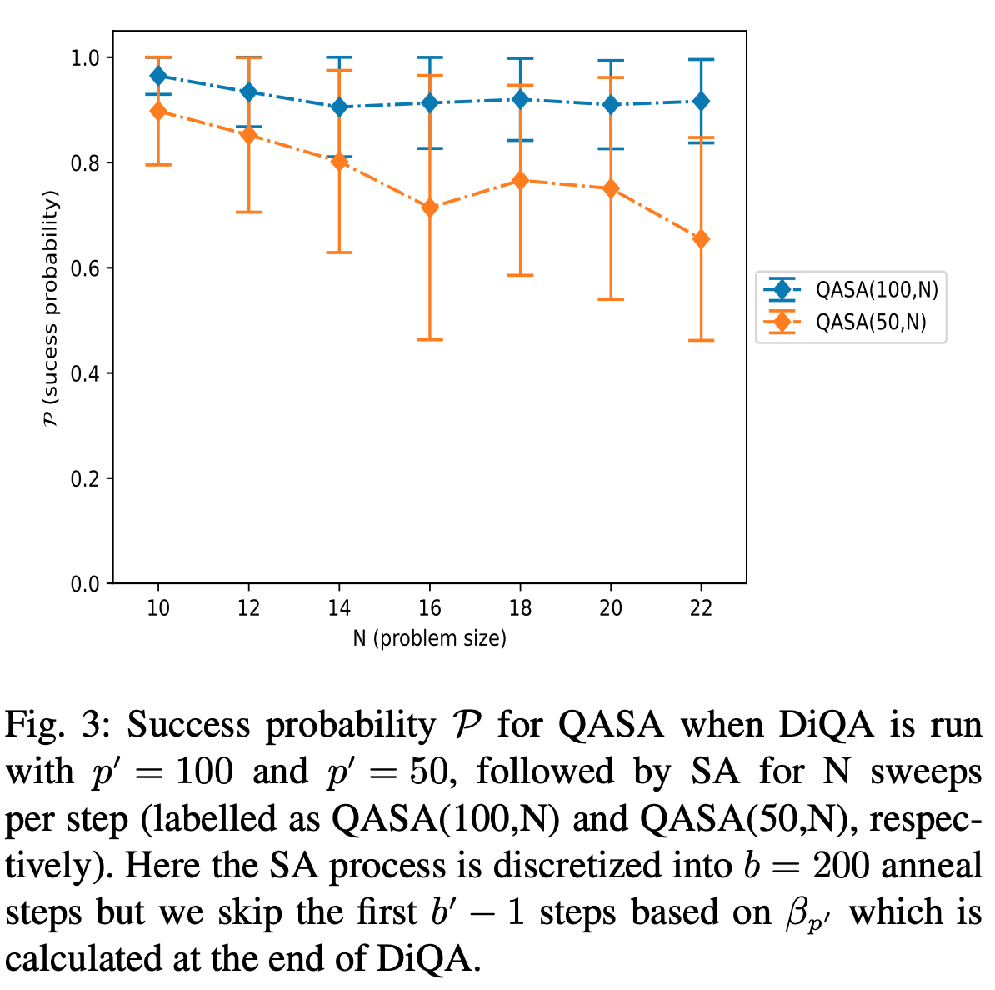
Results and Discussion (QASA Cont)
QASA with p′ = 50 perform similarly to SA with b = 200. For p′ = 100, we see the results from QASA being the best across all of the tests for the set of general-case problems.
The results do show that a technique like QASA can help in optimisation tasks in the near to medium term.

Slide 20
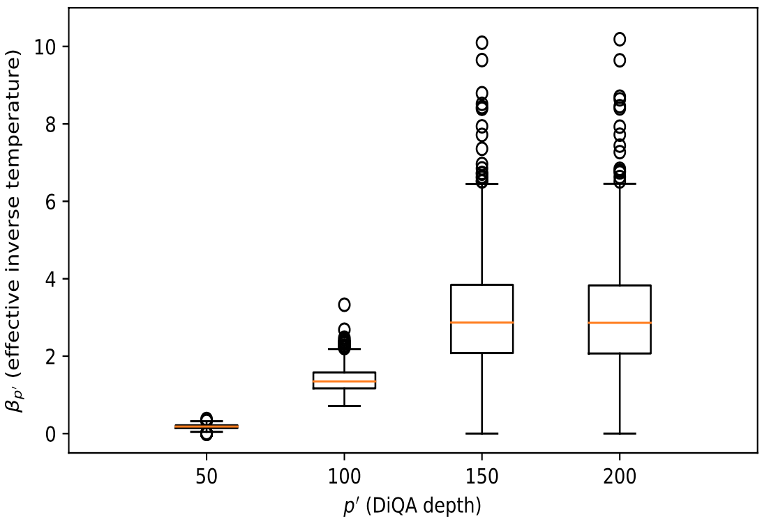
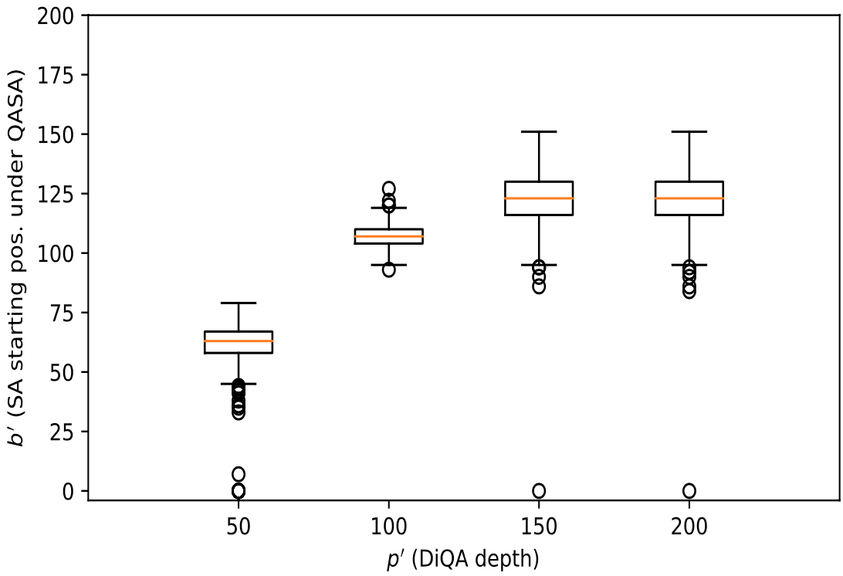
Results and Discussion (QASA Cont)
The median β_{p′} for p′ = 50 and p′ = 100 is relatively close to zero (≈ 0.1815 and ≈ 1.34812 respectively), the median b′ is 64 and 108 due to the exponential SA schedule.
Effect of the exponential schedule can be seen by the outliers for the boxplots of p′ = 150 and p′ = 200; for β_{p′} they appear on top, but they appear on the bottom in the plot for b′ .

Slide 21
Results and Discussion (QASA Cont)
Even though running the DiQA circuit for p′ = 150 only gives us a starting position of b′ = 124, it can still have a time advantage because of how differently an (efficient) anneal step needs to be implemented on a quantum circuit
p′ = 200, stops showing any improvement at all (in β_{p′} or b′). This can be due to several factors
Important to note that the approximation of β_{p′} will be more noisy in practise.

Slide 22
Feasibility (QASA Cont)
Advantage of using the QAOA-ansatz is the prevalence of work that has been done to evaluate its performance
Work by Harrigan et al. (Variational QAOA on superconducting-qubits) suggests a drop off in performance after p = 5 (for their machine). Emergence of error-suppression and mitigation techniques,improvements are observed.
On trapped-ion QPUs, A simulation of QAOA for 40 qubits showed that that the ‘QAOA performance does not degrade significantly as they scaled up the system size’.
It appears that current QPUs may not be able to implement DiQA for a non-trivial depth size. DiQA may be feasible for implementation in the intermediate term, especially if advance mixers are used (for circuit depth reduction).

Slide 23
Future Work
Important work to be done in the future is to study DiQA and QASA with more advanced mixers.
Another interesting research direction to pursue would be to replace simulated annealing (SA) in QASA with simulated quantum annealing (SQA). We would not need to calculate β and can directly feed the quantum annealing parameters equivalent to the p′ + 1 step.
Future work should focus on better noise-resistant techniques to assess β_{p′} in QASA. Performance metrics that allow for approximate answers, like approximation ratios and time-to-solution.

Slide 24
Conclusion
We did a preliminary evaluation of the usefulness of discretized quantum annealing (DiQA) on quantum circuits.
Our benchmark against simulated annealing showed better results for equal number of discretized anneal steps.
Main contribution was the hybrid quantum-classical heuristic which shows QASA performing comparably to SA but for a reduced number of total steps (even with the overhead of DiQA).
Motivation:
Provide new perspectives to the research community
Encourage more research on fixed-parameter quantum optimisation techniques, and hybrid quantum-classical heuristics that can incorporate them

Slide 25
Thank You

