Slide 1
Hackathoners
Member:
Ameya Vivek Shirsat

Slide 2
Introduction
Blockchain is a specific type of database in which data is stored in blocks.
Such blocks are then linked to form a Blockchain.
A Block in a blockchain is composed of Data, Block’s Hash and Previous Block’s Hash.
Blockchain is decentralized, immutable, and more secure than normal databases.
Any kind of data can be stored in blockchain.

Slide 3
Problem Statement
Blockchain for Academic Credential Ecosystem
Verifiable records — trusted and provable.
Proof of identity and consequent ownership of credentials tied to identity.
Digitization and uploading of records and certificates by various stakeholders.
Prove the legitimacy of academic credentials.
Allow students to access their data record.

Slide 4
Development So Far
Student Registration Form.
Ability For Student To View Entered Data In The Form.
Admin Side Form.
Local Data Storage.
Sample Files Uploading Using IPFS.

Slide 5
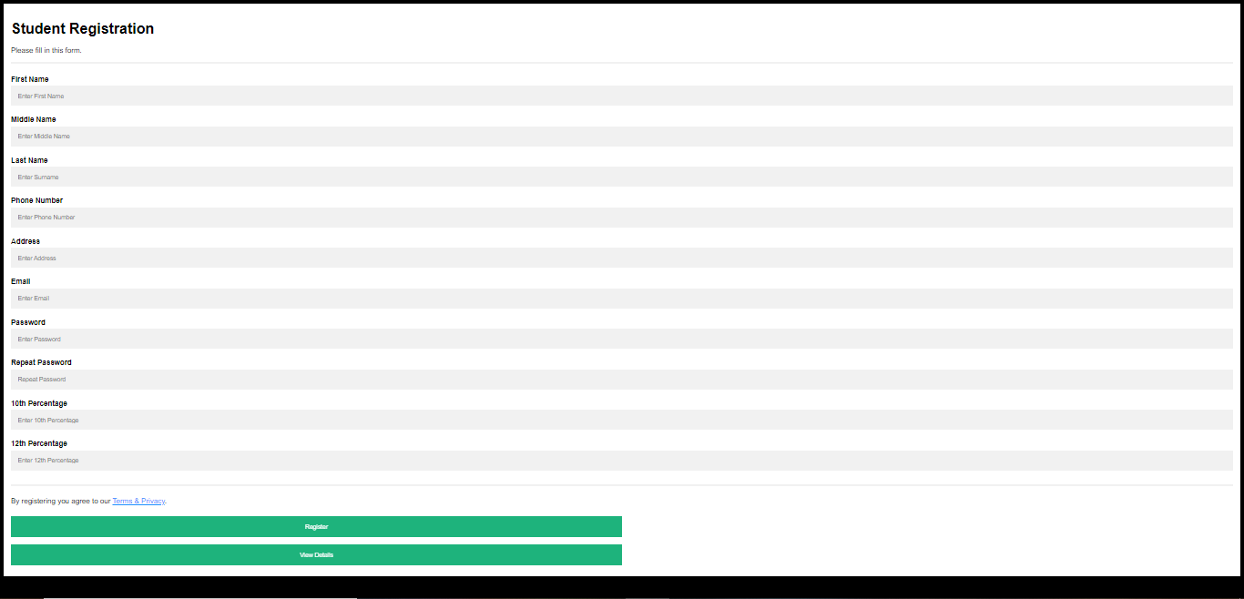

Slide 6
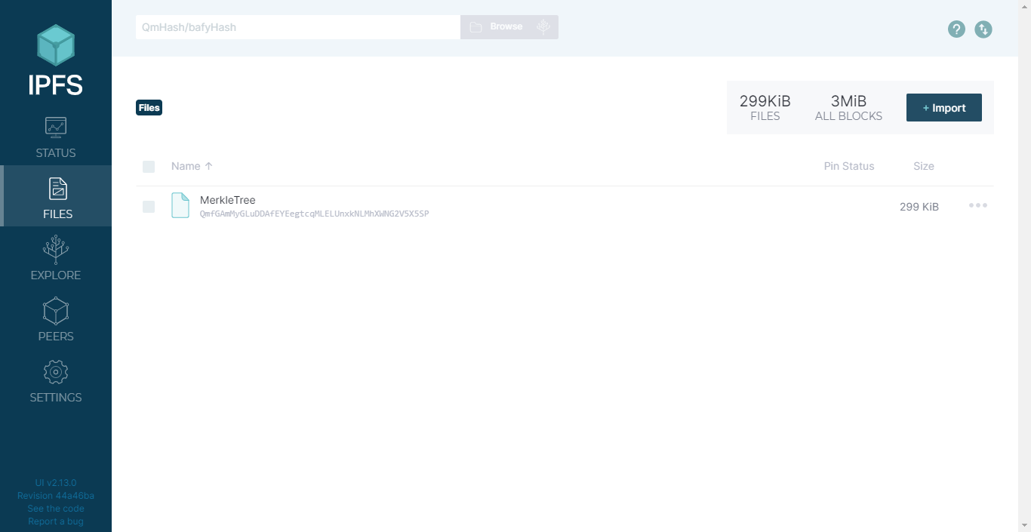

Slide 7
Future Scope
Complete IPFS connection with frontend along with ability to upload data and files (certificates).
Admin side hash and company side hash would be compared using some Smart Contract.
If both hash values match, proves the credentials to be legitimate.
If not then, the credentials are not trusted.
Moreover an interface for companies to search for trusted employees.

Slide 8
Thank You

