Slide 1
IBM DATA SCIENCE COURSE 9
Applied Data Science Capstone:
The Battle of Neighbourhoods.

Slide 2
1. PROBLEM STATEMENT: ANALYSIS OF DUBAI NEIGHBOURHOODS.
Dubai is one of the most popular and modern cities in the world. It has lots of monuments, high rising skyscrapers and vast spread deserts. As a result, Dubai attracts a lot of tourists every year. The figures can even be as high as 15 million. Such a huge tourist crowd is very likely to enjoy great variety of foods. As a result, setting up a restaurant in Dubai would be an incredible idea. It was seen that Dubai lacks Mexican restaurants in some neighbourhoods.
For the project, we will determine the best neighbourhood in Dubai to open a Mexican restaurant.
We will use Foursquare and cluster neighbourhoods in Dubai to determine the best neighbourhood for opening up the restraint in that location. The objective is to have a location that is within one of the more reasonable rent zones, but also within a close enough range to a high rent zone.

Slide 3
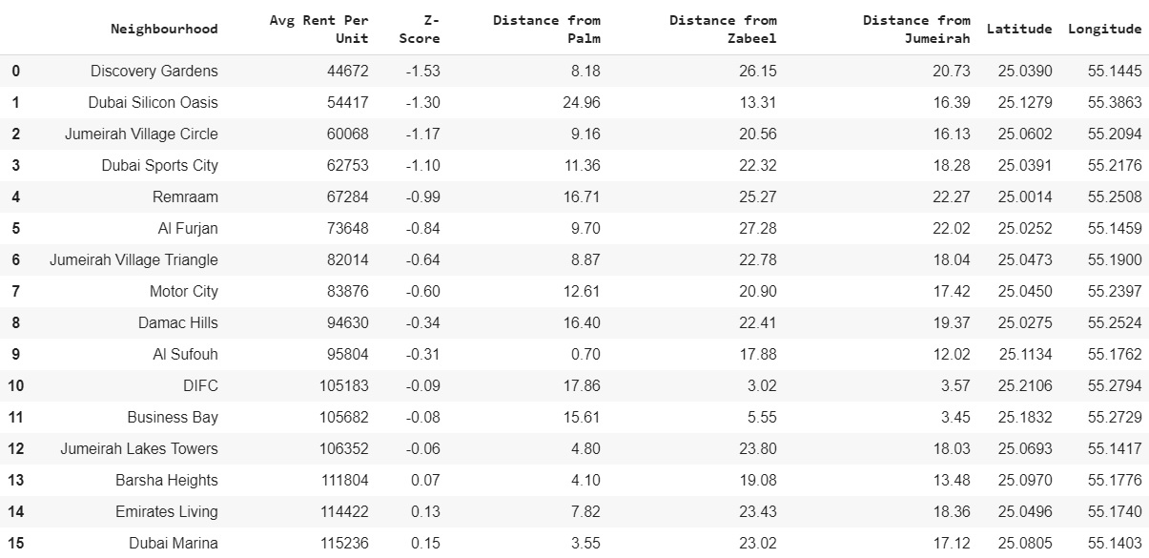
ANALYSIS OF DATA
Excel file dataset of Dubai neighbourhoods.

Slide 4
Most common venues dataframe.

Slide 5
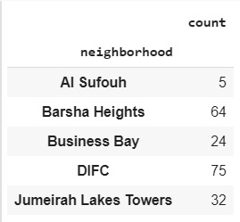
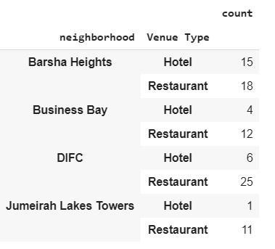
A diagram of obtained venue count from all the neighbourhoods in Dubai shows that DIFC, Dubai Marina and Barsha Heights. Here’s a diagrammatic representation of the results.
A direct comparison between number of hotels and number of restaurants was made in each of the selected neighbourhoods and the following result was obtained.

Slide 6
DATA VISUALIZATION USING MAPS
Dubai venues.

Slide 7
OBSERVATIONS
Dubai Marina consists of a lot of restaurants. Hence, it is saturated.
Barsha Heights has lots of venues to visit and restaurants are relatively less in the area.
Barsha Heights is close to only one high rent neighbourhood.
DIFC is a very tourist attractive zone.
DIFC does not have much restaurants compared to the number of hotel in the place.
DIFC is close to three high rent neighbourhoods.

Slide 8
CONCLUSION
The Python code was implemented and executed successfully. From the Results and Discussion section, we can conclude that Dubai International Finance Center (DIFC) would be the best location to open up a Mexican restaurant after examining all the factors: medium rental index, it is close in proximity to other high rent neighbourhoods, and the ratio of hotels to restaurants is not too high. Other neighbourhoods that were considered were Barsha Heights and the Dubai Marina. Although Barsha Heights seems preferable given the low ratio of hotel venues to restaurants, but it is not close to many high rent neighbourhoods. Dubai Marina was not a preference as it is already saturated with restaurants. Hence, the final destination selected is DIFC.

