Slide 1
Lending Club Case Study
Ameya Parab

Slide 2
Background
This company is the largest online loan marketplace, facilitating personal loans, business loans, and financing of medical procedures. Borrowers can easily access lower interest rate loans through a fast online interface.
Like most other lending companies, lending loans to ‘risky’ applicants is the largest source of financial loss (called credit loss).

Slide 3
Problem Statement
Identifying risky loan applicants so that such loans can be reduced thereby cutting down the amount of credit loss.
Identification of such applicants using EDA is the aim of this case study.

Slide 4
Objectives
Understanding the driving factors (or driver variables) behind loan default
Conduct a comprehensive analysis of a dataset containing consumer attributes and loan attributes.
Gaining insights into the factors influencing loan default rates
Developing strategies to mitigate risks associated with lending.

Slide 5
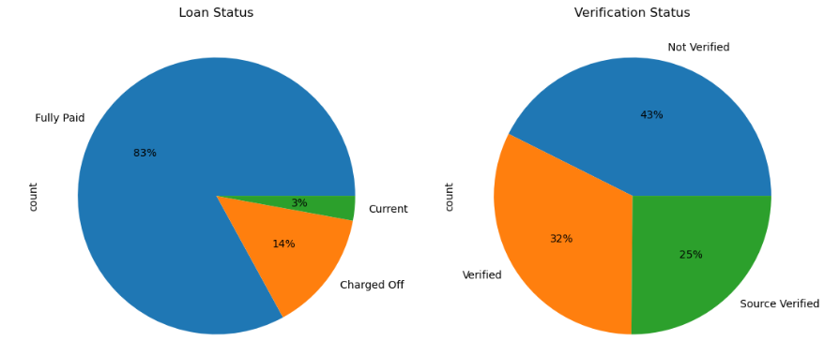
Pie Plot For Loan Status and Verification
14% Loans are defaulted
Majority of loans are not verified

Slide 6
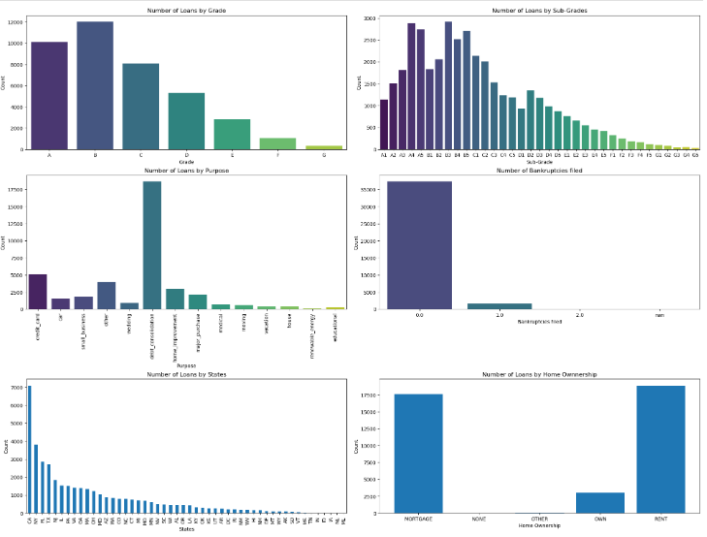
Categorical Analysis

Slide 7
Observations From Categorical Analysis
Majority of loans are concentrated in states like California, New York, Florida and Texas
Majority of loan recipients are either living in the rented house or mortgaged their house
Significant numbers of loans are issued towards debt consolidation which is calls for individual analysis of the loan purposes

Slide 8
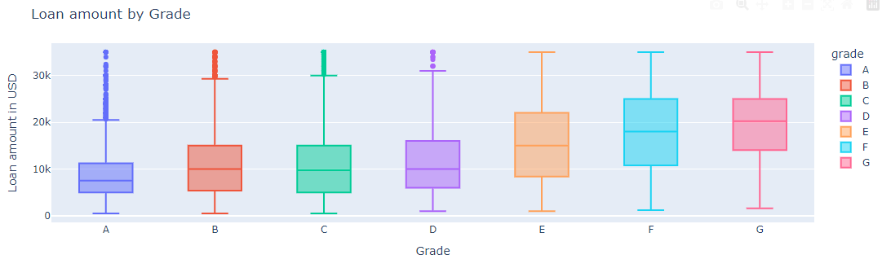
Distribution Of Loans Amount With Respect To Purpose Grade
Looking at median and quartile values, it is observed that high risk categories like E, F and G are offered higher amounts of loans compared to low risk categories

Slide 9
Further Strategy Of Analysis
Data will be filtered for top four states
Grade wise analysis will be done to identify top three purposes where amount of loans are provided higher than expected
Default rate will be analysed for top three purposes for each category

Slide 10
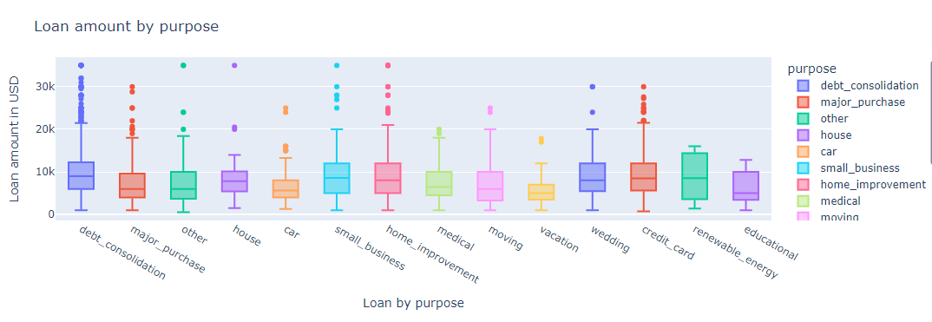
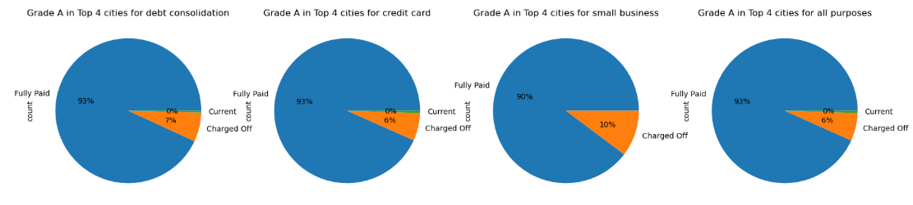
Grade A

Slide 11
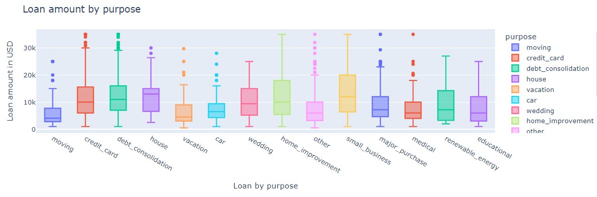
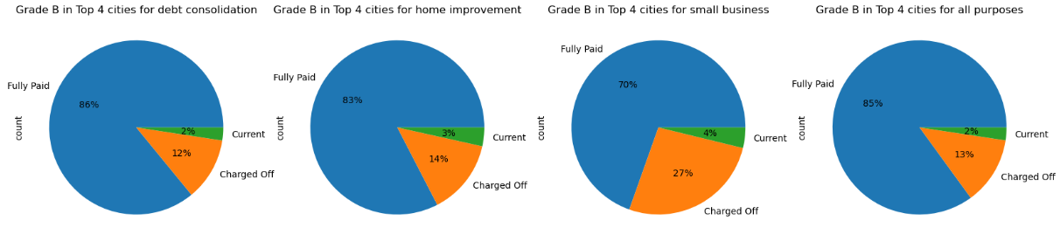
Grade B

Slide 12
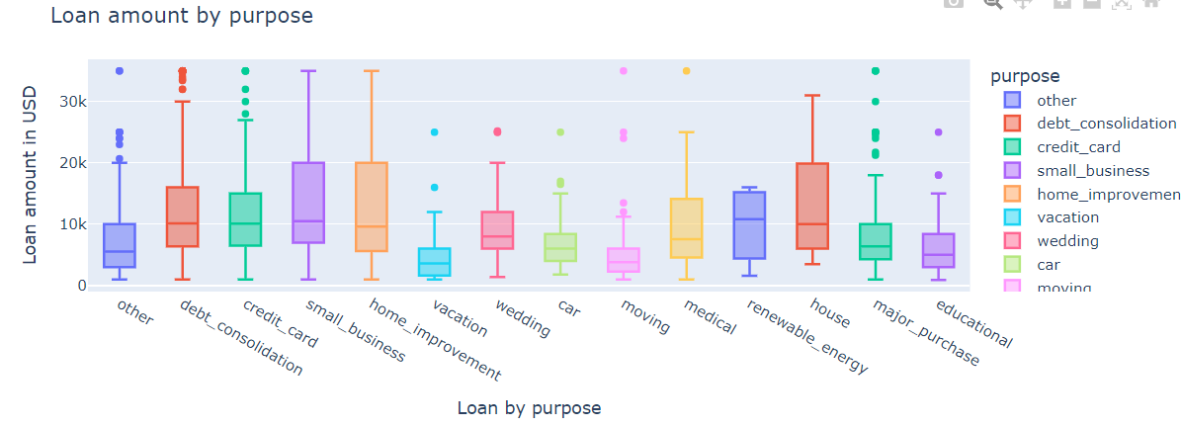
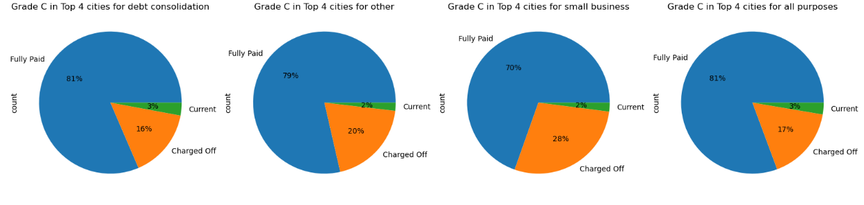
Grade C

Slide 13
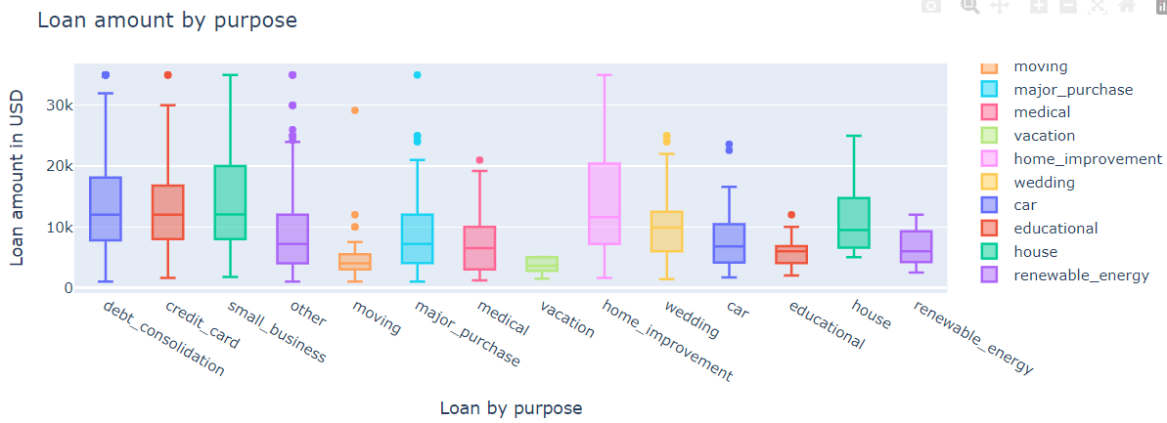
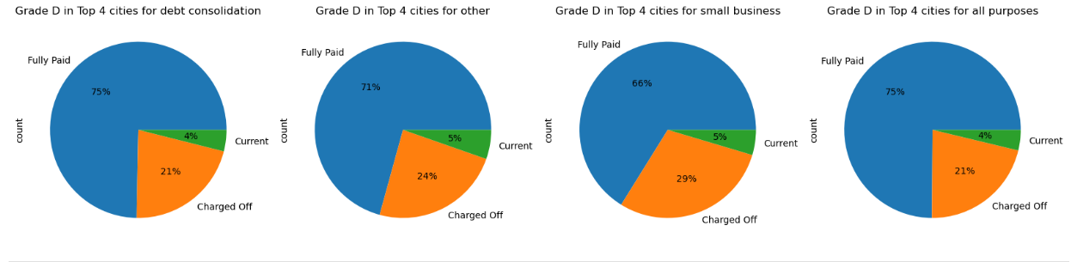
Grade D

Slide 14
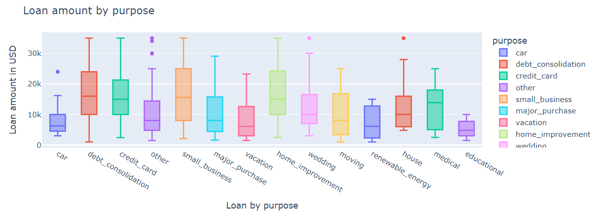
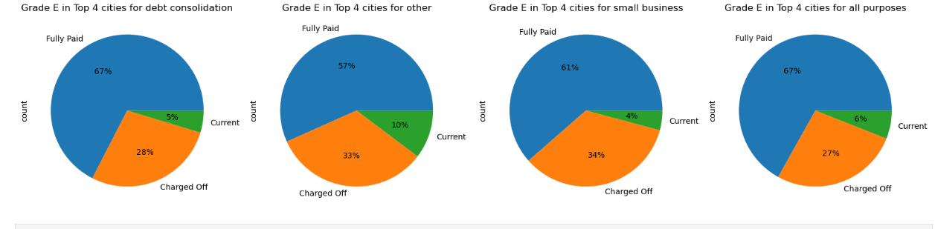
Grade E

Slide 15
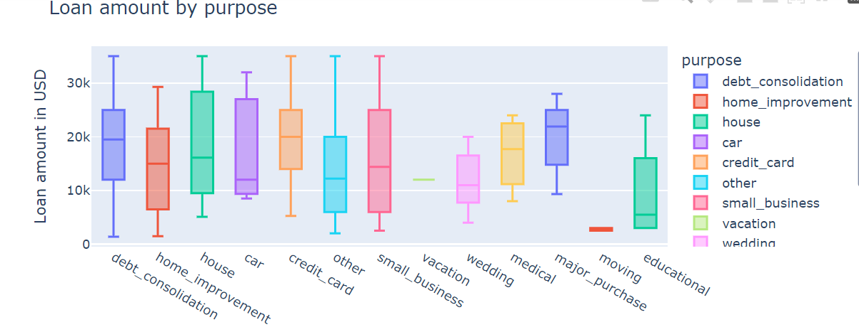
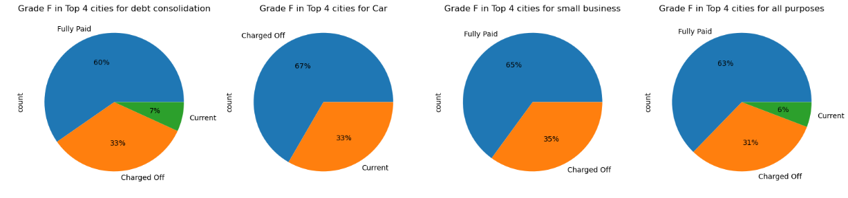
Grade F

Slide 16
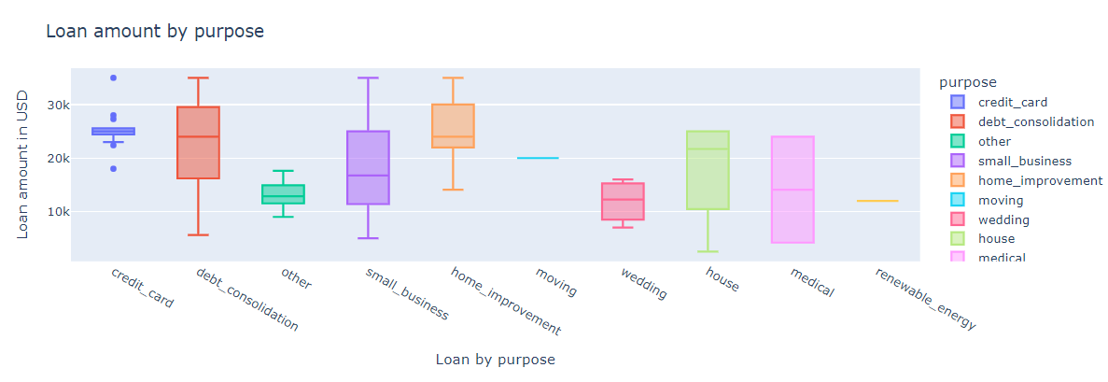
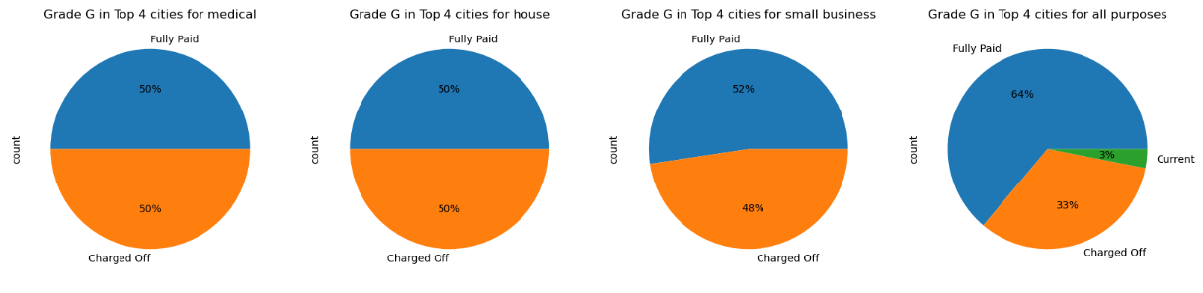
Grade G

Slide 17
Analysis
Loan amounts are offered to high risk categories such as E, F and G higher than expected.
Loans given for small business purposes have observed to be the highest probable cause to get defaulted across all the grades. The probability increases with the risky categories.
Loans given for debt consolidation seems to be next probable factor to default the loan
For Grade E, loans given for car is the next probable factor to default the loan
For Grade F, loans given for medical purposes is the next probable factor to default the loan

