Slide 1
Spectral ANALYSIS OF Discrete SIGNAL
Ameya Upalanchi(66)
Suyash Soni (63)
Sawan Damase(74)
Siddhant Verma(67)
Guided By –
Prof. M.S. Deshpande

Slide 2
Contents
Abstract
Literature Survey
Objectives
Methodology
GUI View
Applications
Time Plan
References

Slide 3
Abstract
What is Spectral analysis ?
The process of determining the frequency contents of a C.T signal in the D.T domain is known as Spectral analysis.
Spectral analysis involves estimating the spectral density function.
Represent a time series in terms of the wavelengths associated with oscillations, rather than individual data values
The spectral density function describes the distribution of these wavelengths

Slide 4
Fourier analysis involves representing a function as a sum of sin and cos terms and is the basis for spectral analysis
By studying the spectral density, seasonal components and/or noise can be identified. Spectral analysis is a very general method used in a variety of domains
Why to do it?
General problem of signal extraction.
Basic results in spectral (or harmonic) analysis
Develop the idea of a filter.

Slide 5
Objectives
The systematic sorting out of the essential frequency components in a time series
The main objective of spectral analysis is the determination of the power spectrum density (PSD) of a random process
The estimation of the PSD is based on a set of observed data samples from the process
Noise analysis of signal in terms of frequency content

Slide 6
Methodology
How to do spectral analysis ?
There are two major spectral analysis techniques used with speech
Fourier analysis Linear Predictive Coding (LPC)
Fourier analysis is used to calculate the spectrum of an interval of a sound wave.
LPC attempts to estimate the properties of the vocal tract filter that produced a given interval of speech sound

Slide 7
Methodology - Fourier analysis
A complex wave can be analyzed as the sum of sinusoidal components.
Fourier analysis determines what those components are for a given wave.
The procedure we will use is the Discrete Fourier Transform
The basic idea is to compare the speech wave with sinusoidal waves of different frequencies to determine the amplitude of that component frequency in the speech wave.
What do we compare with what? – A short interval (‘window’) of a waveform with: – Sine and cosine waves with a period equal to the window length and – sine and cosine waves with multiples of this first frequency

Slide 8
For each analysis frequency, we calculate how well the sine and cosine waves of that frequency correlate with the speech wave.
This is measured by multiplying the amplitude of each point of the speech wave by the amplitude of the corresponding point in the sinusoid and summing the results (dot product)
The degree of correlation indicates the relative amplitude of that frequency component in the complex wave.
The correlation between two sinusoidal waves of different frequencies is always zero - i.e. the contribution of each frequency component to a complex wave is independent of the other frequency components.

Slide 9
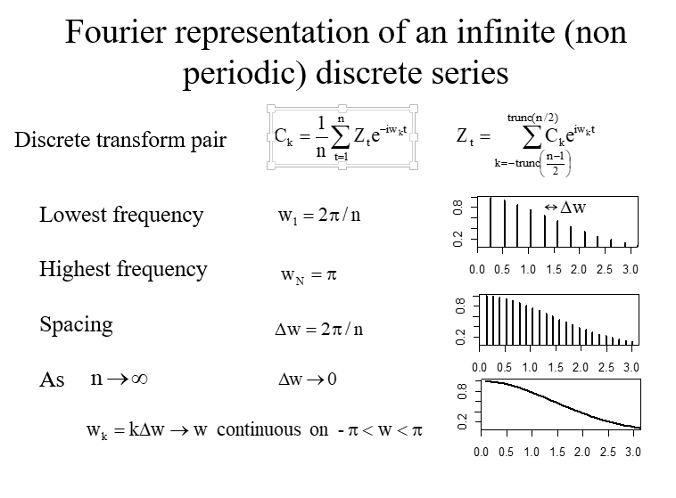
Fourier representation of an infinite (non periodic) discrete series

Slide 10
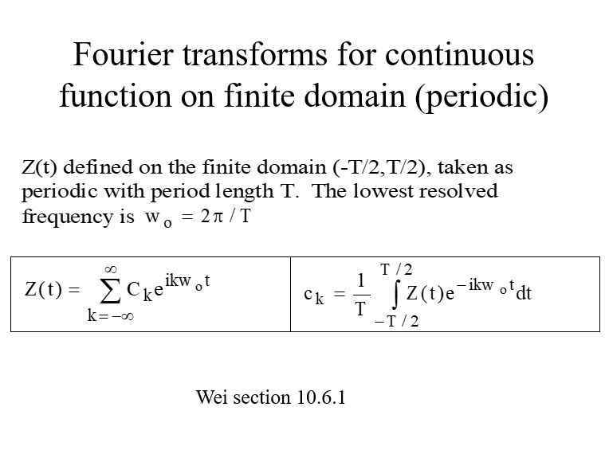
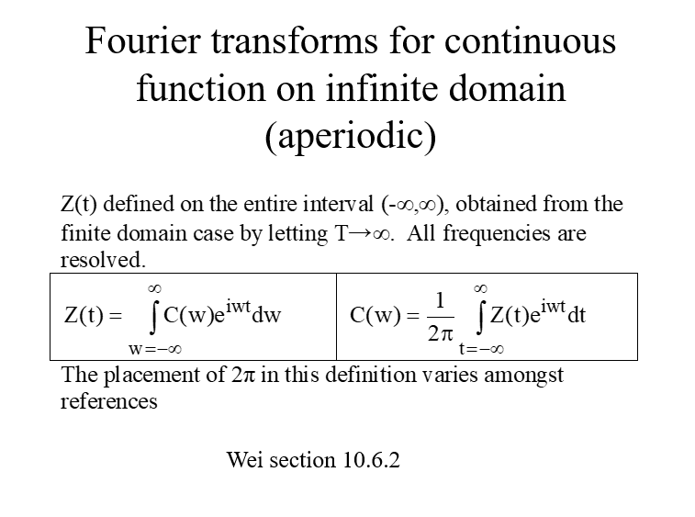
Fourier transforms for continuous function on finite domain periodic & aperiodic

Slide 11
What we get of it ?
Decomposition of process into dominant frequencies
Diagnosis and detection of periodicities and repeatable patterns
Capability to, through sampling from the spectrum, simulate a process with any S(w) and hence any Cov(τ)
By comparison of input and output spectra infer aspects of the process based on which frequencies are attenuated and which propagate through

Slide 12
Methodology – practical
We got it !!!

Slide 13
GUI VIEW
How it is made ?
GUI/APP can be developed in MATLAB. One need a basic knowledge of call backs and basic syntax knowledge. Using GUI for the spectral analysis can be efficient and any non expert can use with easy without knowledge of programming in matlab
Here is the sample of GUI , made with MATLAB app designer

Slide 14
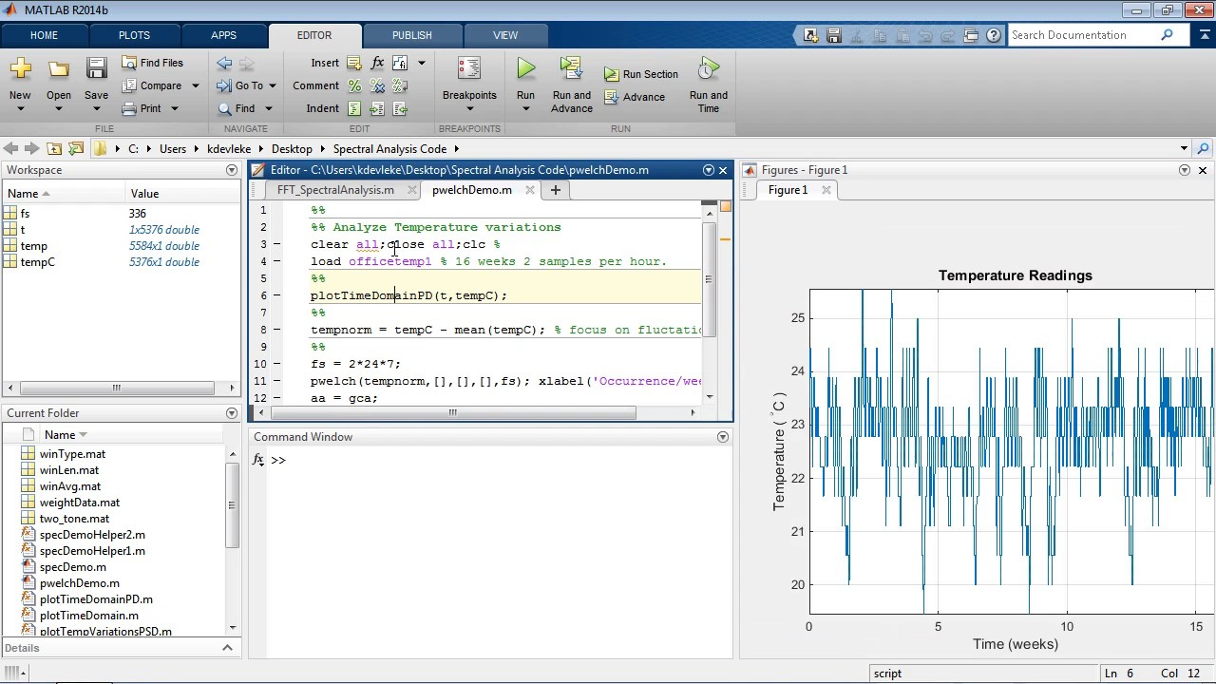
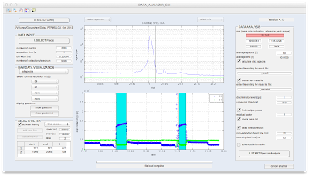

Slide 15
APPLICATIONS
Electronic communication systems, including radio communications, radars, and related systems
plus passive remote sensing technology.
Electronic instruments called spectrum analyzers are used to observe and measure the power spectra of signals
Spectrum Analyzer

