Slide 1


Ameya Barve, Quinn Colognato, and Mary Cotrupi

Slide 2
AGENDA
About MentorMatch
Intended consumers
Prototype
2. Project Structure
Information architecture
Focus areas
3. DEMO
4. Recap
Challenges
Future aspects

Slide 3
About MentorMatch

Slide 4
What is MentorMatch?
MentorMatch pairs RPI students with their perfect mentors in a fun way that’s similar to the popular dating app Tinder.

Slide 5
What makes MentorMatch unique?
Convenience
Online registration & preferences
Simplicity
Minimalist approach and simple UI
Efficiency
Faster than current RPI resources
Notes:
Current RPI resources that provide tutoring to students, like office hours, get crowded very easily (especially with popular classes like data structures). MentorMatch provides a casual way for students to meet with their peers who have already taken the course. Other online services ask people to give away a lot of unnecessary information and people don’t exactly know who they are meeting with. MentorMatch also provides the mentee with a mentor, rather than just a tutor, like ALAC tutoring.

Slide 6
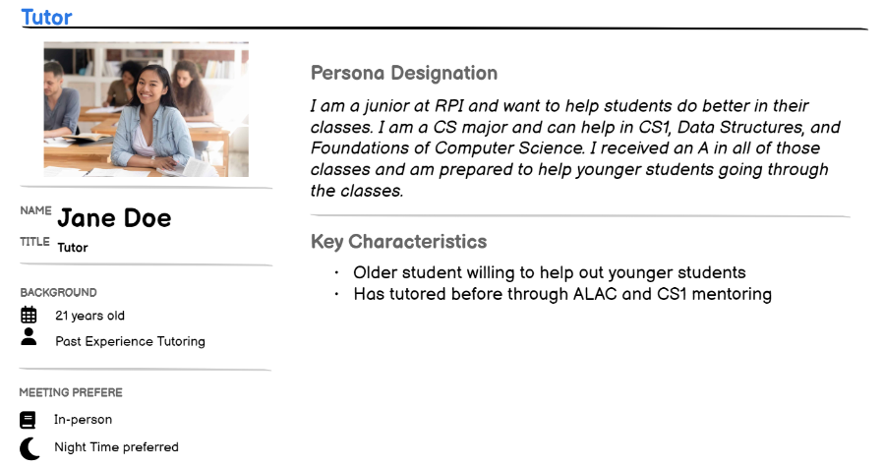
INTENDED CONSUMERS
Persona 1 - Tutor

Slide 7
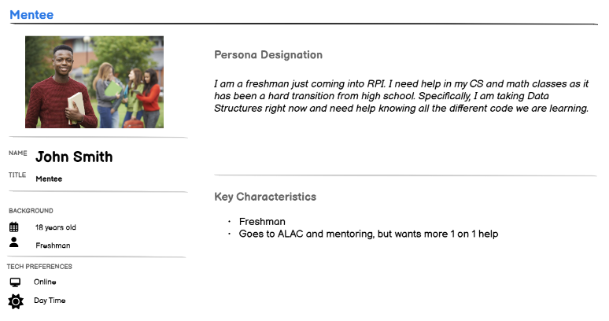
INTENDED CONSUMERS (cont.)
Persona 2 - Mentee

Slide 8

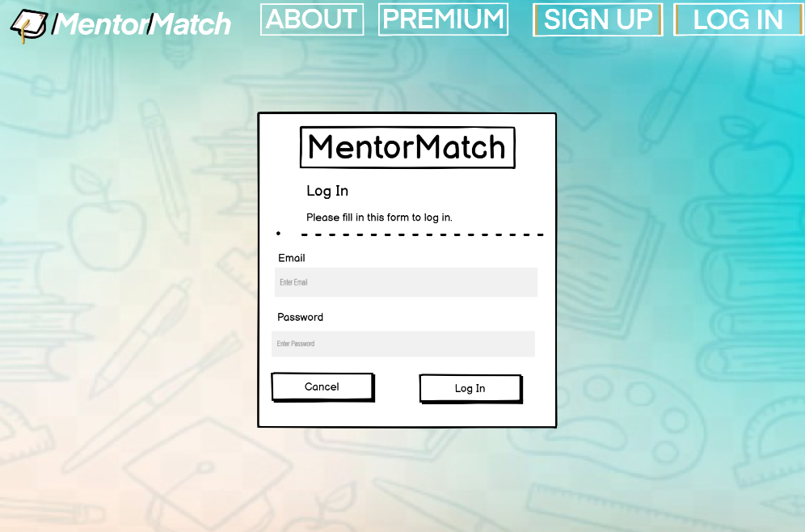
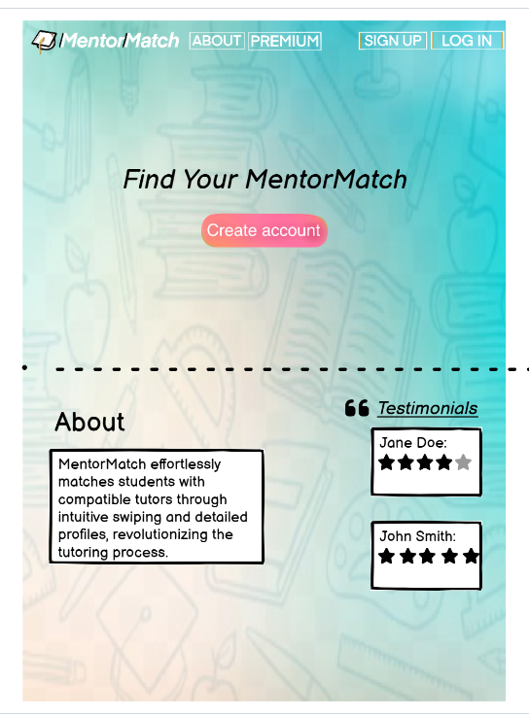
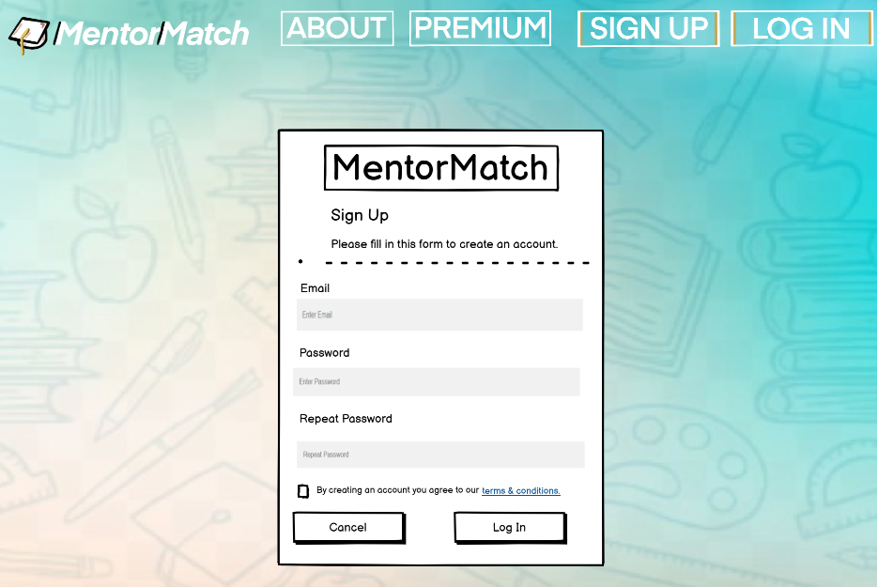
PROTOTYPE
LOG-IN
HOMEPAGE
SIGN-UP
Notes:
balsamiq; swipe page ideas came later however home page still matches pretty closely

Slide 9
2. Project Structure

Slide 10
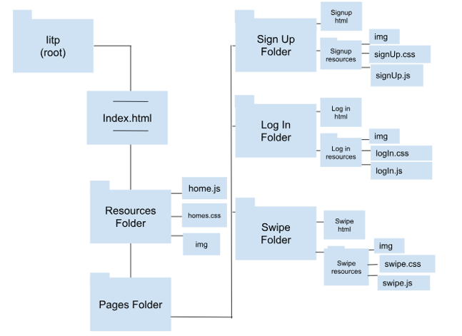
Information Architecture
Notes:
this is our original IA diagram; now, we also have a preferences folder etc.

Slide 11


FOCUS AREAS
HTML/CSS
Database Use
Website: Created a welcoming site theme with cohesive fonts, colors, strategic content layout, and playful Javascript animations
Preferences Page: Reads the real match and preferences data that a user selects and displays it to them
Ameya - Databases & Implementation Quinn - Swipe Page & HTML Mary - Styling & Effects

Slide 12
3. DEMO

Slide 13
4. Recap

Slide 14
What we Discussed:
What we Accomplished:
Match+ (a chance for users to pay extra and unlock more features)
A messaging interface between mentees and mentors
Implementing a working preferences page
A functional swipe page to display the mentors
Database integration to show a user their matches each time they sign in
Functional login and signup pages to store users

Slide 15
CHALLENGES
Swipe Page
Issue: using JavaScript to build the swipe mechanism for the cards
Resolved by creating a card class to add all the necessary card functions and a separate swipe JavaScript file to actually run these functions
Database Integration
Using ajax and php together to associate mentors with users in the sql database

Slide 16
FUTURE ASPECTS
Create a login section and landing page for the tutors
Ensure that two users can’t have the same username
Make the preferences affect which cards get displayed

Slide 17
Thank you!
Questions?

