Slide 1
Pt40Au60_AgBP1
2023-07-12

Slide 2
Input Parameters for DecomNano
Input Parameters (All) 218909 data
Input Parameters (Droped parameters with no answer) 16054 data
Parameter | Min | Max | Mean | Standard Deviation
dP | 2.8 | 2.8 | 2.8 | 0.0
dA | 2.9 | 2.9 | 2.9 | 0.0
fA | 0.6 | 0.6 | 0.6 | 0.0
nAA | 3.6 | 4.8 | 4.2 | 0.4
nPP | 9.3 | 10.7 | 10.0 | 0.5
nAP | 2.3 | 3.3 | 2.8 | 0.3
nPA | 0.0 | 1.4 | 0.7 | 0.5
DA | 0 | 16 | 8.0 | 5.2
DAP | 17 | 17 | 17.0 | 0.0
DP | 0 | 16 | 8.0 | 5.2
Parameter | Min | Max | Mean | Standard Deviation
dP | 2.8 | 2.8 | 2.8 | 0.0
dA | 2.9 | 2.9 | 2.9 | 0.0
fA | 0.6 | 0.6 | 0.6 | 0.0
nAA | 3.6 | 4.8 | 4.1 | 0.4
nPP | 9.3 | 10.1 | 9.4 | 0.2
nAP | 2.3 | 3.3 | 2.6 | 0.3
nPA | 0.0 | 1.4 | 0.6 | 0.5
DA | 0 | 16 | 5.1 | 4.2
DAP | 17 | 17 | 17.0 | 0.0
DP | 0 | 16 | 7.0 | 4.8

Slide 3
Ouput Parameters
Parameter | Min | Max | Mean | Standard Deviation
dP | 2.8 | 2.8 | 2.8 | 0.0
dA | 2.9 | 2.9 | 2.9 | 0.0
fA | 0.6 | 0.6 | 0.6 | 0.0
nAA | 3.6 | 4.8 | 4.1 | 0.4
nPP | 9.3 | 10.1 | 9.4 | 0.2
nAP | 2.3 | 3.3 | 2.6 | 0.3
nPA | 0.0 | 1.4 | 0.6 | 0.5
DA | 0 | 16 | 5.1 | 4.2
DAP | 17 | 17 | 17.0 | 0.0
DP | 0 | 16 | 7.0 | 4.8
nAM_AP | 4.2 | 8.7 | 6.7 | 0.6
nPM_AP | 9.5 | 12.0 | 10.2 | 0.7
nAA_AP | 0.0 | 5.2 | 3.9 | 0.7
nAP_AP | 2.3 | 7.0 | 2.8 | 0.4
nPA_AP | 0.0 | 3.1 | 0.7 | 0.6
nPP_AP | 8.0 | 10.3 | 9.5 | 0.2
XAP | 0.06 | 1.0 | 0.86 | 0.15
XA | 0.0 | 0.53 | 0.05 | 0.07
XP | 0.0 | 0.89 | 0.09 | 0.12
y | 0.0 | 0.47 | 0.19 | 0.13
dAP | 2.8 | 2.8 | 2.8 | 0.0
nMM_AP | 9.5 | 9.5 | 9.5 | 0.0
nAA_A | 0.0 | 9.3 | 5.0 | 2.9
nPP_P | 0.0 | 9.4 | 6.1 | 3.0
NA | 1.0 | 121.2 | 18.5 | 26.3
NP | 1.0 | 133.6 | 33.7 | 36.4
NAP | 146.7 | 146.7 | 146.7 | 0.0
XA*NA | 0.0 | 21.9 | 0.9 | 2.3
XP*NP | 0.0 | 118.6 | 5.9 | 13.3
XAP*NAP | 9.1 | 146.6 | 126.7 | 21.3

Slide 4
Solution of DecomNano
Parameter | Min | Max | Mean | Standard Deviation
nAM_AP | 4.2 | 8.7 | 6.7 | 0.6
nPM_AP | 9.5 | 12.0 | 10.2 | 0.7
nAA_AP | 0.0 | 5.2 | 3.9 | 0.7
nAP_AP | 2.3 | 7.0 | 2.8 | 0.4
nPA_AP | 0.0 | 3.1 | 0.7 | 0.6
nPP_AP | 8.0 | 10.3 | 9.5 | 0.2
XAP | 0.06 | 1.0 | 0.86 | 0.15
XA | 0.0 | 0.53 | 0.05 | 0.07
XP | 0.0 | 0.89 | 0.09 | 0.12
y | 0.0 | 0.47 | 0.19 | 0.13

Slide 5
Other Parameters Calculated in the DecomNano
Parameter | Min | Max | Mean | Standard Deviation
dAP | 2.8 | 2.8 | 2.8 | 0.0
nMM_AP | 9.5 | 9.5 | 9.5 | 0.0
nAA_A | 0.0 | 9.3 | 5.0 | 2.9
nPP_P | 0.0 | 9.4 | 6.1 | 3.0
NA | 1.0 | 121.2 | 18.5 | 26.3
NP | 1.0 | 133.6 | 33.7 | 36.4
NAP | 146.7 | 146.7 | 146.7 | 0.0

Slide 6
Extracted Parameter Related to Hetereogeneity
Parameter | Min | Max | Mean | Standard Deviation
XA*NA | 0.0 | 21.9 | 0.9 | 2.3
XP*NP | 0.0 | 118.6 | 5.9 | 13.3
XAP*NAP | 9.1 | 146.6 | 126.7 | 21.3
y | 0.0 | 0.47 | 0.19 | 0.13
nAM_AP | 4.2 | 8.7 | 6.7 | 0.6
nPM_AP | 9.5 | 12.0 | 10.2 | 0.7

Slide 7
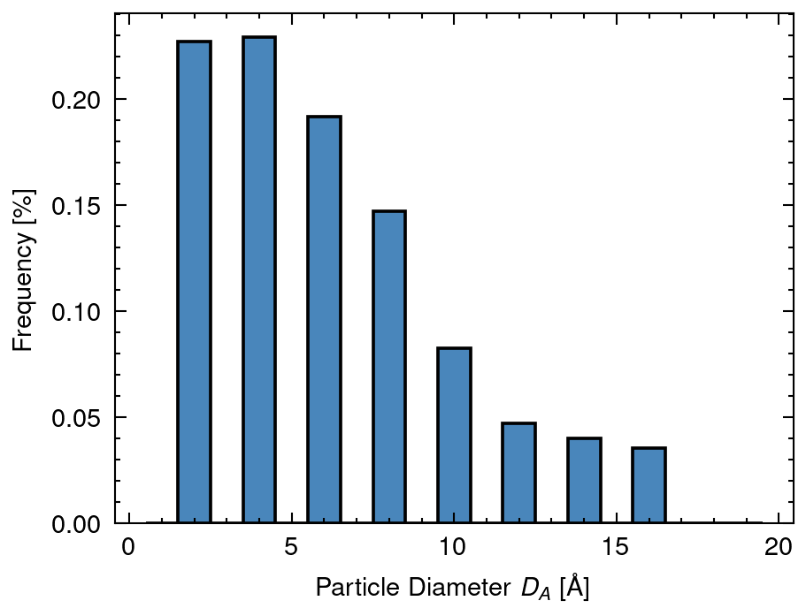
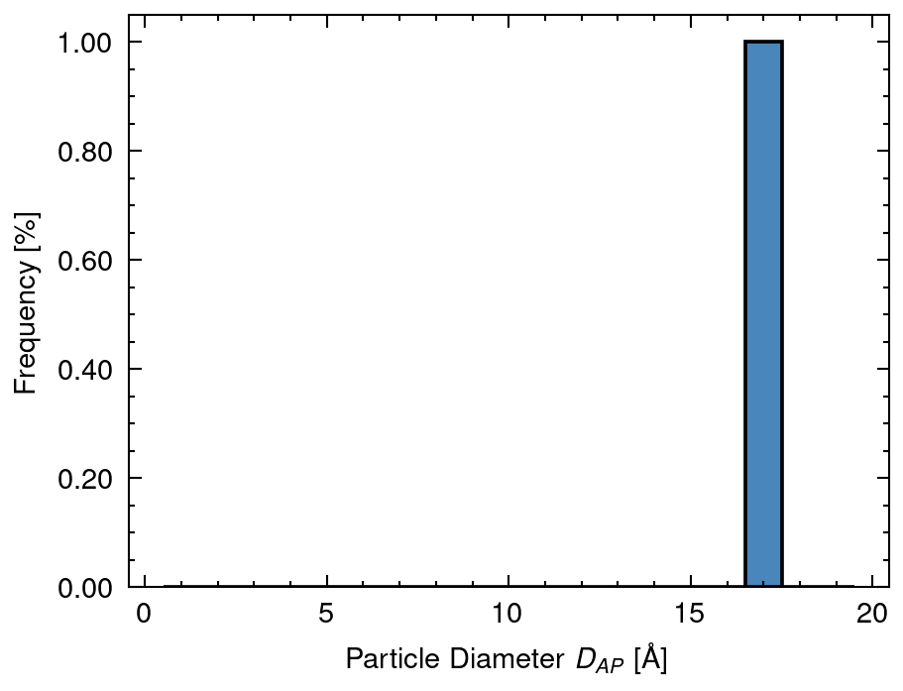
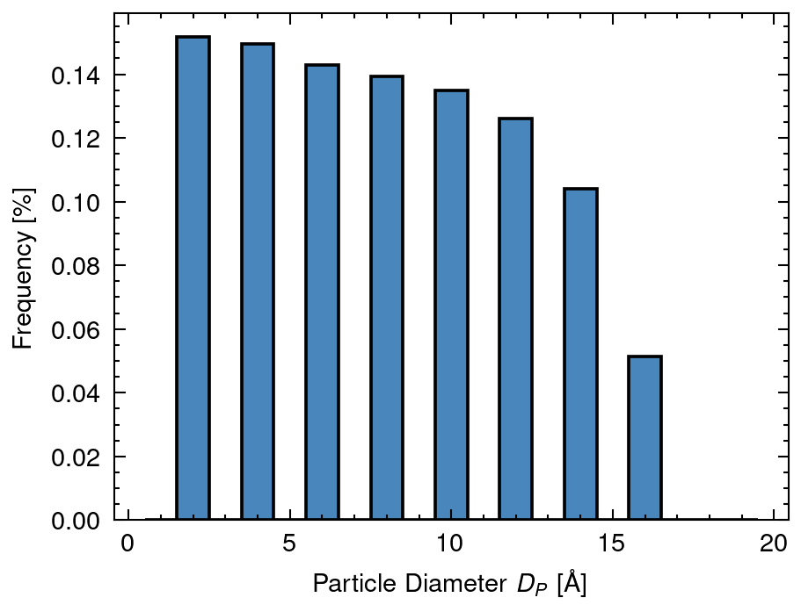
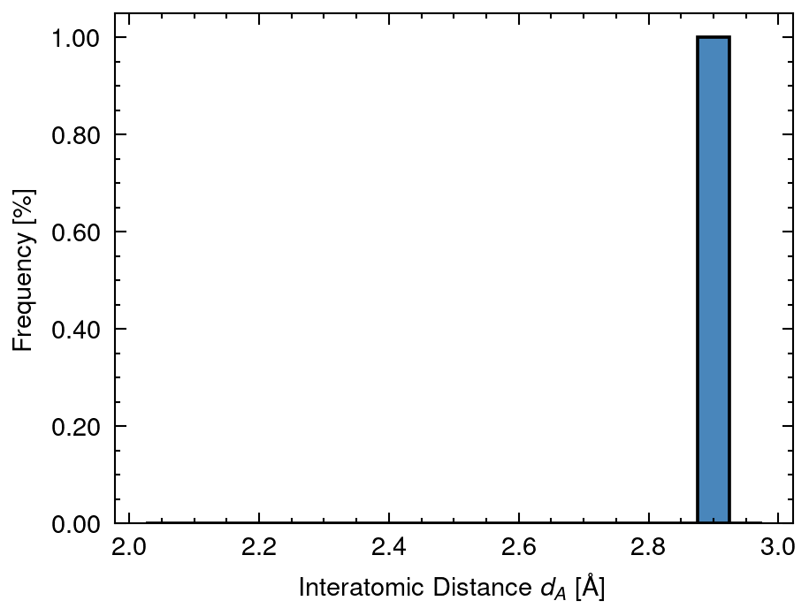
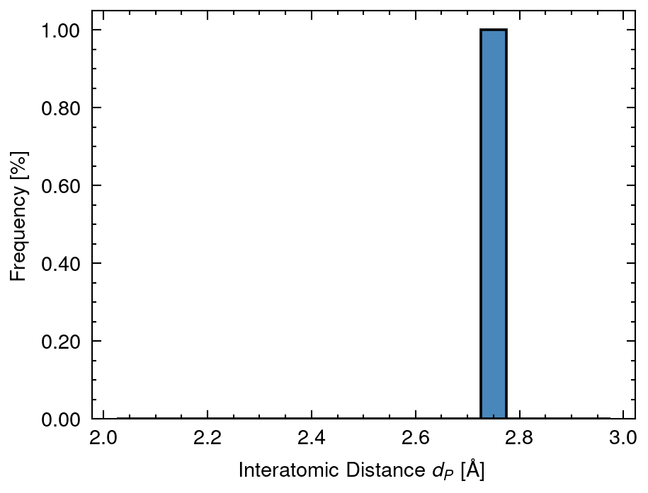
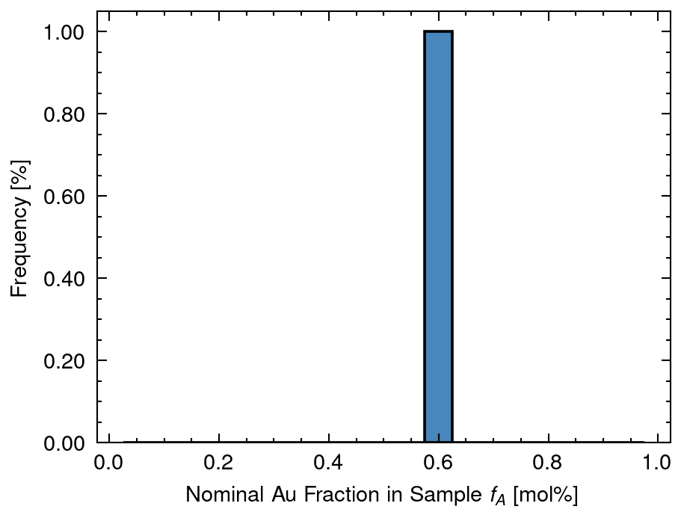
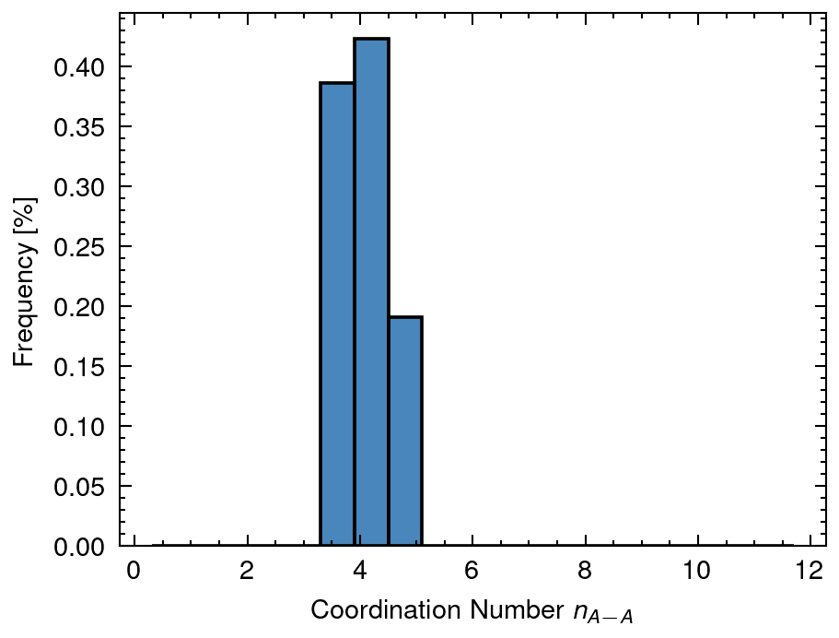
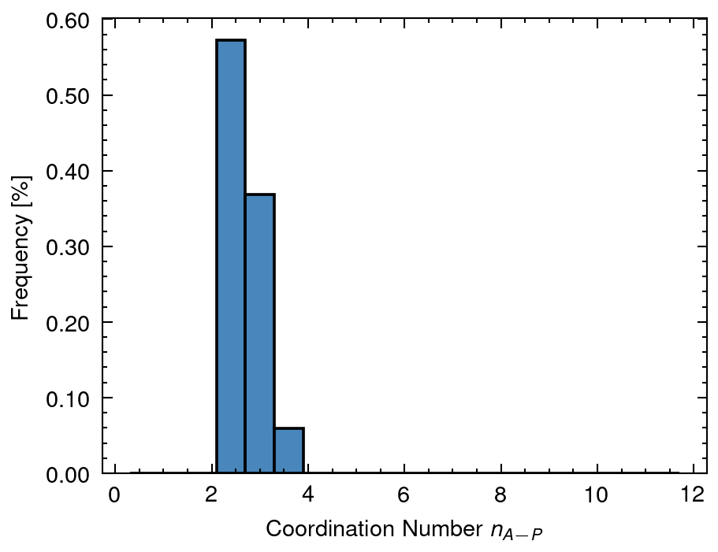
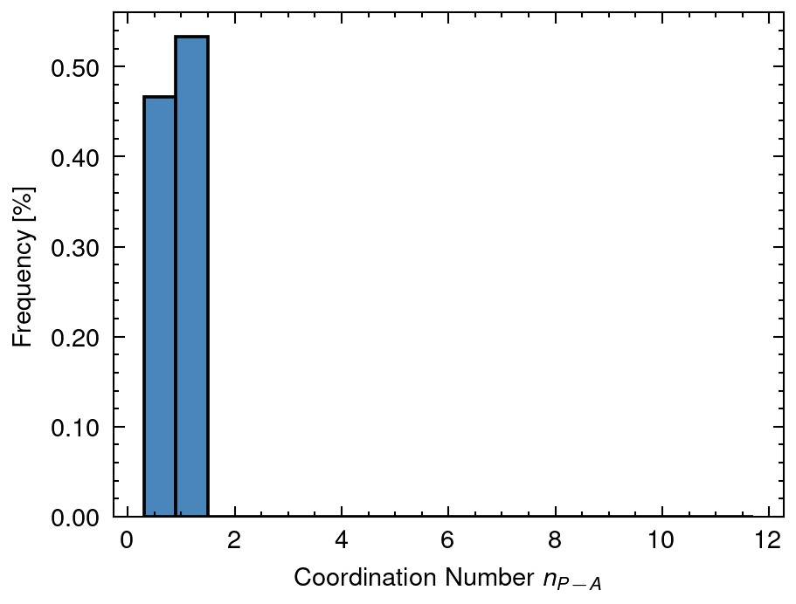
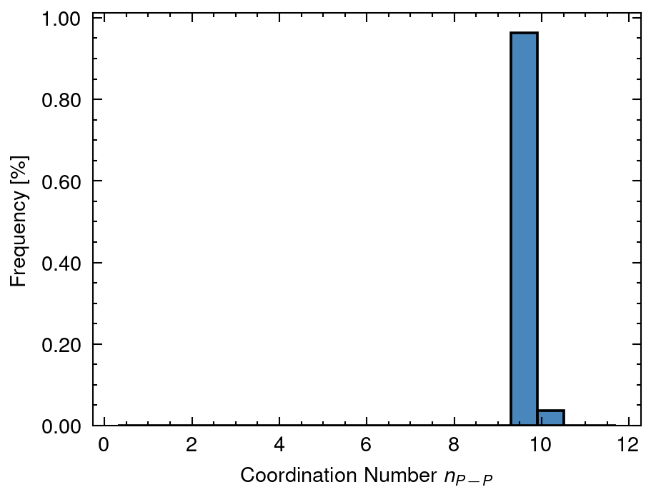
1 Distribution of input data
DA mean: 5.06 sd:4.17
DAP mean: 17.0 sd:0.0
DP mean: 6.97 sd:4.79
dA mean: 2.88 sd:0.0
dP mean: 2.77 sd:0.0
fA mean: 0.6 sd:0.0
nAA mean: 4.09 sd:0.39
nAP mean: 2.61 sd:0.31
nPA mean: 0.65 sd:0.5
nPP mean: 9.39 sd:0.16

Slide 8
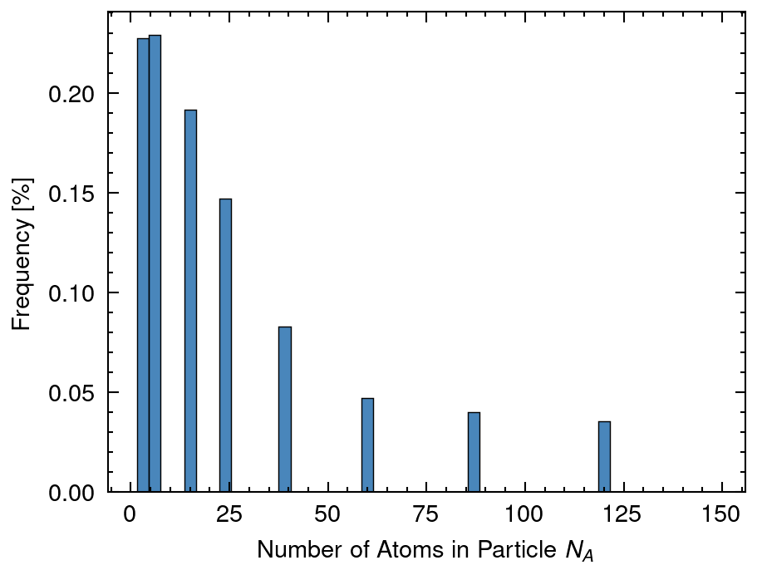
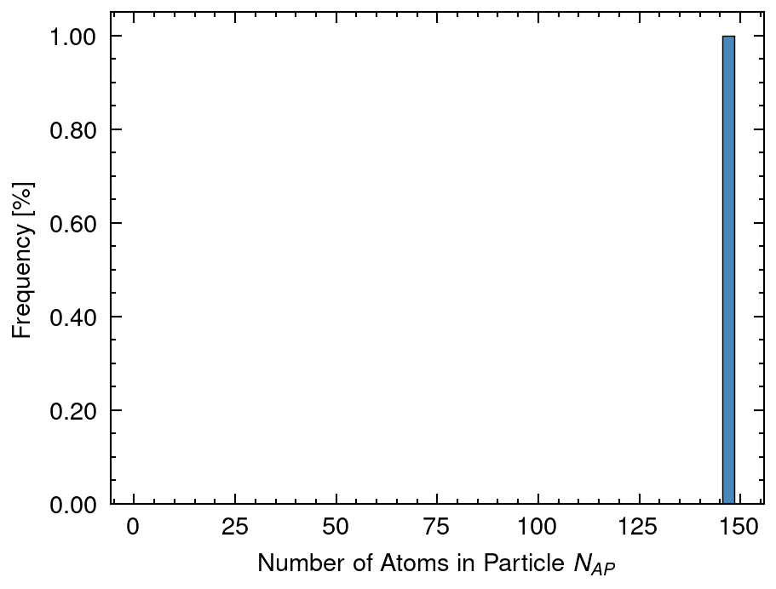
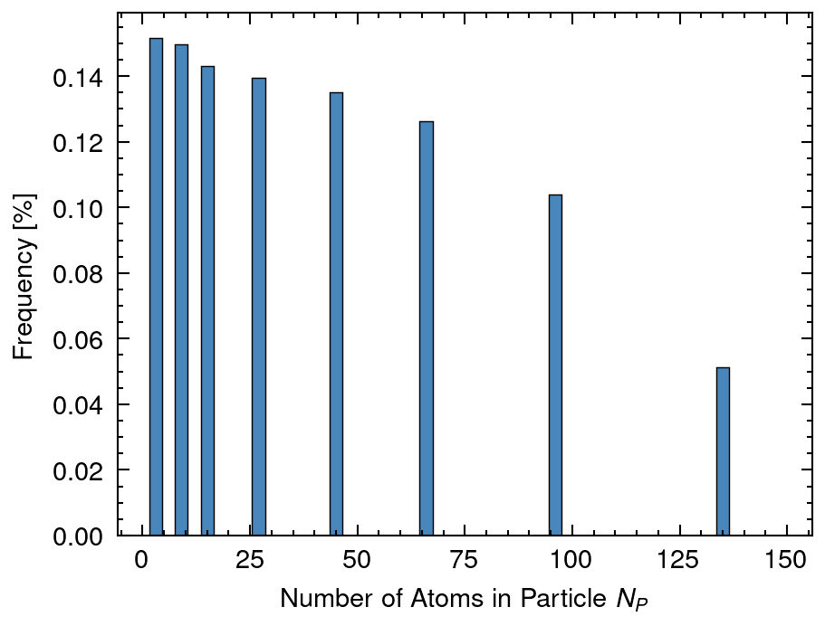
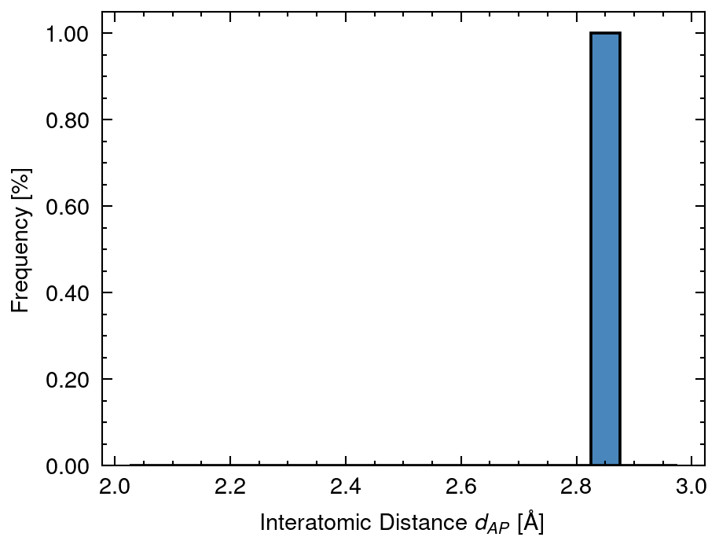
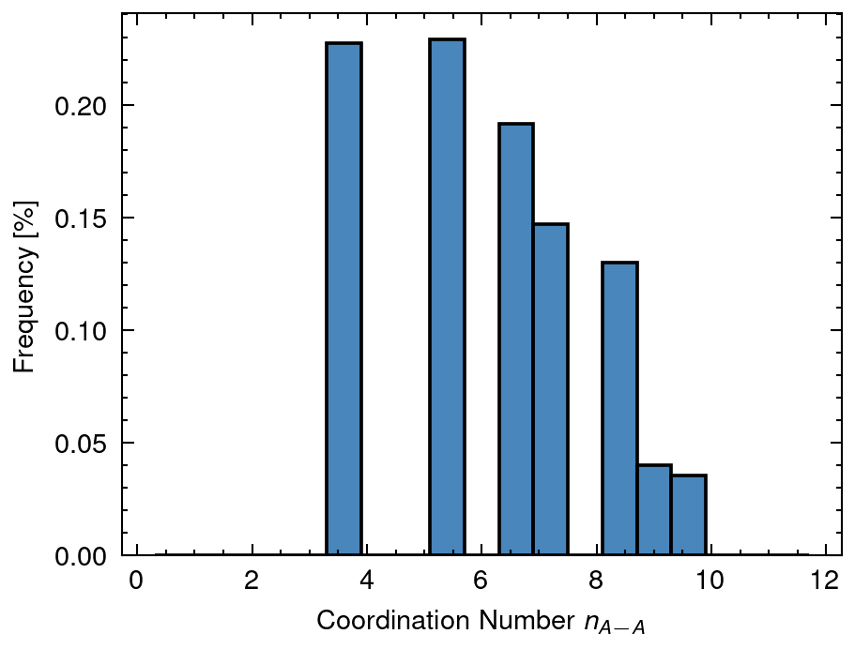
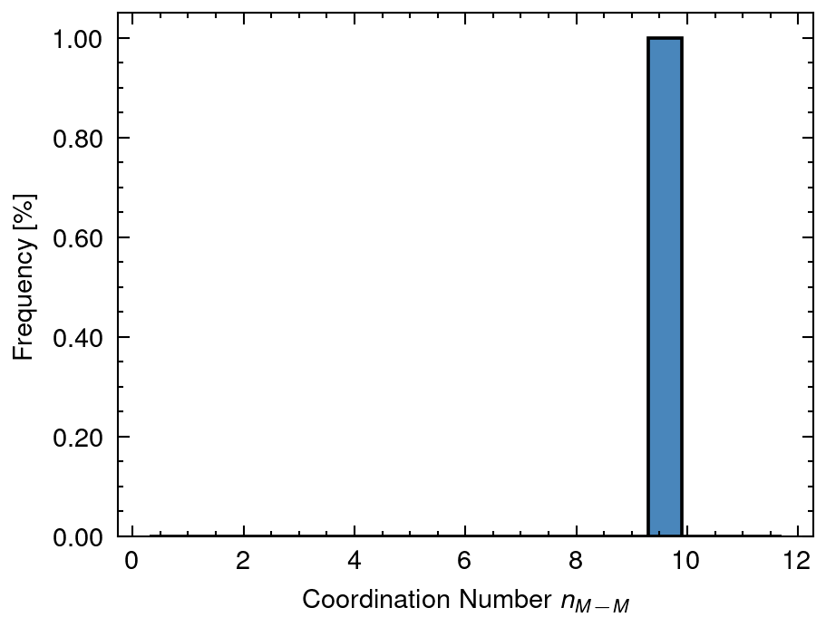
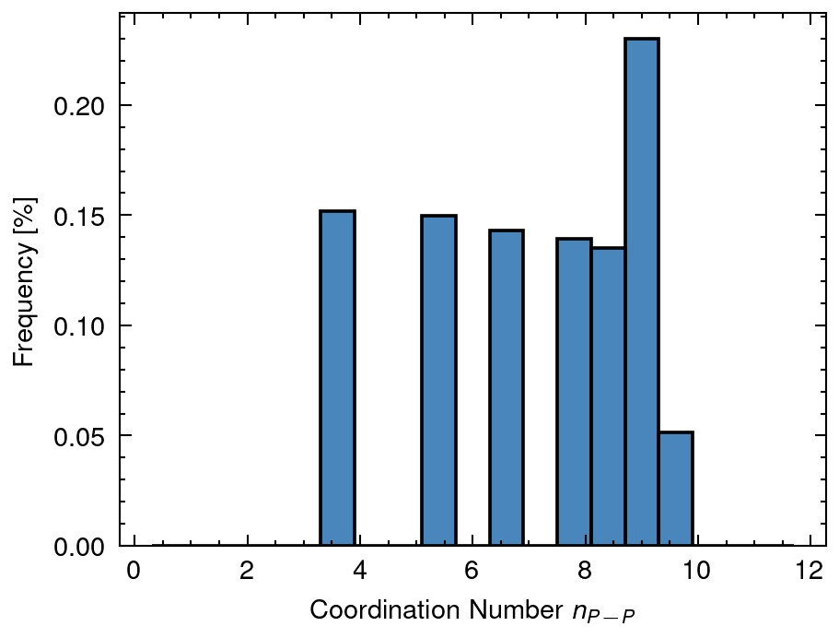
2 Distribution of calculated data
NA mean: 18.54 sd:26.26
NAP mean: 146.65 sd:0.0
NP mean: 33.66 sd:36.4
dAP mean: 2.84 sd:0.0
nAA_A mean: 4.98 sd:2.92
nMM_AP mean: 9.47 sd:0.0
nPP_P mean: 6.08 sd:2.95

Slide 9
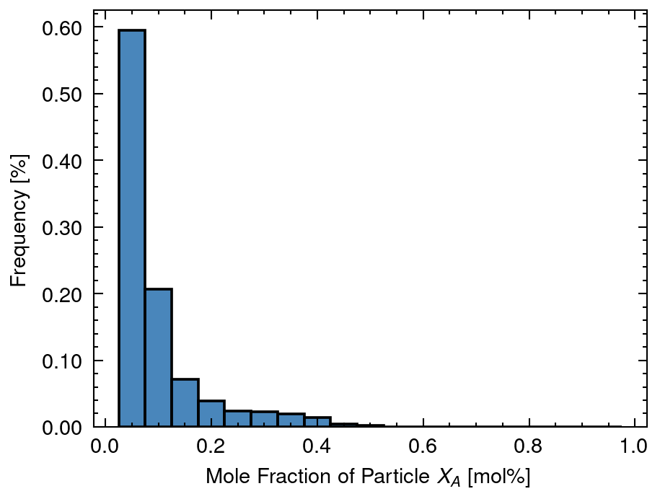
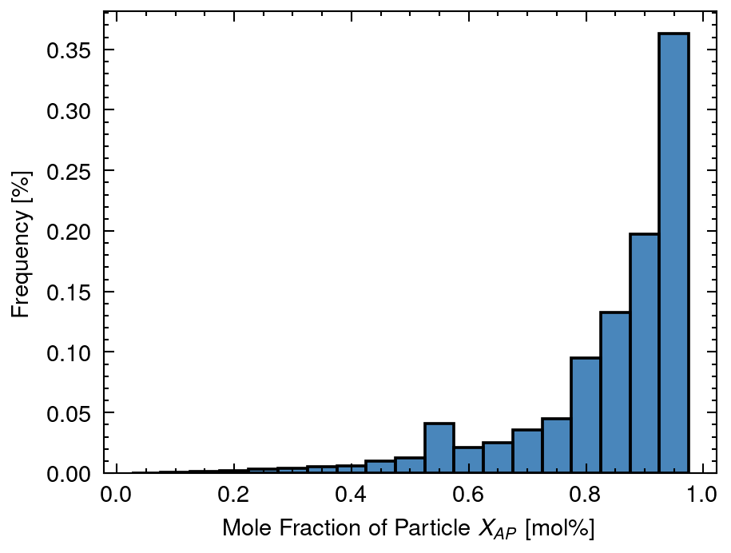
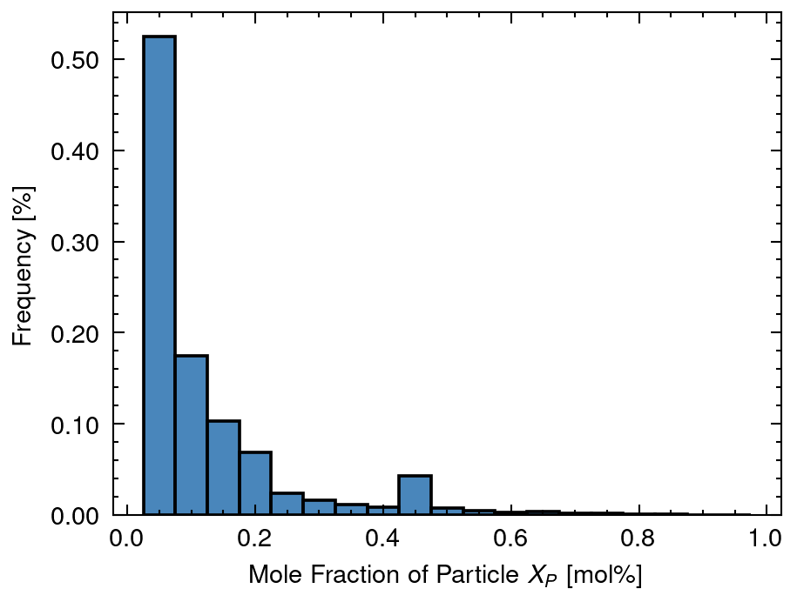
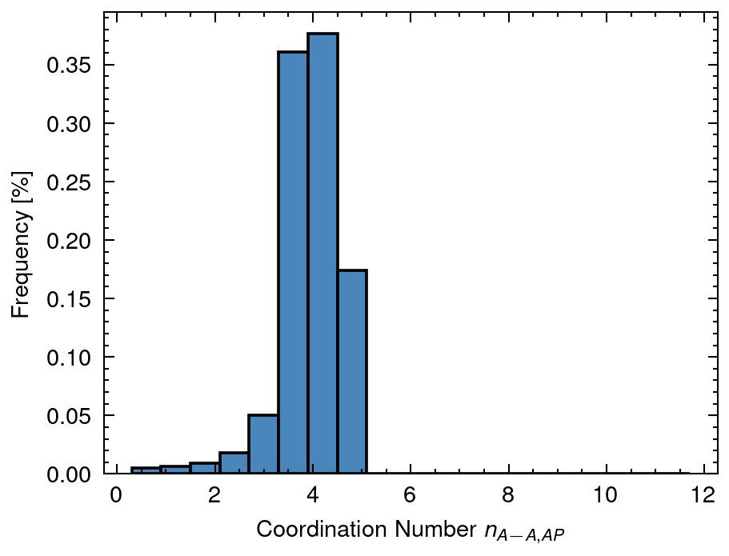
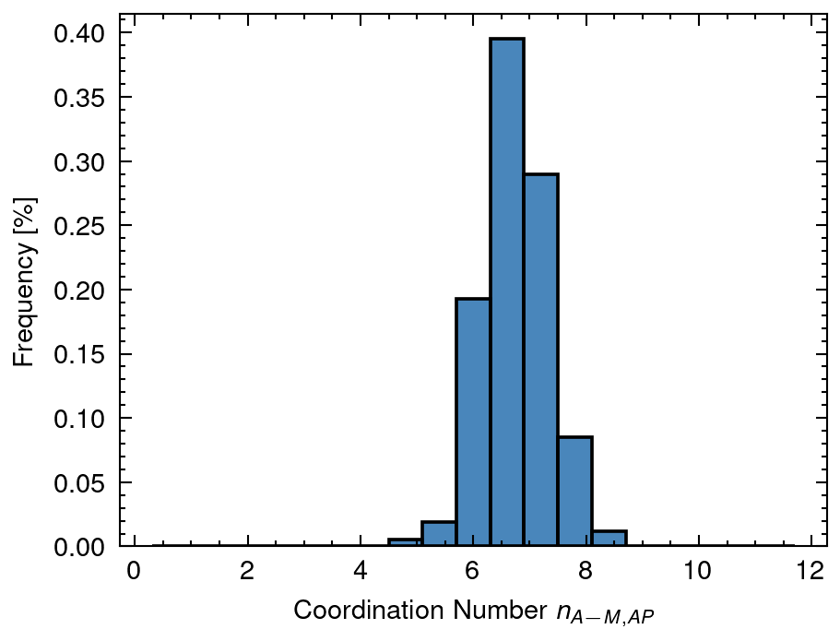
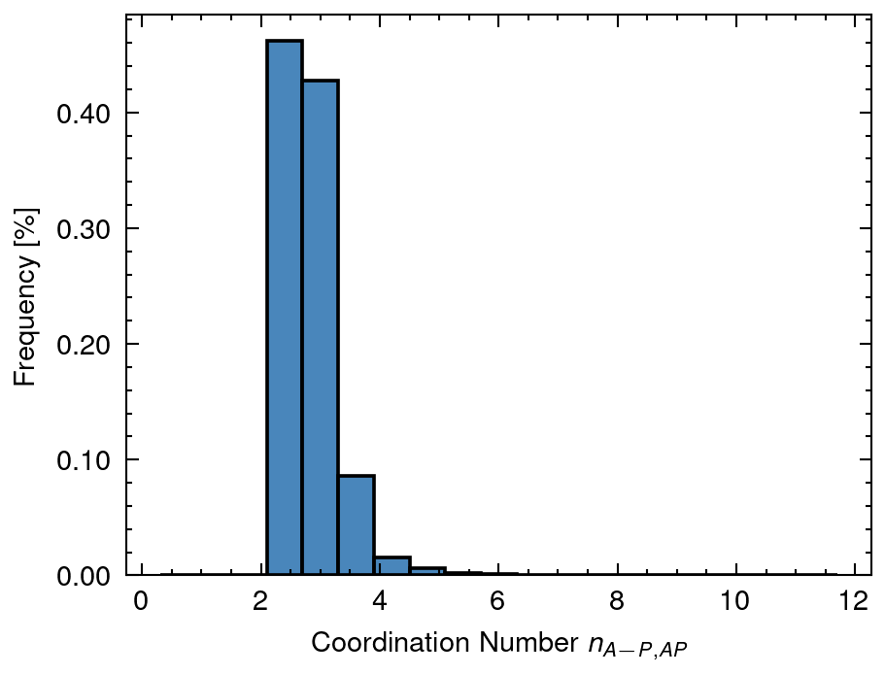
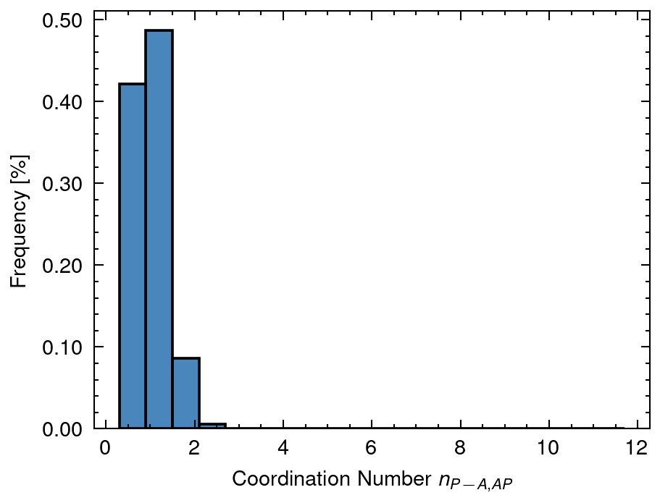
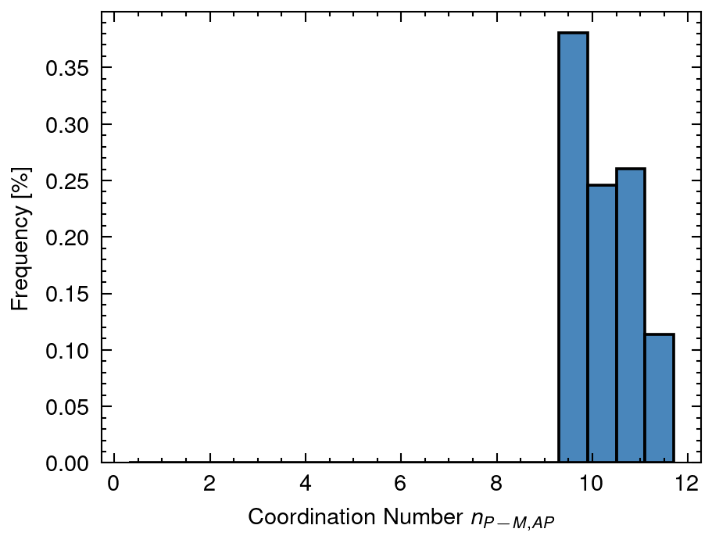
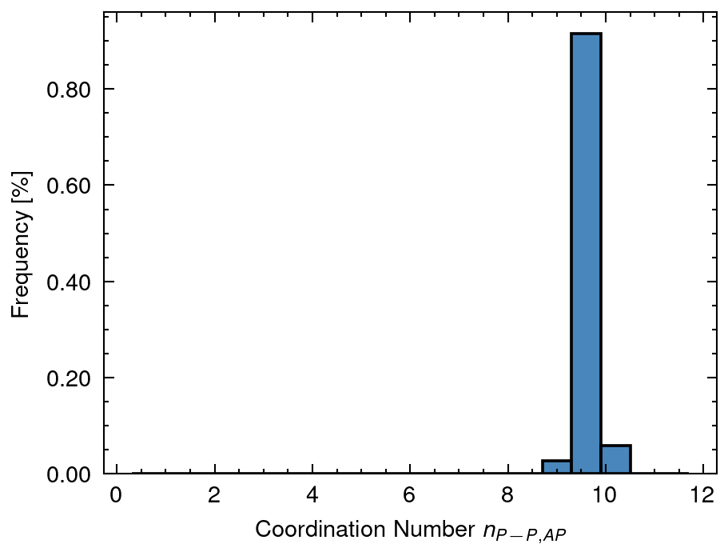
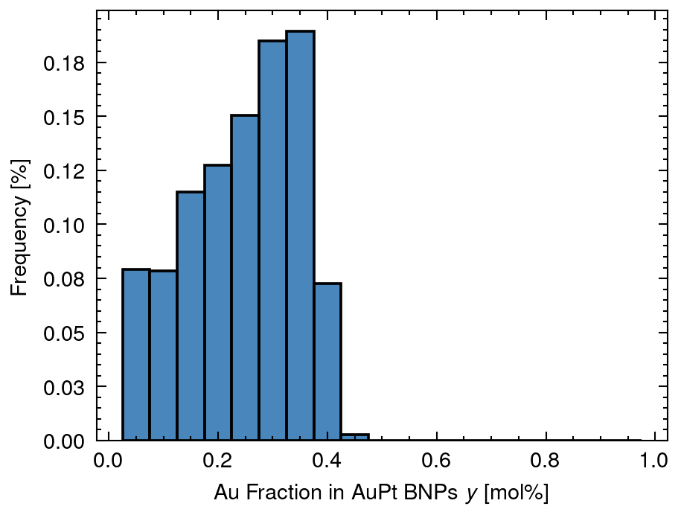
3 Distribution of solved data
XA mean: 0.05 sd:0.07
XAP mean: 0.86 sd:0.15
XP mean: 0.09 sd:0.12
nAA_AP mean: 3.93 sd:0.65
nAM_AP mean: 6.73 sd:0.56
nAP_AP mean: 2.8 sd:0.44
nPA_AP mean: 0.72 sd:0.56
nPM_AP mean: 10.24 sd:0.65
nPP_AP mean: 9.52 sd:0.19
y mean: 0.19 sd:0.13

Slide 10
4 Distribution of n (Overall Cordination Number)
nAA_A mean: 4.98 sd:2.92
nMM_AP mean: 9.47 sd:0.0
nPP_P mean: 6.08 sd:2.95

Slide 11
5 Distribution of X (Fraction of Nanoparticle)
XA mean: 0.05 sd:0.07
XAP mean: 0.86 sd:0.15
XP mean: 0.09 sd:0.12

Slide 12
6 Distribution of y (Fraction of Au in Nanoparticle)
y mean: 0.19 sd:0.13

Slide 13
7 Distribution of D (Atomic Distance)
DA mean: 5.06 sd:4.17
DAP mean: 17.0 sd:0.0
DP mean: 6.97 sd:4.79

Slide 14
8 Distribution of n (Coordination Number of Nanoparticle)
nAA_AP mean: 3.93 sd:0.65
nAM_AP mean: 6.73 sd:0.56
nAP_AP mean: 2.8 sd:0.44
nPA_AP mean: 0.72 sd:0.56
nPM_AP mean: 10.24 sd:0.65
nPP_AP mean: 9.52 sd:0.19

