Slide 1
Pt20Au80_AgBP1_fix_bulk_fraction
2023-07-13

Slide 2
Input Parameters for DecomNano
Input Parameters (All) 261065 data
Input Parameters (Droped parameters with no answer) 29310 data
Parameter | Min | Max | Mean | Standard Deviation
dP | 2.8 | 2.8 | 2.8 | 0.0
dA | 2.9 | 2.9 | 2.9 | 0.0
fA | 0.8 | 0.8 | 0.8 | 0.0
nAA | 6.0 | 7.0 | 6.5 | 0.3
nPP | 9.2 | 10.6 | 9.9 | 0.5
nAP | 0.1 | 1.1 | 0.6 | 0.3
nPA | 0.3 | 1.9 | 1.1 | 0.5
DA | 0 | 18 | 9.0 | 5.7
DAP | 18 | 18 | 18.0 | 0.0
DP | 0 | 18 | 9.0 | 5.7
Parameter | Min | Max | Mean | Standard Deviation
dP | 2.8 | 2.8 | 2.8 | 0.0
dA | 2.9 | 2.9 | 2.9 | 0.0
fA | 0.8 | 0.8 | 0.8 | 0.0
nAA | 6.0 | 7.0 | 6.6 | 0.3
nPP | 9.2 | 10.6 | 9.8 | 0.4
nAP | 0.1 | 1.1 | 0.8 | 0.2
nPA | 0.3 | 1.9 | 0.7 | 0.4
DA | 0 | 18 | 5.2 | 4.0
DAP | 18 | 18 | 18.0 | 0.0
DP | 0 | 18 | 5.8 | 4.4

Slide 3
Ouput Parameters
Parameter | Min | Max | Mean | Standard Deviation
dP | 2.8 | 2.8 | 2.8 | 0.0
dA | 2.9 | 2.9 | 2.9 | 0.0
fA | 0.8 | 0.8 | 0.8 | 0.0
nAA | 6.0 | 7.0 | 6.6 | 0.3
nPP | 9.2 | 10.6 | 9.8 | 0.4
nAP | 0.1 | 1.1 | 0.8 | 0.2
nPA | 0.3 | 1.9 | 0.7 | 0.4
DA | 0 | 18 | 5.2 | 4.0
DAP | 18 | 18 | 18.0 | 0.0
DP | 0 | 18 | 5.8 | 4.4
nAM_AP | 1.6 | 11.7 | 7.4 | 1.0
nPM_AP | 9.4 | 12.0 | 11.1 | 0.6
nAA_AP | 0.0 | 9.1 | 6.2 | 1.5
nAP_AP | 0.1 | 8.1 | 1.2 | 0.8
nPA_AP | 0.3 | 2.6 | 0.9 | 0.4
nPP_AP | 8.3 | 11.7 | 10.2 | 0.5
XAP | 0.03 | 1.0 | 0.71 | 0.22
XA | 0.0 | 0.97 | 0.19 | 0.22
XP | 0.0 | 0.76 | 0.1 | 0.09
y | 0.08 | 0.85 | 0.42 | 0.13
dAP | 2.9 | 2.9 | 2.9 | 0.0
nMM_AP | 9.6 | 9.6 | 9.6 | 0.0
nAA_A | 0.0 | 9.6 | 5.1 | 3.0
nPP_P | 0.0 | 9.6 | 5.5 | 2.9
NA | 1.0 | 163.0 | 17.8 | 20.6
NP | 1.0 | 180.0 | 24.8 | 33.7
NAP | 166.2 | 166.2 | 166.2 | 0.0
XA*NA | 0.0 | 51.2 | 5.1 | 8.7
XP*NP | 0.0 | 102.1 | 3.6 | 7.6
XAP*NAP | 4.7 | 166.1 | 117.9 | 37.3

Slide 4
Solution of DecomNano
Parameter | Min | Max | Mean | Standard Deviation
nAM_AP | 1.6 | 11.7 | 7.4 | 1.0
nPM_AP | 9.4 | 12.0 | 11.1 | 0.6
nAA_AP | 0.0 | 9.1 | 6.2 | 1.5
nAP_AP | 0.1 | 8.1 | 1.2 | 0.8
nPA_AP | 0.3 | 2.6 | 0.9 | 0.4
nPP_AP | 8.3 | 11.7 | 10.2 | 0.5
XAP | 0.03 | 1.0 | 0.71 | 0.22
XA | 0.0 | 0.97 | 0.19 | 0.22
XP | 0.0 | 0.76 | 0.1 | 0.09
y | 0.08 | 0.85 | 0.42 | 0.13

Slide 5
Other Parameters Calculated in the DecomNano
Parameter | Min | Max | Mean | Standard Deviation
dAP | 2.9 | 2.9 | 2.9 | 0.0
nMM_AP | 9.6 | 9.6 | 9.6 | 0.0
nAA_A | 0.0 | 9.6 | 5.1 | 3.0
nPP_P | 0.0 | 9.6 | 5.5 | 2.9
NA | 1.0 | 163.0 | 17.8 | 20.6
NP | 1.0 | 180.0 | 24.8 | 33.7
NAP | 166.2 | 166.2 | 166.2 | 0.0

Slide 6
Extracted Parameter Related to Hetereogeneity
Parameter | Min | Max | Mean | Standard Deviation
XA*NA | 0.0 | 51.2 | 5.1 | 8.7
XP*NP | 0.0 | 102.1 | 3.6 | 7.6
XAP*NAP | 4.7 | 166.1 | 117.9 | 37.3
y | 0.08 | 0.85 | 0.42 | 0.13
nAM_AP | 1.6 | 11.7 | 7.4 | 1.0
nPM_AP | 9.4 | 12.0 | 11.1 | 0.6

Slide 7
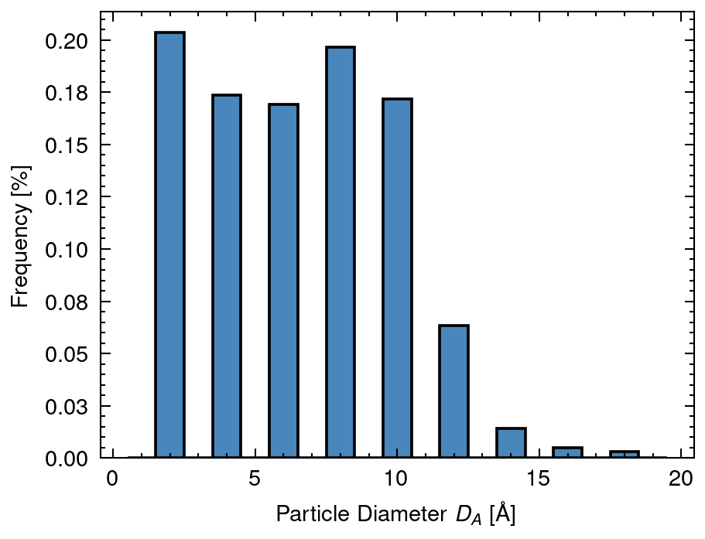
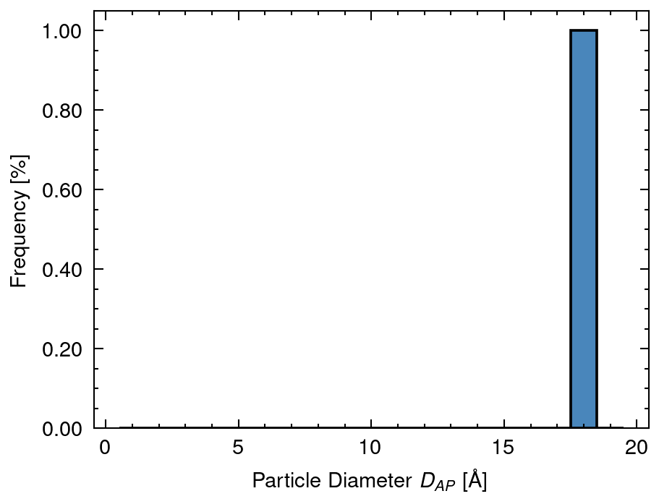
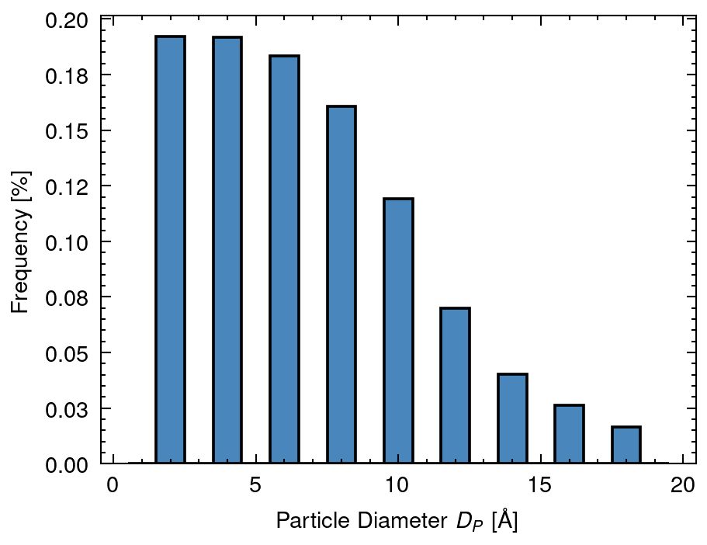
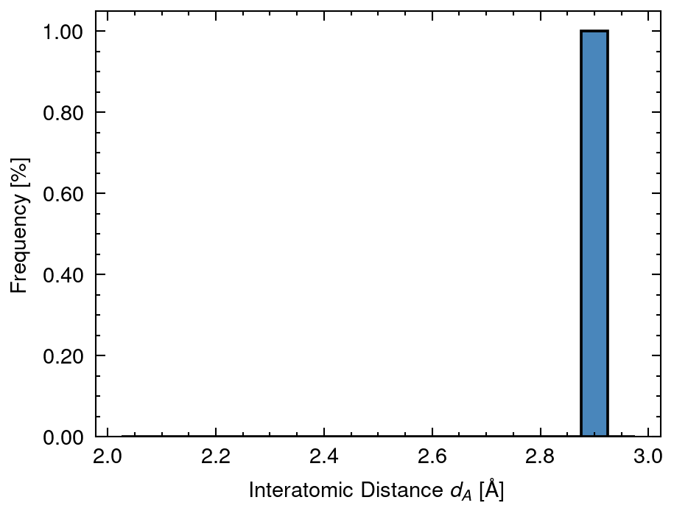
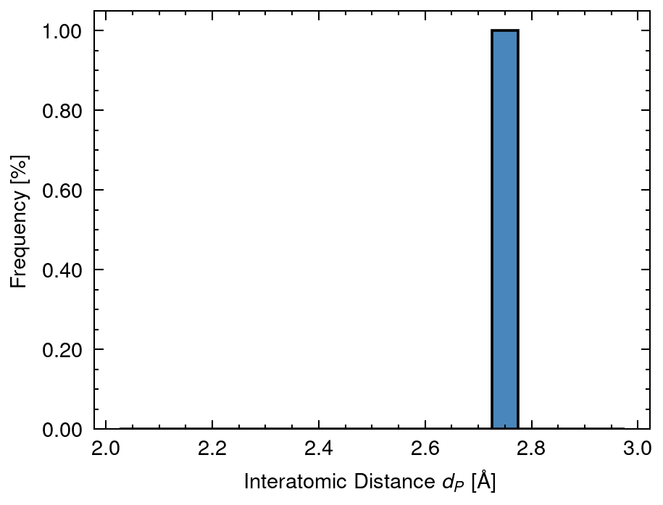
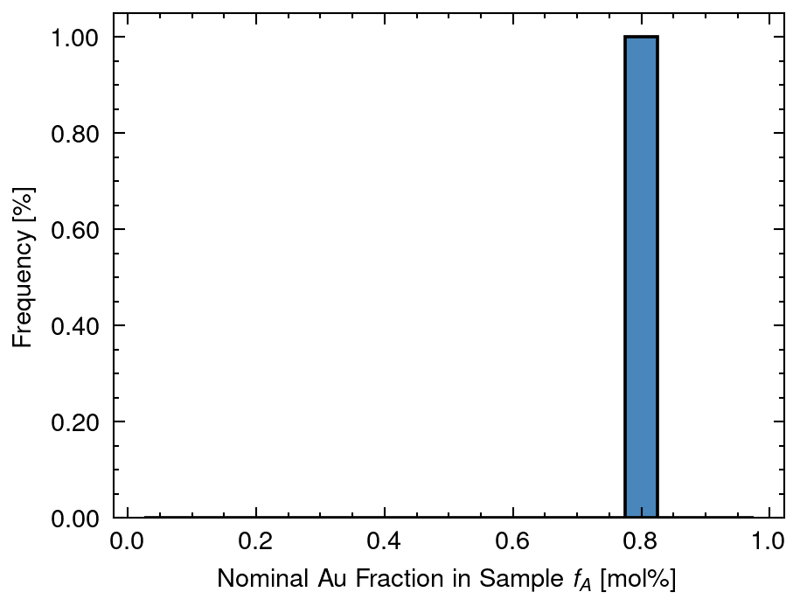
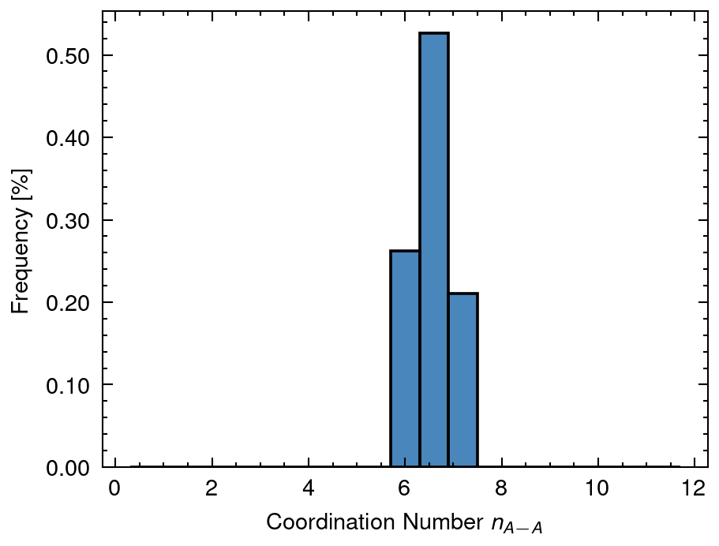
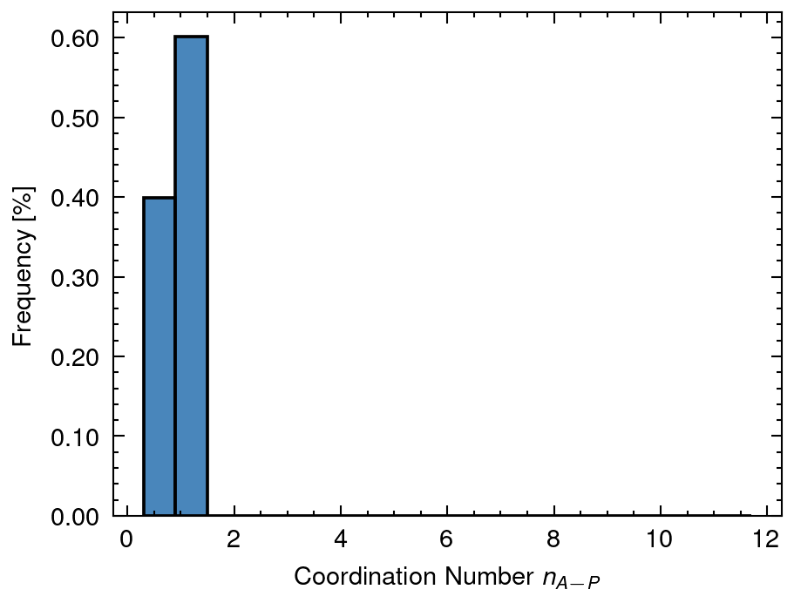
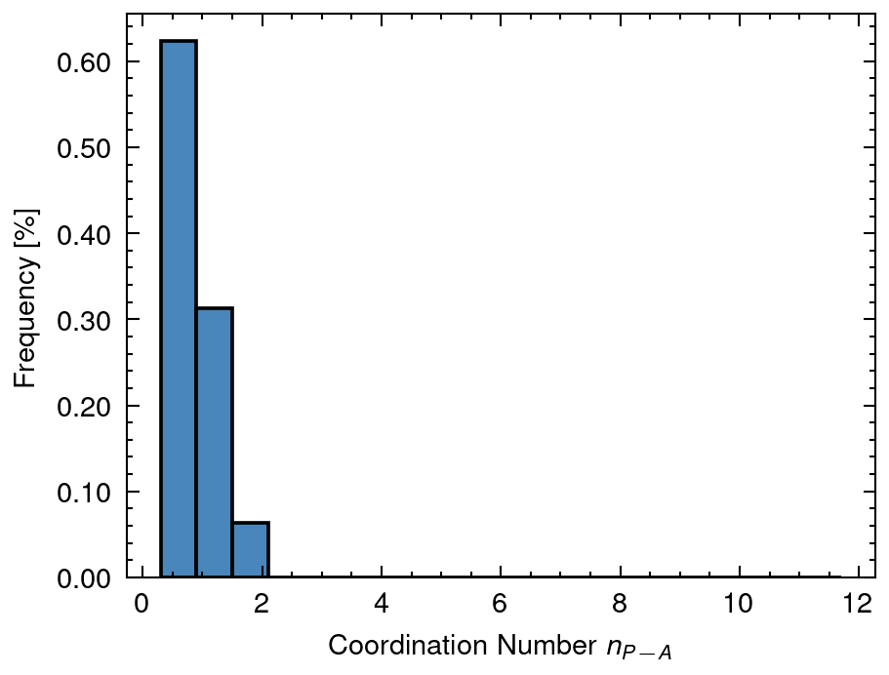
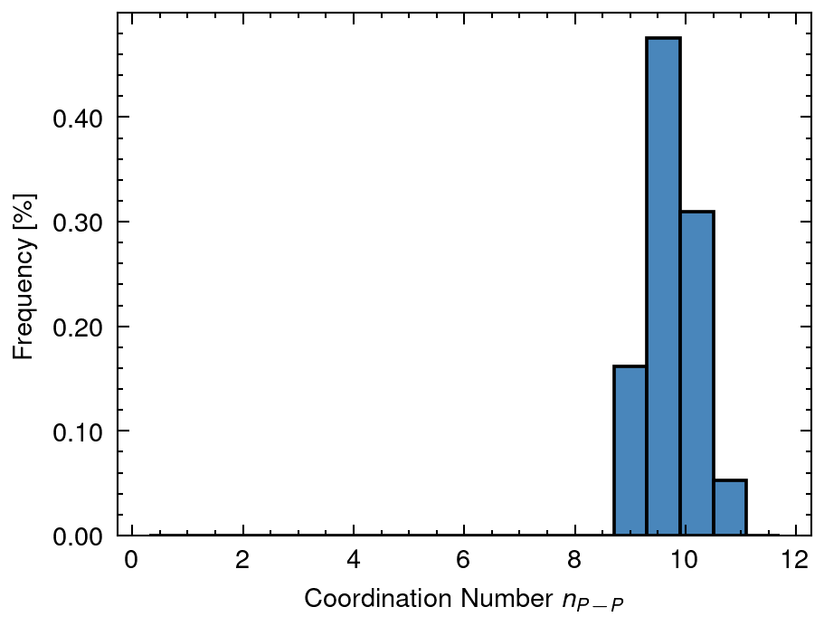
1 Distribution of input data
DA mean: 5.19 sd:3.98
DAP mean: 18.0 sd:0.0
DP mean: 5.77 sd:4.42
dA mean: 2.88 sd:0.0
dP mean: 2.77 sd:0.0
fA mean: 0.8 sd:0.0
nAA mean: 6.56 sd:0.34
nAP mean: 0.84 sd:0.24
nPA mean: 0.73 sd:0.38
nPP mean: 9.76 sd:0.42

Slide 8
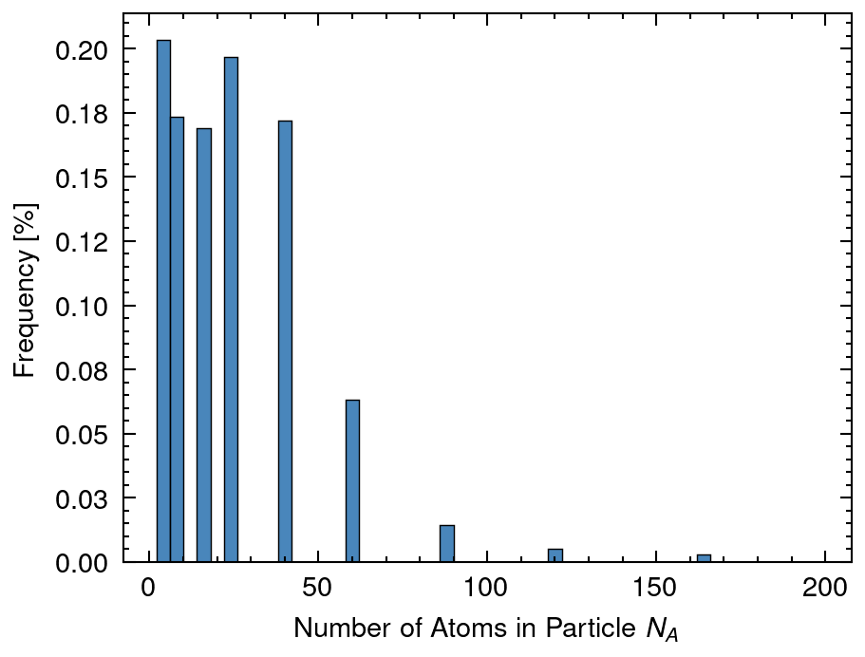
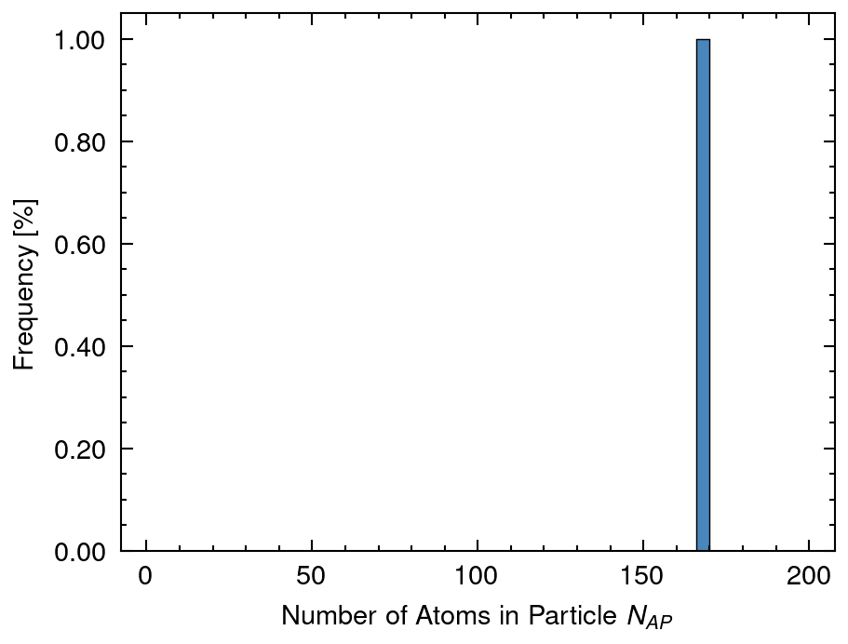
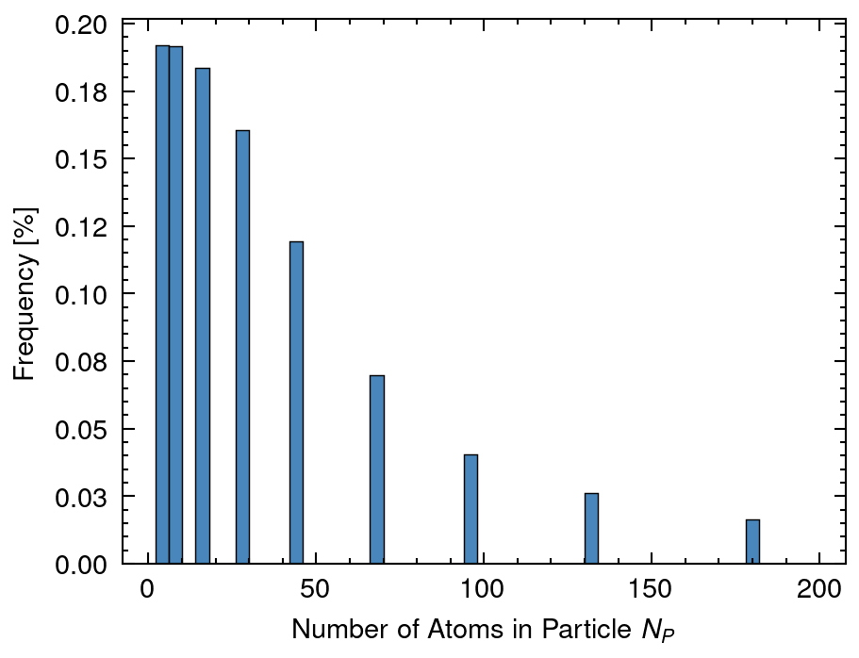
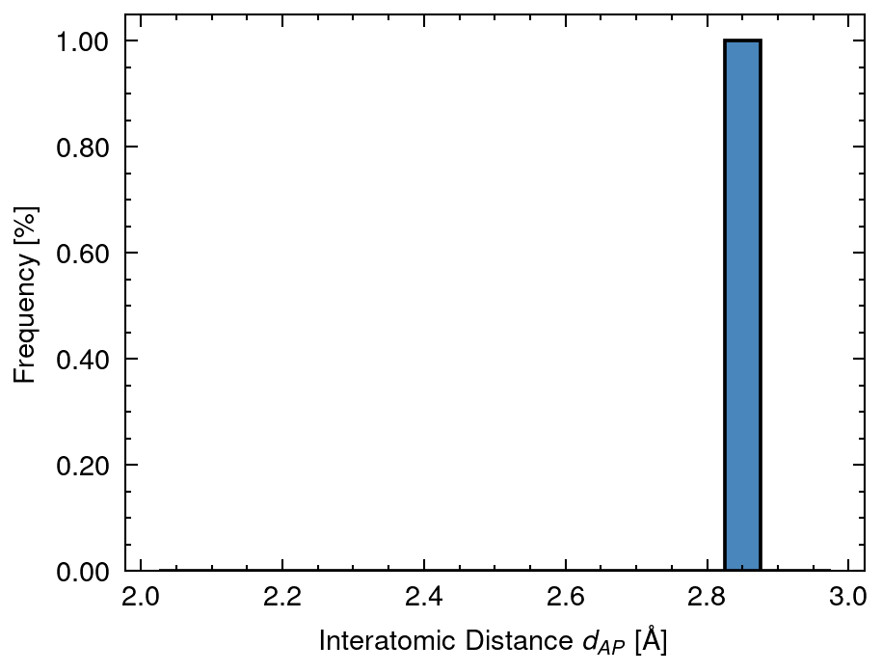
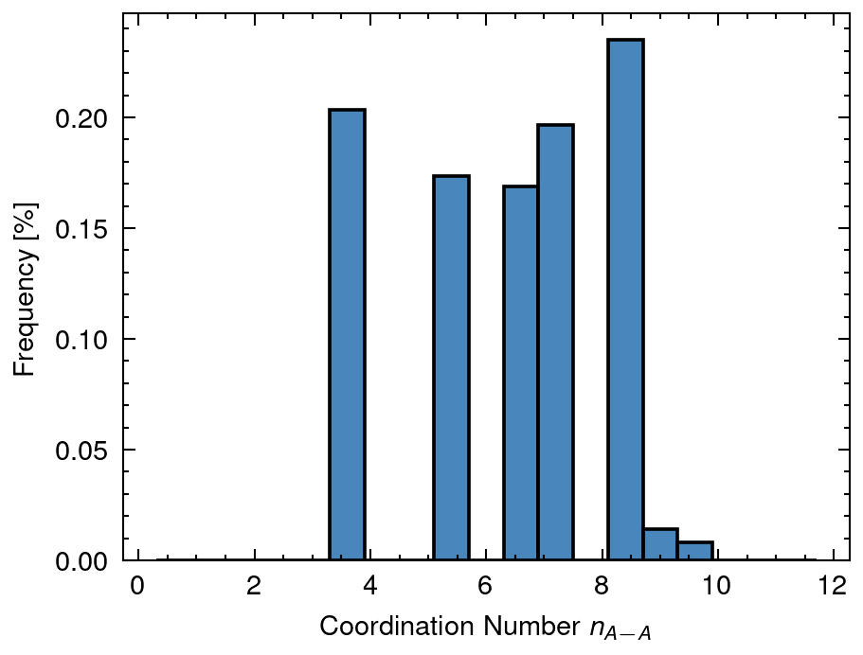
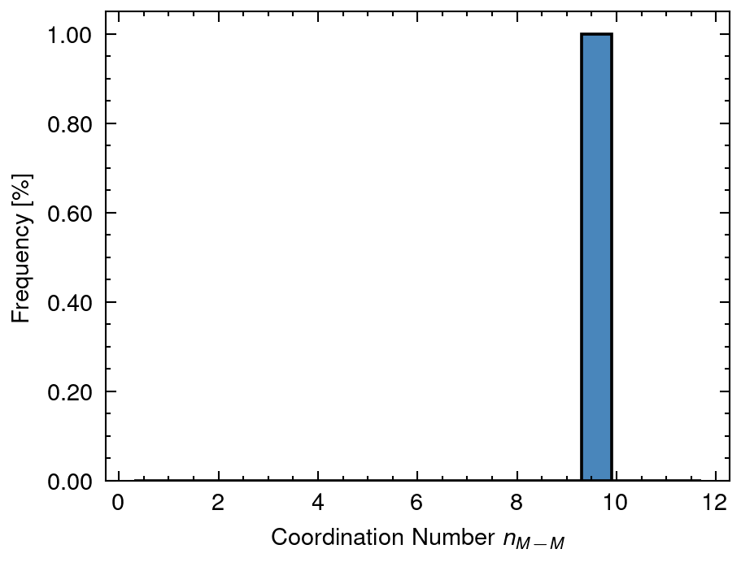
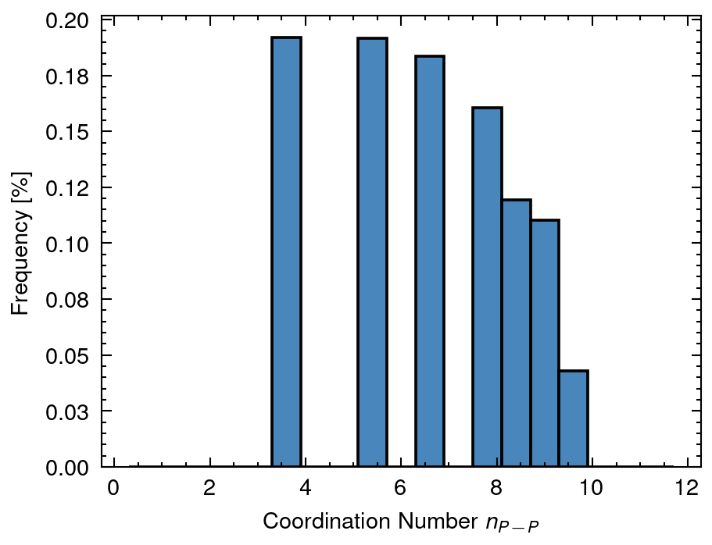
2 Distribution of calculated data
NA mean: 17.85 sd:20.62
NAP mean: 166.22 sd:0.0
NP mean: 24.81 sd:33.69
dAP mean: 2.86 sd:0.0
nAA_A mean: 5.06 sd:3.01
nMM_AP mean: 9.57 sd:0.0
nPP_P mean: 5.49 sd:2.94

Slide 9
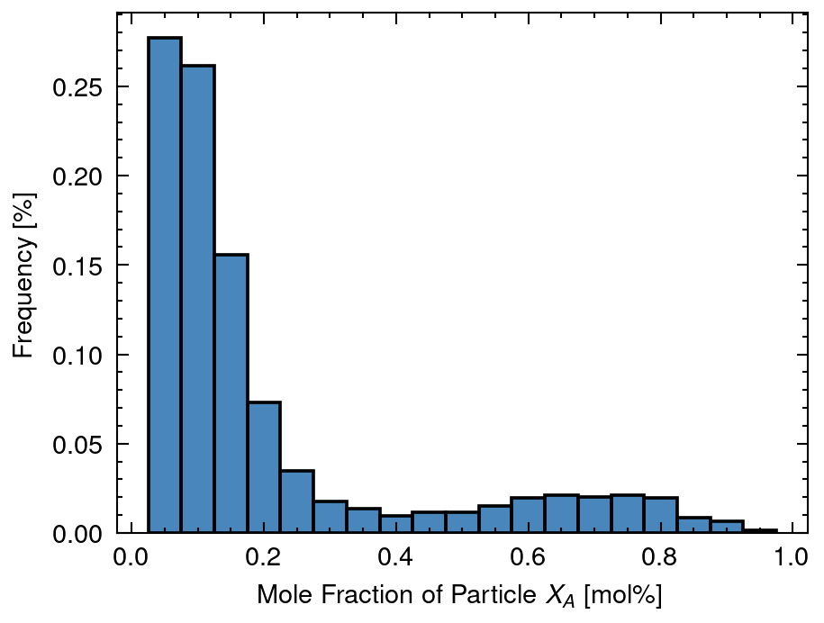
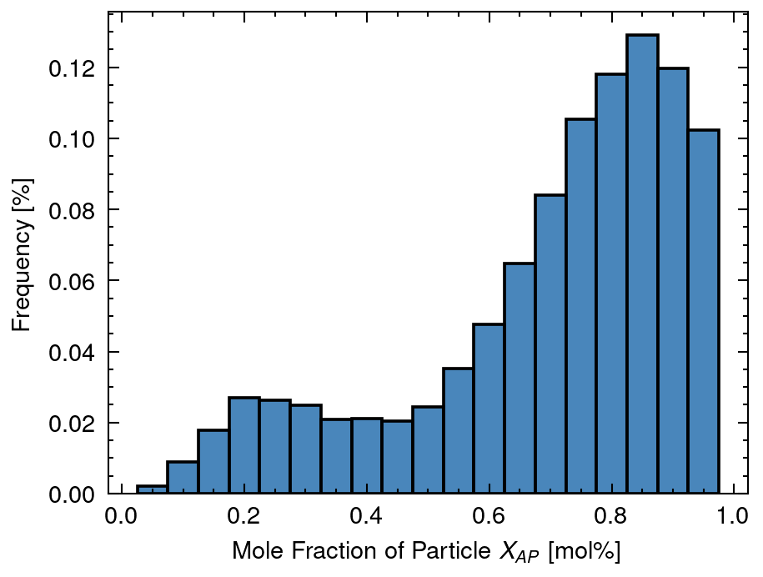
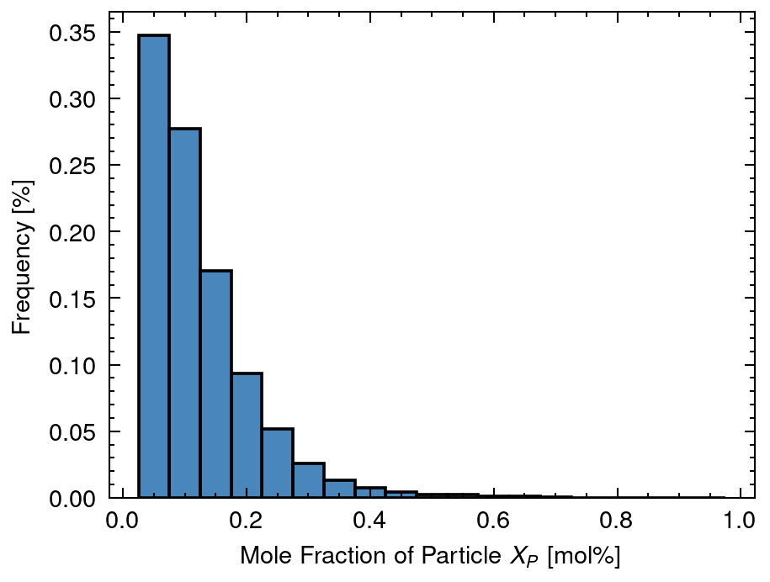
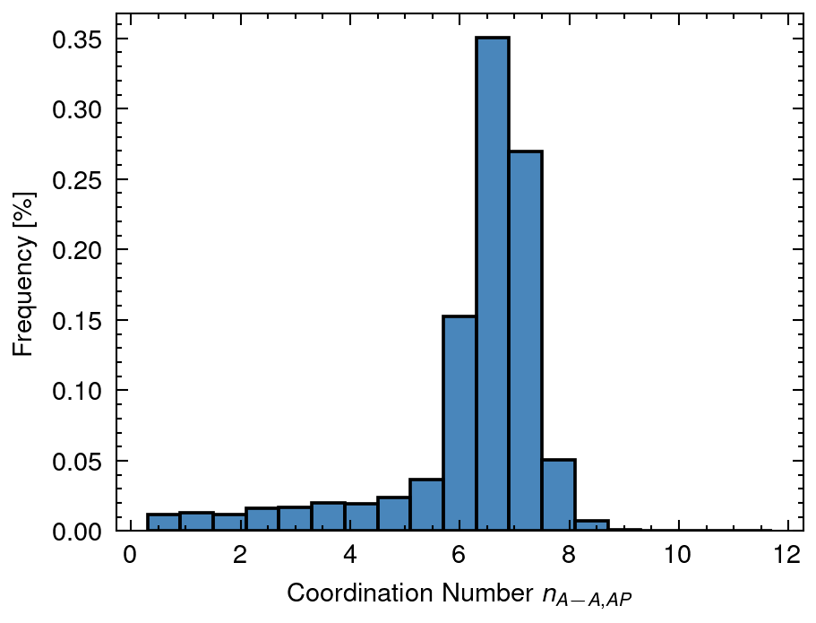
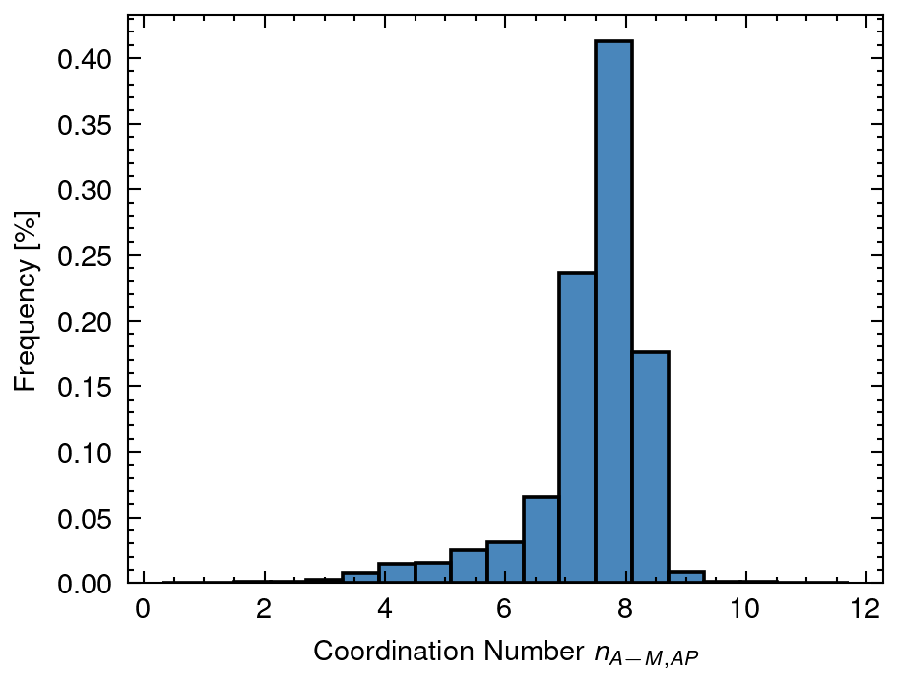
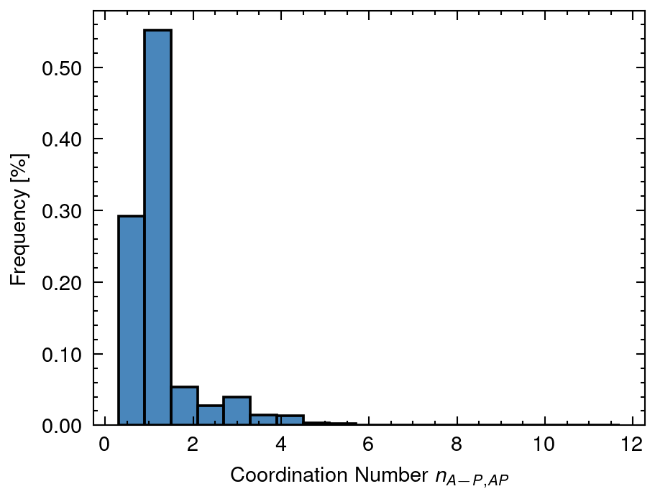
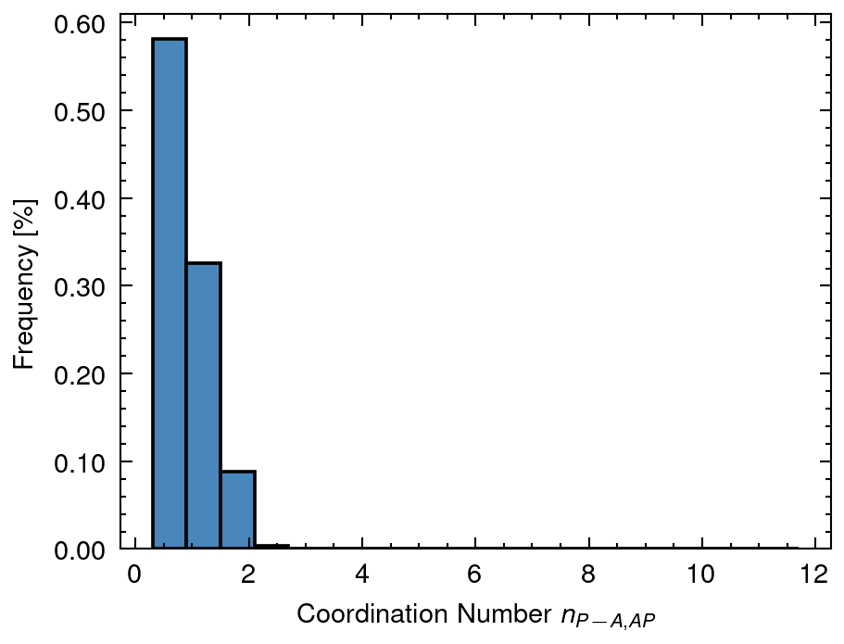
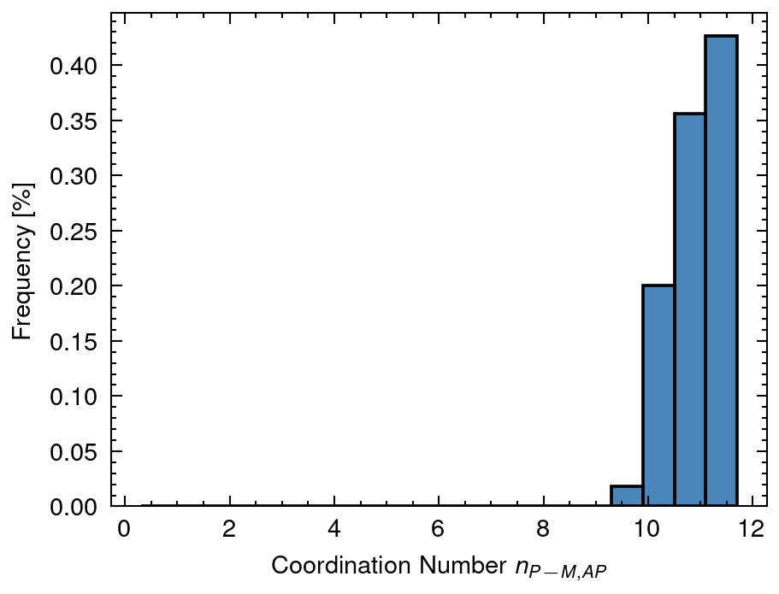
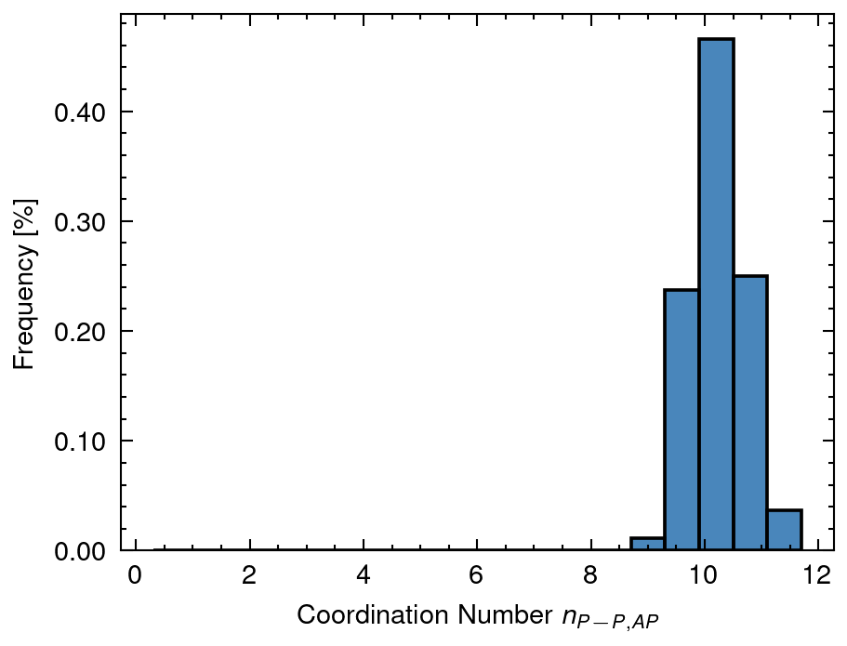
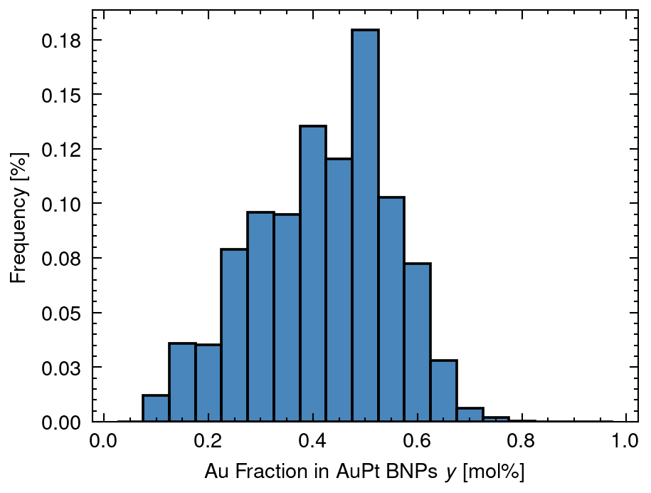
3 Distribution of solved data
XA mean: 0.19 sd:0.22
XAP mean: 0.71 sd:0.22
XP mean: 0.1 sd:0.09
nAA_AP mean: 6.19 sd:1.52
nAM_AP mean: 7.42 sd:0.96
nAP_AP mean: 1.23 sd:0.77
nPA_AP mean: 0.85 sd:0.43
nPM_AP mean: 11.1 sd:0.58
nPP_AP mean: 10.24 sd:0.46
y mean: 0.42 sd:0.13

Slide 10
4 Distribution of n (Overall Cordination Number)
nAA_A mean: 5.06 sd:3.01
nMM_AP mean: 9.57 sd:0.0
nPP_P mean: 5.49 sd:2.94

Slide 11
5 Distribution of X (Fraction of Nanoparticle)
XA mean: 0.19 sd:0.22
XAP mean: 0.71 sd:0.22
XP mean: 0.1 sd:0.09

Slide 12
6 Distribution of y (Fraction of Au in Nanoparticle)
y mean: 0.42 sd:0.13

Slide 13
7 Distribution of D (Atomic Distance)
DA mean: 5.19 sd:3.98
DAP mean: 18.0 sd:0.0
DP mean: 5.77 sd:4.42

Slide 14
8 Distribution of n (Coordination Number of Nanoparticle)
nAA_AP mean: 6.19 sd:1.52
nAM_AP mean: 7.42 sd:0.96
nAP_AP mean: 1.23 sd:0.77
nPA_AP mean: 0.85 sd:0.43
nPM_AP mean: 11.1 sd:0.58
nPP_AP mean: 10.24 sd:0.46

