Slide 1
004 - AutoGrid Example
Content 1
Content 2
Text on Shape

Slide 2
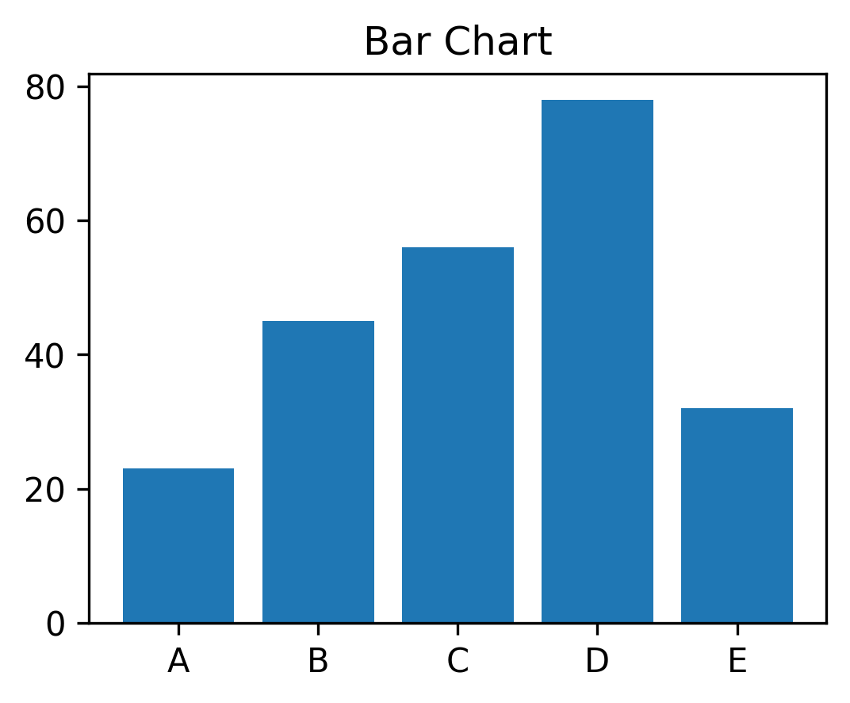
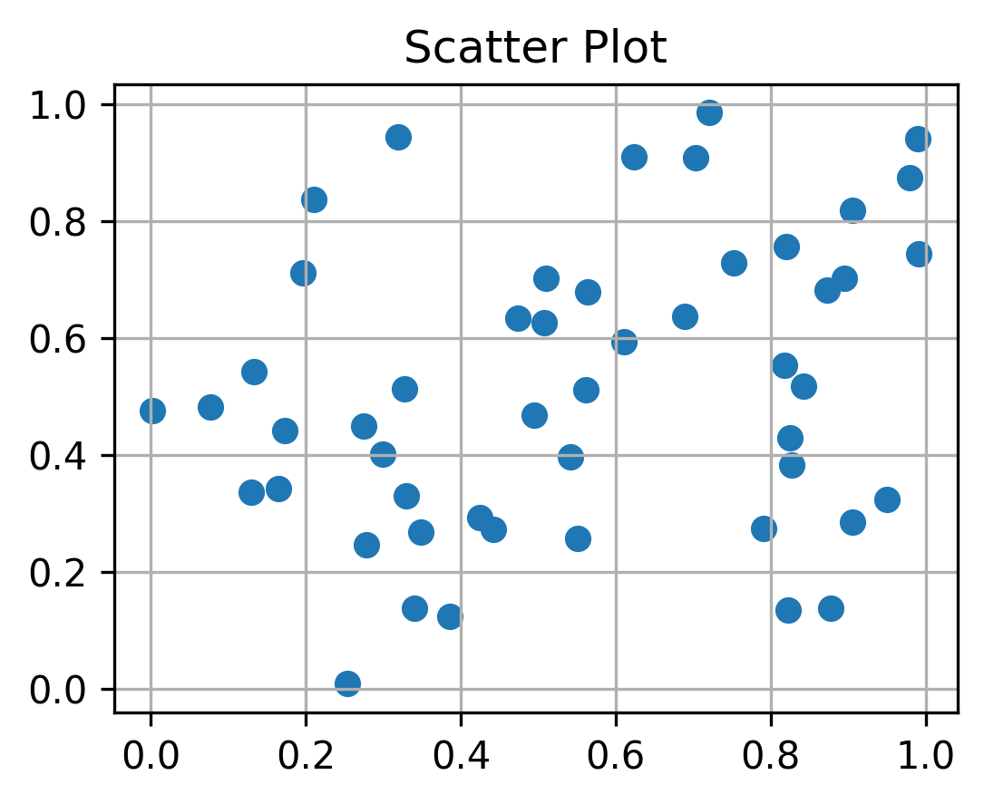
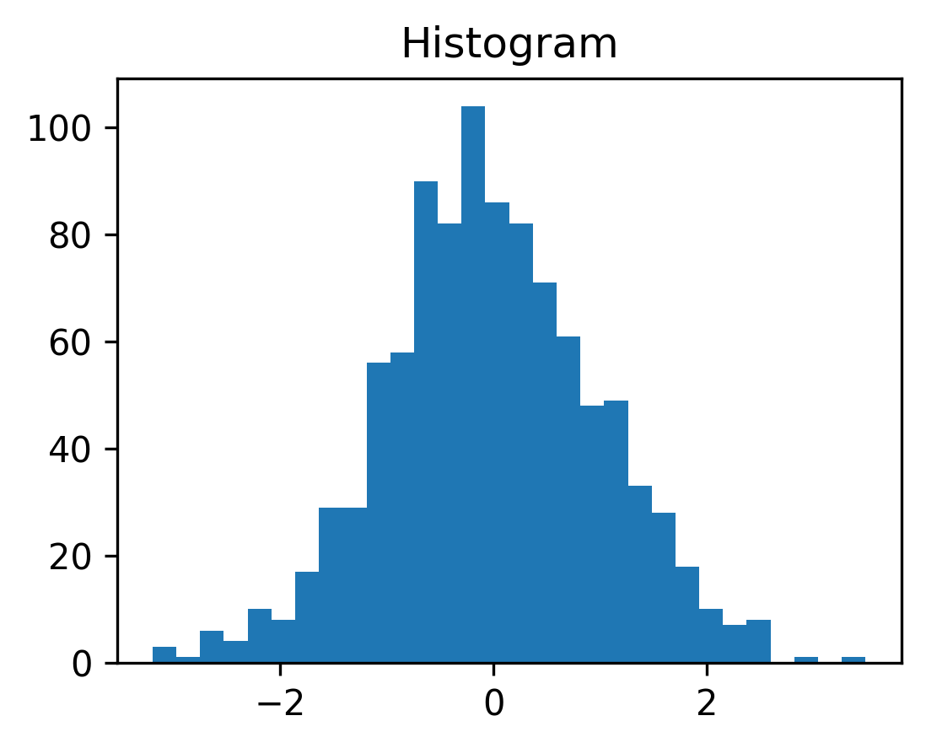
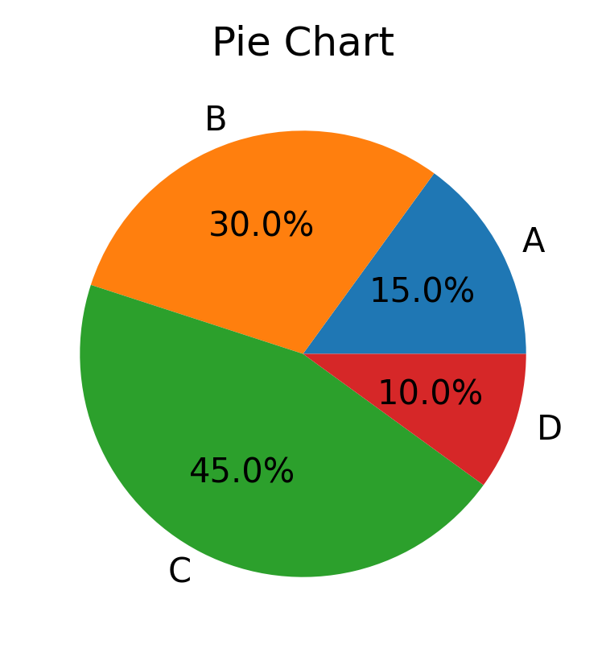
004 - AutoGrid with Plots
Matplotlib Plots in Grid

