Slide 1

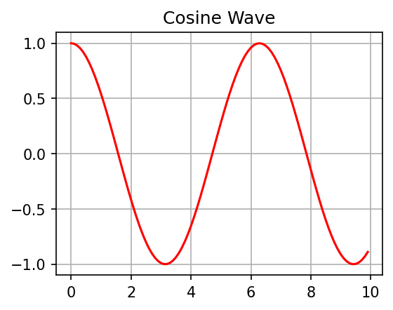
005 - Enhanced Grid Features
Empty Grid with Convenience Methods
This is a textbox added with grid.add_textbox()
Product | Price | Quantity
Widget A | $10.99 | 25
Widget B | $15.50 | 10
Widget C | $5.99 | 50

Slide 2
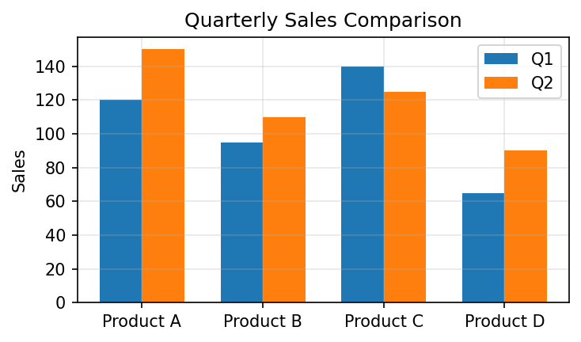
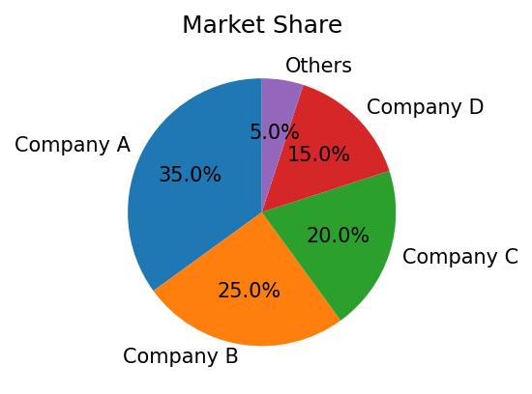
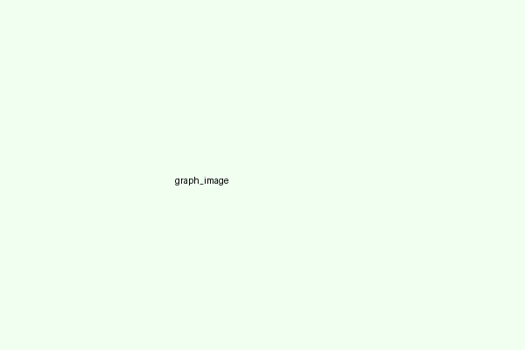
Data Dashboard Example
Quarterly Performance Dashboard
Company Performance Overview - Q2 2025
Category | Q1 Sales | Q2 Sales
Product A | 120 | 150
Product B | 95 | 110
Product C | 140 | 125
Product D | 65 | 90
Q2 2025 Summary:
• Overall sales increased by 15% compared to Q1
• Product A showed the strongest growth at 25%
• Market share increased from 32% to 35%
• New marketing campaign resulted in 20% more leads

