Slide 1
Object API Examples
Direct manipulation of slide elements

Slide 2
Text Examples
This is regular text
This is bold, italic, blue text
Right-aligned text
Middle-aligned text with custom color

Slide 3
Shape Examples
Rectangle
Rounded Rectangle
Oval
Pentagon
Chevron
Star

Slide 4
Table Example
Product | Q1 | Q2 | Q3 | Q4
Product A | 120 | 140 | 135 | 150
Product B | 85 | 90 | 95 | 110
Product C | 45 | 55 | 65 | 70
Product D | 30 | 25 | 40 | 35

Slide 5
Chart Example

Slide 6
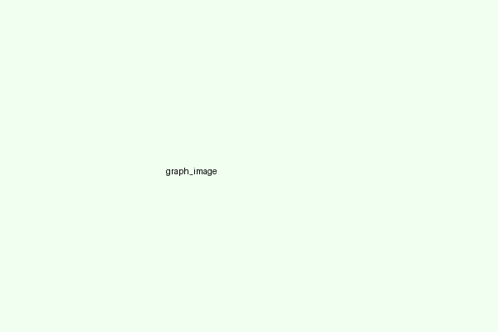
Image Example

Slide 7
Combined Elements
Dashboard Title
Metric | Value
Total Revenue | $1,245,000
Growth Rate | +15.2%
Conversion | 4.8%
$1.24M
Total Revenue
+15.2%
Growth
4.8%
Conversion

Slide 8
Thank You!

