Slide 1
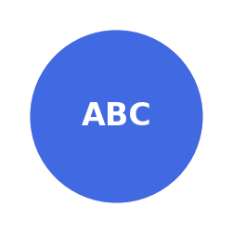
006 - Enhanced Grid Access API
Using grid[row] and grid[row, col] accessors
This text was added using grid[0, 0].add_text()
Product | Price | Quantity
Widget A | $10.99 | 25
Widget B | $15.50 | 10
This text was added using grid[1].add_text()

Slide 2
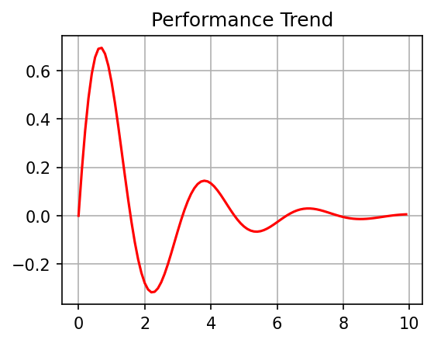
Dashboard Using Enhanced Grid Access API
Q3 2025 Performance Summary
Metric | Value | Change
Revenue | $1.2M | +15%
Profit | $450K | +8%
Customers | 8,500 | +22%
Key Metrics:
Summary:
• Growth exceeded projections in all key areas
• Customer acquisition rate increased by 22%
• New product line contributed 35% of revenue
• International expansion on track for Q4

