Slide 1
Enhanced Grid API Demo
A comprehensive example of the new grid access features in EasyPPTX v0.0.3

Slide 2

Enhanced Grid Access Features
grid[row, col].add_xxx() Syntax
• Directly access specific cells
• Intuitive and concise syntax
• Similar to numpy/matplotlib indexing
Easy Content Addition
Feature | Benefit
Cell Proxy | Direct access
Row Proxy | Sequential access
Unified API | Consistent experience
grid[row].add_xxx() Syntax
• Automatically adds to next available cell
• Perfect for sequential content
• Simplifies row-based layouts
Support for All Content Types

Slide 3
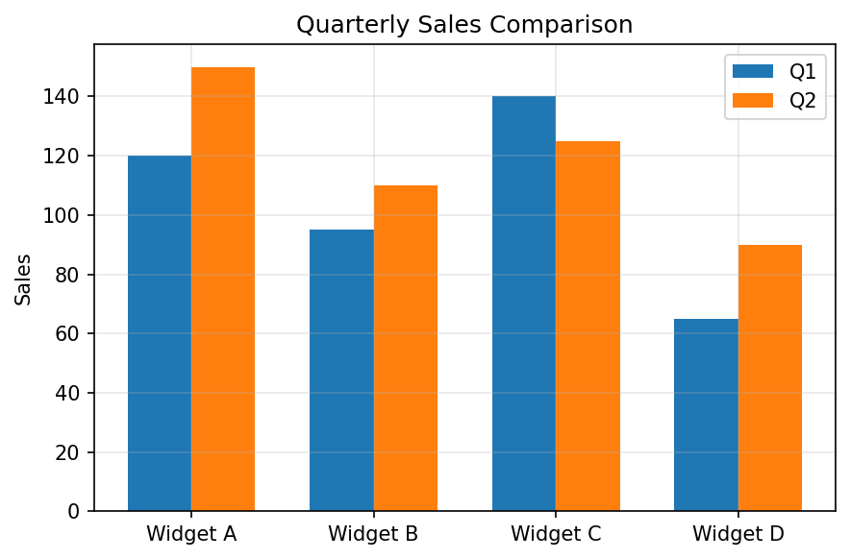
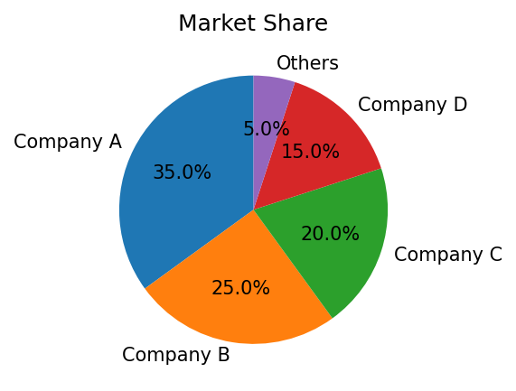
Data Dashboard Example
Quarterly Performance Summary (Q2 2025)
Revenue | $1.2M | +15%
Profit | $450K | +8%
Customers | 8,500 | +22%
Product | Q1 Sales | Q2 Sales
Widget A | 120 | 150
Widget B | 95 | 110
Widget C | 140 | 125
Widget D | 65 | 90
Q2 Summary:
• Overall sales increased by 15% compared to Q1
• Product A showed strongest growth at 25%
• Market share increased from 32% to 35%
Key Metrics

