Slide 1
Quick Slide Deck Creation
Using Enhanced Row-Based API
Created with EasyPPTX v0.0.3

Slide 2
Key Features
Simplified Syntax
Intuitive and concise API
Automatic Placement
Content flows naturally across rows
Reduced Code
Less typing, fewer parameters
All Content Types
Works with text, images, tables, charts

Slide 3
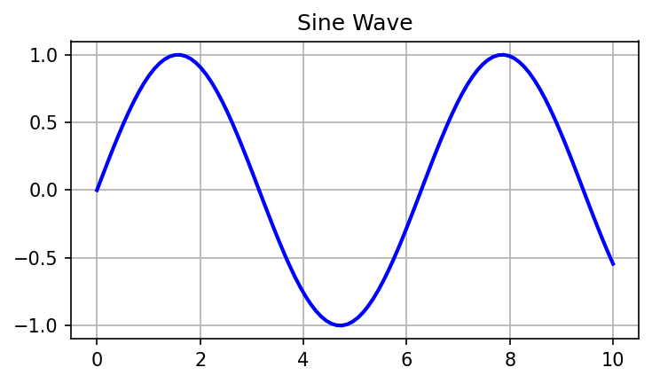
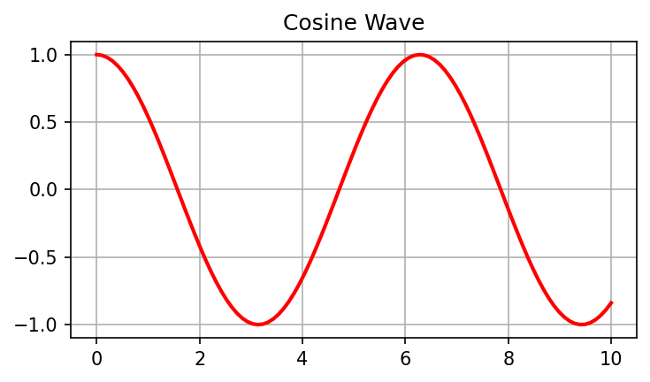
Data Visualization Example
Sine Wave Example
Cosine Wave Example

Slide 4
Table Data Example
Example of using grid[row].add_table() without specifying column indices:
Feature | Description | Benefits
Row Access | Add items sequentially to rows | Easy, streamlined workflow
Cell Access | Direct cell targeting | Fine-grained control
Autogrid | Automatic grid creation | Quick layout development

