Slide 1
Auto Preanalysis of QAS
2022-06-26

Slide 2
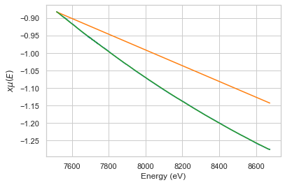
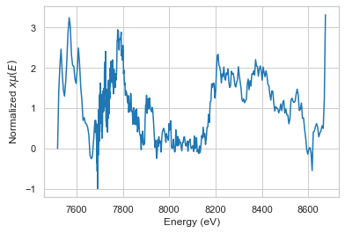
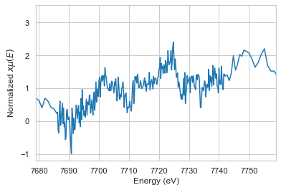
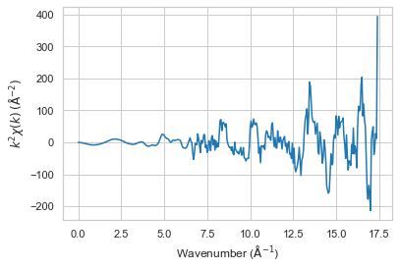
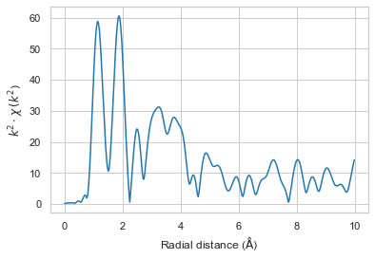
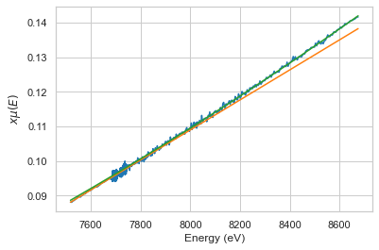
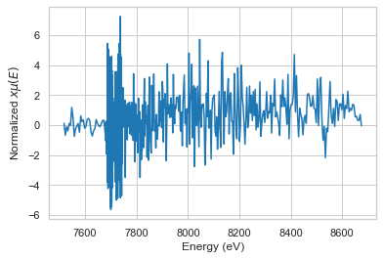
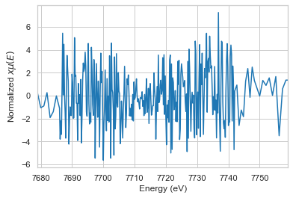
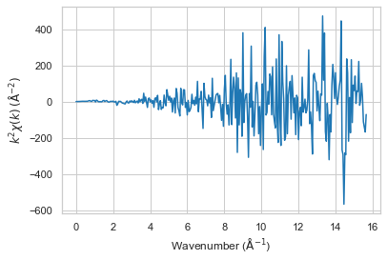
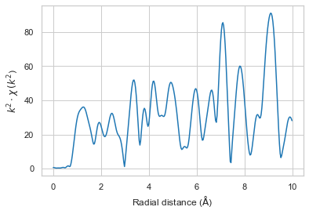
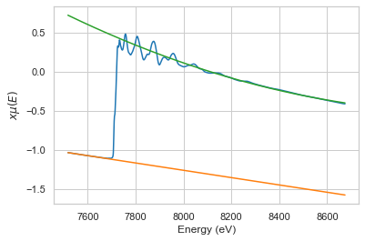
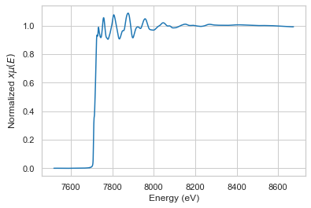
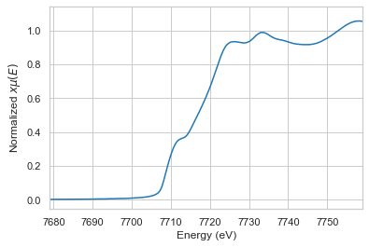
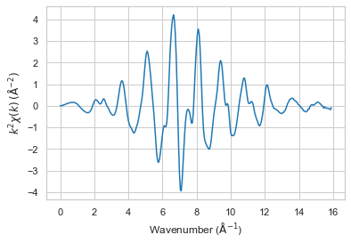
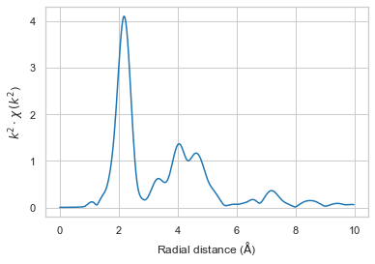
Co foil 0001-r0002
Transmission
Transmission normalized
Transmission (-30 to 50eV)
Transmission k
Transmission R
Fluorescence
Fluorescence normalized
Fluorescence (-30 to 50eV)
Fluorescence k
Fluorescence R
Reference
Reference normalized
Reference (-30 to 50eV)
Reference k
Reference R

Slide 3
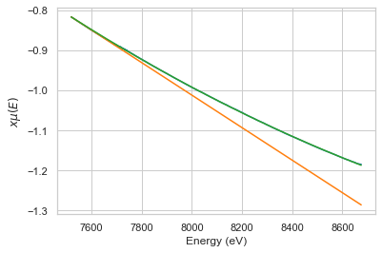
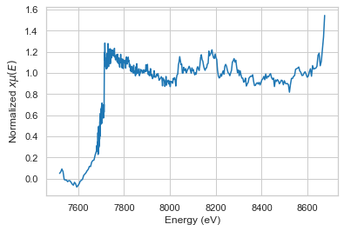
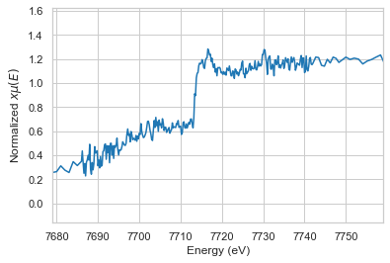
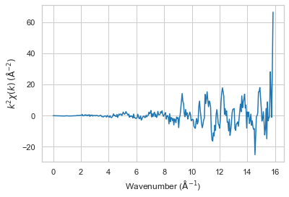
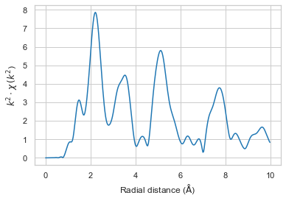
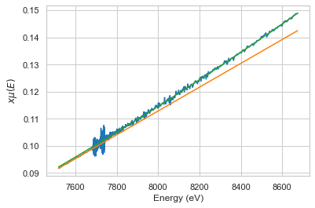
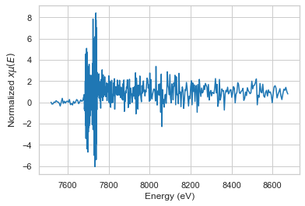
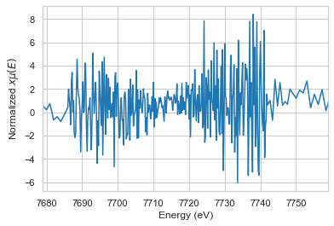
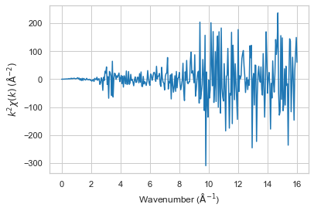
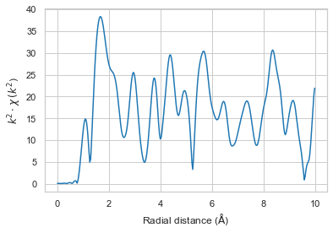
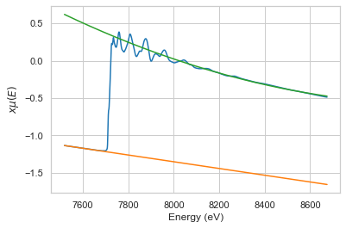
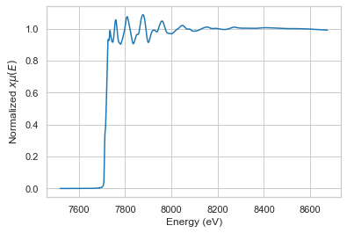
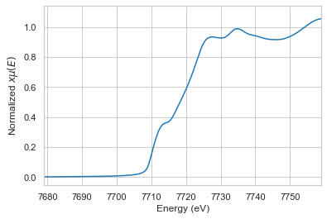


Co foil 0001
Transmission
Transmission normalized
Transmission (-30 to 50eV)
Transmission k
Transmission R
Fluorescence
Fluorescence normalized
Fluorescence (-30 to 50eV)
Fluorescence k
Fluorescence R
Reference
Reference normalized
Reference (-30 to 50eV)
Reference k
Reference R

Slide 4
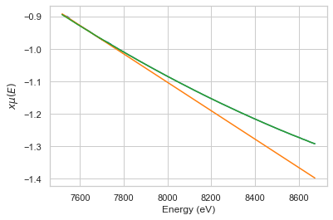
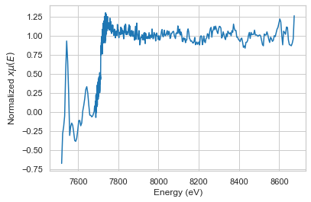
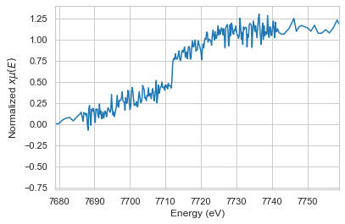
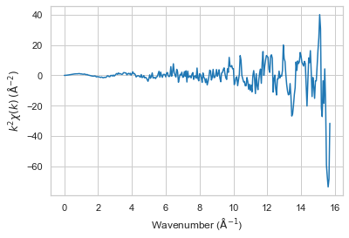
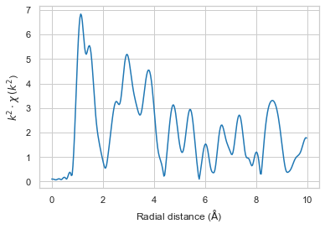
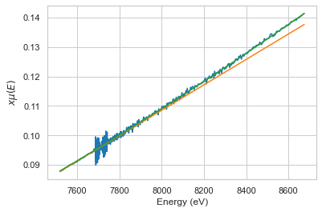
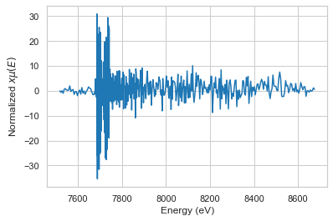
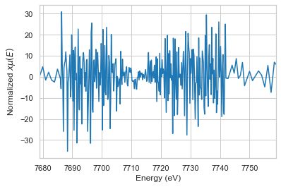
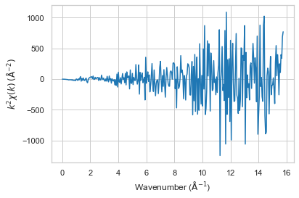
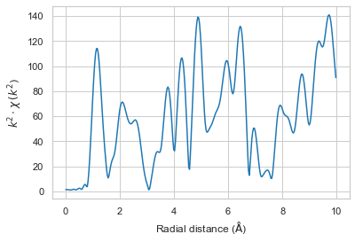




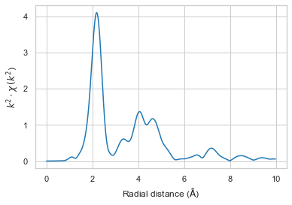
Co foil 0002
Transmission
Transmission normalized
Transmission (-30 to 50eV)
Transmission k
Transmission R
Fluorescence
Fluorescence normalized
Fluorescence (-30 to 50eV)
Fluorescence k
Fluorescence R
Reference
Reference normalized
Reference (-30 to 50eV)
Reference k
Reference R

Slide 5
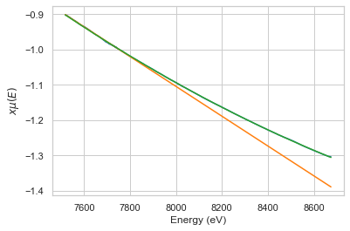
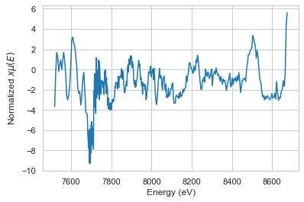
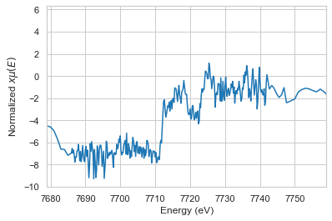
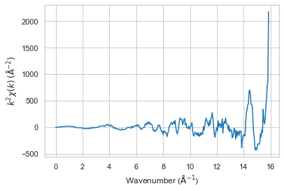
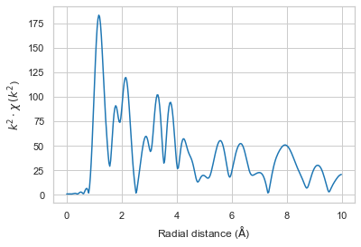
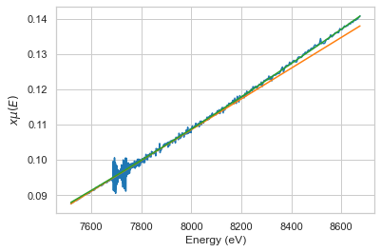
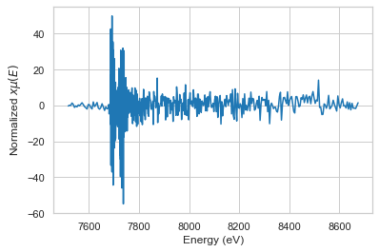
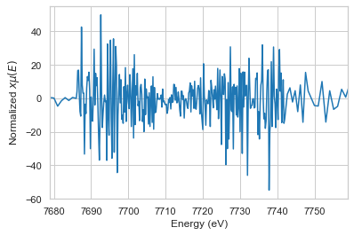
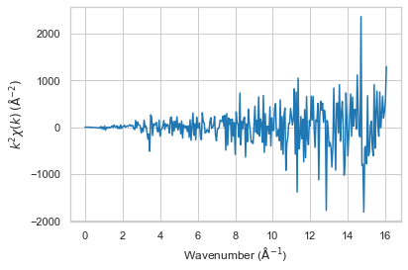
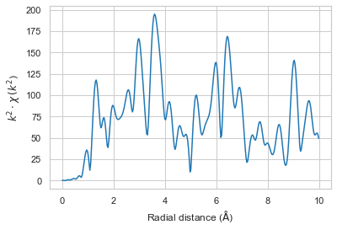





Co foil 0003
Transmission
Transmission normalized
Transmission (-30 to 50eV)
Transmission k
Transmission R
Fluorescence
Fluorescence normalized
Fluorescence (-30 to 50eV)
Fluorescence k
Fluorescence R
Reference
Reference normalized
Reference (-30 to 50eV)
Reference k
Reference R

Slide 6
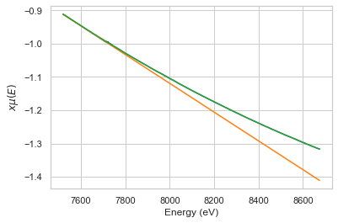














Co foil 0004
Transmission
Transmission normalized
Transmission (-30 to 50eV)
Transmission k
Transmission R
Fluorescence
Fluorescence normalized
Fluorescence (-30 to 50eV)
Fluorescence k
Fluorescence R
Reference
Reference normalized
Reference (-30 to 50eV)
Reference k
Reference R

Slide 7















Co foil 0005
Transmission
Transmission normalized
Transmission (-30 to 50eV)
Transmission k
Transmission R
Fluorescence
Fluorescence normalized
Fluorescence (-30 to 50eV)
Fluorescence k
Fluorescence R
Reference
Reference normalized
Reference (-30 to 50eV)
Reference k
Reference R

Slide 8












all
Transmission all reagion
Transmission (-30 to 50eV)
Transmission k(all)
Transmission R(all)
Fluorescence all reagion
Fluorescence (-30 to 50eV)
Fluorescence k(all)
Fluorescence R(all)
Reference all reagion
Reference (-30 to 50eV)
Reference k(all)
Reference R(all)

Slide 9

merge
TRF Plot
Transmission normalized
Transmission k
Transmission R
Fluorescence normalized
Fluorescence k
Fluorescence R
Fluorescence normalized
Fluorescence k
Fluorescence R

