Slide 1
Effective Feature Extraction via Stacked Sparse Autoencoder for Intrusion Detection System
Group Members: Amey Bhide, Rohan Kapdi
Course: CS-258 Computer Communication System Instructor: Dr. Navrati Saxena

Slide 2
Table Of Contents
1. Introduction
2. Related Work
3. Motivation
4. Problem Statement
5. Solution Approach
6. Our Idea
7. Conclusion
8. References

Slide 3

Introduction
Date
Intrusion Detection Systems (IDS) rely heavily on effective feature representation for accurate classification.
High-dimensional network data can hinder performance due to increased computational complexity.
The paper proposes using a Stacked Sparse Autoencoder (SSAE) to extract meaningful, low-dimensional features.
SSAE learns deep representations automatically, improving both detection accuracy and processing speed.
Experimental results show SSAE outperforms traditional feature selection methods in both binary and multiclass detection tasks.

Slide 4
Related Work

Slide 5
Title: Two-stage Deep Stacked Autoencoder with Shallow Learning for Network Intrusion Detection System [1] (N. Fathima, A. Pramod, Y. Srivastava et al.)
Methodology
Implemented a two-stage model: SSAE for feature extraction followed by a Random Forest classifier.
Focused on addressing class imbalance and improving detection of rare attacks.
Model Two-Stage SSAE + Random Forest
(2021)
Notable enhancements
Handles class imbalance, significant drop in false positives
Performance Improvements
Accuracy: Achieved 87% on the CICIDS-2017 dataset.
[1] https://arxiv.org/abs/2112.03704

Slide 6
Title: A network intrusion detection framework on sparse deep denoising auto-encoder for dimensionality reduction [2] (B. A. Manjunatha, K. A. Shastry, E. Naresh et al.)
Methodology
Introduced a Sparse Deep Denoising Autoencoder (SDDA) to enhance robustness against noisy data.
Integrated ensemble feature selection methods with Long Short-Term Memory (LSTM) networks.
Model Sparse Denoising Autoencoder
+ LSTM (2023)
Notable enhancements
Robust against noisy traffic, cross-dataset generalization with LSTM integration
Performance Improvements
Accuracy: Achieved 99.56% on NSL-KDD.
F1-Score: Reported at 98.05% for NSL-KDD
Results represent a 0.93% increase in accuracy over the original SSAE model on NSL-KDD.
[2] https://www.researchgate.net/figure/Sparse-deep-denoising-auto-encoder-reconstruction-error-distribution

Slide 7
Title: XGBoost Algorithm on Intrusion Detection System in Detecting Network Intrusions [3] (A. Althobaiti and H. Peyvandi)
Methodology
Combined SSAE for deep feature extraction with XGBoost, a gradient-boosting classifier.
Used SSAE's feature learning capabilities and XGBoost's classification strength.
Model
SSAE +XGBoost
Hybrid
(2024)
Notable enhancements
Improved minority class detection (R2L/U2R)
better precision-recall balance
Performance Improvements
Accuracy: Improved to 99.24%, a 0.61% increase over the original SSAE model.
Recall: Achieved 99.40%, indicating a significant enhancement in detecting true positives.
F1-Score: Reported at 0.99, reflecting a balanced improvement in precision and recall.
[3] https://www.sciencedirect.com/science/article/abs/pii/S0167404824005182

Slide 8
Title: Deep Neural Networks based Meta-Learning for Network Intrusion Detection [4] (A. Sohail, B. Ayisha, I. Hameed et al.)
Methodology
Developed a meta-learning framework combining deep sparse autoencoders with ensemble learning.
Aimed to enhance adaptability to new threats and improve generalization across datasets.
SSAE + Meta-Learning (2023)
Notable enhancements
Meta-learning allows adaptability to new attacks and datasets
Strong recall
Performance Improvements
Accuracy: Reported at 91.6% on the test dataset
Recall: Achieved 94% on Test+ indicating improved detection of true positives.
F1-Score: Consistently at 91% across both datasets.
[4] https://arxiv.org/abs/2302.09394

Slide 9
Comparison with the original paper
Aspect | Original Paper (2018) | Our Implementation
Dataset Used | NSL-KDD | NSL-KDD
Preprocessing | One-hot encoding + Min-max normalization | One-hot encoding + Min-max normalization
Feature Dim. Reduction | 121 → 5 | 121 → 5
SSAE Architecture | 4 layers: [100, 85, 55, 30], output: 5 | 4 layers: [100, 85, 55, 30], output: 5
Classifier Used | Softmax | SVM
Accuracy (Binary Classification) | 97.8% | 88.43%
F1-Score (Binary) | 0.972 | 0.8806
False Alarm Rate | 2.04% | 0.75%
Training Time | Higher | Lower

Slide 10

Motivation
The project addresses a critical cybersecurity challenge using innovative deep learning techniques.
SSAE's ability to compress 121 features to just 5 dimensions while maintaining detection accuracy demonstrates an elegant solution to the problem of high dimensional data in intrusion detection systems.
The research offers significant practical impact by dramatically reducing classification time and computational resources, making real-time threat detection more feasible in production environments.
This approach requires fewer training samples than comparable methods while achieving competitive detection rates, representing a more efficient path to building robust security systems.

Slide 11

Problem Statement
Feature quality significantly impacts IDS performance and detection speed.
Traditional Intrusion Detection Systems (IDS) struggle with high-dimensional, noisy, and redundant data.
SSAE allows automatic discovery of informative, low-dimensional features from raw inputs.
Compress 121 original input features into just 5 key features without losing critical information.

Slide 12
Solution: Dataset & Preprocessing
Title: NSL-KDD Dataset & Preprocessing
Dataset:
125,973 samples; 41 original features expanded to 121 after one-hot encoding.
Attack categories: DoS, Probe, R2L, U2R + Normal
Preprocessing Steps:
One-hot encoding of symbolic features.
Normalization using Min-Max scaling.
Train-test split: e.g., 80%-20%.

Slide 13
Solution: Why SSAE?
Challenge : IDS needs to process high-dimensional, noisy data in real time, which is computationally expensive.
Manual feature selection risks discarding valuable data and lacks adaptability to new attacks.
SSAE:
Automatically learns compact, discriminative features.
Ensures only essential neurons activate which reduces overfitting.
Enables real-time intrusion detection with lower computation.

Slide 14
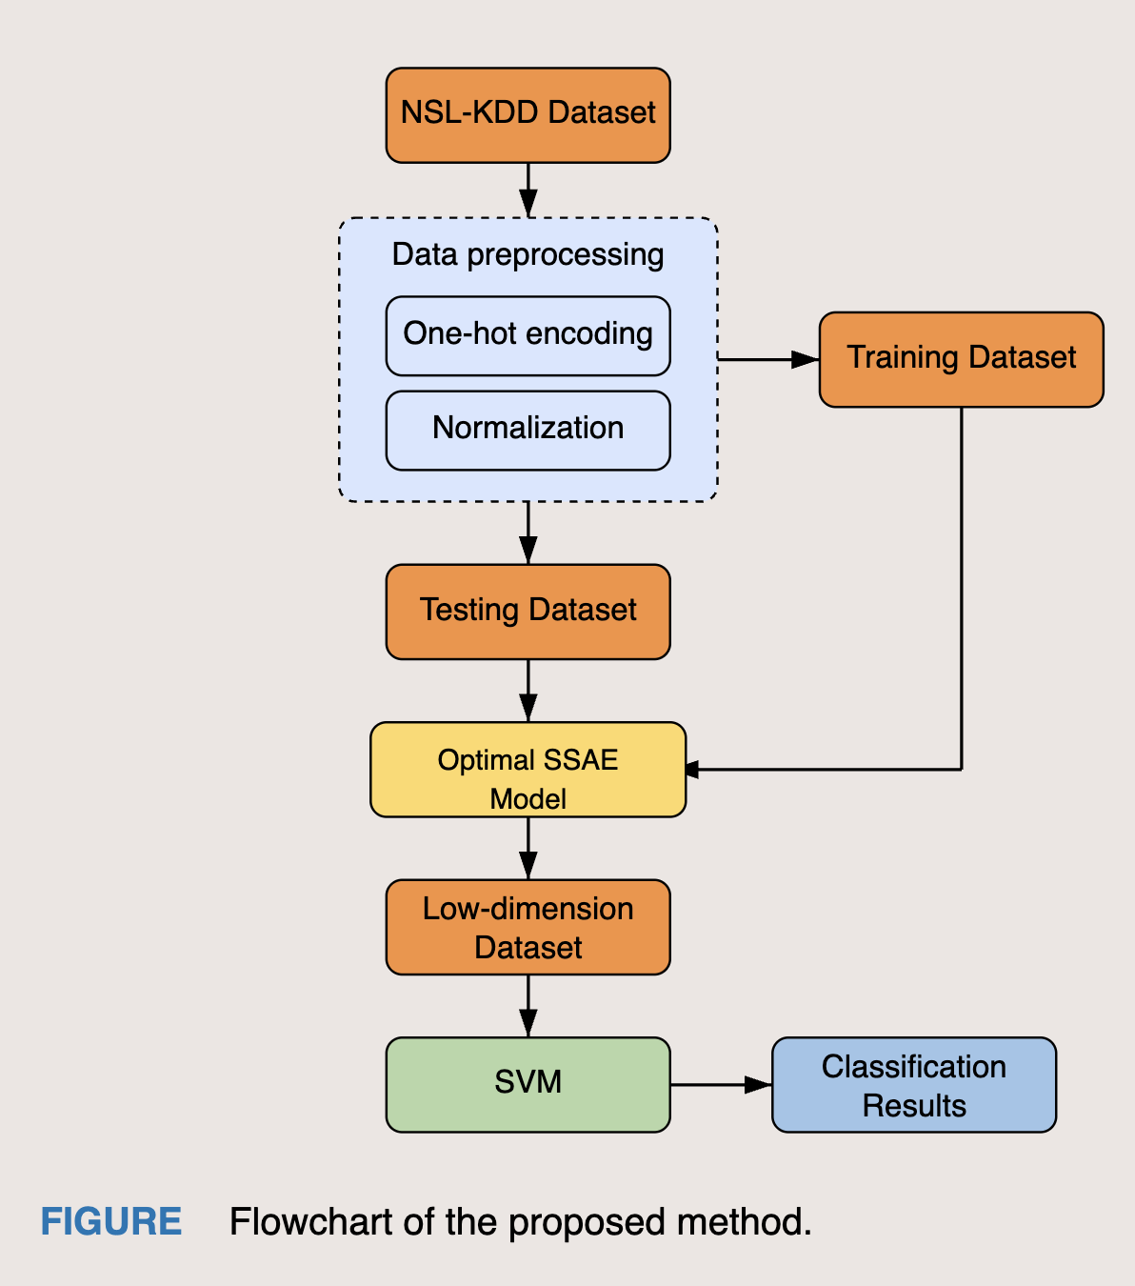
Solution: Flow Diagram

Slide 15
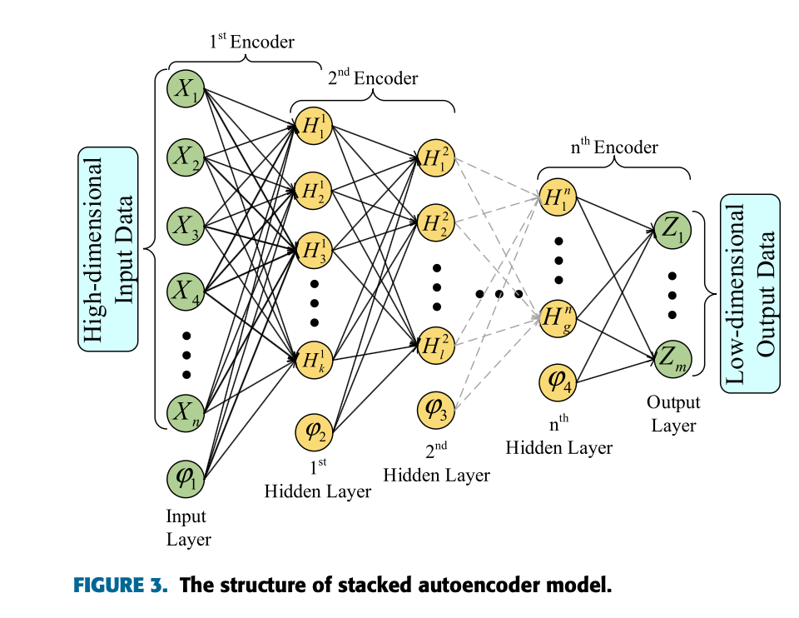
Solution: SSAE Architecture
SSAE consists of several layers of sparse autoencoders stacked sequentially.
Each autoencoder compresses input data to extract high-level abstract features.
Sparsity constraint encourages the model to activate only a few neurons, improving generalization.
This structure is effective in reducing overfitting and focusing on relevant features.
We input 121 vectors and use 4 hidden layers to reduce the dimensionality of the vector to 5.

Slide 16
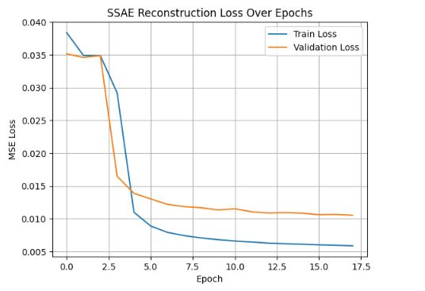

Slide 17
Solution: SVM for classification
Why SVM?
Well-suited for high-dimensional, low-sample feature spaces.
Performs well with nonlinear decision boundaries.
Our Setup
Input: 5-dimensional features from SSAE.
Kernel: RBF (Radial Basis Function)
Goal: Separate normal vs attack traffic efficiently.

Slide 18
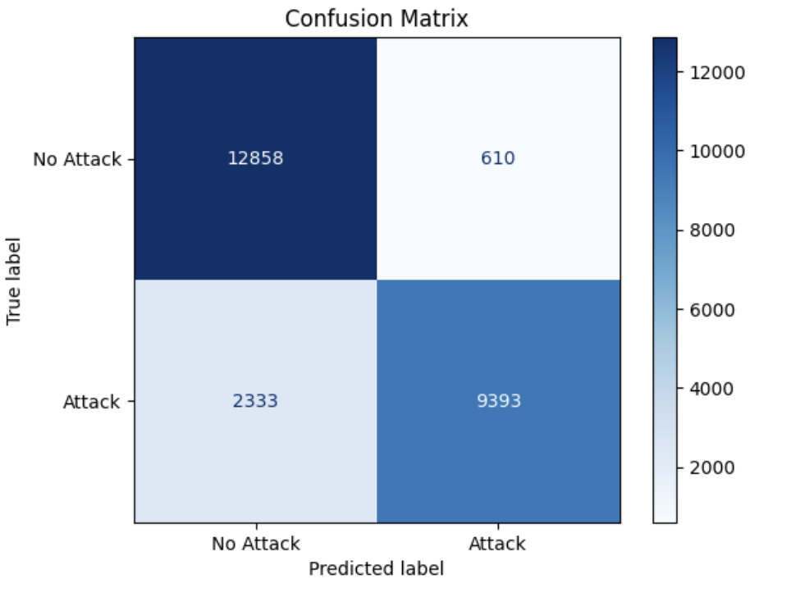
Solution: Evaluation Metrics
Accuracy of the research paper: 97.8% Accuracy achieved by our model: 88.43%
Detection Rate (DR) of the research paper: 98.55% Detection Rate by or model : 88.12%
False Alarm Rate (FAR) of the research paper: 2.04% False Alarm Rate by our model: 0.75%
F1-Score of the research paper: 0.972 F1 Score achieved by our model: 0.8806

Slide 19
Our Idea
1
2
3
4
SSAE extracts a 5-dimensional representation from the 121-dimensional input
These compressed features are input into classifiers like SVM.
The classifiers achieve high accuracy with significantly reduced training and testing time.
SSAE helps general-purpose classifiers perform better by providing more discriminative features.

Slide 20
Conclusion
Experimental results confirmed the model performs comparably to state-of-the-art methods while requiring significantly fewer training samples and computational resources.
The project contributes a practical, efficient solution to network security challenges that balances high detection performance with the computational efficiency needed for real-world deployment.
1
2
This hybrid approach reduces false alarms and improves adaptability to new data.
The experimental results on the NSL-KDD dataset show that SSAE can compress original features to 5 dimensions without losing the the information from original data
3
4

Slide 21

References
N. Fathima, A. Pramod, Y. Srivastava, A. M. Thomas, S. I. S. P., and K. R. Chandran, “Two-Stage Deep Stacked Autoencoder with Shallow Learning for Network Intrusion Detection System,” arXiv preprint arXiv:2112.03704, 2021.
B. A. Manjunatha, K. A. Shastry, E. Naresh, P. K. Pareek, and K. T. Reddy, “A Network Intrusion Detection Framework on Sparse Deep Denoising Autoencoder for Dimensionality Reduction,” Soft Computing, vol. 27, pp. 5895–5913, 2023, doi: 10.1007/s00500-023-09408-x.
A. Althobaiti and H. Peyvandi, “A Hybrid Intrusion Detection System Leveraging XGBoost and RNNs for Enhanced Anomaly Detection in Cloud Data Centers,” IEEE Access, vol. 12, pp. 87654–87666, 2024.
A. Sohail, B. Ayisha, I. Hameed, M. M. Zafar, H. Alquhayz, and A. Khan, “Deep Neural Networks based Meta-Learning for Network Intrusion Detection,” arXiv preprint arXiv:2302.09394, 2023.
B. Yan and G. Han, “Effective Feature Extraction via Stacked Sparse Autoencoder to Improve Intrusion Detection System,” IEEE Access, vol. 6, pp. 41238–41248, 2018, doi: 10.1109/ACCESS.2018.2858277.
C. Yin, Y. Zhu, J. Fei, and X. He, “A deep learning approach for intrusion detection using recurrent neural networks,” IEEE Access, vol. 5, pp. 21954–21961, Oct. 2017.
D. Papamartzivanos, F. G. Mármol, and G. Kambourakis, “Dendron: Genetic trees driven rule induction for network intrusion detection systems,” Future Generation Computer Systems, vol. 79, pp. 558–574, Feb. 2018.

Slide 22
Thank you !
Code and ReadMe: Intrusion_detection_system

