Slide 1
FIGHTING COVID-19 USING DATA SCIENCE
An IBM Data Science Capstone Project

Slide 2
TABLE OF CONTENTS
Introduction
Business Problem
Data
Methodology
Analysis
Result
Discussion
Conclusion

Slide 3
INTRODUCTION
Coronavirus is continuing its spread across the world, with more than 10 million confirmed cases in 188 countries. More than half a million people have lost their lives.
This series of maps and charts tracks the global outbreak of the virus.
Where are coronavirus cases and deaths still rising?
The virus, which causes the respiratory infection Covid-19, was first detected in the city of Wuhan, China, in late 2019.
It then spread quickly across the globe in the first months of 2020, reaching 10 million confirmed cases towards the end of June.

Slide 4
BUSINESS PROBLEM
India says the number of total recoveries has outstripped active Covid infections for the first time.
To reduce the load on hospitals, the government of India intends to make COVID-19 tests easily available to the public, by opening temporary clinics for testing. For this project, we will be restricting ourselves to the worst affected region of Maharashtra: Mumbai.
Our goal will be to identify the perfect locations for these test clinics, to ensure the ease of accessibility for the citizens of Mumbai. These clinics will be set up in locations which are devoid of Hospitals nearby.

Slide 5
DATA
Mumbai Neighbourhood Data: (https://en.wikipedia.org/wiki/List_of_neighbourhoods_in_Mumbai) - This dataset contains all the neighbourhoods in Mumbai. It was scraped from the mentioned Wikipedia page.
WHO COVID-19 Data: (https://covid19.who.int/info) – Provided on the official WHO COVID-19 Dashboard
India COIVID-19 Data: (https://github.com/imdevskp/covid-19-india-data/blob/master/complete.csv) This is pre-prepared data hosted on GitHub by imdevskp
Hospitals in Mumbai: (using Foursquare API)

Slide 6
METHODOLOGY
Firstly, I used exploratory data analysis (EDA) to uncover hidden properties of data and provide useful insights to the reader. To gain an insight in the present situation of the World and India, I tried visualizing the WHO COVID-19 Data and the India COVID-19 Data.
Secondly, I used prescriptive analytics to help the government decide a location for a test clinic. I will employ a model based on K-means Clustering. With the neighbourhoods as centroids, I propose to cluster each hospital based on a fixed radius. This will in turn show us the number of hospitals in each neighbourhood, which will help us identify neighbourhoods which lack medical facilities.

Slide 7
ANALYSIS
Let’s take a brief look on the state of the world. The WHO started documenting since the beginning of January. All my findings are true as of 27th June 2020. I used Plotly, a data visualization package which provides interactive tools to visualize data.
As of 27th June 2020, the cumulative cases reported are close to 9.48 million, while the total deaths is 485,000. These numbers are staggering, showing us the severity of this pandemic. This article compares the current Coronavirus outbreak to Ebola and other major outbreaks.
The month of April saw the most deaths around the world, with numbers close to 187,000.

Slide 8
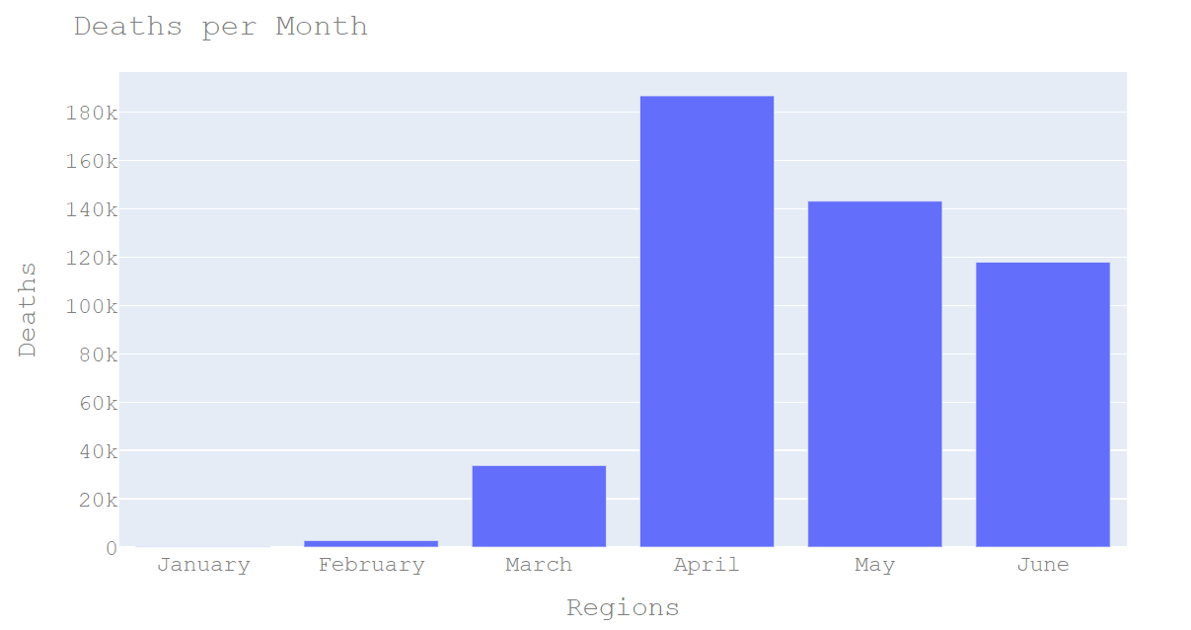

Slide 9
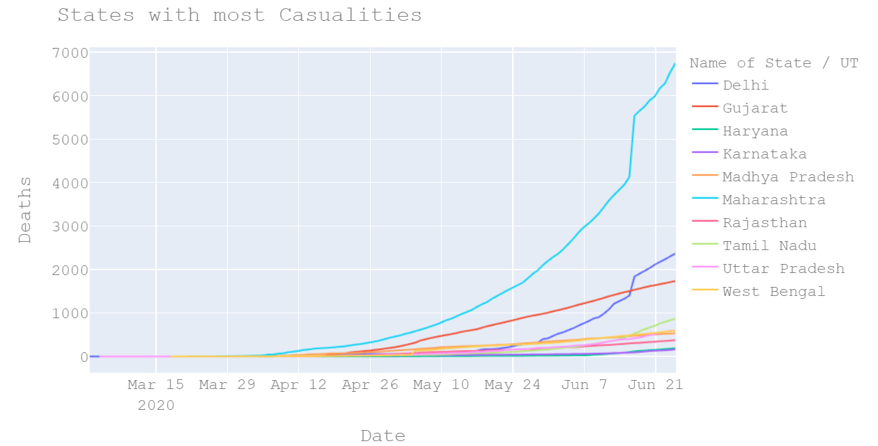

Slide 10
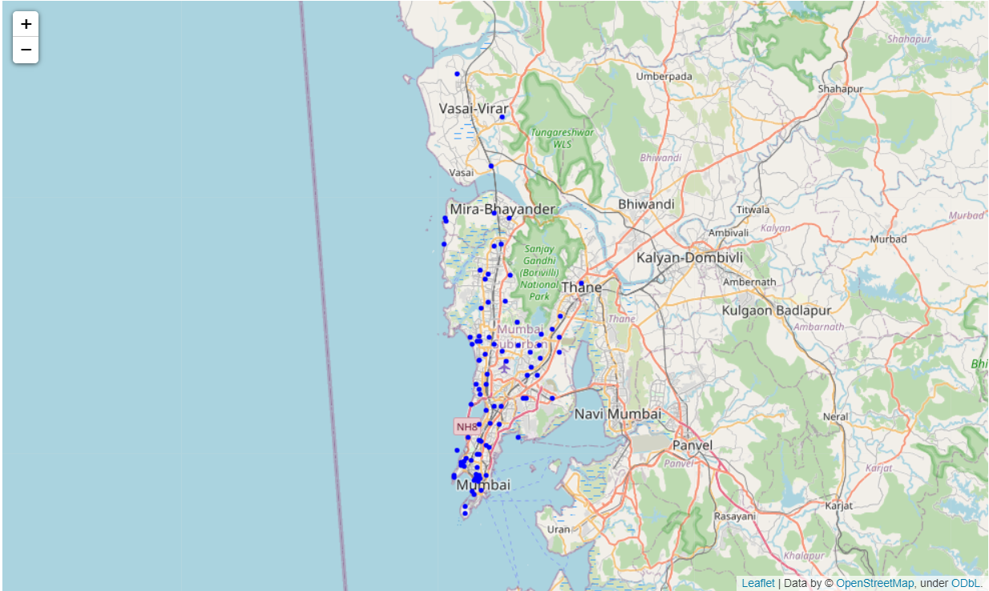
NEIGHBOURHOODS IN MUMBAI

Slide 11
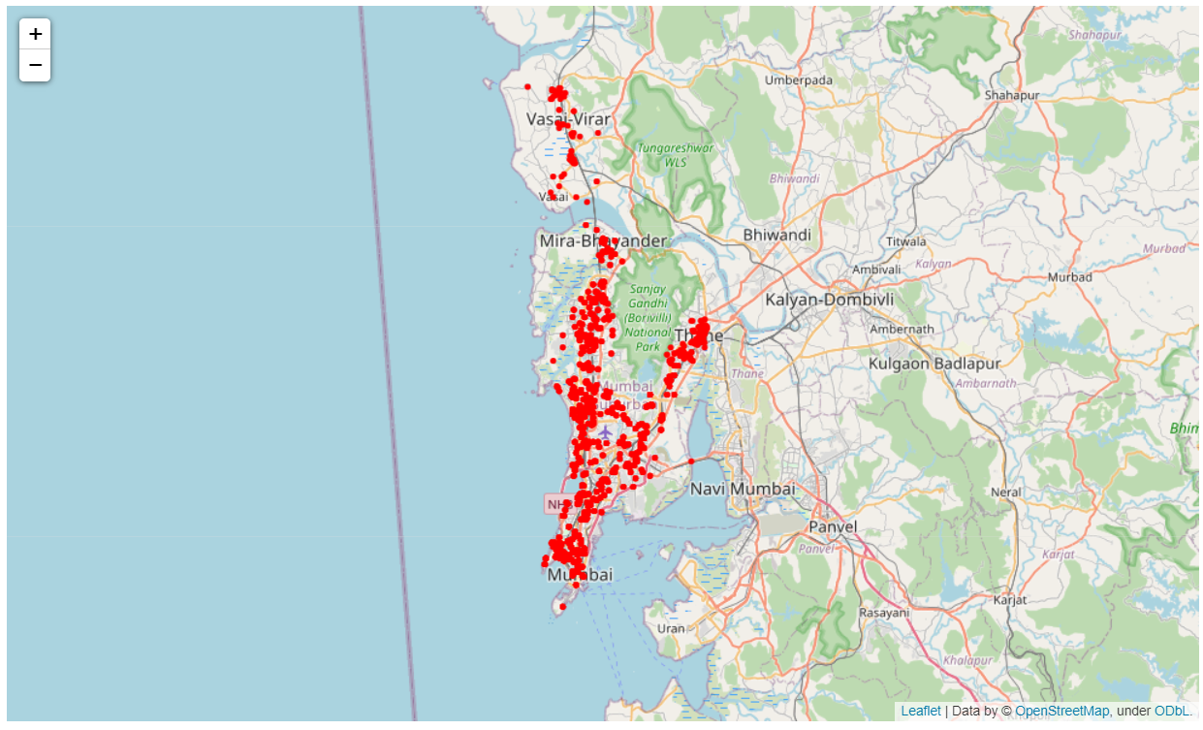
HOSPITALS IN MUMBAI

Slide 12
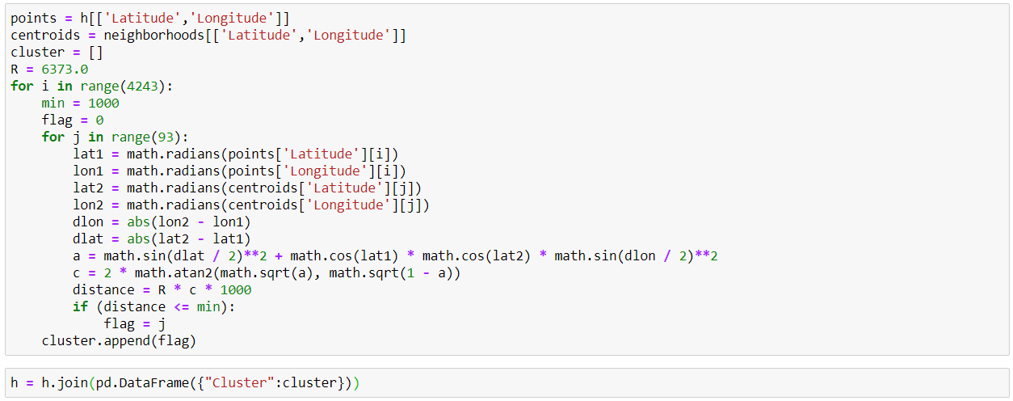
CLUSTERING ALGORITHM

Slide 13
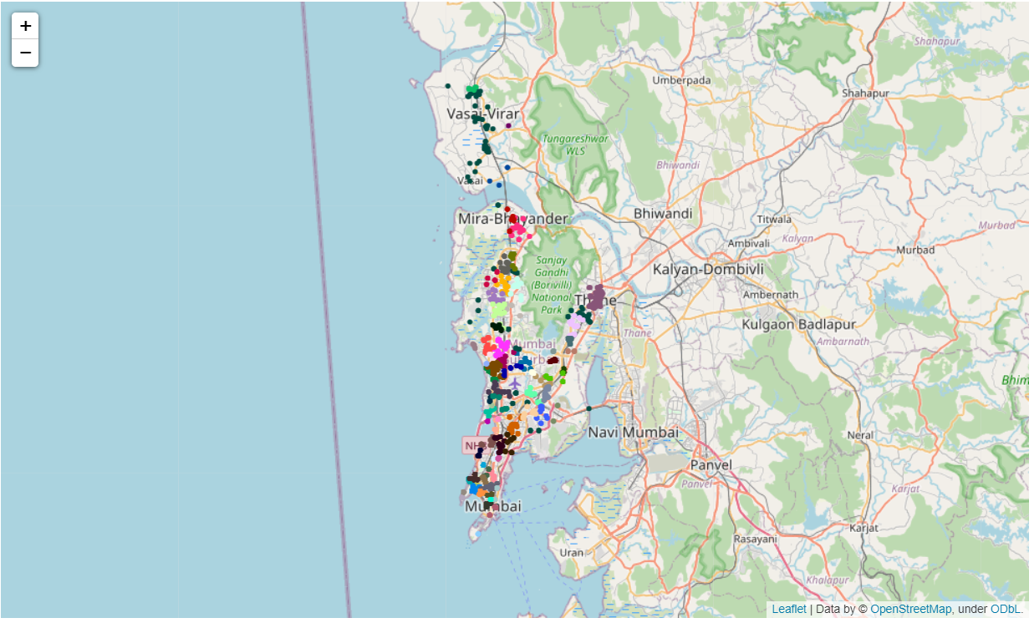
HOSPITALS CLUSTERED ACCORDING TO NEIGHBOURHOOD

Slide 14
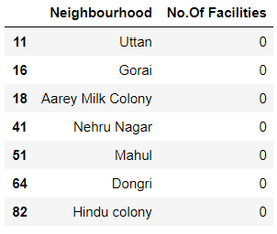
RESULT
The results showed 7 neighbourhoods had no access to a medical facility in a 2km radius. During a pandemic, immediate medical attention is the key to fighting to fighting the virus.
By establishing temporary test clinics in these areas, the government could reduce the load on hospitals and also prevent secondary transmission of the virus. Adding to the list, we have 2 other neighbourhoods (Naigaon & Nalasopara) with less than 5 medical facilities.

Slide 15
DISCUSSION
One of the main assumptions made in this project was that every hospital provided a test for the COVID-19 virus. This is certainly not the case.
Also a few drawbacks of this analysis are that it doesn’t consider the feasibility of establishing a test centre in one of these neighbourhoods: terrain could play a big role.
Population density could also help us in determining the number of test-centres each neighbourhood would need.

Slide 16
CONCLUSION
In the above study, we explored and analysed the medical facilities in Mumbai, India using Data Science.
We used an existing dataset and combined it with data collected from Foursquare API as well as data scraped from a website.
We performed EDA and clustering on these datasets in our pursuit of solutions.
We were able to find satisfactory answers to the questions we posed before the study. T
he study is based on limited data, but it is nevertheless a significant step in shedding light on the medical infrastructures in Mumbai.
This study can be repeated easily for other cities in India.

Slide 17
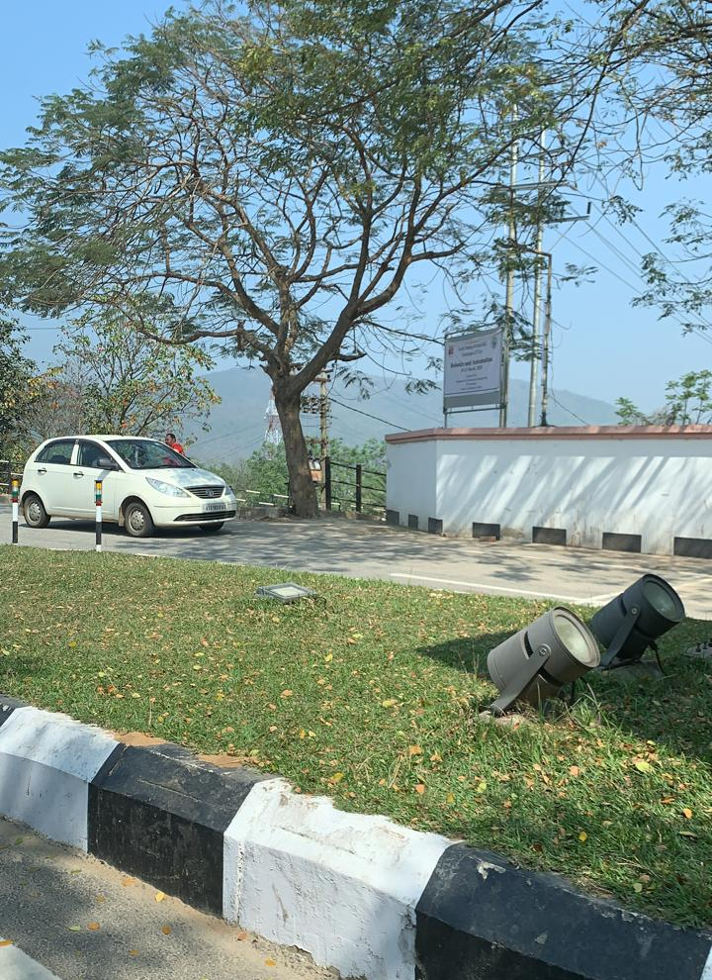
“Coronavirus: The last 'normal' photo on your phone” – (https://www.bbc.com/news/uk-52622673)
Me leaving my University Campus on the 16th of March 2020.

