Slide 1
CSS Animations and Transitions
A Beginner-Friendly Explanation

Slide 2
What are CSS Animations and Transitions?
Used to add visual motion effects that make user interfaces more engaging and interactive without using JavaScript.

Slide 3
CSS Transitions
- Smoothly animate property changes.
- Triggered by user interactions like hover.
- Properties: transition-property, duration, timing-function, delay.

Slide 4
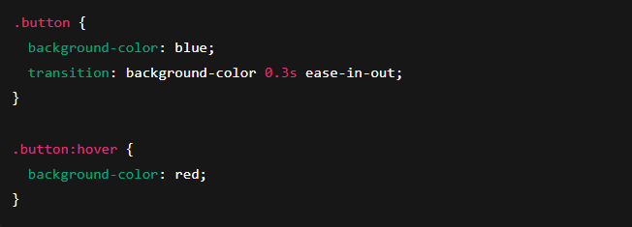
Transition Example
The button is blue by default. When the user hovers over it, the background color smoothly changes to red over 0.3 seconds.

Slide 5
CSS Animations
- Animate elements in multiple steps.
- Use @keyframes to define stages.
- Properties: name, duration, timing, delay, iteration, direction, fill-mode.

Slide 6
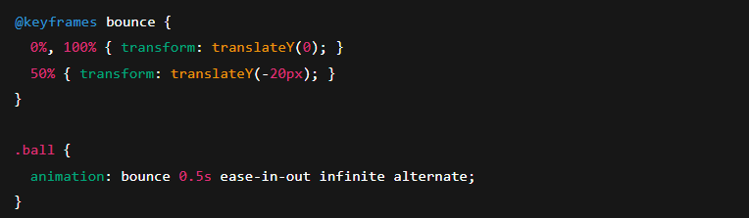
Animation Example
The .ball element keeps bouncing up and down endlessly.

Slide 7
Bounce Animation
@keyframes bounce {
0%, 100% { transform: translateY(0); }
50% { transform: translateY(-20px); }
}
.ball {
animation: bounce 0.5s ease-in-out infinite alternate;
}

Slide 8
Transitions vs Animations
- Transitions: simple, triggered by interaction.
- Animations: more complex, can run automatically.
- Transitions: buttons, inputs.
- Animations: loaders, modals.

Slide 9
Performance Tips
- Use transform and opacity for smooth animations.
- Avoid animating width and height.
- Use 'will-change' to optimize performance.

Slide 10
Conclusion
CSS Transitions and Animations make web pages more dynamic and attractive with minimal effort and no JavaScript.

