Slide 1

Section 1

Slide 2
What is Git, GitHub, GitLab ?
Git “distributed version control system” is free and open source.
GitHub is a GUI to simplify using git control system, It’s like a place you put your projects and files on, or simply platform for hosting and collaborating on Git repositories.
[GitLab / Bitbucket] is another examples of a GUI platforms for using git.
Git and GitHub are not attached to each other, you can use git without GitHub, They are not the same thing.

Slide 3
What could you do with Git?
With Git, you have a full control on your projects.
You can contribute on other projects uploaded with the acceptance of Project Owner.
You, your team can work on the same project easily and push, pull, reflect changes simply.
You can control the versions of you project easily.

Slide 4
How to create a GitHub Account?
Go to https://github.com/ and click Sign Up.
Insert your email and press Continue.
Create Your Password and press Continue.
Enter Your Username and press Continue.
https://daringfireball.net/projects/markdown/syntax#list

Slide 5
How to create a GitHub Account?
Solve the Puzzle Captcha and click Create Account.
Check your Email inbox and enter the delivered Code.
Choose how many members you work with and Student Type.

Slide 6
How to create a GitHub Account?
Choose one of the plans.
Done! -> go to show your Dashboard.

Slide 7
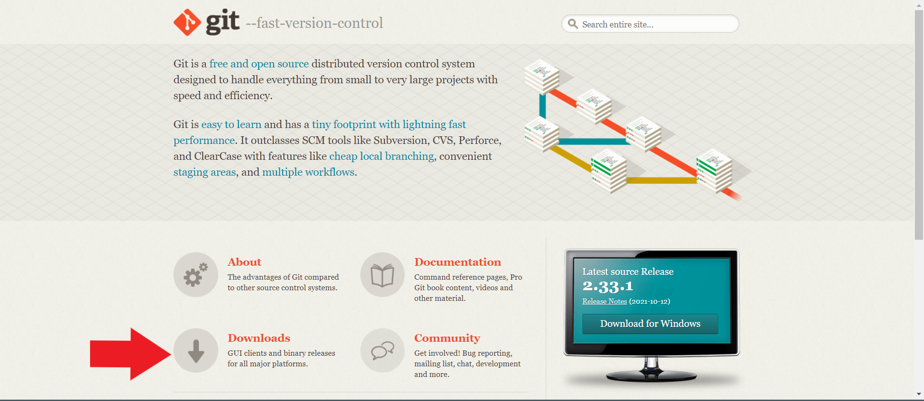
Install Git
--> Go To https://git-scm.com/ and Download Git for Desktop and install it with default settings.

Slide 8
Git Commands
After making your project go to the folder and Right click and choose Git Bash Here.
This will open the Git Command Line.
“cd [path]” : to change the working directory.
“ls” : to show the content of current directory.
“touch [file name + extension]” : to create file.
“rm [file name + extension]” : to delete file.
“mkdir [folder name ]” : to cteate folder / directory.
“rmdir [folder name ]” : to delete folder / directory.
Type “git version” : to check the version of the Git installed on your machine.
Type “git init” : to initiate a local repository of the project.

Slide 9
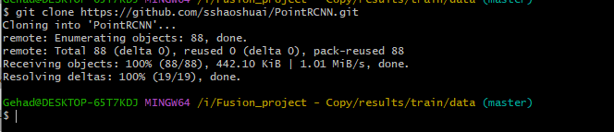
Git Commands
Now Go To the branch that we have created, and we can see all files of our test program uploaded successfully.
Now to clone the repo to our local device to work with it this called clone it.(download)
By Command Line, Open Command Line and type :
git clone https://github.com/testName/repoName.git

Slide 10
Git Commands
Type “git status” : to show modified files in working directory. staged for your next commit (the red files and folders are not committed to the repo).
Type “git add <filename>” : to add file to the staged area.
but to add all modified files Type : “ git add * ” OR “ git add . ”
Now if we make a little change in any file and save it and checked the status again, we can see the modified files with red color so add them again by “ git add . ”
git reset head <filename>” to remove from staging area.
Type : [ Git commit –m “first version” ].

Slide 11
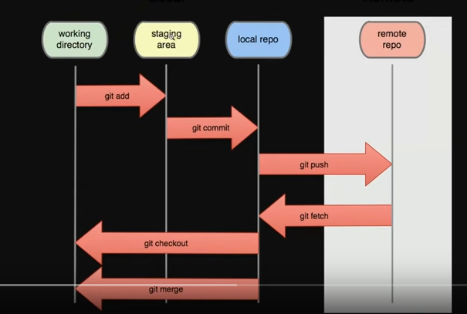

Slide 12
Git Commands
Now suppose we finished our edits and want to upload the project to GitHub by using git.
Now to push the project to the remote repository:
- Git push origin master
But first u need to authenticate yourself to Git Bash, Type :
Git config --global user.name "user-name“
Git config --global user.email anymail@gmail.com

Slide 13
Git Commands
After that we can commit our work like this:
Type : [ Git commit –m “first commit” ].
Now our project ready to be uploaded to the remote repository.
Go to the remote repository and get the link.
Now this command links our repository to the remote repo.
git remote add origin https://github.com/testname/repoName.git
- Specifies the remote repository for your local repository(linking).
- The url points to a repository link on GitHub.

Slide 14

Write C++ program to write ”Hello of words ” in a file.

Slide 15
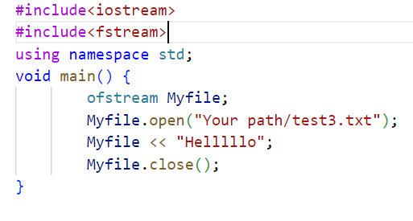

Slide 16

Write C++ program to read ”Hello of words ” in a file

Slide 17
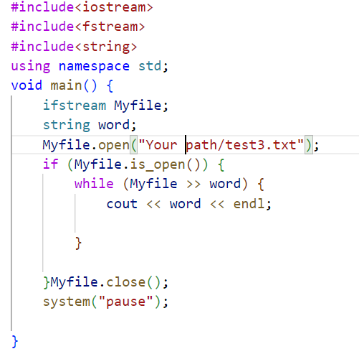

Slide 18
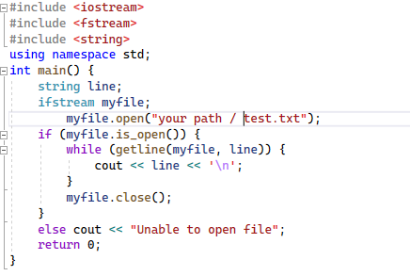

Slide 19
Thanks For You

