Slide 1
Introduction to Information System
Section 2

Slide 2

Write C++ program to count number of words in a file.

Slide 3
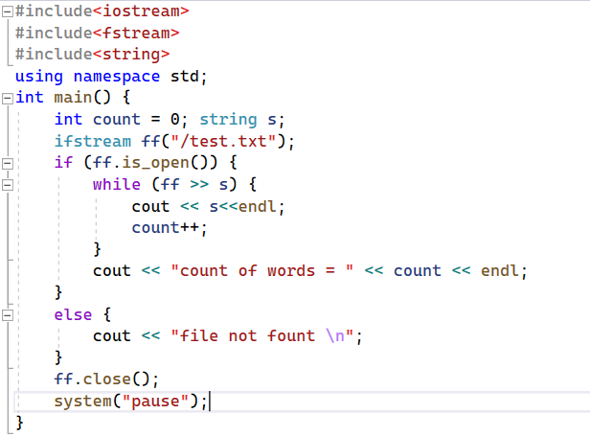

Slide 4
Write C++ program to count lines in a file.

Slide 5
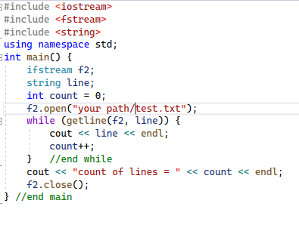

Slide 6
Write C++ program to store this table in a file
Name | Telephone Number
Ali | 01000000001
Mona | 01100000001
Menna | 01000000002

Slide 7
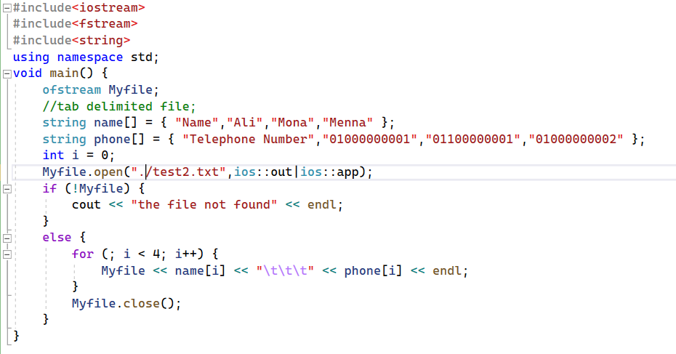

Slide 8
Add new field as Age in the next table. Do you need to change your program
Name | Telephone Number | Age
Ali | 01000000001 | 21
Mona | 01100000001 | 20
Menna | 01000000002 | 18

Slide 9
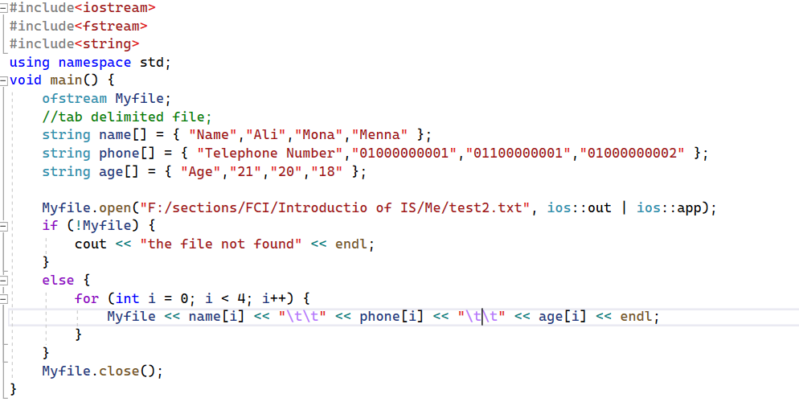

Slide 10
Writing then Reading from a Text File using an Array of String

Slide 11
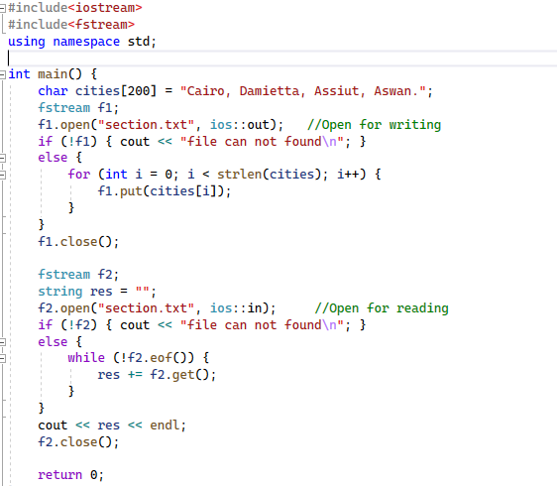

Slide 12
Write C++ program to delete specific word from the file.

Slide 13
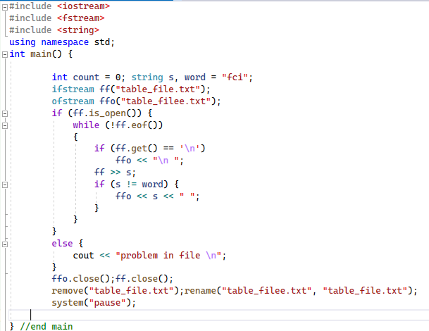

Slide 14
Add more function in your code to search with name and get the telephone number.
Name | Telephone Number
Ali | 01000000001
Mona | 01100000001
Menna | 01000000002

Slide 15
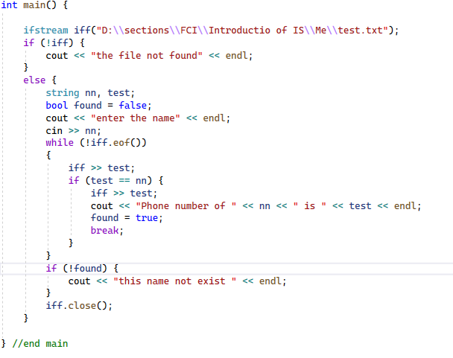

Slide 16
Thanks For You

