Slide 1

Home Credit Default Risk
By: Amgad Abdallah

Slide 2
Project Pipeline
EDA
Auto EDA
Problem understanding
Literature
review
Automation
Model selection and Tuning
start
Base line modeling
Auto Feature Engineering and selection
Preprocessing
Concept/data drifts
Monitoring model performance
Validating model for production
Choosing deployment schema
Model Validation

Slide 3
Business problem understanding
Many people struggle to get loans due to insufficient or non-existent credit histories. And, unfortunately, this population is often taken advantage of by untrustworthy lenders.
Home Credit strives to broaden financial inclusion for the unbanked population by providing a positive and safe borrowing experience. To make sure this underserved population has a positive loan experience.
Home Credit makes use of a variety of alternative data--including telco and transactional information--to predict their clients' repayment abilities.
Objective: ensure that clients capable of repayment are not rejected and that loans are given with a principal, maturity, and repayment calendar that will empower their clients to be successful.
Why is credit risk important?
Credit defaults affect the economy.
Prevent lenders from lending to certain borrowers.
Prevent borrowers from borrowing too much.

Slide 4
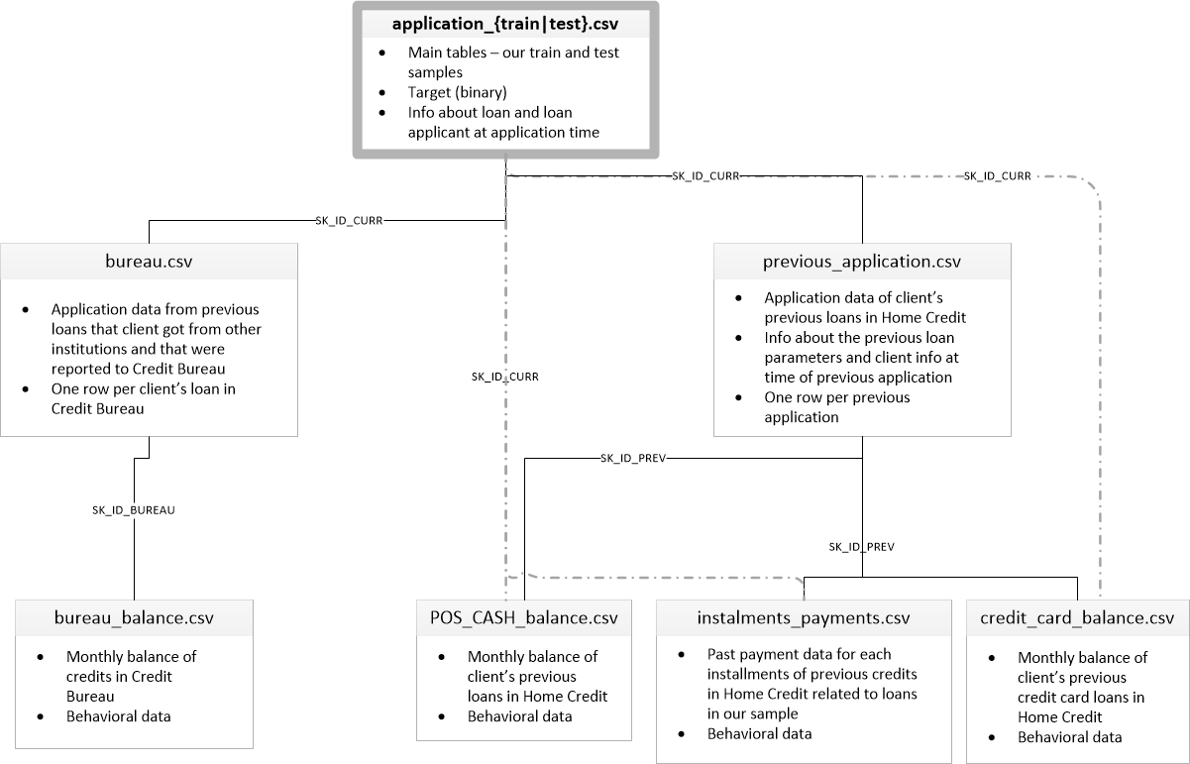
Dataset Description
The dataset provided contains lots of details about the borrower. It is segregated into multiple relational tables, which contain applicants’ static data such as their gender, age, number of family members, occupation, and other related fields, applicant’s previous credit history obtained from the credit bureau department, and the applicant’s past credit history within the Home Credit Group itself.
The dataset is an imbalanced dataset, where the Negative class dominates the Positive class, as there are only a few number of defaulters among all the applicants.
The Negative Class here refers to Non-Defaulters and Positive Class to Defaulters.

Slide 5
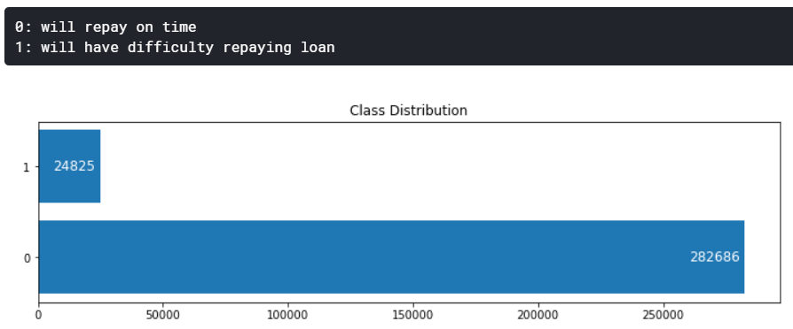
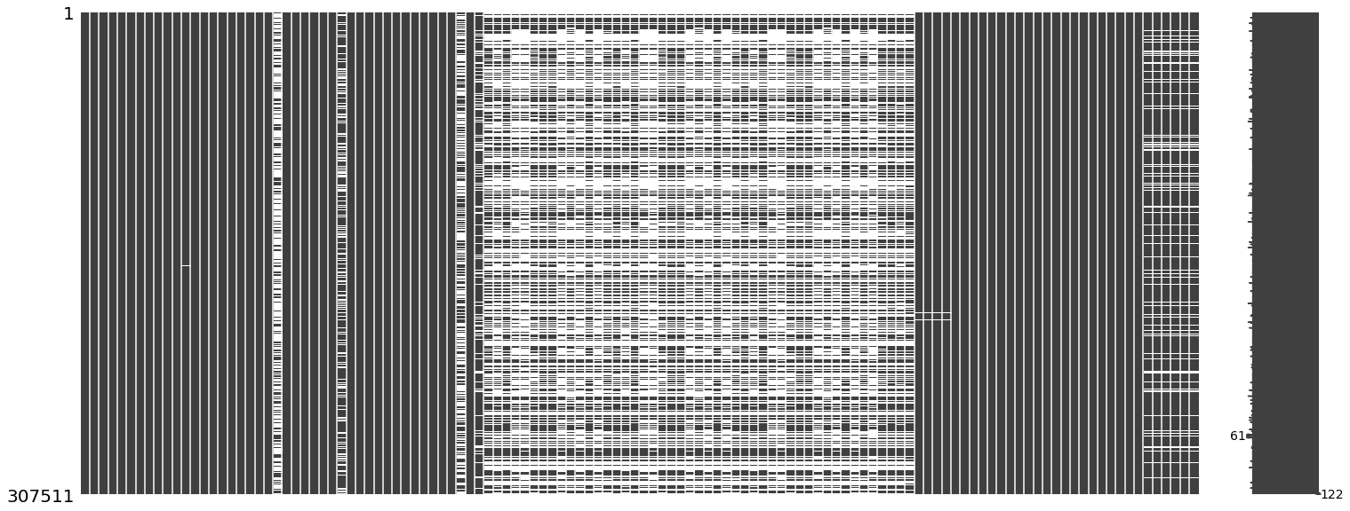
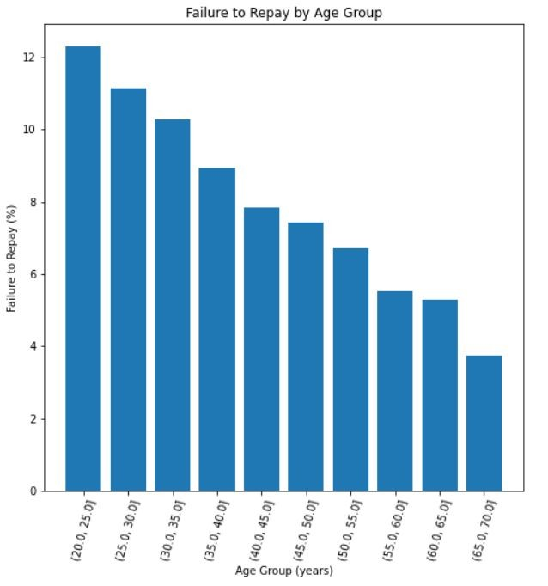
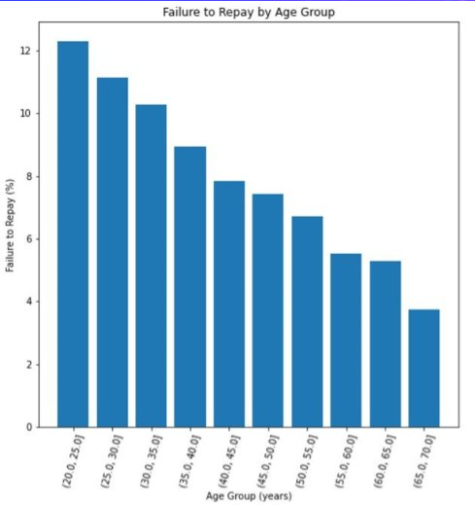
EDA
- The dataset is extremely unbalanced.
- the matrix shows extremely large numbers containing missing numbers, initially I thought to pick a model can handle these missing data (e.g.: XGBoost).
- We can see here that most people who have difficulty to repay their loan (target=1) is distributed at around 30s years old, younger people is less likely to be able to repay their loan in time.

Slide 6
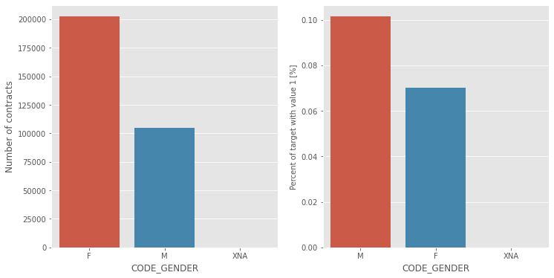
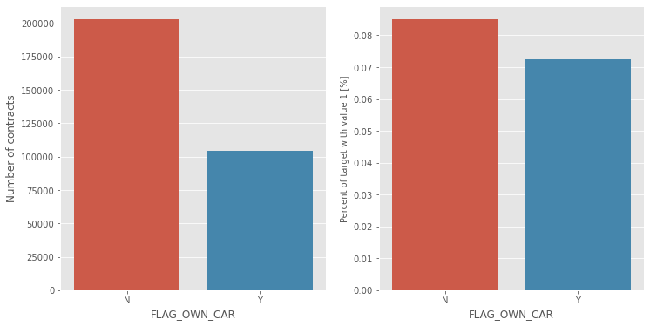
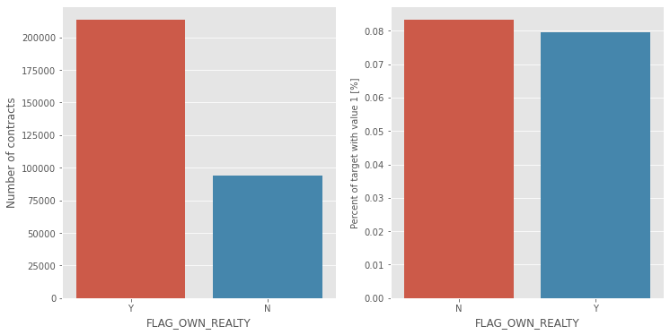
EDA
The number of female clients is almost double the number of male clients. Looking to the percent of defaulted credits, males have a higher chance of not returning their loans (almost 10%) comparing with women (almost 7%).
The clients that owns a car are almost a half of the ones that doesn't own one. The clients that owns a car are less likely to not repay a car that the ones that own. Both categories have not-repayment rates around 8%.
The clients that owns real estate are more than double of the ones that doesn't own. Both categories (owning real estate or not owning) have not-repayment rates less than 8%.

Slide 7
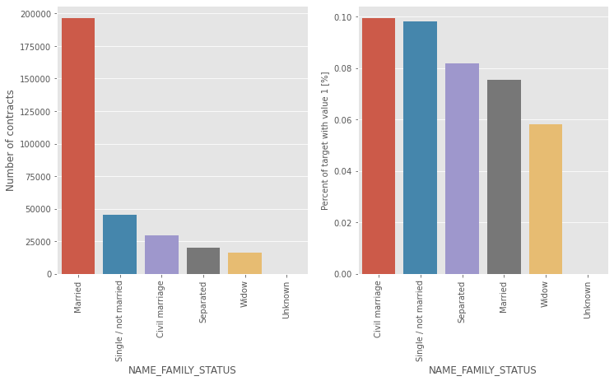
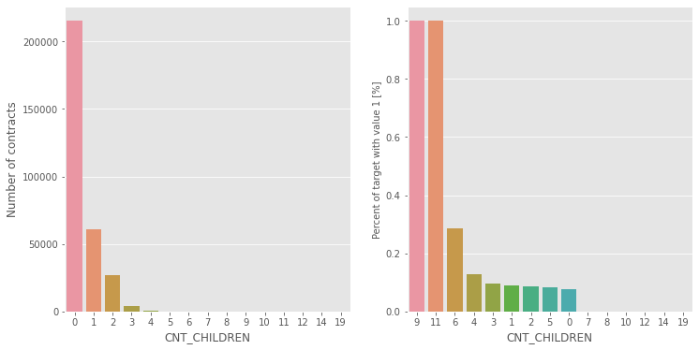
EDA
Most of clients are married, followed by Single/not married and civil marriage. In terms of percentage of not repayment of loan, Civil marriage has the highest percent of not repayment (10%), with Widow the lowest
Most of the clients taking a loan have no children. The number of loans associated with the clients with one children are 4 times smaller, the number of loans associated with the clients with two children are 8 times smaller; clients with 3, 4 or more children are much rarer. As for repayment, clients with no children, 1, 2, 3, and 5 children have prents of no repayment around the average (10%). The clients with 4 and 6 children are above average in terms of percent of not paid back loans (over 25% for families with 6 children). As for clients with 9 or 11 children, the percent of loans not repaid is 100%!!

Slide 8
Automation process
The Automation toke place in 2 tasks:
1- EDA
2- Feature Engineering.
Auto EDA
The purpose for this is to give higher level managers a descent dashboard to look at, as well as a quick overview of the data.
The Profiling was built using only important features that were extracted by LightGBM feature importance attribute, while the dashboard was built using streamlit.
Auto Feature Engineering
run deep feature synthesis with the time variables, with the correct specified categorical variables, with the interesting features, with the seed features, and with the custom features.
I didn't run this on entire dataset due to limitations of computational power.
I have created many features, including time variables, properly represent variables, and reduced memory usage, as well as using some primitive.

Slide 9
Feature Selection
For this I used LightGBM feature importance attribute, I ran CV of 2 folds (I am still feeling bad about it, but my machine would be litteraly on fire :)).
I used grid-search for tuning the model, to ensure I have reasonably approximate to the important featuers.
Drawbacks: there might be some important features depend on some non-important features, I would have spent more time in selecting features with different techniques (e.g.: RFE.), but I cheated from Kaggle anyway :)
DATA CLEANSING
For this task, every data file treated with suitable process, it includes:
1- Dealing with missing data and understanding the mechanism of missing data.
2- Renaming features.
3- Scaling.
4- much more done in the code!

Slide 10
Machine Learning Model
For this problem, I have chosen lightGBM classifier.
For hyper-parameter tuning I used Hyperopt (library for bayesian optimization (using TPE) with cross-validation.
The Model Achieved training's AUC ~91%, and ~80 on validation.
I have created a single notebook named "End-to-End", with a full pipeline, it's ready for offline deployment schema, and it can be easily deployed as well using any kind of schemas.

Slide 11
What would I do to Improve the output?
When I have more time, I would do the following:
1- communicate with domain experts.
2- read more papers and try different methodologies.
3- I would try Graph Neural Networks, as I can see the data is complex and may include non-Euclidian relationships.
4- I would optimize the model based on business constraints, (e.g.: the business must achieve 8% revenue, we must consider our service price w.r.t. competitors,...etc.) - I may use DRL for this multi-objective optimization task.

