Slide 1

AGROSUL × AGROSTECH
Certificado
Proof of land compliance and crop health for Brazil's small farms — generated entirely from open data and autonomous agents.
A strategic product concept, merging Agrostech's data engine, Agrosul's Swarm platform, and the open-data land-market thesis · July 2026

Slide 2



01 — THE OPPORTUNITY
Brazil's agriculture is built on small farms.
3.9M
77%
23%
family-farm properties
of all rural establishments
of the farmland they work
Small farms are everywhere in Brazilian agriculture — and almost invisible to credit, compliance, and precision ag.
Source: Embrapa · Censo Agropecuário
2

Slide 3


02 — WHY NOW
Two deadlines just made proof mandatory.
January 2026
December 2026
Farms without an analyzed CAR — or with an active embargo — lose access to subsidized Plano Safra credit lines, at any size.
The EU Deforestation Regulation requires plot-level, deforestation-free proof for every export lot that reaches the EU market.
Compliance just became mandatory — and smallholders have no affordable way to produce it.
CERTIFICADO — Strategic Product Concept
3

Slide 4



03 — THE OLD WAY
Manual checks. Cold outreach. Imagery priced for someone else's farm.
Fragmented open data
SIGEF, SICAR, and MapBiomas each publish on separate portals with schemas that shift without notice.
$40–60
Manual verification
per km², typical VHR tasking price
Brokers, lawyers, and banks still check land and environmental status by hand, one property at a time.
with a 50 km² order minimum — before a single hectare is certified.
Imagery built for someone else
High-resolution tasking is priced and packaged for thousand-hectare operations, not a 20-hectare family plot.
CERTIFICADO — Strategic Product Concept
4

Slide 5
04 — THE SHIFT
Why agents, not another workflow tool.
Capability | Static automation | Autonomous agents
Orchestration | Manual node-to-node mapping | Natural-language task routing
Resilience | Breaks silently on schema changes | Self-heals across data sources
Context | Lost between tools | Shared memory across every agent
Execution | Sequential and linear | Parallel across sub-tasks
Team impact | Template personalization only | Saves 30–50% of execution time
CERTIFICADO — Strategic Product Concept
5

Slide 6


05 — THE INSIGHT
We didn't start from zero. We started from production.
Geomart — Agrostech
Swarm — Agrosul
Already scrapes SIGEF-certified parcels and MapBiomas alerts — today, to find enterprise sales leads.
Already prices NDVI/NDRE flyovers at R$22–60 per hectare for mid-to-large producers.
Solis already watches Sentinel-2 NDVI and flags any farm with a health drop over 15%.
Mercurius already gates every drone mission by ROI before it flies.
Certificado repoints this same engine at the 3.9 million farms it was never built to reach.
CERTIFICADO — Strategic Product Concept
6

Slide 7
Introducing Certificado
An automated compliance and health certificate — generated entirely from free, public data — for any farm, regardless of size.
CERTIFICADO — Strategic Product Concept
7

Slide 8
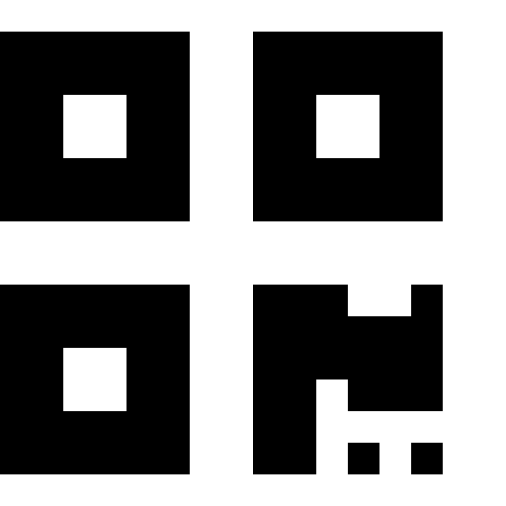
06 — THE PRODUCT
What's inside a Certificado.
Land status
Deforestation trace
CAR regularized in SICAR, boundary certified in SIGEF, zero active embargoes.
MapBiomas Alerta cross-check — no validated alert on record for the property.
Crop-health trend
Verifiable document
Season-over-season NDVI from Sentinel-2, plotted in plain language.
A QR-coded PDF any bank, buyer, or auditor can check in seconds.
CERTIFICADO — Strategic Product Concept
8

Slide 9




07 — HOW IT WORKS
Four agents. One certificate. Zero manual work.
1
2
3
4
Data Agent
Certificate Agent
Distribution Agent
Monitor Agent
Pulls SIGEF, SICAR, MapBiomas & Sentinel-2 for the farm's exact polygon.
Compiles findings into a plain-language, PT-BR certificate.
Issues and renews it over WhatsApp — no app, no login.
Watches for change; a new alert or NDVI drop triggers a re-issue.
CERTIFICADO — Strategic Product Concept
9

Slide 10
08 — THE ECONOMICS
Open data isn't the compromise. It's the unlock.
$0
$2,000+
minimum tasking order for very-high-res imagery (50 km² @ $40–60/km²)
Sentinel-2 — 10 m resolution, every 5 days, free forever from ESA Copernicus.
≈ 250×
the size of an average 20-hectare family farm — just to meet the order minimum.
CERTIFICADO — Strategic Product Concept
10

Slide 11
08 — THE ECONOMICS
Match resolution to the decision it informs.
Source | Resolution / cadence | Cost | Best for
Sentinel-2 (Copernicus) | 10 m · every 5 days | Free | Certificado — compliance & health baseline
PlanetScope | 3 m · daily | Subscription / hectares managed | Swarm monitoring — active-season scouting
Pléiades / Maxar | 30–50 cm · tasked | $5–25/km² archive · $40–60/km² tasked | Carbon & ESG MRV — audit-grade evidence
Certificado never needs the expensive tier — the decisions it supports (credit, deforestation-free proof, health baseline) are exactly the ones 10 m free data answers well.
CERTIFICADO — Strategic Product Concept
11

Slide 12


09 — THE BUSINESS MODEL
One certificate. Three ways to grow with a farmer.
Certificado
Swarm Monitoring
Carbon & ESG MRV
Free / low-cost
R$1.20–60 / ha
R$8,000–20,000 / laudo
Open-data compliance & health certificate. Top-of-funnel, self-serve, WhatsApp-delivered.
Agrosul's drone & satellite reports — NDVI, DEM, stand count — for active-season decisions.
Agrostech's audit-grade reports for Verra / Gold Standard carbon certifiers.
A Monitor Agent flag — an NDVI anomaly, a fresh alert — becomes the qualified signal that moves a farmer up the ladder.
CERTIFICADO — Strategic Product Concept
12

Slide 13
Meet farmers where they already are.
No dashboard. No download. Certificado is issued, renewed, and explained over WhatsApp — the channel Agrostech's bots already speak.
CERTIFICADO — Strategic Product Concept
13

Slide 14
10 — ROADMAP
Three phases, built on what already runs.
1
2
3
Pilot
Distribute
Compound
Wire Geomart and Solis into a single Certificado generator for one municipality.
Launch the WhatsApp bot with freshness, completeness, and dedup gates before any certificate ships.
Turn Monitor Agent flags into a live upsell path toward Swarm monitoring and Carbon MRV.
CERTIFICADO — Strategic Product Concept
14

Slide 15
11 — THE VISION
80.8M hectares
farmed by families across Brazil — most of it still outside precision ag, formal credit, and carbon markets.
Certificado is how that land enters the data economy — one open, verifiable, free certificate at a time.
Certificado
Agrosul × Agrostech

