Slide 1
Telecom Customer Churn

Slide 2
Problem:
What is churn?
Customer Churn is one of the largest and most prevalent problems facing telecommunications companies today.
In its Q1 of this year, Verizon saw a 0.90% churn of its postpaid phone customers.[1]
With 92,192,000[2] postpaid customers in Q1 of 2023, this rate would lose 829,728 customers that quarter.
Customer Churn leads to an immense loss of revenue for many telecom companies and understanding the motivation and trends of customer churn can help them maintain their client base and millions in revenue each year.

Slide 3
Data:
https://www.kaggle.com/datasets/reyhanarighy/data-telco-customer-churn/data
Two continuous features: Tenure (in years) and monthly charges (usd).
7 categorical features
Dependents (binary), Online Security (binary do they use it or not), Internet Service (DSL, Fiber Optic, no -> do they subscribe to internet service or not), Device Protection (binary), Tech Support (binary), Contract (Length of current contract), and Paperless Billing (binary).
Target: Churn
4930 entries

Slide 4
Solution?
Use predictive modeling and analysis to understand the reasons and motivations behind customers churning, and provide potential remedies to mitigate the short and long term churn percentage. (Under the assumption that we are working for a specific company, such as Verizon.)
The models and methods used could have a wide application, but are designed to provide insight towards preventing customers from one provider churning to another, and thus would be best used with one provider.

Slide 5
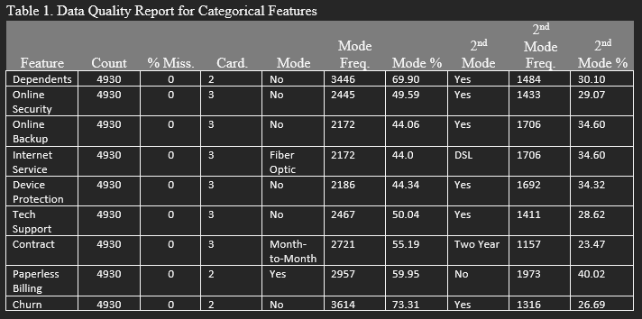
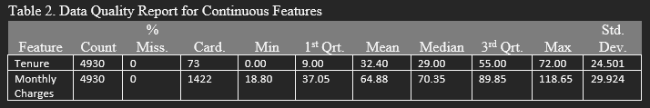
Data Quality Report:

Slide 6
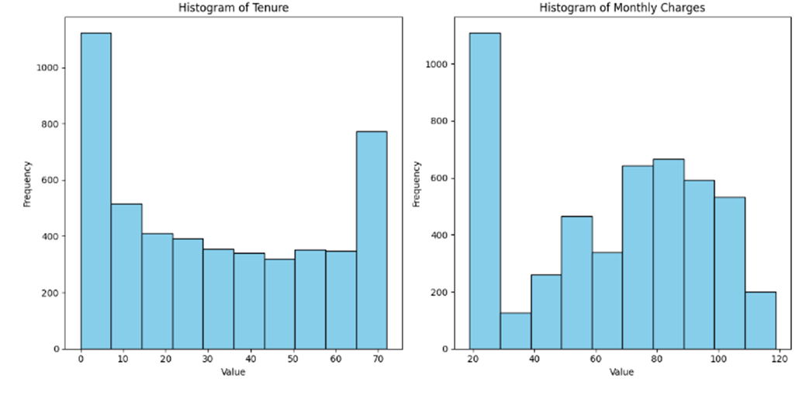
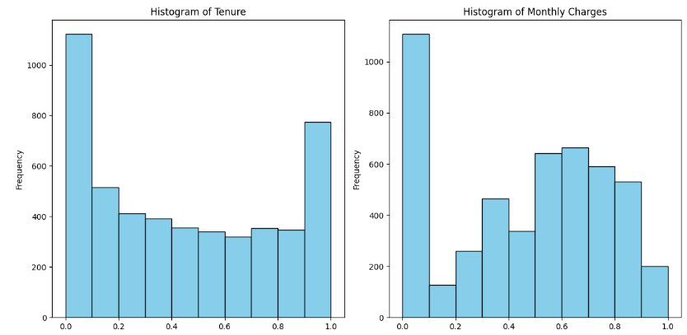
Outliers and Normalization
There is no outliers in the continuous features according to an 1.5 IQR test on the data so our values are very precise. This can be seen in the charts below.
Min Max normalization:

Slide 7
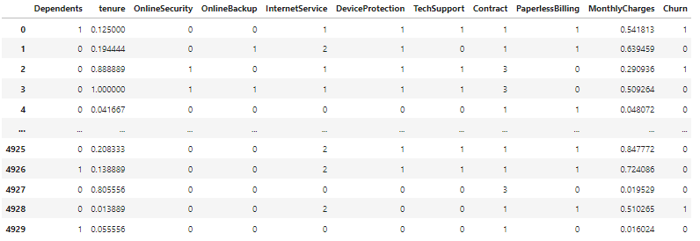
Feature selection and transformations:
Categorical Feature Encoding:
Feature addition: “Total Charged” = Tenure * Monthly Charges
All categorical features are either encoded to binary, (0, 1, 2) or (1, 2, 3) in the case of contract.

Slide 8
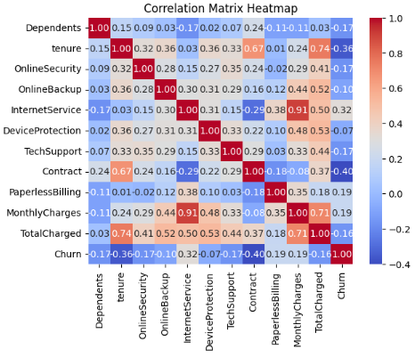
Low correlation between churn and [Device Protection, Online Backup, Online Security, and Dependents]
Large positive correlation between Monthly Charges and Internet Services.
Churn has a much larger correlation with internet services than monthly charges.
(for internet services “no” = 0, “DSL” = 1, and “Fiber Optic” = 2. )

Slide 9
Model selection
Two potential models: Random Forest and Logistic Regression.
Random Forest:
Handles Non-Linearity and Complex Relationships well
Robust to Overfitting - due to the averaging of many trees.
High Prediction Accuracy
Feature Importance:
Logistic Regression:
Good Baseline for future Modeling
Works Well with Binary Classification
Easily Interpretable
Efficient with Linear Relationships
Feature Importance

Slide 10
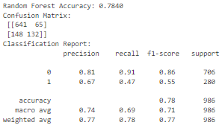
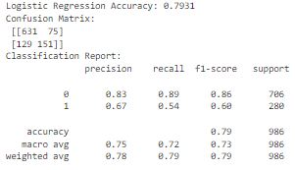
Evaluation metrics:
True Positive Rate Priority: The goal is to stop customers from churning, and thus the goal should be to maximize TP occurrence, minimize FN occurrences, and mostly disregard FP.
(Random Forest with 25 trees and max depth of 5)
After running the models many 100 times and averaging their accuracies, the Logistic Regression model never had an accuracy more than 0.5% greater than the RF model. But the RF model had a consistently higher recall.

Slide 11
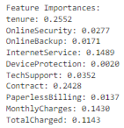
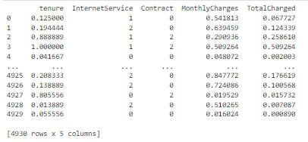
Evaluation settings and sampling
Using Random Forest feature importances we can calculate which features have little to no effect on the overall quality of the model and remove them to save computational costs.

Slide 12
Optimization
Randomized Search Cross-Validation explores randomly selected sets of hyperparameters, trains models using these configurations, and evaluates their performance using cross-validation. By comparing these results, it identifies the hyperparameter combination that maximizes the model's performance, improving its accuracy or other metrics without exhaustively testing every possible combination.
After Running Randomized Cross Validation this is the obtained results:
The accuracy improves to be better than the original Logistic Regression accuracy, but overall had only small improvement ( < 0.75%).

Slide 13
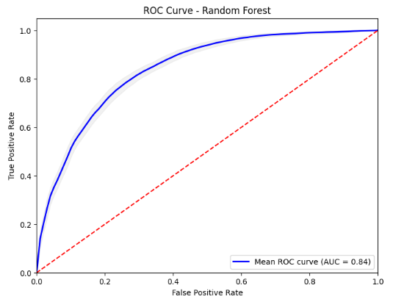
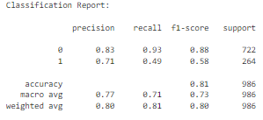
Evaluation:
The classification report shows a very high recall (TPR) which shows that our model succeeds in achieving our original goal. The ROC curve is high, but not as good as the logistic regression as RF sacrifices precision for recall.

Slide 14
Future work?
Provide a confidence measure for how likely any one entry is to churn and then filter out results that are below a certain confidence threshold. This may help reduce FP rate.
Improve precision for random forest.
Run and optimize Logistic Regression model.
Compare both accuracy and use of resource to run each model.
More feature engineering.

Slide 15
Business Applications:
People don’t care about the price nearly as much as they do the internet connection quality.
Very strong negative correlation between churn and contract length. Very few churners with one or two year contracts, almost all month to month.
Prioritize improving internet service to the best quality it can be, and provide incentives for customers to take up contracts a year or longer.
The longer a customer remains with the same provider, the less likely they are to churn. There should be a substantial amount of resources going towards preventing churn in the first 5 years of a clients tenure.

Slide 16
Sources:
https://www.fiercewireless.com/wireless/verizons-rising-churn-problem
https://www.verizon.com/about/system/files/VjgyMzFWNmUxeUxkbW5SeDJQeTVkQmI4bFg4RzVwS2xXdUJ6OHNhTnRLaz06Ojk3bH4hehpkMioUBQIXE3U.pdf (page 8)

Slide 17
Questions?

