Slide 1
Expectations and Skills for Undergraduate Students Doing Research in Statistics and Data Science
Jo Hardin
Pomona College
jo.hardin@pomona.edu
@jo_hardin47
Github: hardin47

Slide 2
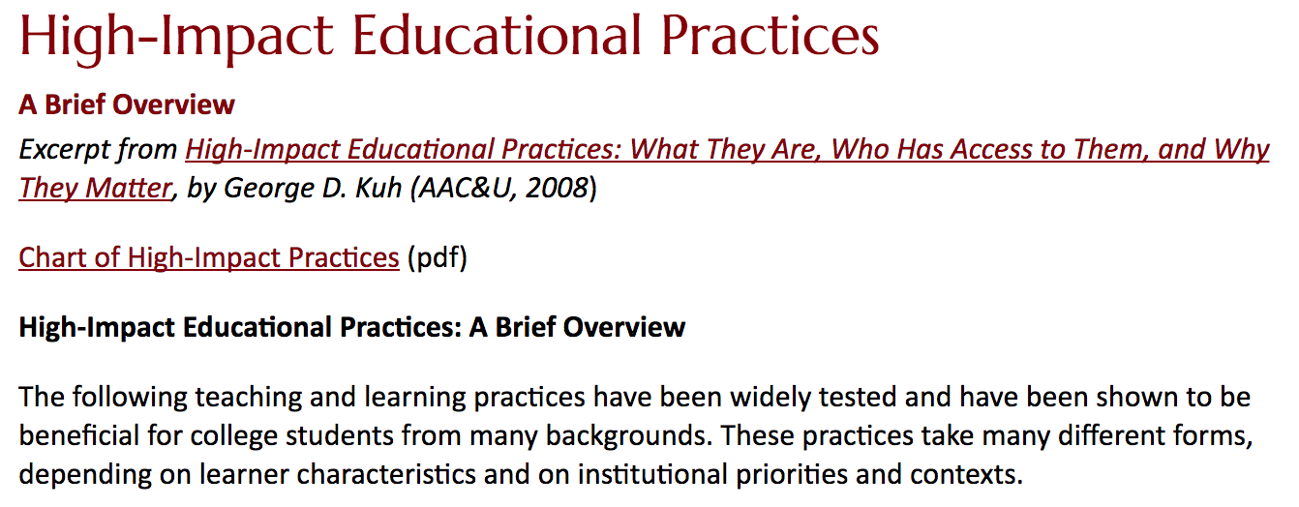
Undergraduate Research
Statistics curriculum guidelines
Data science curriculum guidelines
GAISE recommendations

Slide 3
Needed skills for successful undergrad research
Make an argument
Engage with theory
Work independently
Wrangle data

Slide 4
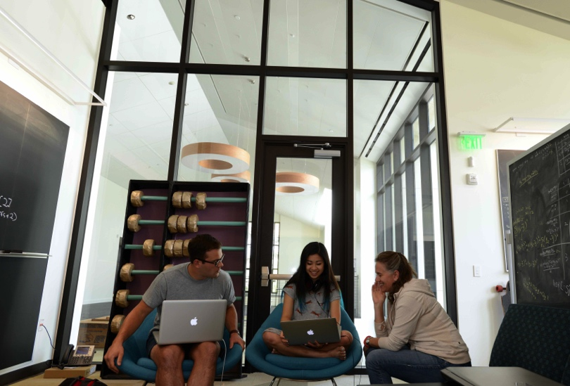
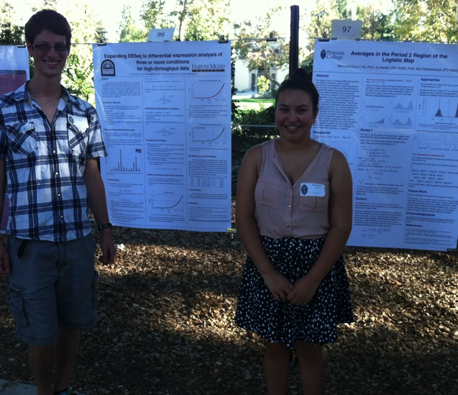
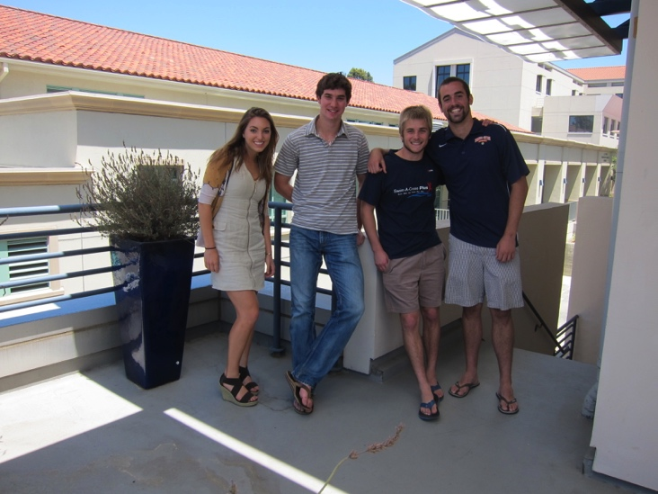
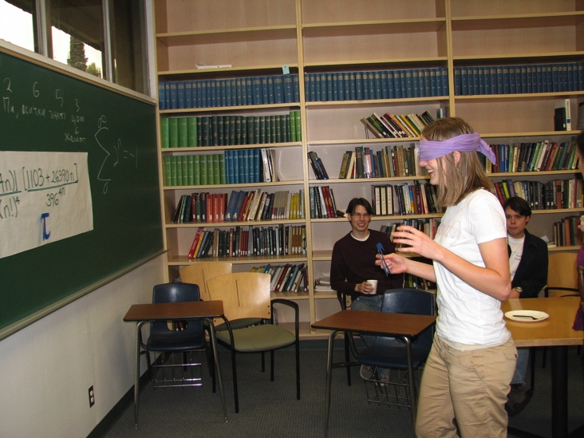
My background
Research with ~4 students / summer
Senior thesis projects ~4 students / year
12 peer-reviewed pubs w/undergrads

Slide 5
Make an Argument
In the Classroom
Theoretical
Simulation
Literature
Hypothesis test using mean and median to demonstrate two different approaches to the same scientific hypothesis
Simulation studies (e.g., bootstrap confidence intervals)
How do we know that? How can we argue that result is better than the other?
Notes:
A recent project of mine used canonical correlation analysis to identify correlated pairs of linear combinations of variables. The setting is sufficiently complicated that it would be difficult to find the theoretical distribution underlying each correlated linear combination (keeping in mind that each pair is also correlated with other pairs), but the analysis is not useful unless there is a way for the practitioner to know whether a large correlation is actually statistically significant. We were able to derive a permutation algorithm to define significance (the method also doubled as a way to measure false positive and false negative rates). The permutation method, however, was not trivial to implement, and it required that the students understood how the distributional aspects are determined by both the linear combinations as well as the complex correlation structures.

Slide 6
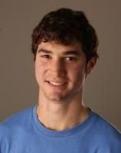
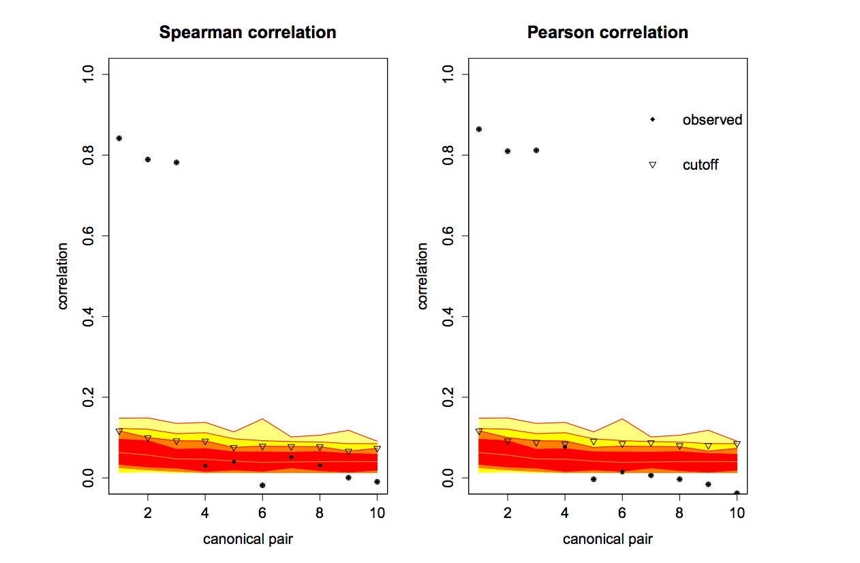
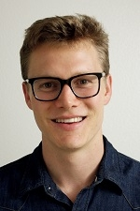
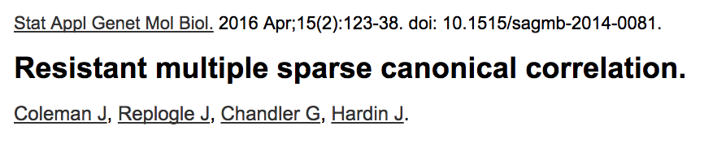
Make an Argument
As compared to what?
Permutation test for cutoff
Simulation analysis to demonstrate FP& FN rates

Slide 7
Engage with Theory
In the Classroom
Connect theoretical ideas to core principles in statistics
Moment generating function: why do they uniquely determine a distribution?
Simulate theoretical results for visualization of the process.
Notes:
One of my recent projects involves creating prediction intervals for a random forest model. The novelty comes from the derivation of the appropriate standard error. There are a handful (not many) of papers on the topic, a few very theoretical papers and a few who approach the problem in a different applied way. My student and I have had to work through how our ideas add to the literature and how those ides can be synthesized into an argument. Our conversations circle back repeatedly to “what are we trying to argue and how can we argue that effectively?”

Slide 8
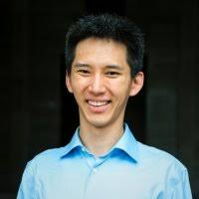
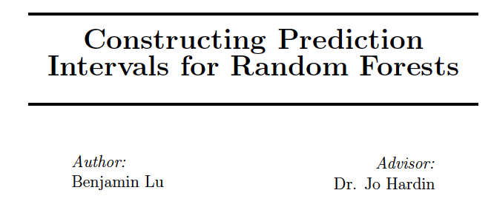
Engage with Theory
Kept coming back to his knowledge of prediction intervals for SLR (MSE)
June 2016 – July 2017
Organization was impeccable

Slide 9
Work Independently
In the Classroom
What did you do?
Why did you do it?
What is the next step?
What do you still not understand?
Independent projects (peer assessment!)
Reflect on assignments (quickly or in detail)
Notes:
Madison’s blog. Nick Horton (personal communication) requires his students to reflect via a Google form with a mechanism running in the background to inform him if they didn’t do it!

Slide 10
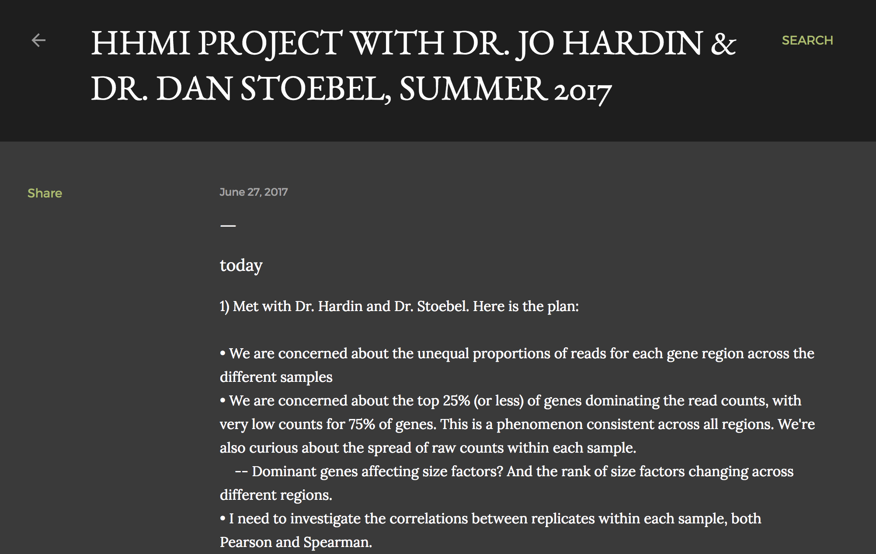
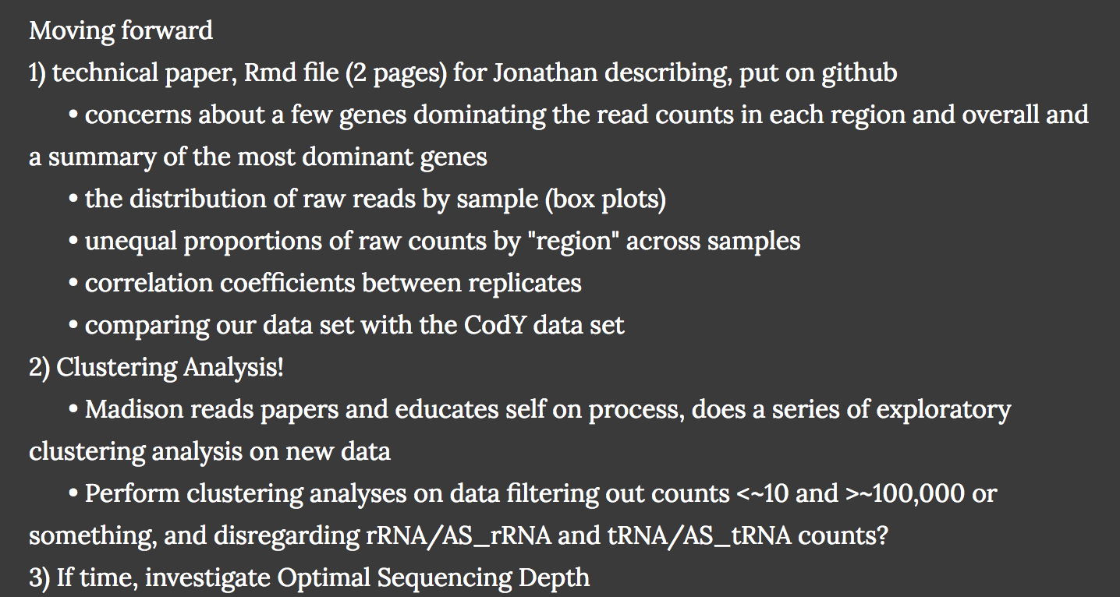
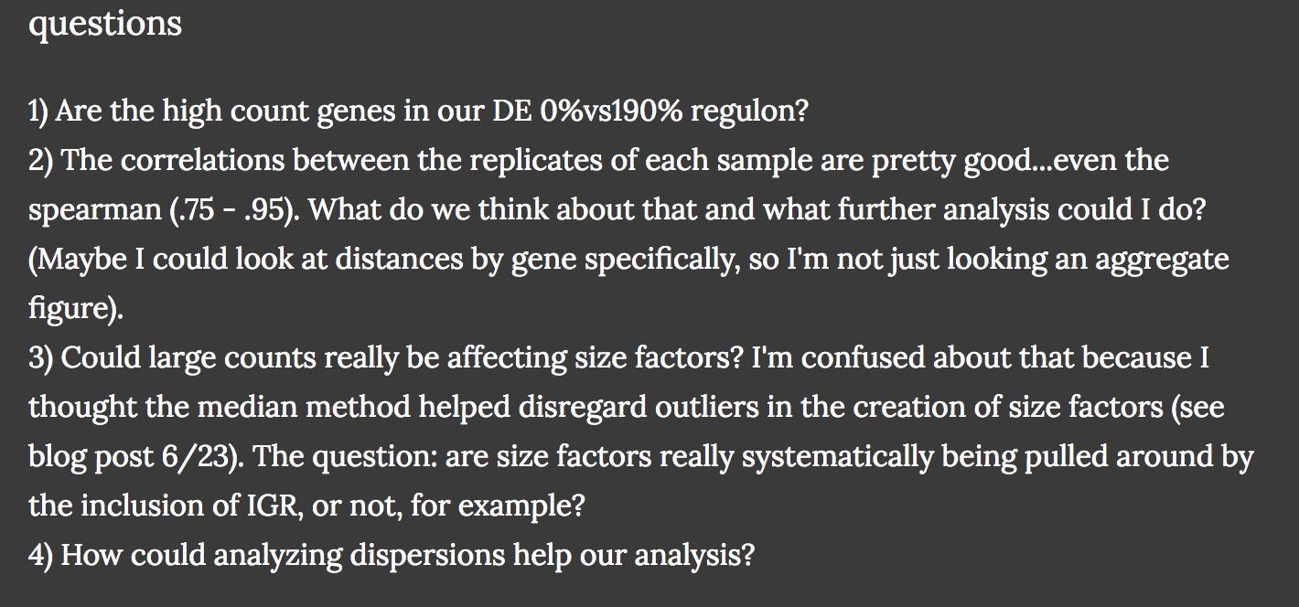
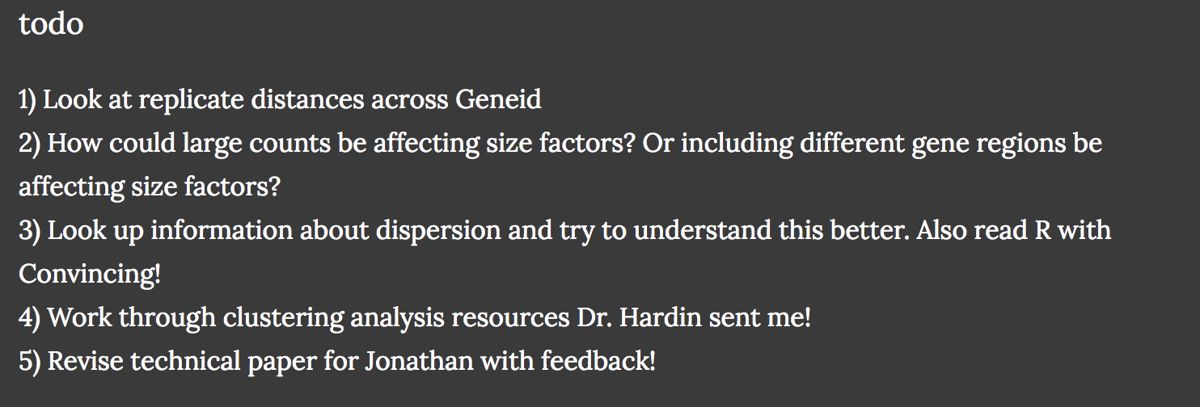
Work Independently
Madison’s daily blog
Use Google Doc to reflect (automatic updates back to you!)

Slide 11
Wrangle Data
In the Classroom
Data Science
Statistics
Theoretical
Practice, practice, practice
Learn how to problem solve independently
Data wrangling should happen in every class at every level
Notes:
Or working with new software programs (e.g., the quo function in dplyr version 0.7.1 as of June 22, 2017) can give the student a sense of being part of a larger community of statisticians and data scientists.

Slide 12
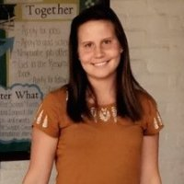
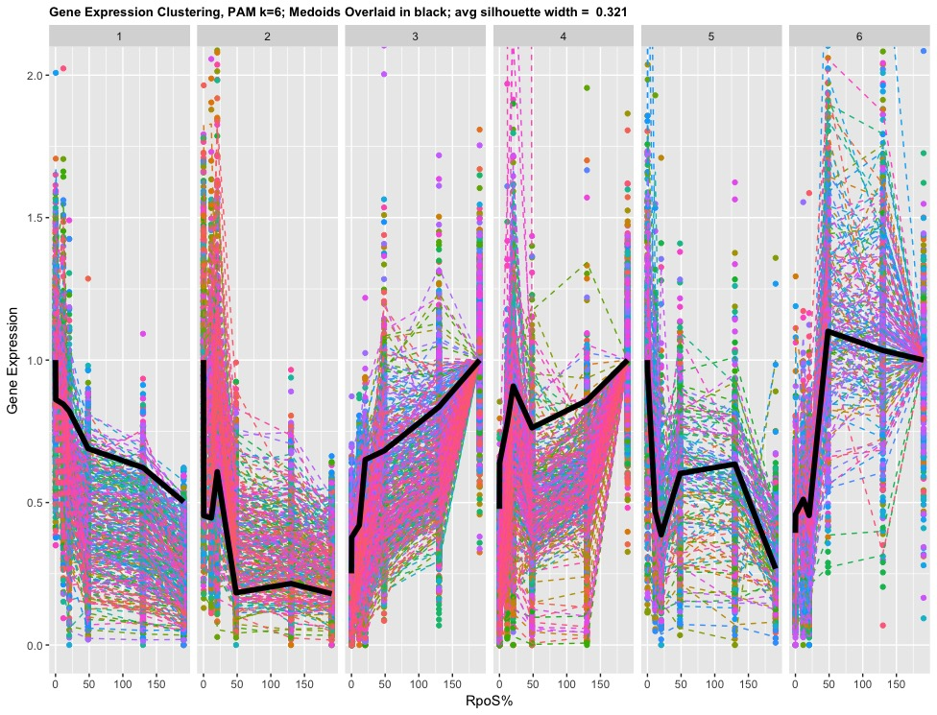
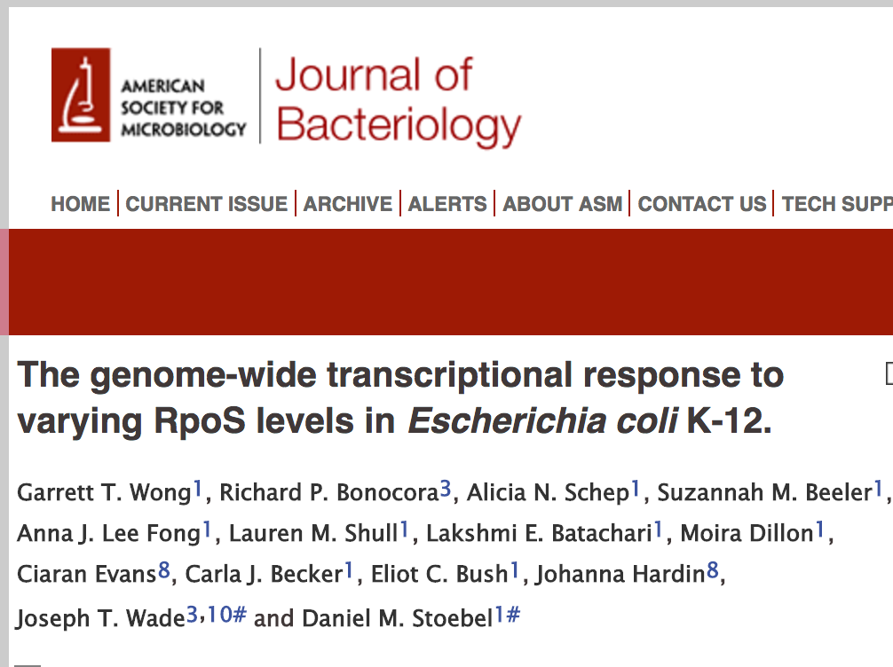
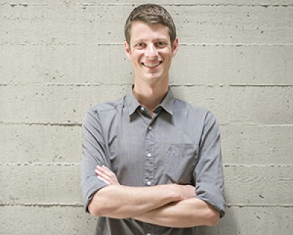
Wrangle Data
dplyr
ggplot
grep
DataCamp
Madison found a potentially important intergenic region

Slide 13
What else?
Become a part of the larger community (e.g., quo() function in dplyr v 0.7.1, June 22, 2017)
Use Git & GitHub (http://happygitwithr.com/ )
Bring your love of research to the classroom to generate excitement.

Slide 14
Thank you!
Jo Hardin
Pomona College
jo.hardin@pomona.edu
@jo_hardin47
Github: hardin47

