Slide 1
Expectations and Skills for Undergraduate Students Doing Research in Statistics and Data Science
Jo Hardin
Pomona College
jo.hardin@pomona.edu
@jo_hardin47
Github: hardin47

Slide 2
Curriculum Guidelines
Statistics
Data science
GAISE

Slide 3
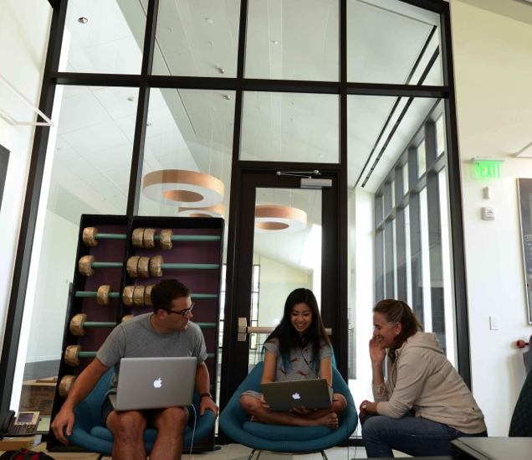
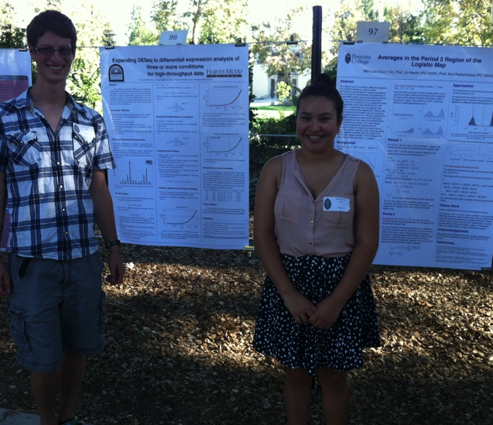
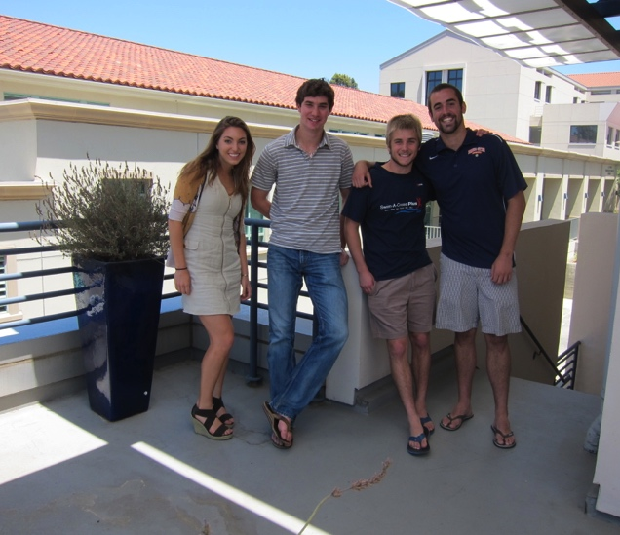
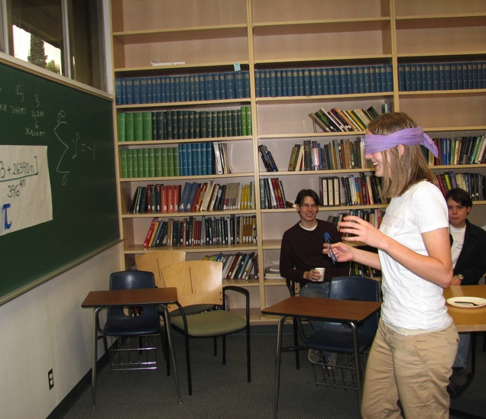
My background
Journals???

Slide 4
Skills
Make an argument
Engage with theory
Work independently
Data wrangle

Slide 5
To-do
I still need to add in examples of my projects as examples for each of the topics I describe below.

Slide 6
Make an Argument
In the Classroom
Theoretical
Simulation
Literature
Hypothesis test using mean and median to demonstrate two different approaches to the same scientific hypothesis
Simulation studies (e.g., bootstrap confidence intervals)
How do we know that? How can we argue that result is better than the other?

Slide 7
Engage with Theory
In the Classroom
Connect theoretical ideas to core principles in statistics
Moment generating function: why do they uniquely determine a distribution?
Simulate theoretical results for visualization of the process.

Slide 8
Work Independently
In the Classroom
What did you do?
Why did you do it?
What is the next step?
What do I still not understand?
Independent projects (peer assessment!)
Reflect on assignments (quickly or in detail)

Slide 9
Wrangle Data
In the Classroom
Data Science
Statistics
Theoretical
Practice, practice, practice
Learn how to problem solve independently.
Data wrangling should happen in every class at every level.

Slide 10
What else?
Becoming a part of the larger community (e.g., quo function in dplyr v 0.7.1, June 22, 2017)
Using Git & GitHub
Bring your love of research to the classroom to generate excitement.

Slide 11
Thank you!
Jo Hardin
Pomona College
jo.hardin@pomona.edu
@jo_hardin47
Github: hardin47

