Slide 1

DATA ENGINEER — TECHNICAL TEST · ARTEFACT
Chicago Taxi
Lakehouse
An end-to-end, orchestrated medallion pipeline that ingests raw taxi trips, cleans and models them, and serves analytics-ready marts — reproducible locally with a single command.
Dagster
PySpark
Apache Iceberg
MinIO
DuckDB
FastAPI
React
Docker
raw → bronze → silver → gold → BI

Slide 2


THE ASSIGNMENT
The brief, in one page
The mission
Imposed stack
Ingest raw trip files into the datalake
Land source data as-is, partitioned
Clean & transform into analytical tables
Type, dedupe, enrich and quality-check
Expose ready-to-use aggregates for BI
Revenue/day, avg trip duration, top pickup zones
Dagster or Airflow for orchestration
Spark / PySpark for processing
Docker Compose — one command, all local
wrvz-psew
~212M
6 months
Chicago Taxi Trips
Socrata SODA API
rows across
2013 – 2023
windowed slice
Jul – Dec 2023
A public dataset far too large to pull whole — so we filter and window it at the API.
Chicago Taxi Lakehouse
02
Notes:
The task: build an orchestrated, reproducible, medallion datalake pipeline on the Chicago Taxi Trips dataset. Imposed: Dagster/Airflow, PySpark, Docker Compose. The dataset is ~212M rows so we window it (Jul–Dec 2023) via the SODA API.

Slide 3
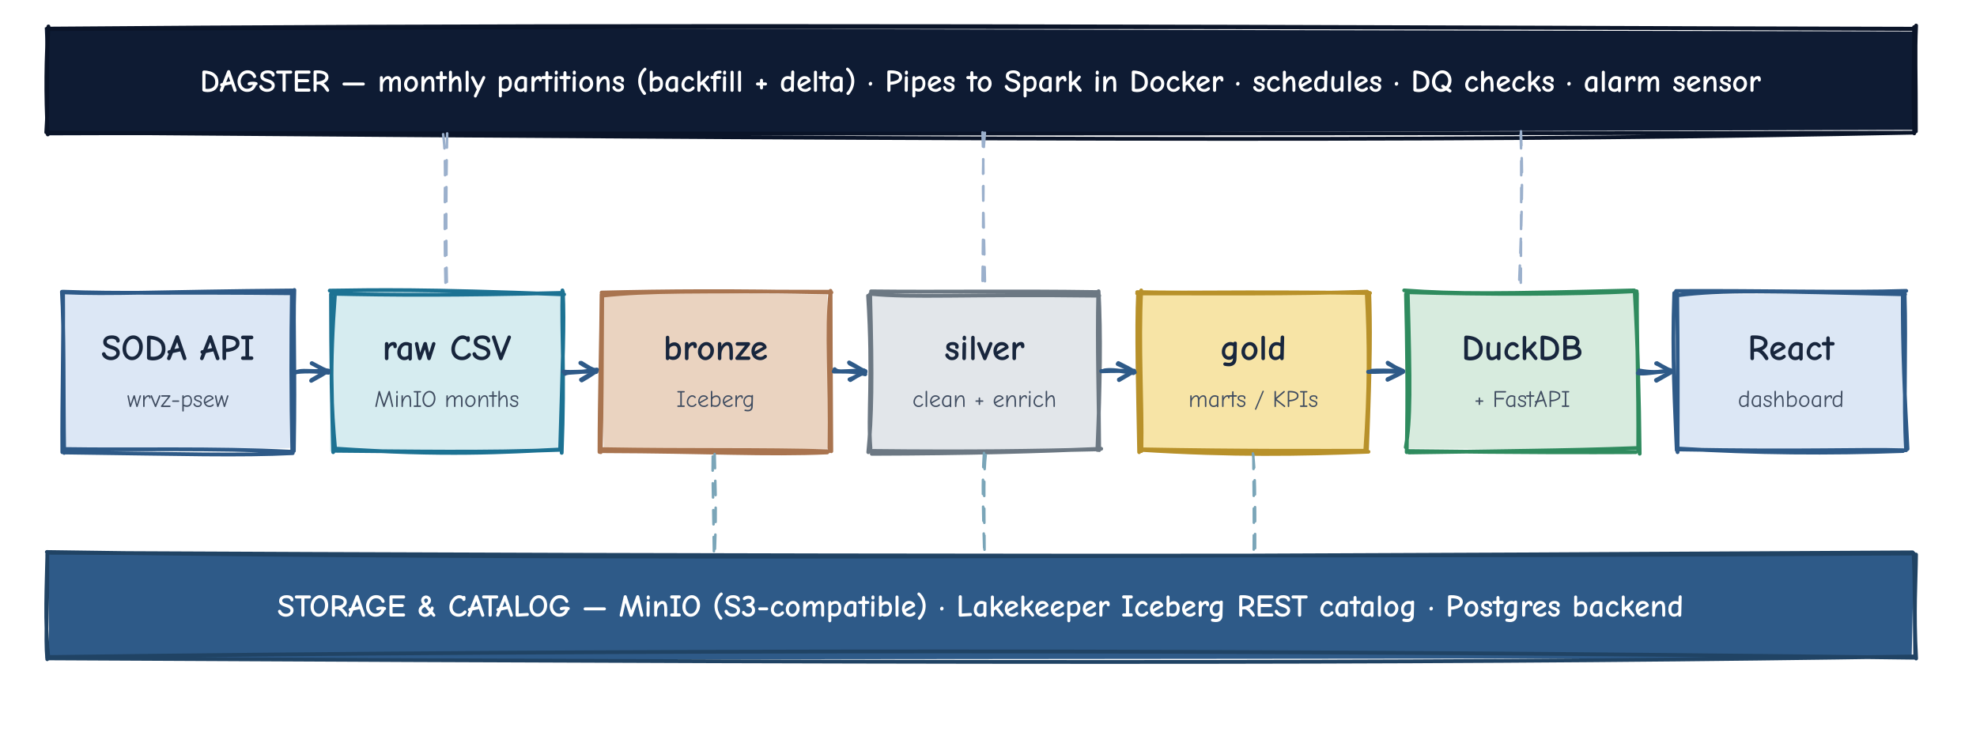
SOLUTION AT A GLANCE
End-to-end architecture
Chicago Taxi Lakehouse
03
Notes:
Dagster (top) orchestrates everything via Pipes, launching Spark jobs in Docker. Flow: SODA API → raw CSV in MinIO → bronze → silver → gold Iceberg tables → DuckDB/FastAPI → React. MinIO + Lakekeeper (REST catalog) + Postgres form the storage/catalog foundation. Swapping MinIO for AWS S3 is config-only.

Slide 4









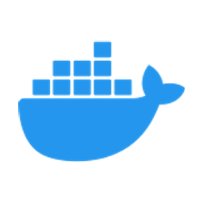
TOOLING
The stack, and why each piece
Dagster
PySpark 4.1.1
Apache Iceberg 1.11
Lakekeeper
MinIO
Asset-based orchestration. Runs natively on the host; launches Spark via Pipes.
Distributed processing for bronze → silver → gold transforms.
Table format: schema evolution, partitions, snapshots, compaction.
Lightweight, JVM-free Iceberg REST catalog — one source of truth.
S3-compatible object store — the datalake floor. Swaps to AWS S3.
Postgres
DuckDB
FastAPI
React + Vite
Docker Compose
Catalog metadata backend behind Lakekeeper.
In-process SQL engine reading gold Iceberg tables for BI.
Thin JSON API exposing gold marts to the dashboard.
Dashboard with Recharts: trends, heatmap, rankings.
One command brings the whole lakehouse up locally.
Chicago Taxi Lakehouse
04
Notes:
Each tool earns its place. Spark is pinned to 4.1.1 because Iceberg has no Spark 4.2 runtime. Lakekeeper is a single Rust binary, JVM-free. DuckDB is read-only BI; all writes stay in Spark.

Slide 5




DESIGN RATIONALE
Four decisions that shape everything
Spark in Docker, pinned to 4.1.1
Monthly partitions give two modes free
Iceberg has no Spark 4.2 runtime, and Windows PySpark workers are buggy. Containerising keeps Java off the host and the engine reproducible.
A partition-range backfill loads history; a scheduled latest-partition run does incremental deltas — same asset, no extra code.
One REST catalog, no dev/prod split
MinIO now, AWS S3 later — config only
Lakekeeper is the single source of truth for both Spark writers and the DuckDB reader — no catalog drift between write and read.
S3-compatible endpoints mean the move to real S3 is endpoint + credentials, with zero code changes to the pipeline.
Chicago Taxi Lakehouse
05
Notes:
These four choices explain most of the architecture: containerised Spark for reproducibility, monthly partitions for dual backfill/delta modes, a single catalog to avoid drift, and object storage that swaps to S3 by config.

Slide 6
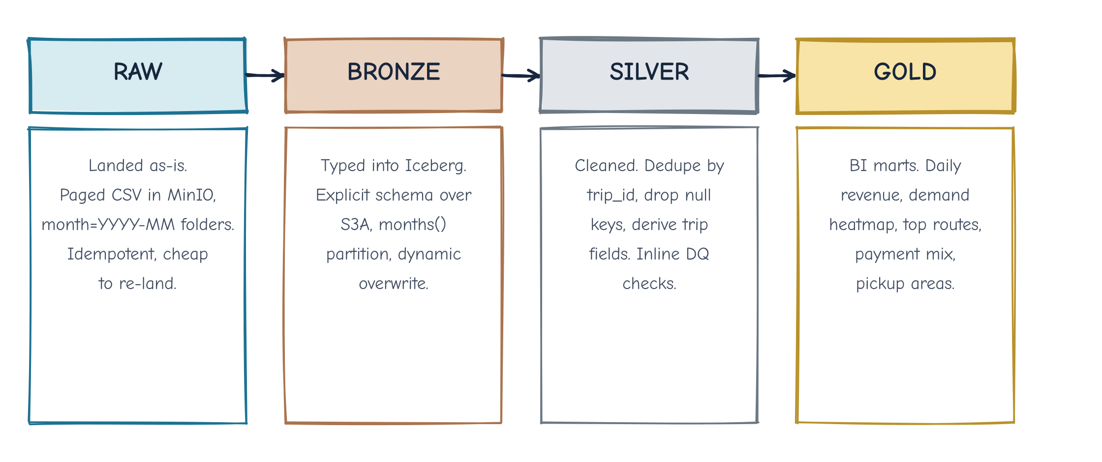
DATA MODELLING
The medallion, layer by layer
Iceberg tables: lakehouse.bronze.taxi_trips · silver.taxi_trips · gold.*
Chicago Taxi Lakehouse
06
Notes:
Four layers. Raw is plain CSV in MinIO. Bronze types it into Iceberg. Silver cleans, dedupes and derives analytical fields. Gold aggregates into BI marts. Each layer is its own Iceberg table, month-partitioned where relevant.

Slide 7
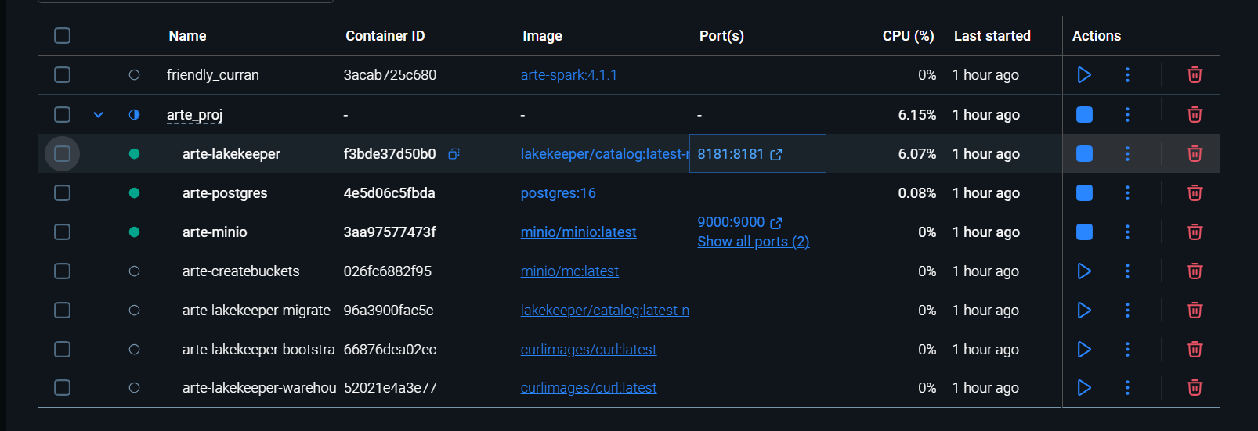
EVIDENCE · INFRASTRUCTURE
One command brings the stack up
docker compose up -d — arte-spark (4.1.1), Lakekeeper, Postgres and MinIO all running, alongside the bucket-create and catalog-bootstrap containers.
Chicago Taxi Lakehouse
07
Notes:
The whole stack comes up with a single docker compose up -d: the Spark image, Lakekeeper (REST catalog), Postgres (catalog backend), MinIO (object store), plus the one-shot bucket/catalog bootstrap containers.

Slide 8
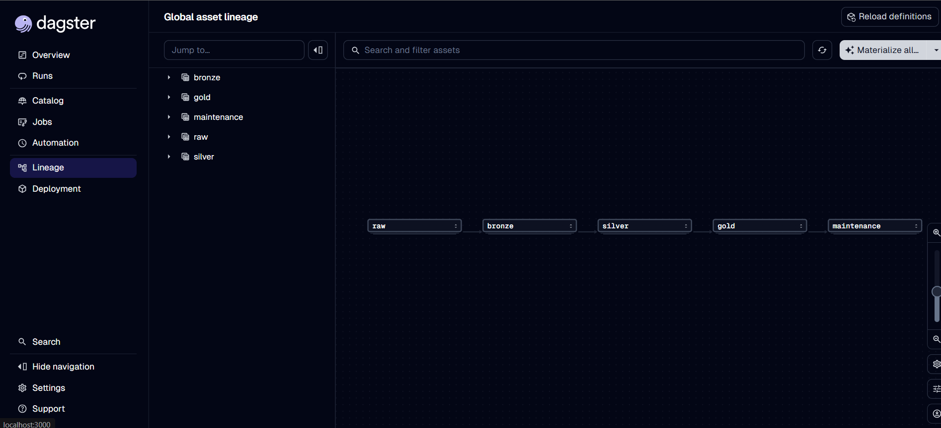
EVIDENCE · ORCHESTRATION
The Dagster asset lineage
The materialized asset graph — raw → bronze → silver → gold → maintenance — the medallion flow wired as Dagster assets.
Chicago Taxi Lakehouse
08
Notes:
The global asset lineage in the Dagster UI shows the pipeline exactly as designed: raw feeds bronze, then silver, then gold, with the maintenance (Iceberg compaction/expire) asset downstream.

Slide 9
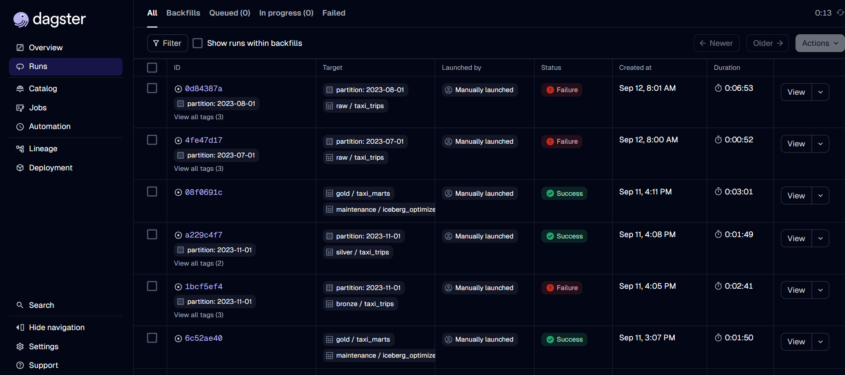
EVIDENCE · ORCHESTRATION
Backfill & incremental runs
Per-partition materializations with status and duration. Failures show up in red and stop the run — surfaced explicitly rather than skipped silently, exactly what the blocking checks are for.
Chicago Taxi Lakehouse
09
Notes:
The Runs view shows per-partition materializations (raw/bronze/silver/gold + maintenance) with durations and Success/Failure status. Failures are surfaced loudly — the intended behaviour of the blocking ERROR checks.

Slide 10
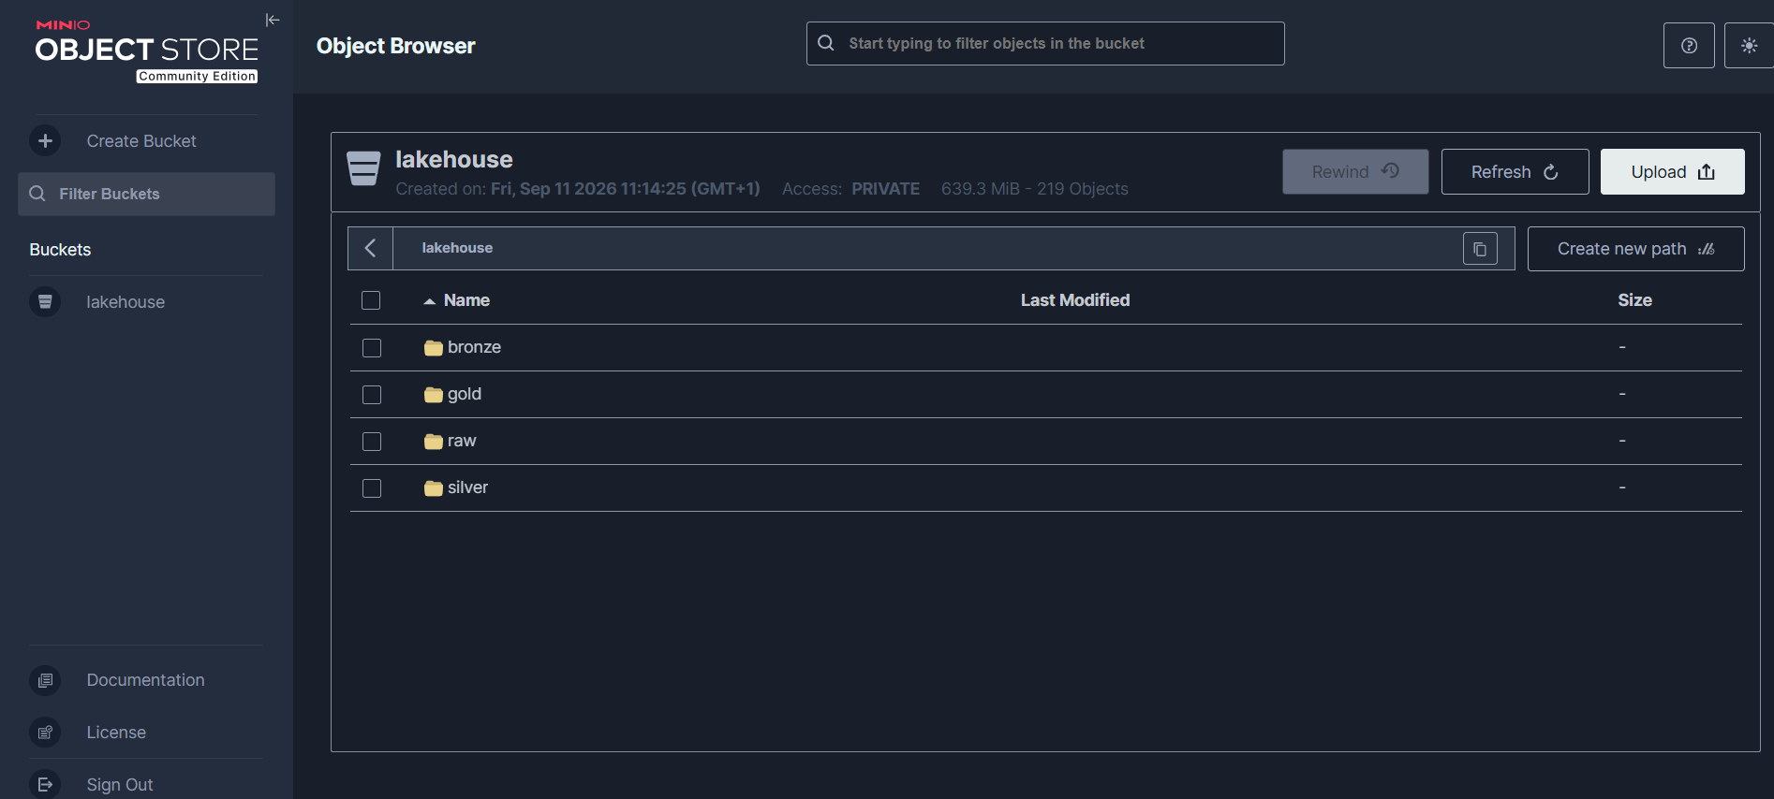
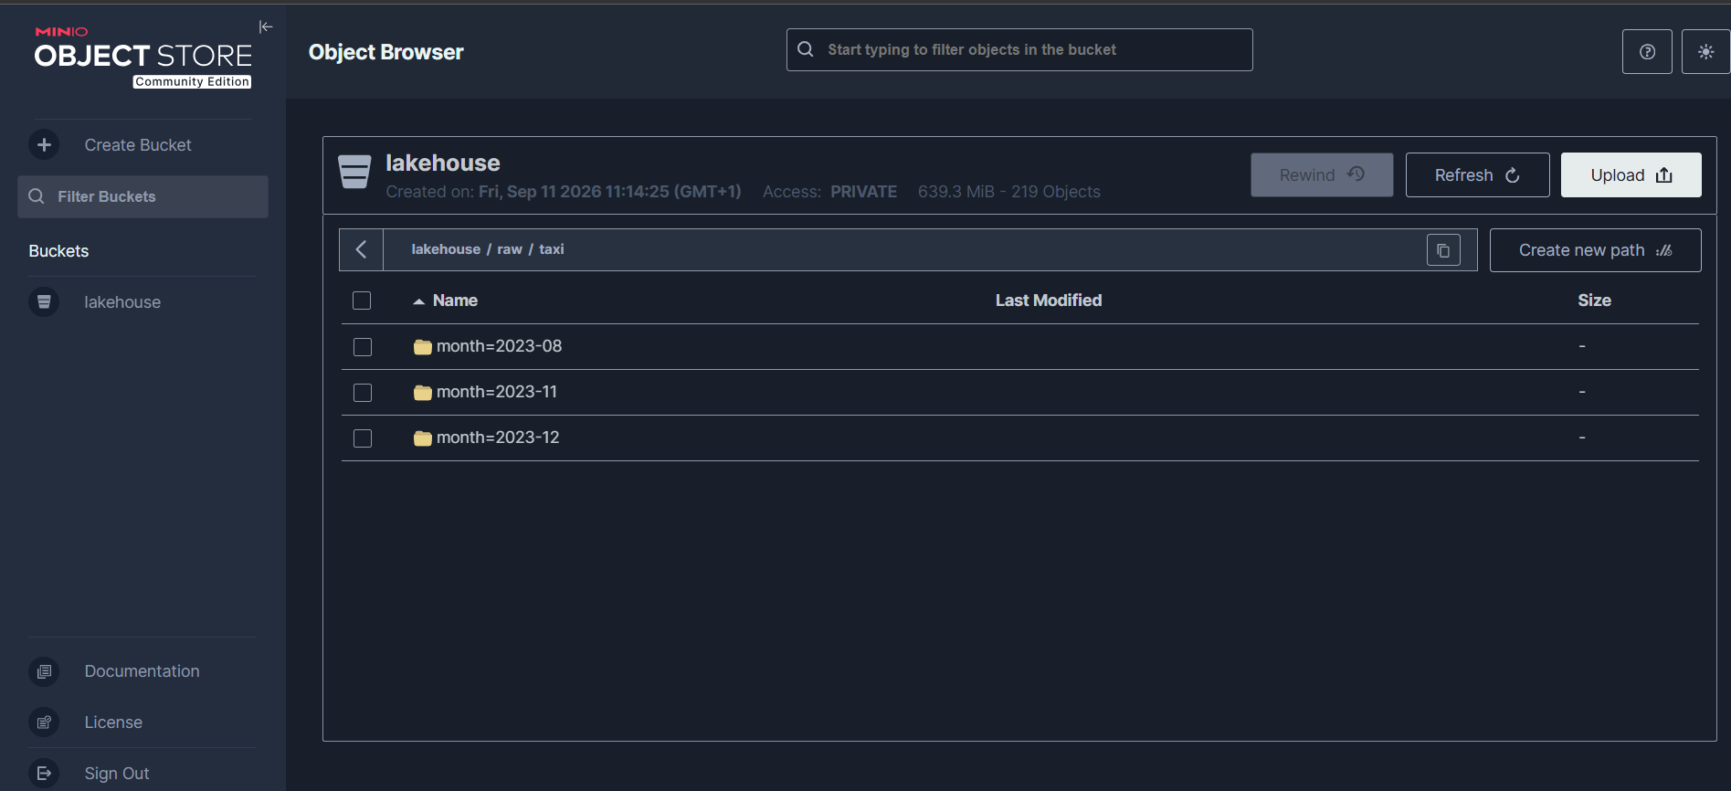
EVIDENCE · STORAGE
Medallion layers in MinIO
The lakehouse bucket — raw / bronze / silver / gold (219 objects).
raw/taxi landed as month=YYYY-MM/ folders — idempotent per month.
Chicago Taxi Lakehouse
10
Notes:
MinIO object browser: the single lakehouse bucket holds the four medallion layers, and the raw layer is physically organised into month=YYYY-MM/ folders — human-inspectable and cheap to re-land.

Slide 11
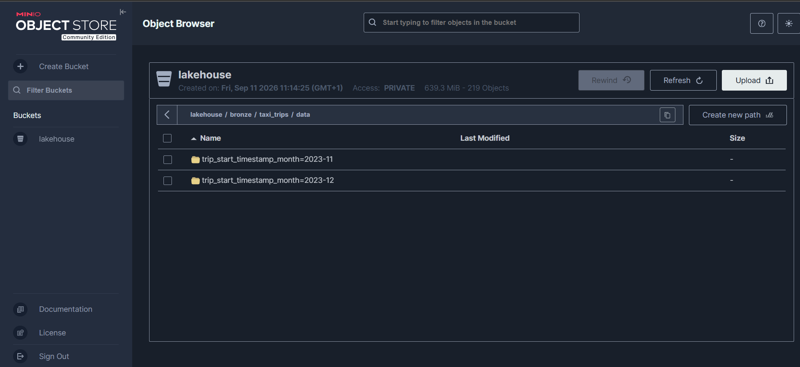
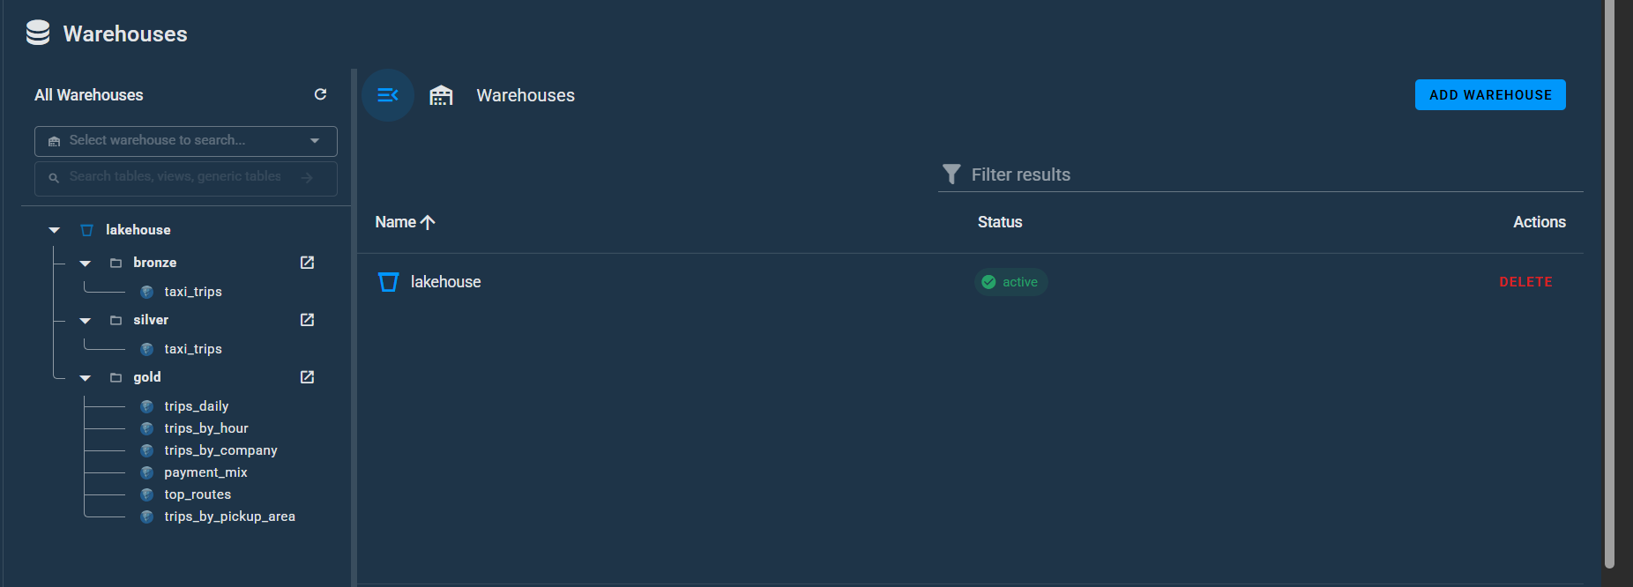
EVIDENCE · STORAGE & CATALOG
Iceberg partitions & the REST catalog
Lakekeeper warehouse — bronze & silver plus all six gold marts, catalog active.
bronze.taxi_trips, physically partitioned by trip_start_timestamp_month.
Chicago Taxi Lakehouse
11
Notes:
Left: the bronze Iceberg table's data partitioned by months(trip_start_timestamp). Right: the Lakekeeper REST catalog listing the bronze/silver tables and all six gold marts under the active lakehouse warehouse — the single source of truth for Spark and DuckDB.

Slide 12
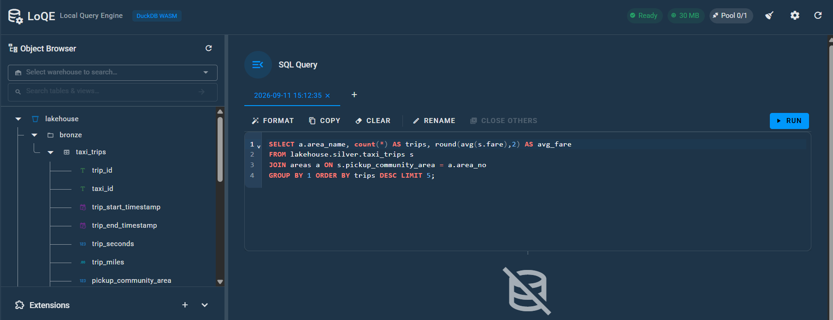
EVIDENCE · QUERY
Querying the lakehouse with DuckDB
DuckDB (local query engine, WASM) reads the Iceberg tables through Lakekeeper — here joining silver.taxi_trips to community areas for the top pickup zones.
Chicago Taxi Lakehouse
12
Notes:
DuckDB queries the gold/silver Iceberg tables directly via the Lakekeeper catalog — the same catalog Spark writes to. The example joins silver trips to the community-area dimension to rank pickup zones.

Slide 13
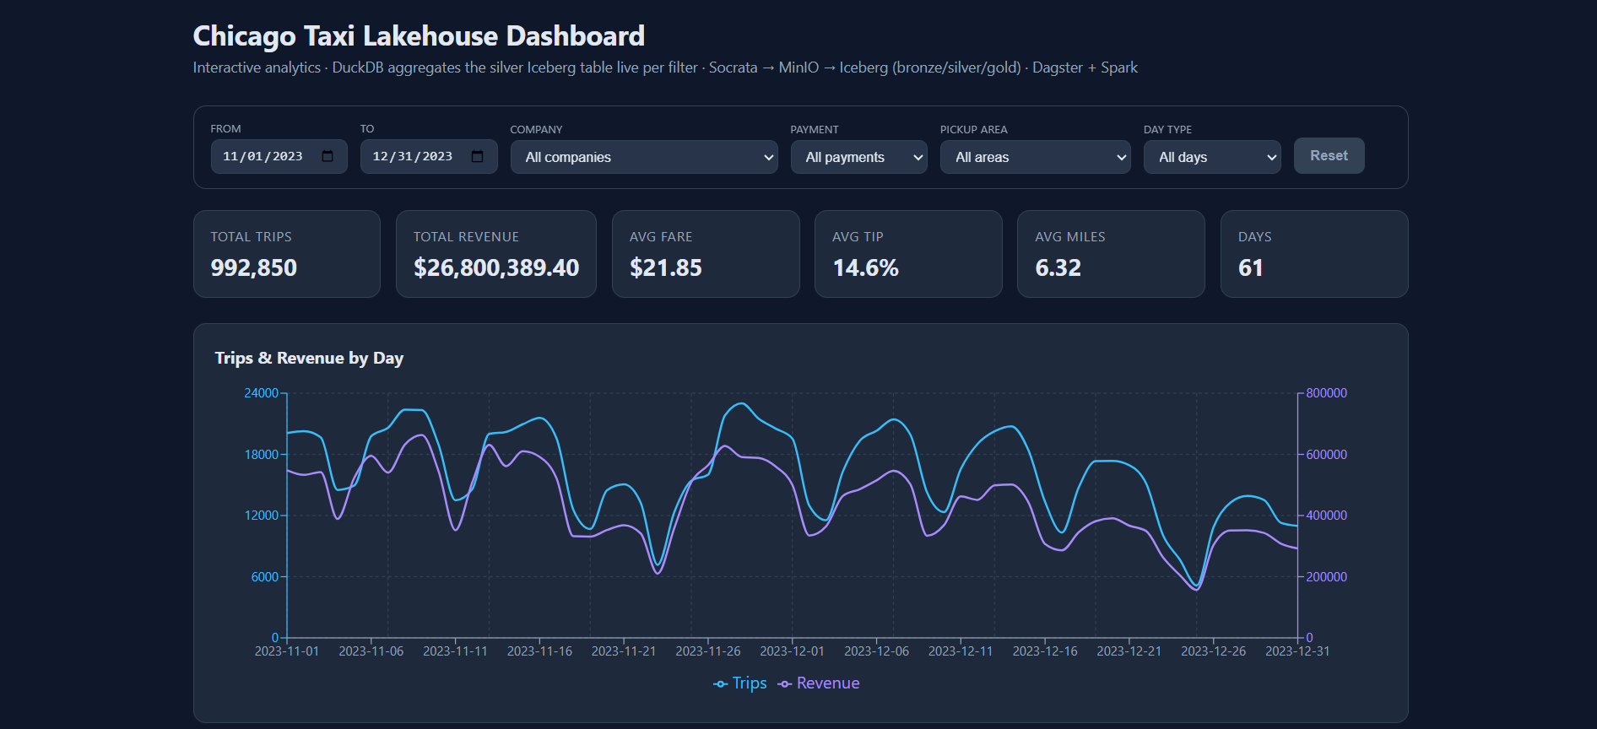
EVIDENCE · BI DASHBOARD
The analytics dashboard
Live KPIs for Nov–Dec 2023 — 992,850 trips · $26.8M revenue · $21.85 avg fare · 14.6% avg tip — with the daily trips-vs-revenue trend. Every filter re-queries DuckDB live.
Chicago Taxi Lakehouse
13
Notes:
The React dashboard's overview: KPI cards and the daily trips vs revenue chart for the loaded Nov–Dec 2023 window. Changing any filter (date, company, payment, area, day type) re-runs the DuckDB aggregation live.

Slide 14
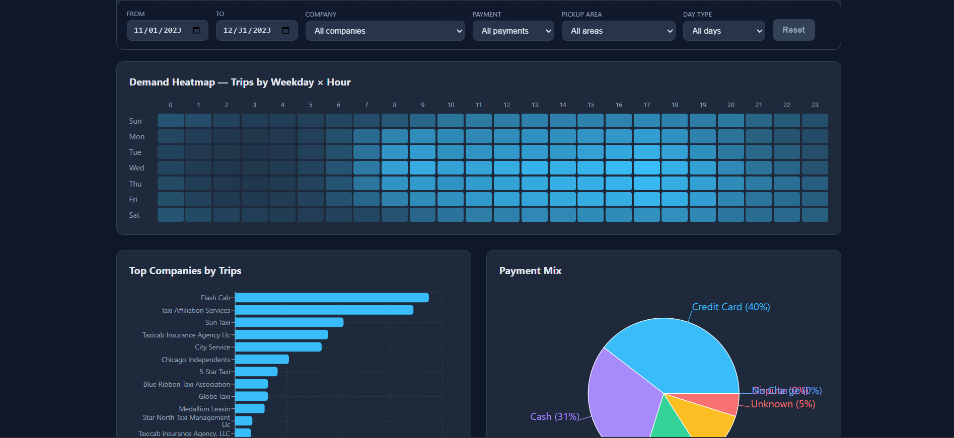
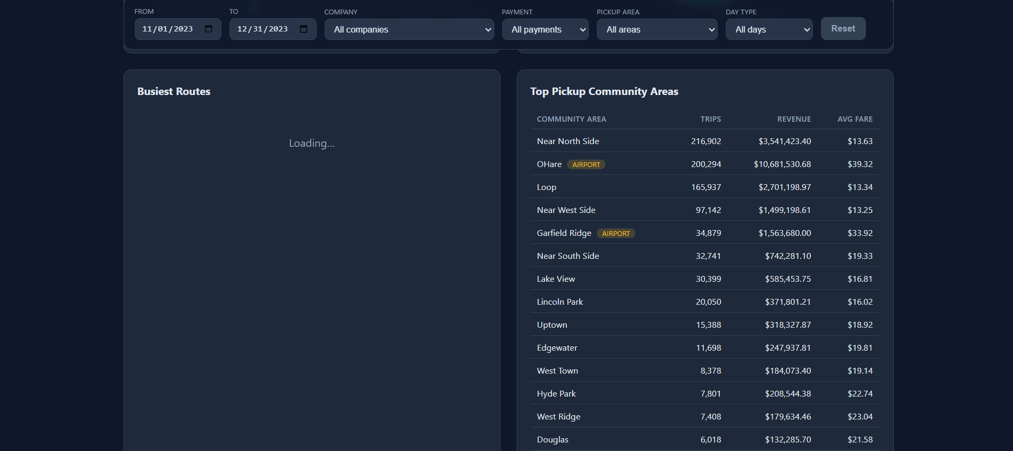
EVIDENCE · BI DASHBOARD
Demand, payment mix & top areas
Weekday × hour demand heatmap, top companies, payment mix (Credit 40% · Cash 31%).
Top pickup areas — O'Hare & Garfield Ridge flagged as airports; Near North Side leads.
Chicago Taxi Lakehouse
14
Notes:
More of the dashboard: the weekday-by-hour demand heatmap, top companies by trips, the payment-type mix, and the top pickup community areas with airport flags (O'Hare, Garfield Ridge/Midway).

Slide 15

INGESTION
SODA API → raw CSV in MinIO
A standalone extractor, separate from Spark
API query
GET /resource/wrvz-psew.csv
$where=trip_start_timestamp
>= START and < END
$select=trip_id, taxi_id, fare …
$limit=50000 &$offset=N
Pure-Python requests + boto3 — no Spark needed to land raw
Pages one month window: $where filters trip_start_timestamp, $select projects only needed columns
$order + $limit=50000 + $offset for stable pagination
X-App-Token header avoids Socrata throttling
Retry / backoff on 429 & 5xx responses
Streams SODA's native .csv straight to MinIO — no JSON→CSV step
Idempotent: deletes the month prefix before writing
Landed layout in MinIO
lakehouse/
└─ raw/taxi/
├─ month=2023-07/part-0000.csv
├─ month=2023-08/part-0000.csv
├─ …
└─ month=2023-12/part-0000.csv
Chicago Taxi Lakehouse
15
Notes:
Ingestion is a standalone Python extractor (requests + boto3), deliberately separate from bronze. It pages the SODA API filtered by month, projects only needed columns, uses an app token, retries on errors, and lands CSV idempotently to month folders in MinIO.

Slide 16



TRANSFORM
Bronze & Silver in Spark
BRONZE — read & type
SILVER — clean & enrich
Spark reads raw CSV over S3A (hadoop-aws) with an explicit StructType — no inferSchema at scale
Writes Iceberg partitioned by months(); dynamic partition overwrite = clean per-month replays
Dedupe by trip_id, drop null-key rows, overwritePartitions back into silver
Derives trip_date, trip_hour, day_of_week, duration_min, speed_mph, tip_pct, is_airport
Derived analytical fields
trip_date
trip_hour
day_of_week
duration_min
speed_mph
tip_pct
is_airport
Real anomalies caught — logged as non-blocking WARN
speed_mph = 101,520
tip_pct = 153.8
The data quality layer flagged impossible values without failing the run — visible in the UI for triage.
physically impossible speed
tip larger than the fare
Chicago Taxi Lakehouse
16
Notes:
Bronze reads raw CSV over S3A with an explicit schema and writes month-partitioned Iceberg via dynamic overwrite. Silver dedupes, drops null keys and derives analytical fields. Quality checks caught genuinely bad rows — e.g. speed_mph of 101,520 and a 153% tip — logged as WARN rather than failing the run.

Slide 17





SERVING LAYER TABLES
Gold marts for the BI team
trips_daily
trips_by_hour
trips_by_company
trips, revenue, avg fare, avg tip %, avg miles, avg duration — by day
hour-of-day × day-of-week demand heatmap
trips, revenue and avg fare per operator
payment_mix
top_routes
trips_by_pickup_area
share of trips by payment_type
pickup → dropoff area pairs, trips, avg fare
trips & revenue per community area (+ airport flags)
Directly answers the brief: revenue per day · average trip duration · top pickup zones
Chicago Taxi Lakehouse
17
Notes:
Six gold marts cover the analytics the brief asked for and more: daily revenue and durations, demand by hour/weekday, company and payment breakdowns, top routes, and pickup-area rankings with airport flags (O'Hare 76, Midway 56).

Slide 18


ORCHESTRATION
One asset graph, two run modes
Backfill — history
Delta — incremental
Materialize a partition range (UI backfill or CLI). Loads any span of months on demand — used for the full 6-month load.
A schedule runs the newest month on a cadence; a weekly lookback re-materializes the last 2 months to absorb late / corrected trips.
Pipes → Docker
Monthly partitions
Maintenance asset
Dagster launches the Spark container per run and streams logs, metadata and materializations back.
raw → bronze → silver are month-partitioned; raw is upstream of bronze; the window is passed as env.
rewrite_data_files, rewrite_manifests, expire_snapshots on silver/gold — scheduled after loads.
Chicago Taxi Lakehouse
18
Notes:
Because assets are monthly-partitioned, the same graph gives a range backfill (history) and a latest-partition schedule (delta) with a lookback for late data. Dagster launches Spark in Docker via Pipes. A maintenance asset compacts Iceberg after loads.

Slide 19
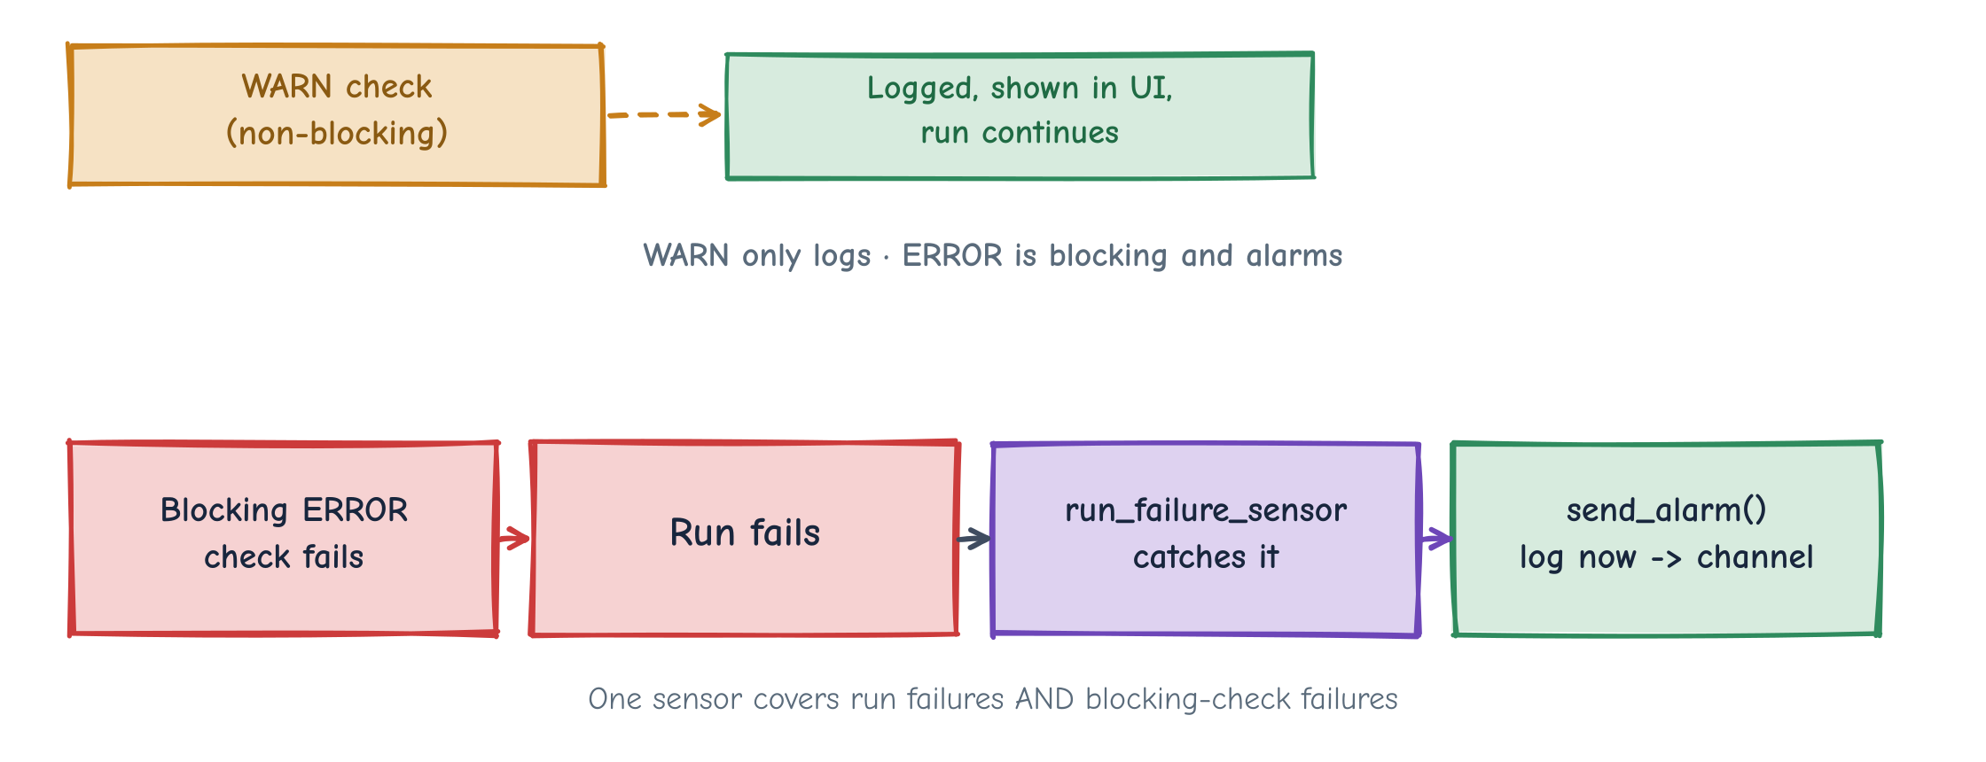

OBSERVABILITY & DATA QUALITY
Every step is logged, timed and checked
Native Dagster: structured logging · timed steps (elapsed) · numeric-metadata trend plots · gold freshness checks
Chicago Taxi Lakehouse
19
Notes:
Observability is fully native Dagster. Two check tiers: WARN (non-blocking, logged and shown) and ERROR (blocking, fails the run). A single run_failure_sensor catches failures and blocking-check failures and calls send_alarm() — currently log-only, with one drop-in point for Teams/Slack/email. Freshness checks flag stale gold.

Slide 20


PERFORMANCE
Partitioning & Spark tuning
Physical layout
Write tuning
months(trip_start_timestamp) partitioning on bronze & silver
Aligns with the monthly job window — avoids tiny-file explosion
raw lands as month=YYYY-MM/ folders in MinIO
hash distribution mode; ~128 MB target files; zstd parquet
WRITE ORDERED BY (trip_start_timestamp, pickup_community_area)
Dynamic partition overwrite for clean per-month replays
Read tuning
Maintenance
Partition pruning + predicate pushdown on date ranges
Explicit StructType — no inferSchema at scale; column projection at the API
Broadcast join for the small community-area dim; AQE on by default
rewrite_data_files + rewrite_manifests compaction
expire_snapshots to keep metadata lean
Scheduled as a Dagster asset after loads
Chicago Taxi Lakehouse
20
Notes:
Iceberg month partitioning matches the job window and prevents small-file explosion. Writes use hash distribution, ~128MB zstd files and sort ordering for data skipping. Reads lean on pruning, pushdown, projection, broadcast joins and AQE. A maintenance asset compacts and expires snapshots.

Slide 21
SERVING
From gold marts to a dashboard
DuckDB
FastAPI
React + Recharts
Reads gold Iceberg tables through Lakekeeper. ACCESS_DELEGATION_MODE 'none' so the MinIO secret is used (avoids 403s). Read-only BI — all writes stay in Spark.
Thin JSON endpoints per mart: /api/summary, /trips-daily, /trips-by-hour, /trips-by-company, /payment-mix, /top-routes, /pickup-areas. CORS on for the Vite dev server.
Daily trips/revenue line, hour × weekday heatmap, company bar, payment pie, top-routes table, pickup-area ranking — fetched via react-query.
One catalog, two consumers. Spark writes and DuckDB reads through the same Lakekeeper REST catalog — no dev/prod split, no drift between write and read.
Chicago Taxi Lakehouse
21
Notes:
DuckDB reads gold Iceberg via the same Lakekeeper catalog Spark writes to, exposed through a small FastAPI service to a React dashboard. The key gotcha: set ACCESS_DELEGATION_MODE 'none' so DuckDB uses the MinIO S3 secret instead of vended credentials.

Slide 22


REPRODUCIBILITY
How to run it locally
Prerequisites
Configure the window
1
Docker Desktop + uv installed. (Optional) a free CHICAGO_DATA_PORTAL_TOKEN in .env to speed extraction.
2
Set the backfill window in .env (e.g. TAXI_BACKFILL_START=2023-07-01). Build the Spark image arte-spark:4.1.1.
Bring infra up
Start Dagster
3
docker compose up -d — starts MinIO, Lakekeeper and Postgres, and creates the warehouse bucket. Idempotent; data persists.
4
run_dagster.ps1 sets DAGSTER_HOME and launches the UI + daemon (asset graph, run timeline, logs, checks).
Materialize the pipeline
Explore the results
5
Backfill the month range raw → bronze → silver, then rebuild gold marts + run Iceberg maintenance.
6
Start FastAPI + the React dashboard; browse marts in MinIO and query them through the API.
Chicago Taxi Lakehouse
22
Notes:
The whole pipeline is reproducible: install Docker + uv, set the window in .env, build the Spark image, docker compose up -d for MinIO/Lakekeeper/Postgres, launch Dagster, backfill the months, then start the API and dashboard.

Slide 23


NEXT STEPS
What I'd do with more time
Full-year (and multi-year) backfill
Wire a real alert channel
Scale the windowed load to the full history; consider daily partitions where finer deltas matter.
Drop a Microsoft Teams / Slack / email webhook into the single send_alarm() point.
CI + automated tests
Data contracts & docs
Unit tests on transforms and the SODA client; a lint/test gate; smoke-test the compose stack in CI.
Formalise schemas and expectations; auto-generate a data dictionary for the marts.
Richer marts & lineage
Cloud deploy
More BI aggregates, column-level lineage, and cost/row trend dashboards over the captured metadata.
Flip MinIO → AWS S3 by config and run the same graph on managed infra.
Chicago Taxi Lakehouse
23
Notes:
With more time: scale to full-year/multi-year backfills, wire a real alert channel into send_alarm(), add CI and tests, formalise data contracts and docs, build richer marts and lineage, and deploy to cloud by flipping MinIO to S3.

Slide 24
IN SUMMARY
A clean, reproducible lakehouse
that actually runs.
Medallion pipeline — raw → bronze → silver → gold — on real Chicago Taxi data
Dagster + PySpark + Iceberg + DuckDB, all up with one docker compose up
Two run modes free from monthly partitions; native DQ, observability & alerting
MinIO today, AWS S3 tomorrow — a config change, not a rewrite
Thank you — happy to walk through the code and the running system.
Notes:
Recap: a reproducible medallion lakehouse on real Chicago Taxi data, orchestrated by Dagster, processed by Spark, stored in Iceberg on MinIO, served by DuckDB/FastAPI to a React dashboard — with native data quality, observability and alerting. Thank you.

