Slide 1

Capstone Project
Alexsandra Guerra
March 2017
Spring Board Data Science Intensive

Slide 2

Introduction
Client
Problem & Needs
The client is Southern California Edison (SCE). SCE’s mission is to provide clean, reliable, and safe power to its residents. In order to meet the clean energy demands of its customers, SCE has many teams and projects aimed to meet the demands for increased solar PV systems by its customers. It is also conducting studies to better understand the adoption of solar PV systems by commercial customers.
SCE research and development engineers will use this analysis on a quarterly basis to keep track of the increase of solar on the grid, and to compare and track performances against other CA IOUs. This analysis will help SCE engineers identify potential partners for demonstration projects.
Objective:
Create script to clean data, analyze and output visualizations to SharePoint Site.

Slide 3

The data used is public record of solar PV installation applications
The data is from California Solar Initiative (click here to access) and is a record of anyone trying to connect their Net-energy-metering (NEM) solar PV system to the grid. The data includes over 111 columns, each row representing one application. The columns of interest in this analysis are listed to the right.
California Distributed Generation Statistics publishes all IOU solar PV net energy metering (NEM) interconnection data from the three large California Investor Owned Utilities (IOUs) which include Pacific Gas & Electric Company (PG&E), Southern California Edison Company (SCE), and San Diego Gas & Electric Company (SDG&E) per CPUC Decision (D.)14-11-001.
Data fields of interest:
Utility (SCE, PGE, SDGE)
Application Status
Installer (like SolarCity)
Application Completed Date
Service ZIP

Slide 4
Project Steps & Process
Data exploration – looked at the data using python summary tools, histograms, and plots. Plotted many different representations and grouping of the data.
Presented to client – feedback from client identified which plots and information was most helpful and met client needs
First iteration of project:
Created data cleaning scripts – this process was the longest part of the project. (see Part 1: Clean Up)
Generated HTML reporting scripts
Presented HTML report and visualization to client – feedback from the client identified data accuracy concerns
Validated data and investigated data insights
Met with client to discuss findings
Second iteration of project
Client asks for new visualization tool – PowerBI in SharePoint
Split up scripts for faster processing and organization – outputs specific dataframes for PowerBI
Created PowerBI queries of dataframe outputs
Created visualizations with PowerBI and new interactive filtering of data set
Presented to client
Identified next steps

Slide 5
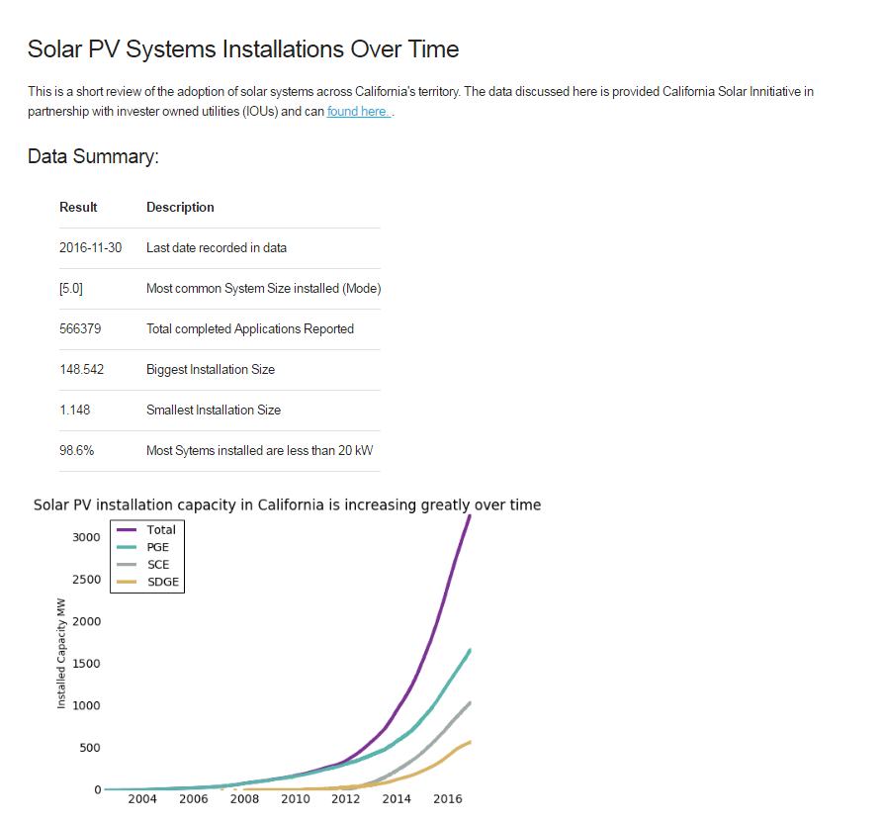
After discussing project with client, the project pivoted and went through a 2nd iteration
1st iteration of project
2nd iteration of project
Python scripts
Python scripts
SharePoint Site
Interactive Visuals
Clean Up,
HTML Output
1. Clean Up
Analysis, & Output
2. Analysis & Output
Power BI Visualization

Slide 6
Data was cleaned & filtered for relevant information
1_clean_and_filter.ipynb
Run to load and clean data. Outputs an excel file to then load into step 2
2_run_analysis.ipynb
This is step 2 that plots and looks at the data and outputs to HTML template for SharePoint Site (using beautilfulSoup)
Limitations of Data:
The data set is limited to the record keeping of the individual utilities that provide the data to CSI. For example, only data that was required after a date was included, so the complete history and total installations is not represented.
App Status: Only applications with status of “installed” were included
Installer: Needed to reformat string values to be consistent (all uppercase)
Duplicates: Dropped duplicates of the application with same APP ID and system size
Erroneous installation data:
Removed the bottom & top 0.5% of data on System Size DC (erroneous)
Removed systems sized larger than 1000 kW in System Size DC
Removed any applications with ‘System Size DC’ as null
Transformed data to time-index
Shrunk dataset by removing over 60 irrelevant and empty columns. This made the data set easier to work with.
Scripts:

Slide 7
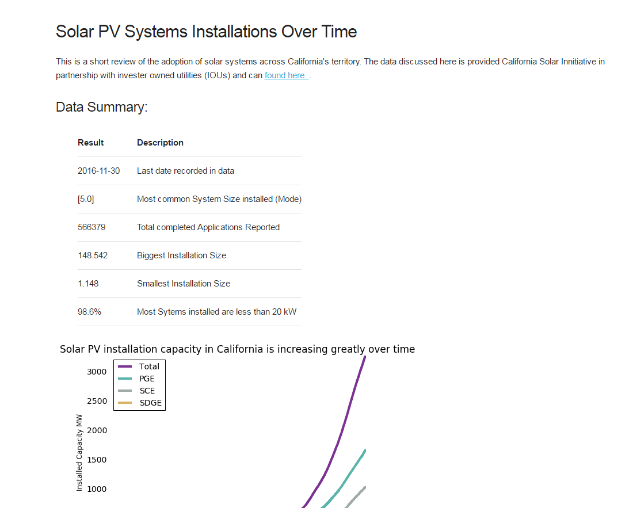
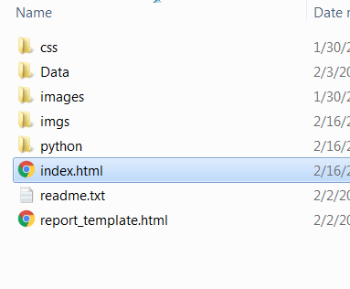
Iteration 1 - results are output to HTML template
Files & Folders:
Web page with plots and statistics tables

Slide 8
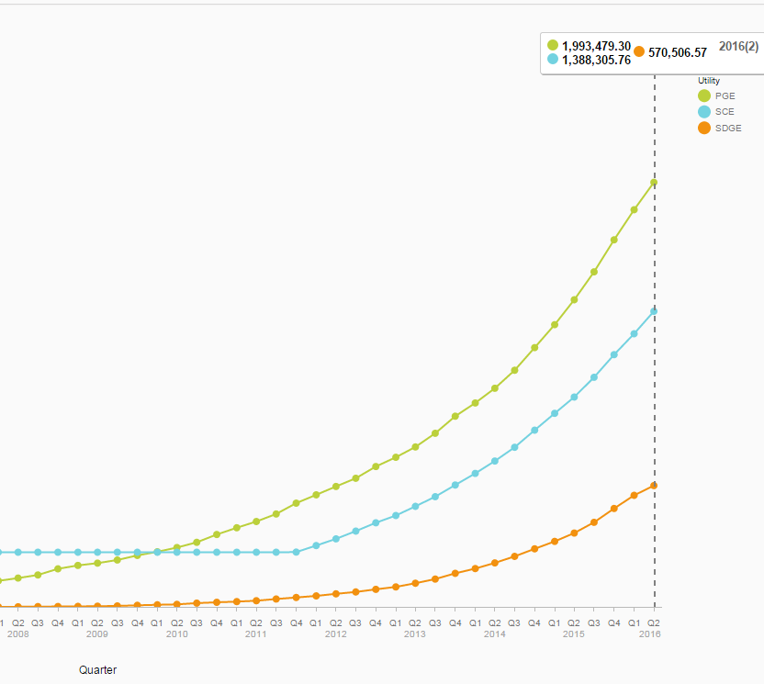
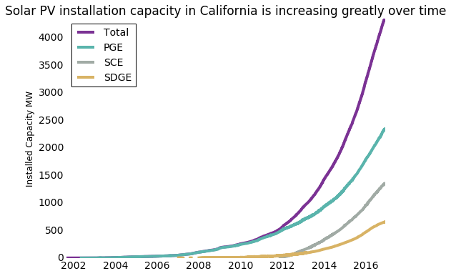
Data Validation: compare to SAP Lumira visualization tool
Python – cumsum()
SAP Lumira
Comaprison to validate that the script & results are making sense
- The results match well

Slide 9
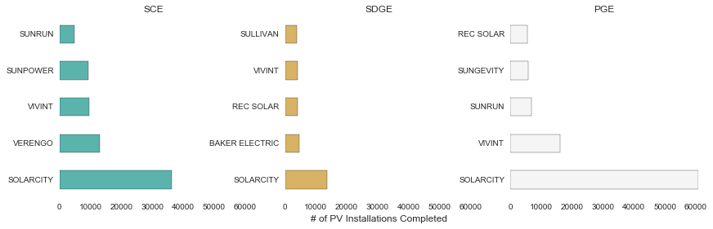
Another Limitation: Variation in spelling of solar installers
SolarCity vs Solar City vs Solarcity
Sunpower Corporation vs Sunpower
SunRUN and REC Inc

Slide 10
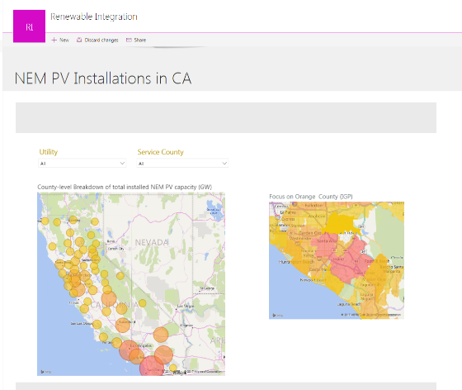
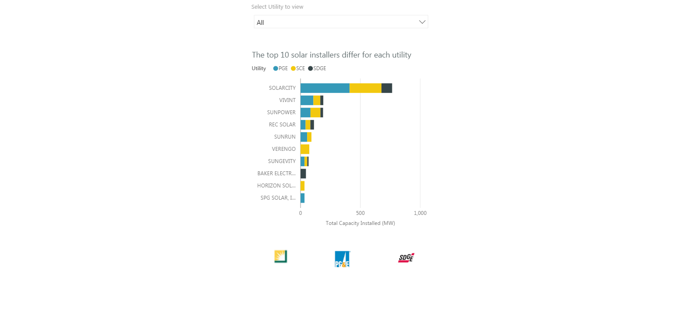
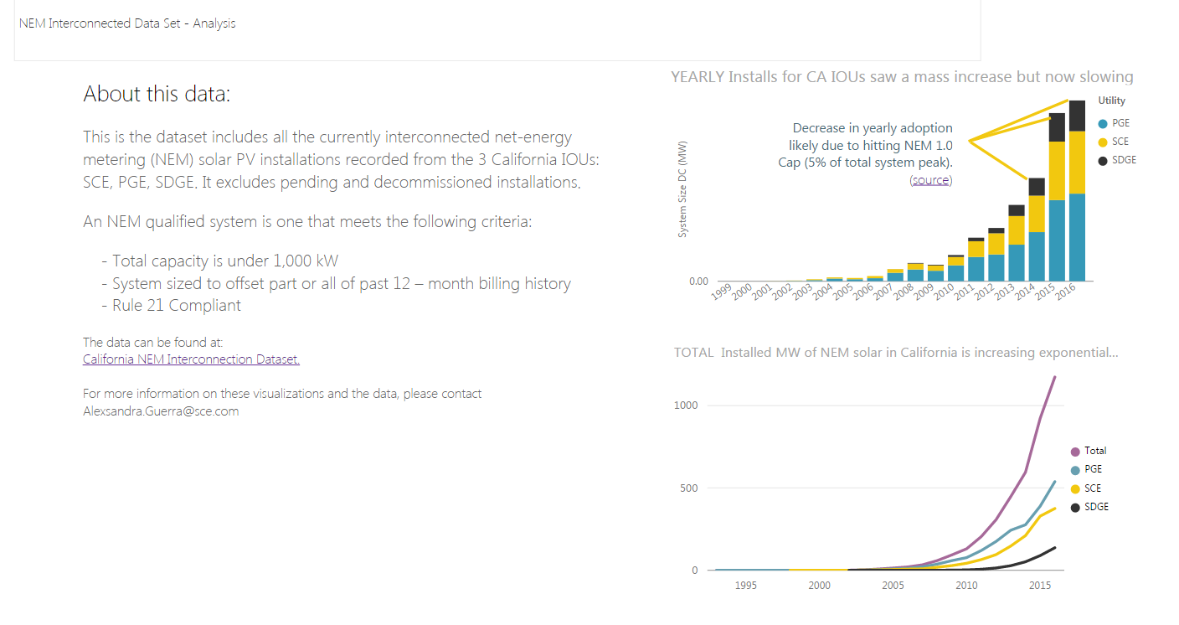
2nd Iteration: PowerBi interactive plots on SharePoint
PowerBI is a useful tool for data analysis and visualization. However, python is a more agile and easier to use tool for data clean up (in my opinion) and so the work that was already done for this project was used to output several summary DataFrames that were then input into the PowerBI software tool. This allowed for quick upload and automatic visualization of the updated data from the python scripts.
< 3 of 3 >
1 of 3 >
< 2 of 3 >

Slide 11
2nd Iteration: PowerBi interactive plots on SharePoint
PowerBI is a useful tool for data analysis and visualization. However, python is a more agile and easier to use tool for data clean up (in my opinion) and so the work that was already done for this project was used to output several summary DataFrames that were then input into the PowerBI software tool. This allowed for quick upload and automatic visualization of the updated data from the python scripts.
< 3 of 3 >
1 of 3 >
< 2 of 3 >

Slide 12
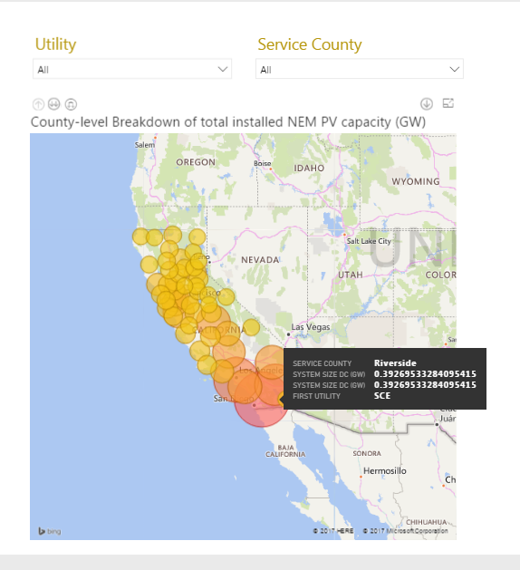
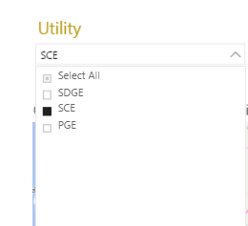
Example of PowerBI Interaction
Can Select which Electric Utility (IOU) to filter the data viewed on the map
Can hover over the bubble to show more details and underlying data. Ex:
Total installed PV capacity
Service County
Utility

Slide 13

Finding: There is a slowdown in adoption of PV, where the rate of change in added solar capacity yearly is decreasing.
NEM 1.0 quotas being met. Regulators set the NEM 1.0 (first version) to cap incentives at 5% of the peak capacity of each utility’s system. NEM 2.0 is now coming into effect. This is likely true for PGE, however SCE has not yet met its NEM limit.
Saturation: The cities and customers who are most likely to adopt PV systems have already adopted and a natural saturation is being met.
Nonetheless, there is still a large growth in NEM installations that can be expected.
http://bit.ly/2c4ZYVL
http://on.sce.com/2onqGPO
1 of 3 >

Slide 14

Finding: Southern counties have the most PV installations
San Diego County has the most solar NEM installations than any other county, Los Angeles being second. However, the dataset does not include LADWP (Los Angeles Department of Water and Power), which is publically owned and does not have to report these installations like the IOUs, and therefore not included in the dataset. Thus, the recorded difference here in Solar PV between these two counties is larger than the actual difference.
While the data set here of IOU installed NEM solar PV systems is only a subset of PV distributed installations in California, it makes up approximately and thus is a reasonable representation of the total California system, as the difference is less than 3%.

Slide 15
Finding: Some solar installers are strong everywhere, others are strong in certain regions
Each utility has its own top installers. In San Diego (San Diego Gas and Electric), the top installers include smaller installers who are not prominent in the larger territories of PGE and SCE, such as: Baker Electric, Sullivan, and Stellar Solar, which are not even in the top 10 installers of SCE or PGE.
Solar City is the strongest player in installing solar systems in California’s large IOUs. It has over 122,000 installations and 760 MW of installed NEM solar, out-performing the runner-up, Vivint, by over 300% which has approx. 33,000 installations and 190 MW of added capacity.

Slide 16
Client Feedback & Next steps
Suggested next steps from client:
Visualize performance of utilities in terms of customer base size and territory size. This would give context to the penetration of PV systems per utility.
Add a page to track installation application turn over time, i.e. the time it take for permitting and approval before the customer can actually connect their system to the grid
Client feedback was positive. Found use for tool internally to:
Identify locations for partner cities in demonstration projects
Track solar installations across utilities for performance tracking
Identify potential partners (installers)
Client asked to share this tool with internal stakeholders:
Other principle project managers
Generation interconnection group that tracks records of installations

