Slide 1
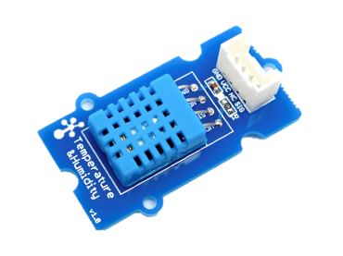
WoT Client (Browser)
WoT Thing (Garage door controller)
Firmware
Thing Description
WoT Interface
Driver API
Local Hardware
1. Action request
2. Action response

Slide 2
Things Directory
(Cloud)
WoT Client (Browser)
Thing Description
WoT Thing (Garage door controller)
Firmware
WoT Interface
Driver API
Local Hardware
1. Action request
2. Action response

Slide 3
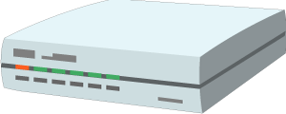
WoT Client (Browser)
Servient (Gateway)
WoT Thing
(Garage door controller)
Firmware
WoT Scripting API
Thing Description
WoT Runtime
Thing Description
WoT Interface
WoT Interface
WoT
Interface
Driver API
Local Hardware
1. Action request
1. Action request
2. Action response
2. Action response

Slide 4
Cloud
Thing Description
WoT Client
(Browser)
Servient (Gateway)
WoT Thing
(Garage door controller)
Firmware
WoT Scripting API
WoT Runtime
Thing Description
WoT Interface
WoT Interface
WoT
Interface
Driver API
Local Hardware
1. Action request
1. Action request
2. Action response
2. Action response

Slide 5
Servient (Single tenant)
Application Script 1
Application Script 2
WoT Scripting API
Generic Servient Security metadata
Thing Description
WoT Runtime
Thing Description
Protocol Bindings
System API
HTTP(S)
CoAP(S)
Local Hardware
Proprietary Communi- cation
…
MQTT
Web Client
Thing
Legacy Device
Servient

Slide 6
Servient (Multi-tenant)
WoT Runtime 1 Security metadata
WoT Runtime 2 Security metadata
Application Script 1
Application Script 2
Application Script 1
Application Script 2
WoT Scripting API
WoT Scripting API
Thing Description
WoT Runtime Instance 1
WoT Runtime Instance 2
Thing Description
WoT Runtime Core
Script Manager
Protocol Bindings
System API
Generic Servient Security metadata
HTTP(S)
CoAP(S)
Local Hardware
Proprietary Communi- cation
…
MQTT
Web Client
Thing
Legacy Device
Servient

