Slide 1
DIGICARE SYSTEM

Slide 2
TABLE OF CONTENTS
01
04
02
05
03
Introduction
Flow Diagram
Problem Statement
Object Diagram and Demo
06
Problem Solution
Future Scope

Slide 3
Digicare System
INTRODUCTION
DigiCare system will assist user in consulting a doctor online and get all the required services such as food, medicine delivery, sanitization, transportation through the system without even getting out of their home thus helping an individual to recover quickly without spreading infection

Slide 4
Problem Statement
According to recent news about 74% of the population in MA getting infected by delta variant are fully vaccinated with every fourth person getting admitted to the hospital.
Covid-19 resulted in massive disruptions in healthcare where people were and are scared of visiting a doctor because of the fear of getting infected.
All professionals switched to work remotely due to this pandemic. Doctors and nurses have been heroes to us, but it is high time to understand and care about their health as well.
It is extremely important to provide services for covid 19 while continuing essential services for non-COVID-19 illnesses.
To rapidly meet the changes of this pandemic, it is essential to replace physical/in-person patient-physician interaction with digital interface to connect all the doctors and nurses from hospitals through a portal.

Slide 5
Problem Solution
GO DIGITAL - Digital system can improve health care by increasing access to healthcare services for individuals. This digicare system will help an individual to maintain their health without visiting a hospital until unless it is a severe case. This health-care system will help a registered user in :
Booking an appointment
Getting tests done
Providing regular nurse visits to home quarantined patients
Providing food services
Providing sanitization services
Providing transport facilities
Keeping a track of beds available in the hospital
Providing medicines at doorstep

Slide 6
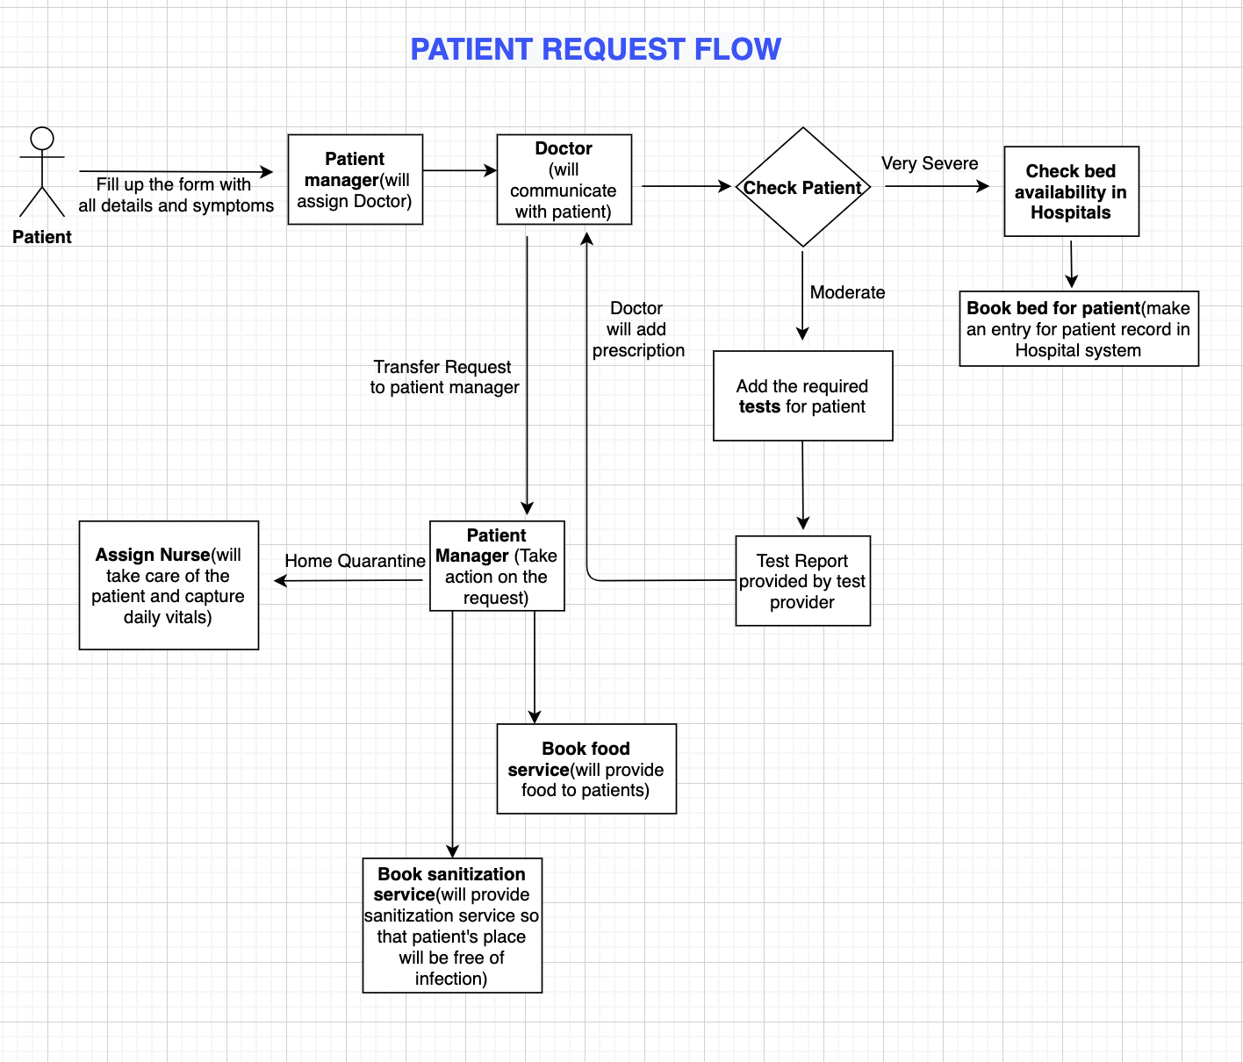
FLOW DIAGRAM

Slide 7
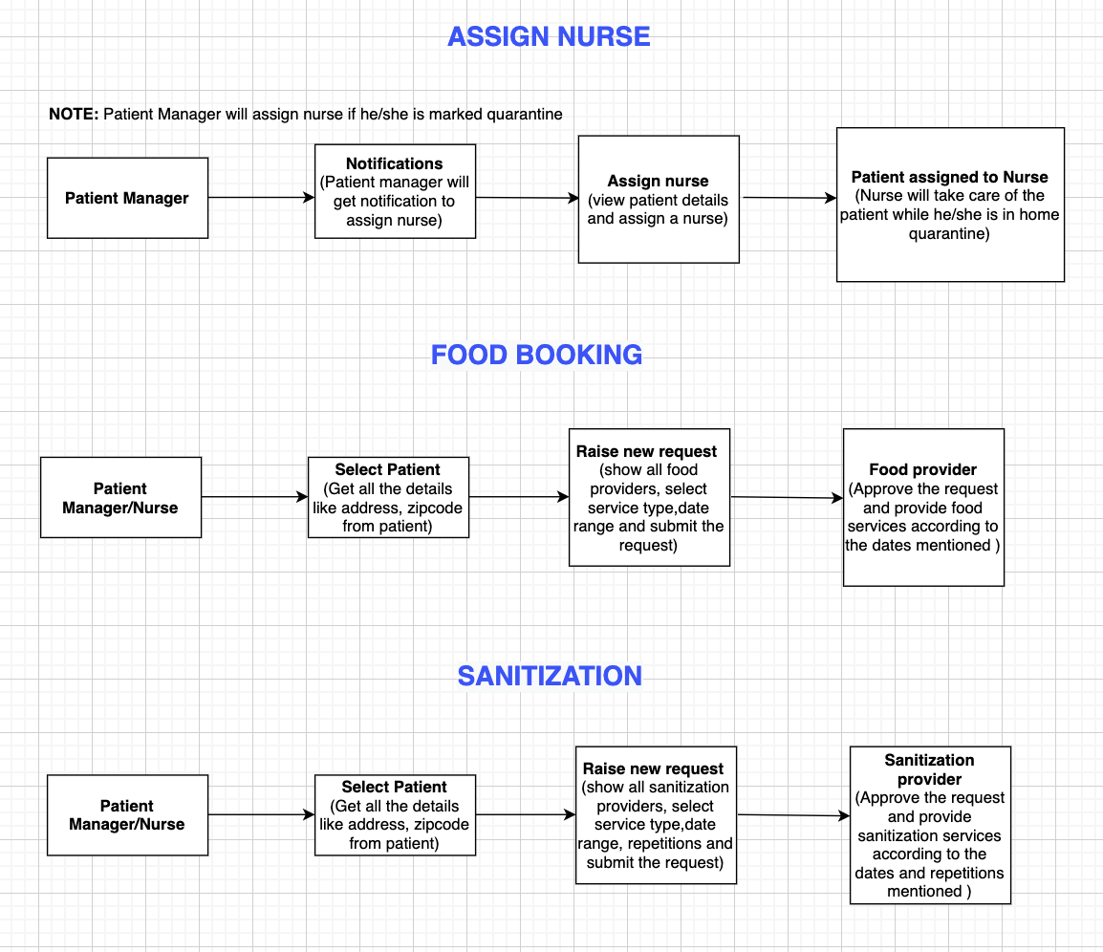
FLOW DIAGRAM

Slide 8
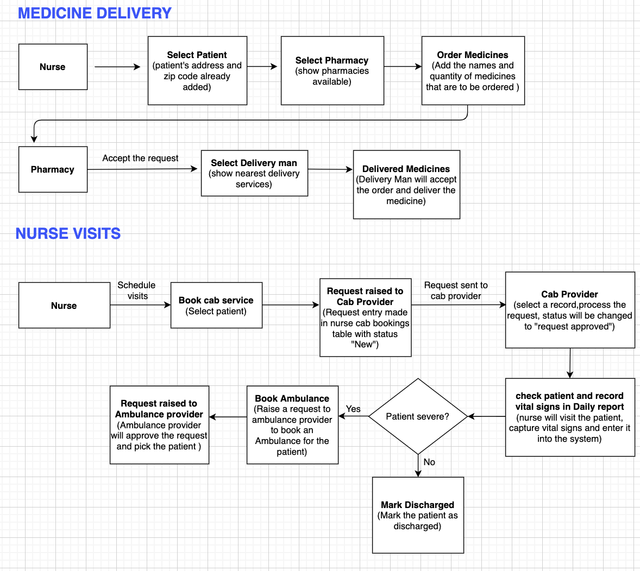
FLOW DIAGRAM

Slide 9
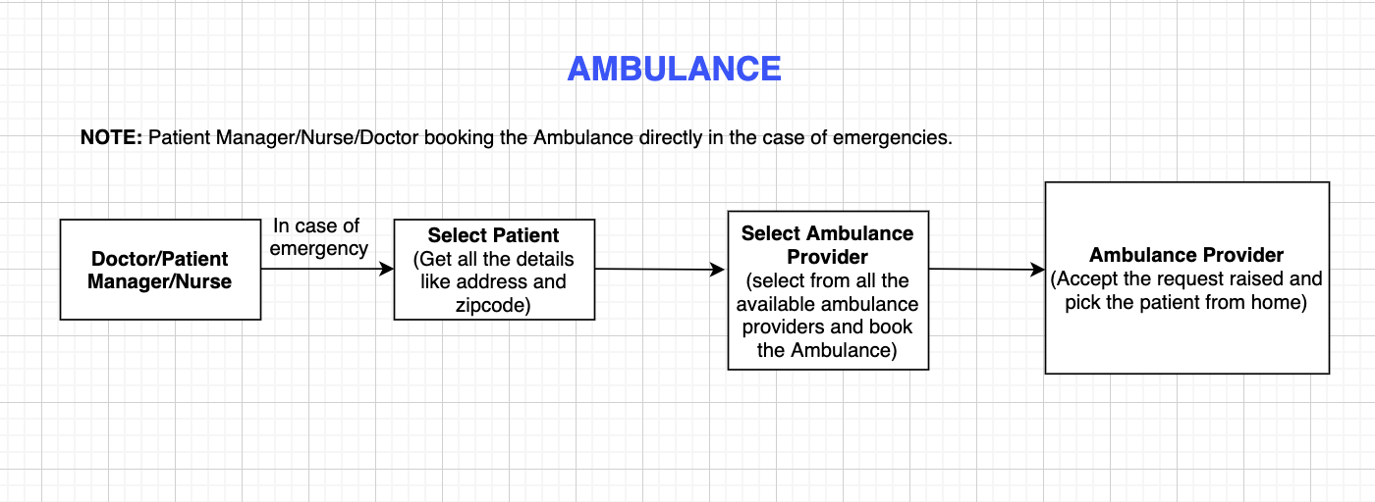
FLOW DIAGRAM
Click to view flow diagram(in Draw.io) :
https://app.diagrams.net/#G1QG0XbT2cMOz-Gx26nH1skZ3zCktGRY4_

Slide 10
OBJECT DIAGRAM
ENTERPRISE:
Hospital Enterprise
Patient Support Enterprise
Testing Enterprise
Necessities Provider Enterprise
Food Supplying Enterprise
Sanitization Enterprise
Transportation Enterprise
ORGANIZATION:
Nurse Organization
Doctor Organization
Patient manager Organization
Testers Organization
Pharmacy Organization
Delivery Man Organization
Food Provider Organization
Sanitization Provider Organization
Cab Provider Organization
Ambulance Provider Organization
Click to view object diagram –
https://app.diagrams.net/#G1RUXU6gF-tZGjFevTyJs5FFC5k6vP1HBj

Slide 11
DEMO
RUN THE PROJECT

Slide 12
FUTURE SCOPE
The system can be further extended to provide trackers to each patient where nurse does not have to visit the patient regularly to capture vital signs.
The health tracker will track the vitals of an individual and will give an alert to the nurse if any of the vital sign is abnormal

Slide 13
THANK YOU

