Slide 1
CS725 Aerial Object Vs. Bird CLASSIFICATION and Detection
The Accurators
Ami Pandat 23v0006 Kshitij Acharya – 23v0011
Faculty Advisor: Prof. Sunita Sarawagi

Slide 2
Background
Enhanced Airspace Safety: Identifying non-bird aerial objects, like drones or other aircraft, is crucial for avoiding collisions and maintaining the safety of air traffic.
Improved Wildlife Conservation: Accurate bird detection helps in monitoring and protecting bird populations, especially in areas where human-made aerial objects frequently operate.
Advancements in Air Traffic Management: Differentiating between birds and aerial objects aids in the development of more sophisticated air traffic control systems, ensuring efficient and safe management of increasingly crowded skies.
National Security and Defense: Detecting and distinguishing aerial objects is vital for national security, helping to identify unauthorized or hostile aircraft in restricted airspace.
Enhanced Data for Environmental Research: Accurate bird detection contributes valuable data for environmental and ecological studies, particularly in assessing the impact of human activities on bird migration and behavior.

Slide 3
PROBLEM
Object DETECTION
Detecting aerial object and birds through image dataset
CLASSIFICATION
Classifying birds and aerial object images
RANDOM FOREST
A robust algorithm to distinguish aerial object and birds
YOLOV5
Deep learning based object detection algorithm

Slide 4
Model selection
Random Forest for Classification
YOLOv5 for Detections:
Robust to Overfitting: Random Forest is less prone to overfitting, especially with large datasets, ensuring more generalizable results.
Handles Non-Linear Data: It can handle non-linear relationships effectively, which might be present in the features extracted from aerial vs. bird images.
Feature Importance: Provides valuable insights into feature importance, helping to understand which characteristics are most significant for differentiating birds from aerial vehicles.
High Performance and Accuracy: YOLOv5 is known for its excellent balance of speed and accuracy in object detection tasks.
Efficient with Large Datasets: YOLOv5 performs well with large and diverse datasets, making it suitable for detecting a wide range of objects.
Scalability: The architecture is scalable, allowing for adjustments based on the complexity.

Slide 5
RANDOM FOREST
Data Acquisition: Collected aerial object images from the VisioDetect dataset and bird images from the COCO dataset.
Data Preprocessing: Selected two types of drones from VisioDetect and a subset of bird images from COCO to address dataset imbalance.
Dataset Balancing: Curated a balanced dataset of 5000 images to prevent model bias toward the majority class.
Dataset Splitting: Divided the dataset into training (85%), validation (9%), and testing (6%) sets.
Feature Extraction: Applied Histogram of Oriented Gradients (HOG) to extract features from each image.
Model Training: A Random Forest classifier was trained on the training set using the extracted features.
Hyperparameter Tuning: Used the validation set to tune the hyperparameters of the Random Forest model.
Model Evaluation: Assessed the model's performance on the test set to evaluate its generalization to new data.
Result Analysis: Analyzed the classification results, including a feature importance assessment and confusion matrix visualization.

Slide 6
Evaluation
Classification Report:
precision recall f1-score support
0 0.86 0.80 0.82 225
1 0.81 0.87 0.84 225
accuracy 0.83 450
macro avg 0.83 0.83 0.83 450
weighted avg 0.83 0.83 0.83 450
Confusion Matrix:
[[179 46]
[ 30 195]]

Slide 7
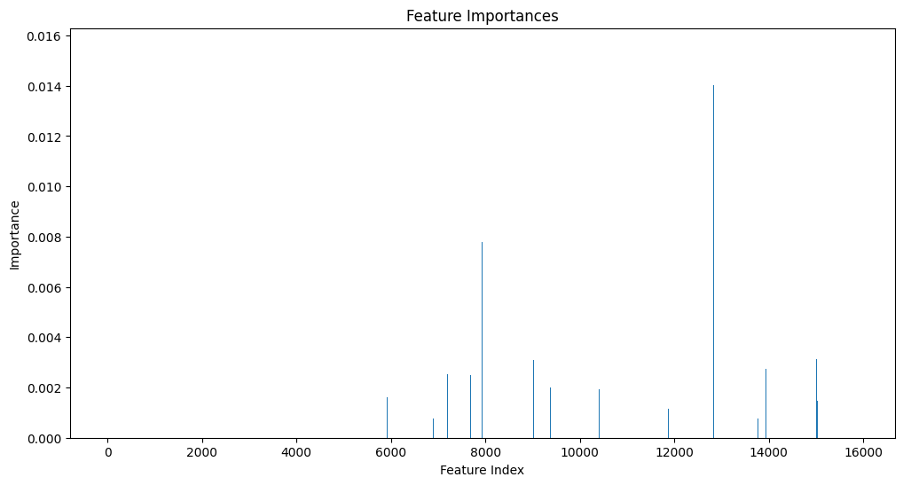
RF Evaluation

Slide 8
YOLOV5
Data Collection: Gathered images of aerial objects from the VisioDetect dataset and bird images from the COCO dataset.
Data Preprocessing: Selected specific types of drones and bird images, creating a balanced dataset to mitigate initial class imbalances.
Dataset Organization: Partitioned the balanced dataset of 5000 images into training (85%), validation (9%), and test (6%) subsets.
Model Configuration: Configured the YOLOv5 model parameters and architecture to suit the binary classification task.
Transfer Learning: Applied transfer learning by using a pre-trained YOLOv5 model to leverage learned features from a large and diverse dataset.
Model Training: Fine-tuned the YOLOv5 model on the training set, adjusting weights to the specific task of detecting birds and aerial objects.
Model Validation: Validated the model using the validation subset to optimize performance and reduce overfitting.
Performance Evaluation: Tested the model's detection capabilities on the unseen test set to assess accuracy, precision, recall, and mAP (mean Average Precision).
Result Interpretation: Interpreted the outcomes, focusing on the detection precision for both classes and analyzing the model's ability to generalize.

Slide 9
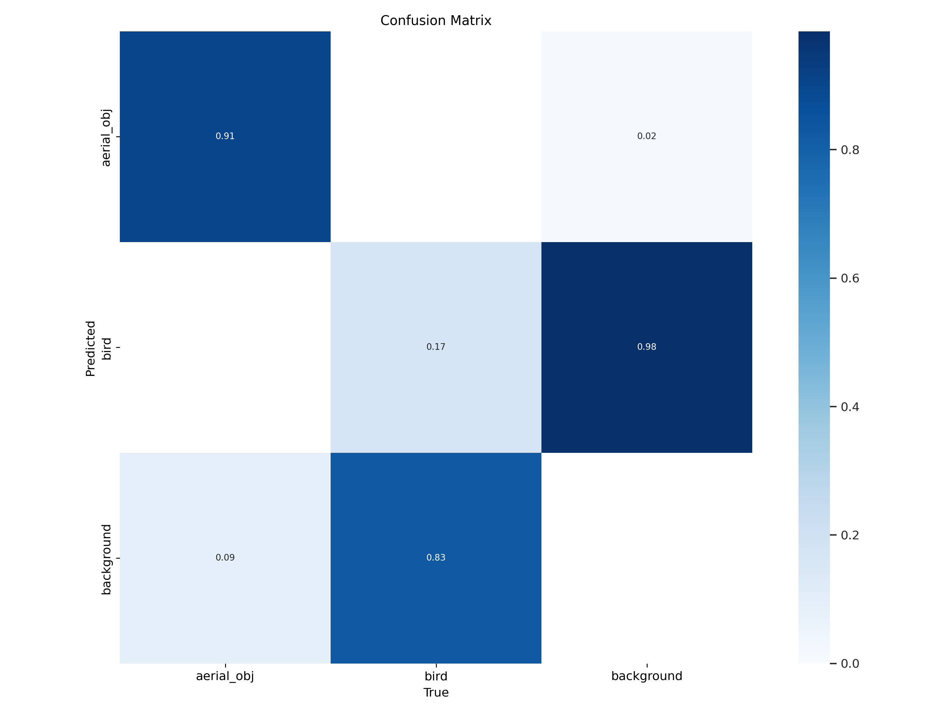
Evalutaion

Slide 10
RANDOM FOREST – YOLOV5
RF
YOLOV5
Proved ideal for image classification with extracted features
Less computationally demanding, and easier to interpret.
Advanced object detection with automatic feature learning
Suitable for larger dataset applications
Requires significant computational power.

Slide 11
SETUP
DATASET
TOOLS
VISIODECT: Drone images dataset
COCO: Bird images dataset
Google colab, Jupyter Notebook
BALANCING DATASET
TRAINING
Balanced dataset manually for 5000 images
Train: 85% Valid:9% Test:6%
Trained for 200 epochs Yolov5s and Random forest

Slide 12
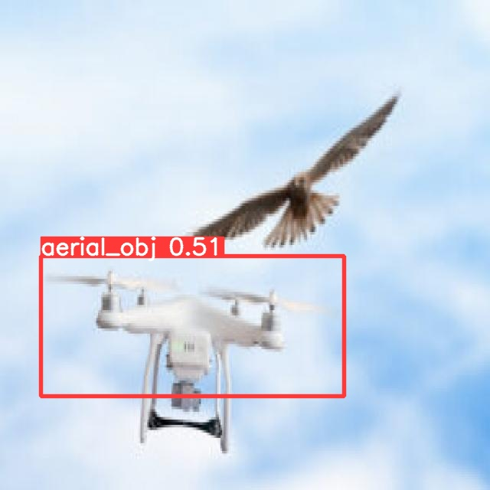
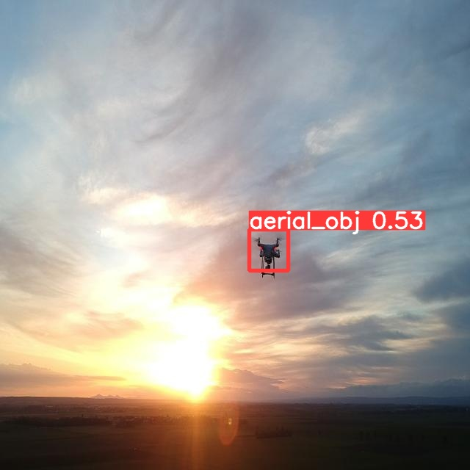
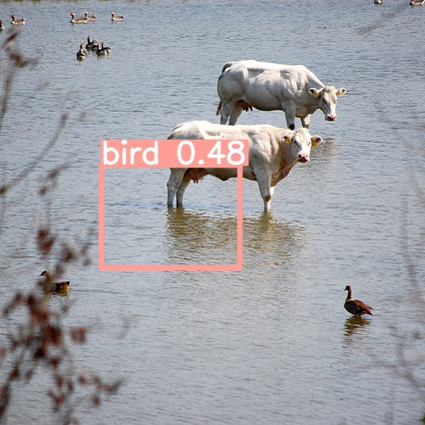
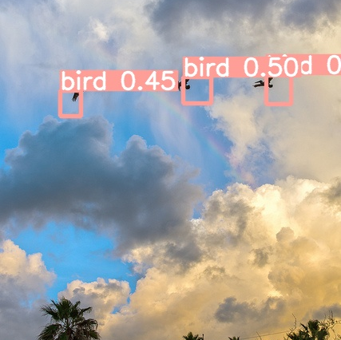
Detection
Correct classification
Correct Classification
Misclassification and detection
Correct classification
Drone but missed Bird
Drone
Bird

Slide 13
Partial detections
Bounding boxes generated by your YOLOv5 model are only partially covering the birds in the images.
Possible reasons
Suggested improvements from literature
Occlusion and Overlapping Objects: Parts of the birds might be occluded or overlapped with other objects, leading to incomplete bounding box predictions.
Limited Training Data: If the dataset used for training is not sufficiently diverse or large, the model may not learn to generalize well across different bird appearances and poses.
Adjustment of Anchor Boxes: Tweaking the size and aspect ratios of anchor boxes in YOLOv5 can help in better fitting the diverse shapes of birds.
Advanced Preprocessing Techniques: Implementing techniques like image segmentation or edge detection as a preprocessing step might help better initial birds’ localization.

Slide 14
TAKEAWAYS
Dataset Imbalance: Initially faced significant class imbalance, affecting model training and accuracy.
Size Discrepancy: Drones were much smaller in image scale compared to birds, posing a challenge in detection accuracy.
Pixel Occupation: Birds occupied a larger pixel area in images, leading to easier detection than the smaller-sized drones.
Background Dependency: The algorithm showed high performance in clear sky backgrounds but struggled with more complex environments.
Detection Limitation: The model's effectiveness was constrained to ideal conditions, limiting its applicability in varied backgrounds.
Need for Data Augmentation: The disparity in object sizes and backgrounds indicates a potential need for advanced data augmentation techniques.
Model Adaptability: Future improvements could focus on enhancing the model's adaptability to diverse backgrounds and object sizes.

Slide 15
FUTURE WORK
DATASET
Size of objects
HYPERPARAMETER TUNING
A balanced dataset with all typed of objects will help improve results
Background for different weather condition might cause problem in this objective
We need to wisely tune the parameters based on requirements
All types of object vary in size of pixels in image
This pixel imformation play vital role in object detection
Bounding box information

Slide 16
THANK YOU

