Slide 1
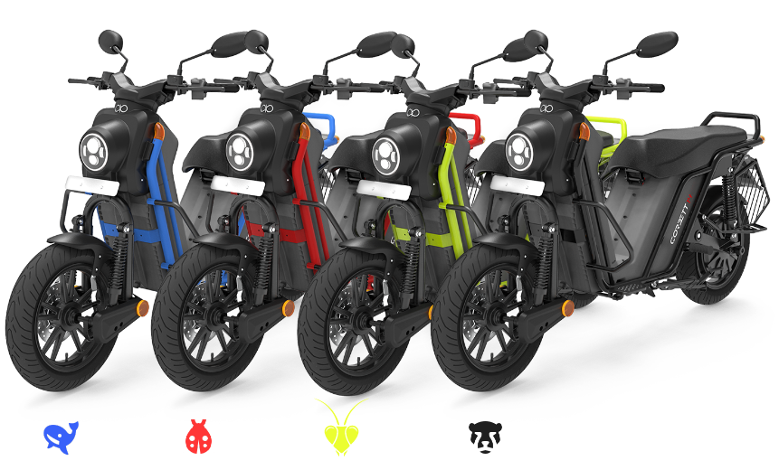

Boom Bikes Sharing
Ami Gandhi

Slide 2



Agenda
Problem Statement
Reading and Understanding the Data
Data Visualization (Univariate Analysis)
Data Preparation
Splitting the Data into Training and Testing Sets
Building a linear model
Residual Analysis of the train Data

Slide 3
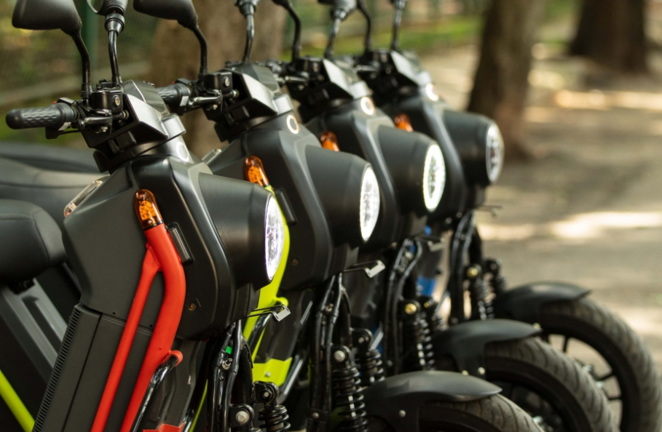
Introduction
A US bike-sharing provider ‘BoomBikes’ has recently suffered considerable dips in its revenues due to the ongoing Corona pandemic. The company is finding it exceedingly difficult to sustain itself in the current market scenario. So, it has decided to produce a mindful business plan to be able to accelerate its revenue as soon as the ongoing lockdown comes to an end, and the economy restores to a healthy state.

Slide 4

Problem Statement:
Which variables are significant in predicting the demand for shared bikes?
How well do those variables describe the bike demands?

Slide 5
Data Visualization Univariate Analysis(barplot) - For Year (0: 2018 and 1:2019)

Slide 6
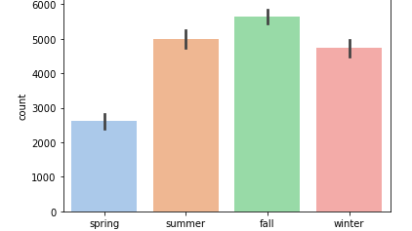
Bar plot for Season

Slide 7
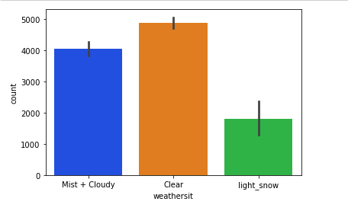
Univariate Analysis (bar plot)
Plot for Weathers

Slide 8
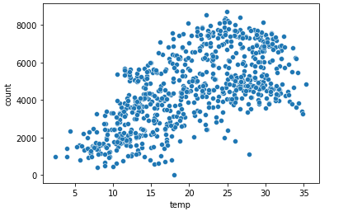
Scatter Plot
Temperature
The count of the bike is higher when the temperature is mostly between 20 to 35 deg. Celsius.

Slide 9
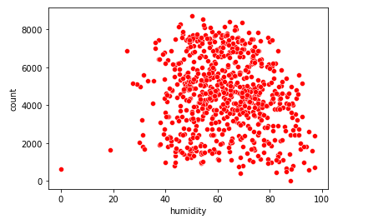
Scatter Plot
Humidity
when humidity is between 60% to 100% people prefer bikes more.

Slide 10

Splitting the data into 'Training' and 'Testing’: - In ML will split the data in a 70-30% ratio.
Rescaling the Features:
Here, all the numeric values are mapped between 0 to 1.
In rescaling, we found our R- square: 0.826 and Adj. R-Squared value: 0.822

Slide 11
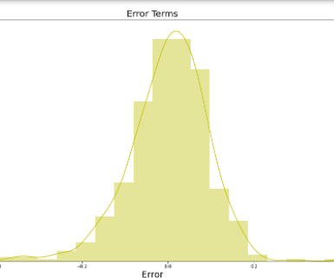
Residual Analysis of the train data
As we can see Error is mostly nearby the 0. or else we can say that Error terms are normally distributed.

Slide 12
Making Predictions
We used the model to make predictions.
R2 score: 0.82
Adjusted R2 score: 0.80

Slide 13
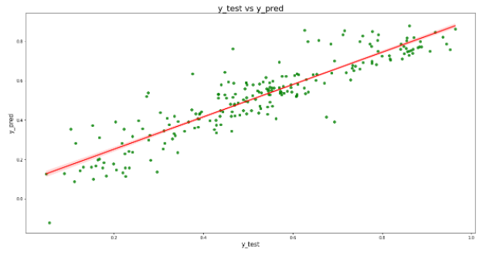
Model Evaluation
Scatter plot to understand the prediction spread.
And Visualising the fit in the test set

Slide 14
Analysis Comparison: Train Model Vs Test Model
Train Data:
R2 score: 0.826
Adjusted R2 Score: 0.822
Test Data:
R2 Score: 0.822
Test Data:
Difference in R2 score :
Between Train Data & Test Data: 1.5%
Adjusted R2 Score: 0.802
Train Data

Slide 15
Final Analysis:
The temperature variable has the highest coefficient of 0.3680, which means if the temperature increases by one unit, the number of bike rentals increases by 0.3680.
There are some variables with negative coefficients. A negative coefficient suggests that the dependent variable tends to decrease as the independent variable increases.
Mist + Cloudy: -0.0799, light snow: -0.3135, spring: -0.1462 has a negative coefficient, which suggests as the independent variable changes have given a one-unit shift in the independent variable while holding other variables in the model constant.

Slide 16

Business Goals:
Temperature could be a prime factor in making the decision for the Organization.
Demand for bikes was higher in 2019 in comparison to 2018.
Demands are high during Working Days, so, provide great offers to the working individuals.

Slide 17


Thank You
Ami Gandhi
amitamakuwala9@gmail.com

