Slide 1
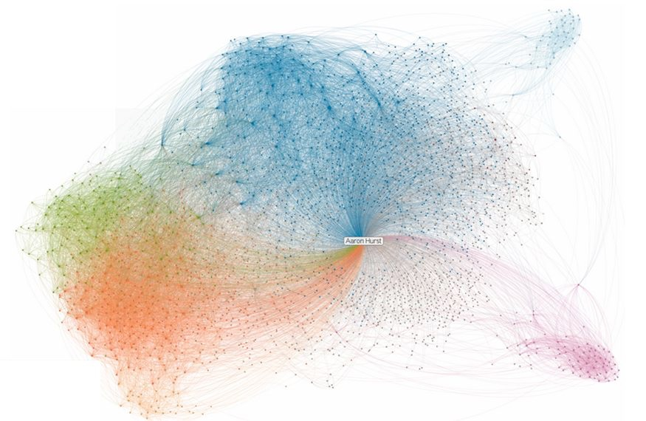
The importance of
a null model
Emma K. Towlson, Louis Shekhtman, Sebastian Ruf, Michael Danziger
Based on slides from R. Sinatra

Slide 2
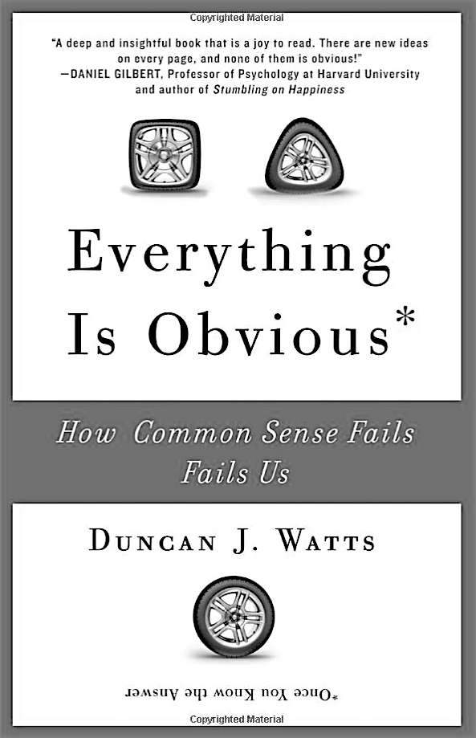
Notes:
Columbia, story of organ donation between austria and germany.
In one was 99% and the other 12% of people that are subscribed as organ donor.

Slide 3
Good science means making comparisons with respect to an expectation

Slide 4
The sad case of Sally Clark
Notes:
See wikipedia

Slide 5
Build an expectation for your measures
...to networks with same N and <k> as your data (ER networks)
Measurement on your network data.
compare...
...to networks with same degree distribution (degree-preserving randomizations, configuration model, ...)

Slide 6


Build an expectation for your measures
Measure, for example, the clustering coefficient
Comparison to ER network
Generate many Erdös-Rényi networks with same N and <k>
In each of them measure the clustering coefficient,
Average the clustering coefficient over all realizations to get a single number

Slide 7


Build an expectation for your measures
Measure, for example, the clustering coefficient
Comparison with networks with same degree sequence
Generate many degree-preserved randomizations (same
degree sequence)
In each of them measure the clustering coefficient,
Average the clustering coefficient over all realizations to get a single number

Slide 8
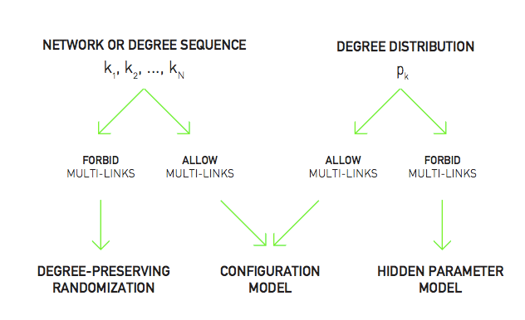
Degree-preserving randomization, configuration model, hidden parameter model?
A.-L. Barabási. (2014). Network Science, Chapter 4.

Slide 9
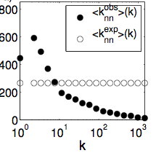


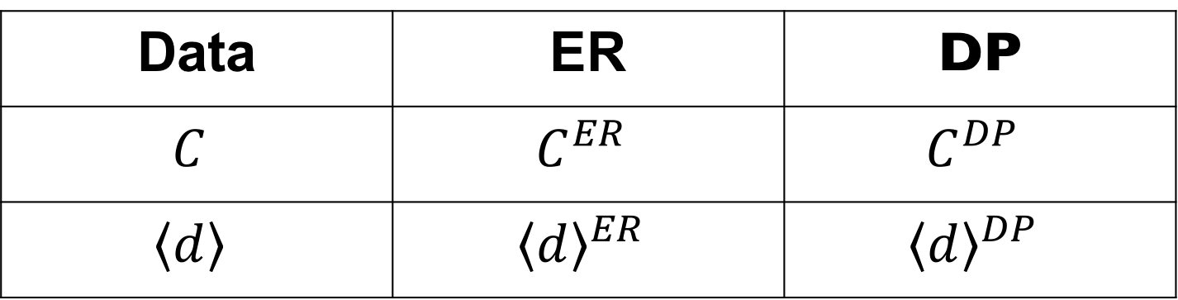
For your final project
Have a table for global quantities, like clustering coefficient, average path length (one network --> one number)
Data | ER | DP
$$C$$ | $$C^{ER}$$ | $$C^{DP}$$
$$\left\langle d\right\rangle$$ | $${\left\langle d\right\rangle }^{ER}$$ | $${\left\langle d\right\rangle }^{DP}$$
Have plots to compare distributions, scaling, etc

Slide 10
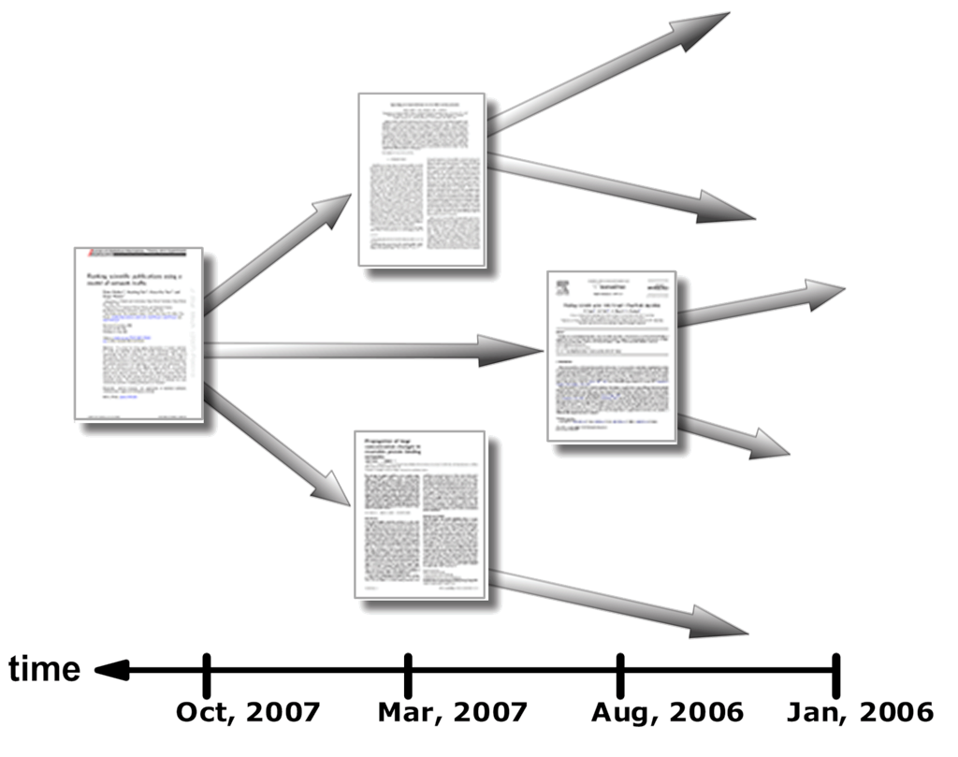
In some cases rewiring (configuration model) is not a good starting point
TIME
citation network
Notes:
ask why they are not good examples of simple rewiring

Slide 11
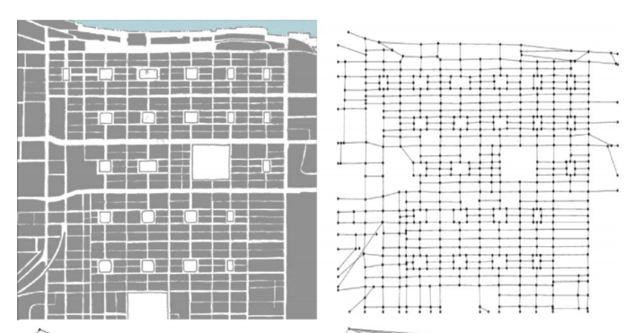
In some cases rewiring (configuration model) is not a good starting point
SPACE
Urban infrastructure

Slide 12
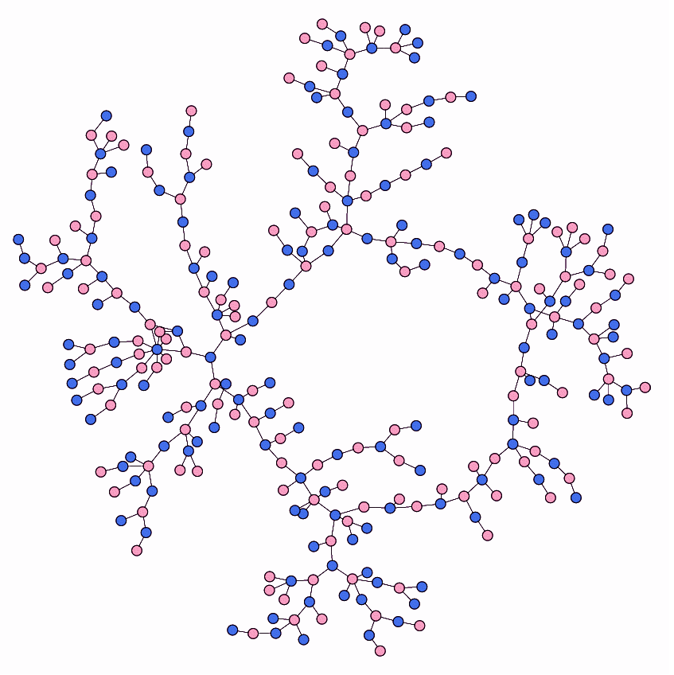
In some cases rewiring (configuration model) is not a good starting point
OTHER NODAL PROPERTIES
e.g. sexual relationships

Slide 13
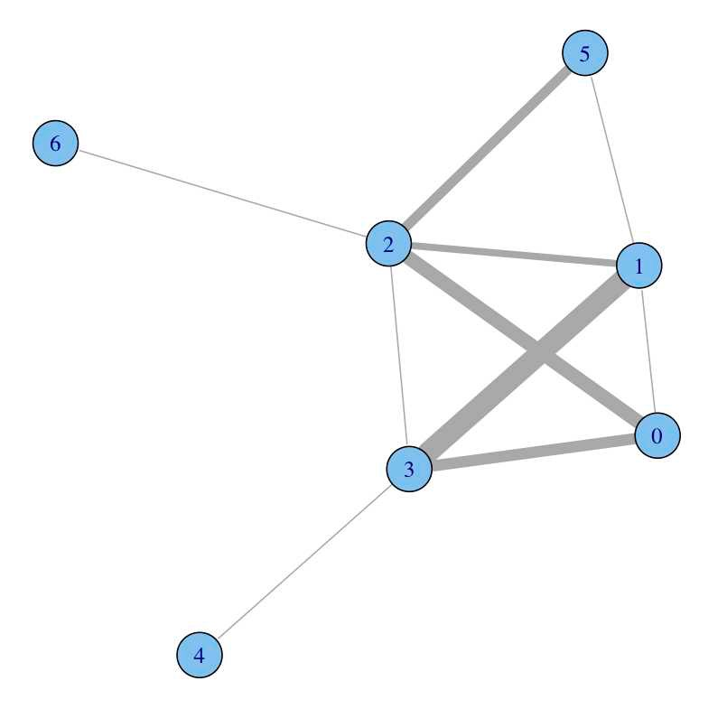
In some cases rewiring (configuration model) is not a good starting point
LINK PROPERTIES
e.g. weighted networks, bipartite networks

Slide 14

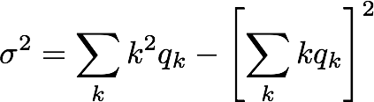
Assortativity coefficient
with
data
null model
In some cases, the null model is built in, but you still have to be aware of which null model that is!

Slide 15
Github
For your final projects, you’re expected to put the code and findings on github.
https://github.com/

Slide 16
‘Fake’ Github
First you have to make an account at github.com
After you sign in, there is a ‘Start a Project’ link you can click on. Then fill out the ‘repository name’ and click create repository
After creating the repository, you’ll see something to ‘upload an existing file’ which you can use to upload your jupyter notebooks and any other files you may need to add.
I’d also suggest adding a README.md (which will show up as the title and information on your project page).

Slide 17
Basics of ‘Real’ Github
git clone [address] – this will download/clone a github to your local computer
git add [filename] – this will add a file to be maintained in the github
git commit [filename] – this will ‘commit’ or save the versions of the current files
git push – this will push all commits to the github
git pull – this will download the latest version of all files
This is very commonly used in software engineering projects

Slide 18
Github Recommendations
Make a separate folder for all raw data files
Make a folder for pre-processed files
Add modules/code in an easy to understand format e.g. perhaps in a folder or if its just one file then perhaps as a standalone
Add a README.md file to make it easy to understand your project and the layout of the folders (this will render on the homepage of your github project)

