Slide 1
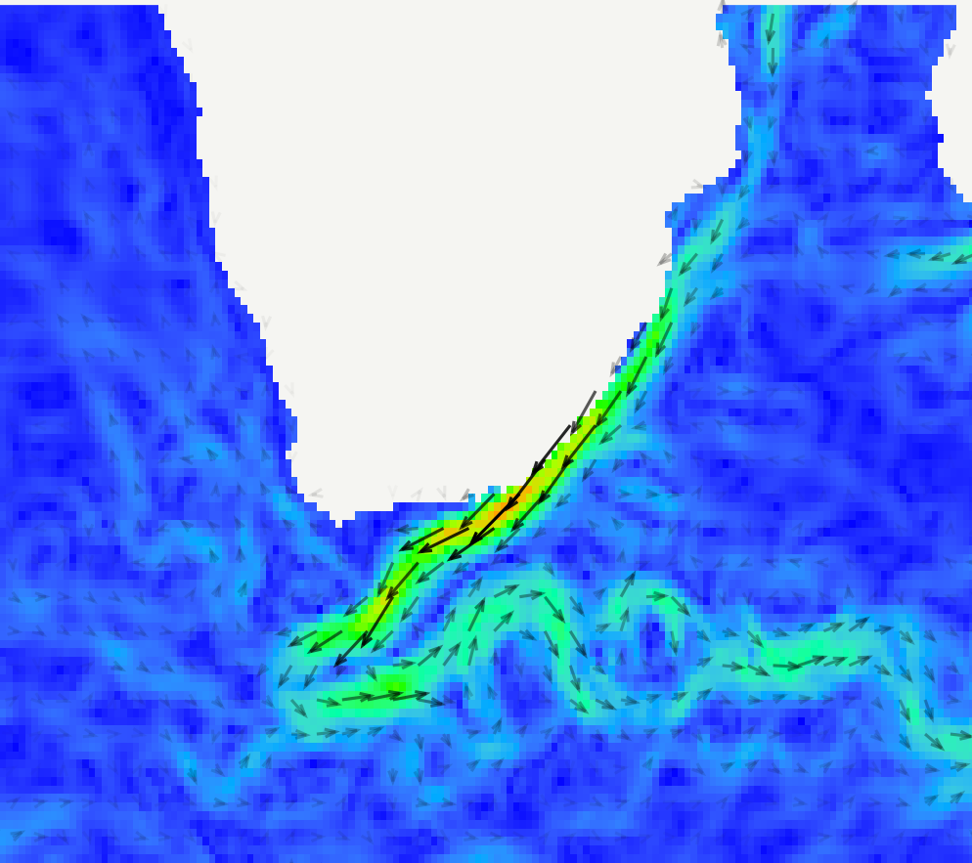

Quantifying the impact of wind and wave action on seawater temperature along the South African coastline
Presenter: Amieroh Abrahams
Supervisor: Prof. AJ Smit
Co-supervisors: Dr. Robert Williamson and Dr. Robert Schlegel
University of the Western Cape
Department of Biodiversity and Conservation Biology
Notes:
1

Slide 2
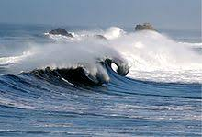


Introduction
Seawater temperature is a key indicator of environmental change
Nearshore processes (wave action, coastal winds, surface radiant heating)
Temperature variation for the biogeographical limits of organisms
Notes:
2

Slide 3
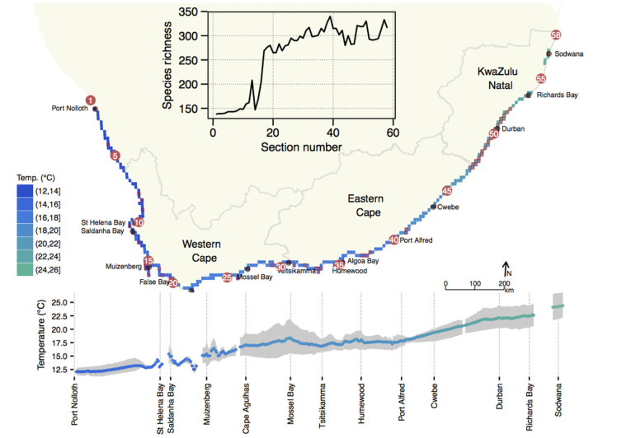
Introduction
Benguela Current – Driven by anticyclone high pressure systems
Agulhas Current – Driven by wind stress curl between the southeast trade winds
Temperature gradients are associated with differences in ecosystem
physiology, species distribution, and habitat structure
Notes:
3

Slide 4
Introduction
SACTN dataset: in situ collected seawater temperature
Datasets available:
Reanalysis: wind and wave
Satellite SST
Notes:
.
4

Slide 5
Aim of the study
The intention of this study was to examine the influence of broader scale ocean physical data on the coastal seawater temperature variability
Objectives
To examine whether or not oceanic SST and wind and wave action contribute towards a variation in seawater temperatures along the South African coastline
To examine whether or not we can use broad scale data to understand small scale differences along the coastline
Notes:
.
5

Slide 6
Methods
Wind and wave dataset
NCEP: Wind and wave characteristics comprise of wave height (hs), wave period (tp), wave direction (dir), wind direction (dirw) and wind speed (spw)
Temperature datasets
In situ: SACTN
Satellite SST data: AVHRR, MUR, CMC, K10
Notes:
.
6

Slide 7

Methods
Analyses were conducted in R software version 3.4.2
The data used within this study and comprehensive script used for data analyses and production of figures can be found at
https://github.com/AmierohAbrahams/HONOURSPROJECT
Notes:
Sactn data consist of satellite-derived SST and in situ derived sst
7

Slide 8
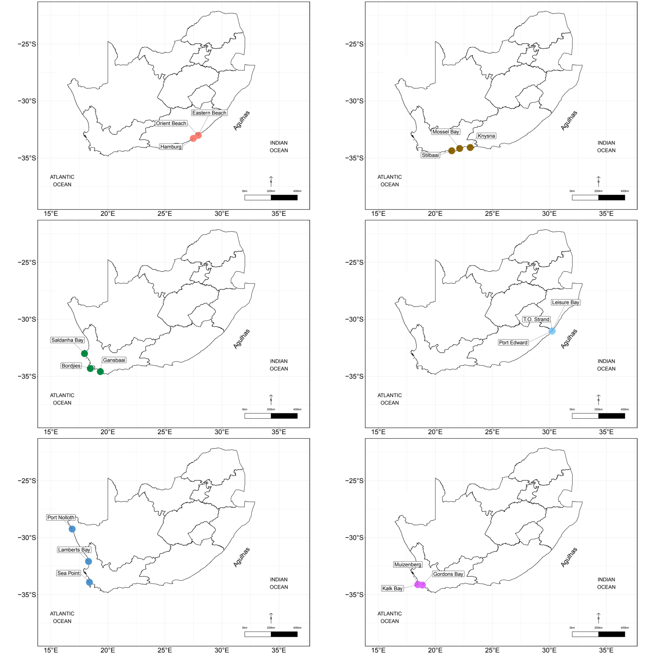
Site Selection
Sites were selected based on a clustering algorithm
Mean, minimum, and maximum temperatures
Three sites per cluster
Notes:
Sactn data consist of satellite-derived SST and in situ derived sst
8

Slide 9
Analysis
Haversine formula
Matched sites in same cluster
Mean and SD
Linear Models
ANOVA analyses
Notes:
Data was minimised by only looking at the temperature recorded after 2001 and only to extract those data or locations which had more than one source. Once this was determined a site list was constructed to identify all the sites which had more then one source and this constituted 8 of the sites
we were able to create a plot which shows the overlapping time by the sites
9

Slide 10
Results: Linear regressions
Relationship between satellite SST and coastal in situ seawater temperature
In situ data | Satellite data | Variability (%)
SACTN | AVHRR and K10 | 58
 | MUR and CMC | 55
Notes:
One year focus year was selected which is the year 2005 and three of the 8 sites were chosen. These three sites were chosen to show how the temperature varies along each coast.
Hout bay – West coast
Ballito – East coast
Mossel bay- south coast
Now inorder to test whether various temperature is affected by environmental factors we will be working with wave data, wind data, air sea temperature data
10

Slide 11
Results: Linear regressions
Data | Wind and wave direction (%) | Wave height (%) | Wave period (%)
SACTN | 0–3 |  | 7
AVHRR | 0–3 | 9
MUR | 0 | 10
CMC | 0–3 | 12
K10 | 0 | 4
Notes:
One year focus year was selected which is the year 2005 and three of the 8 sites were chosen. These three sites were chosen to show how the temperature varies along each coast.
Hout bay – West coast
Ballito – East coast
Mossel bay- south coast
Now inorder to test whether various temperature is affected by environmental factors we will be working with wave data, wind data, air sea temperature data
11

Slide 12
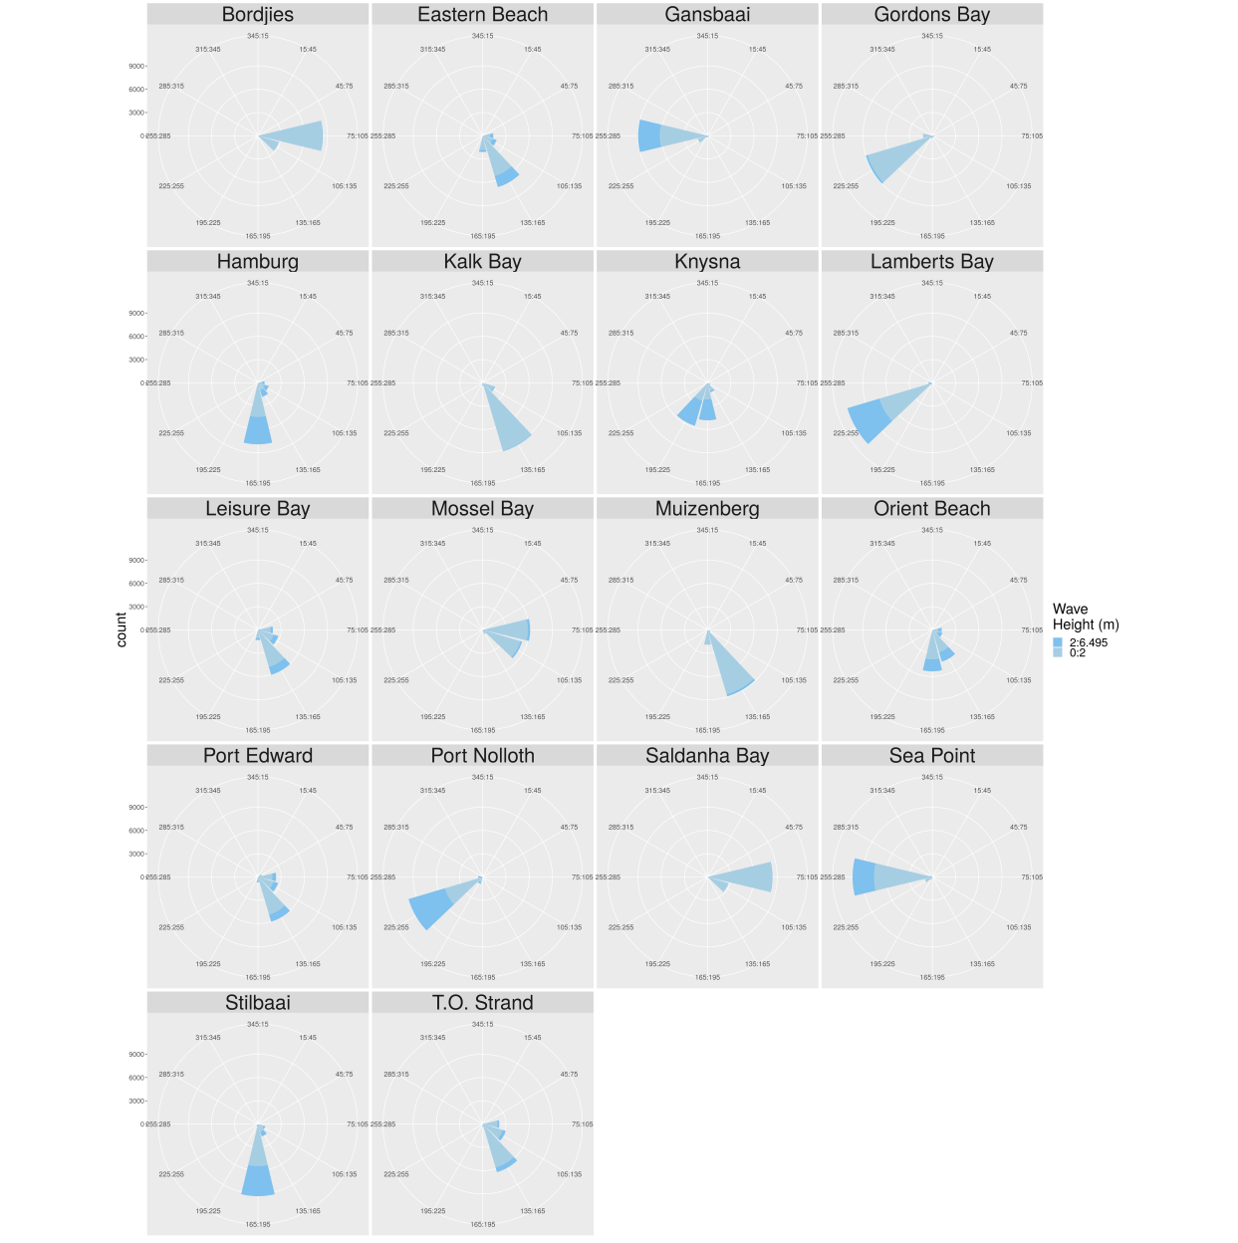
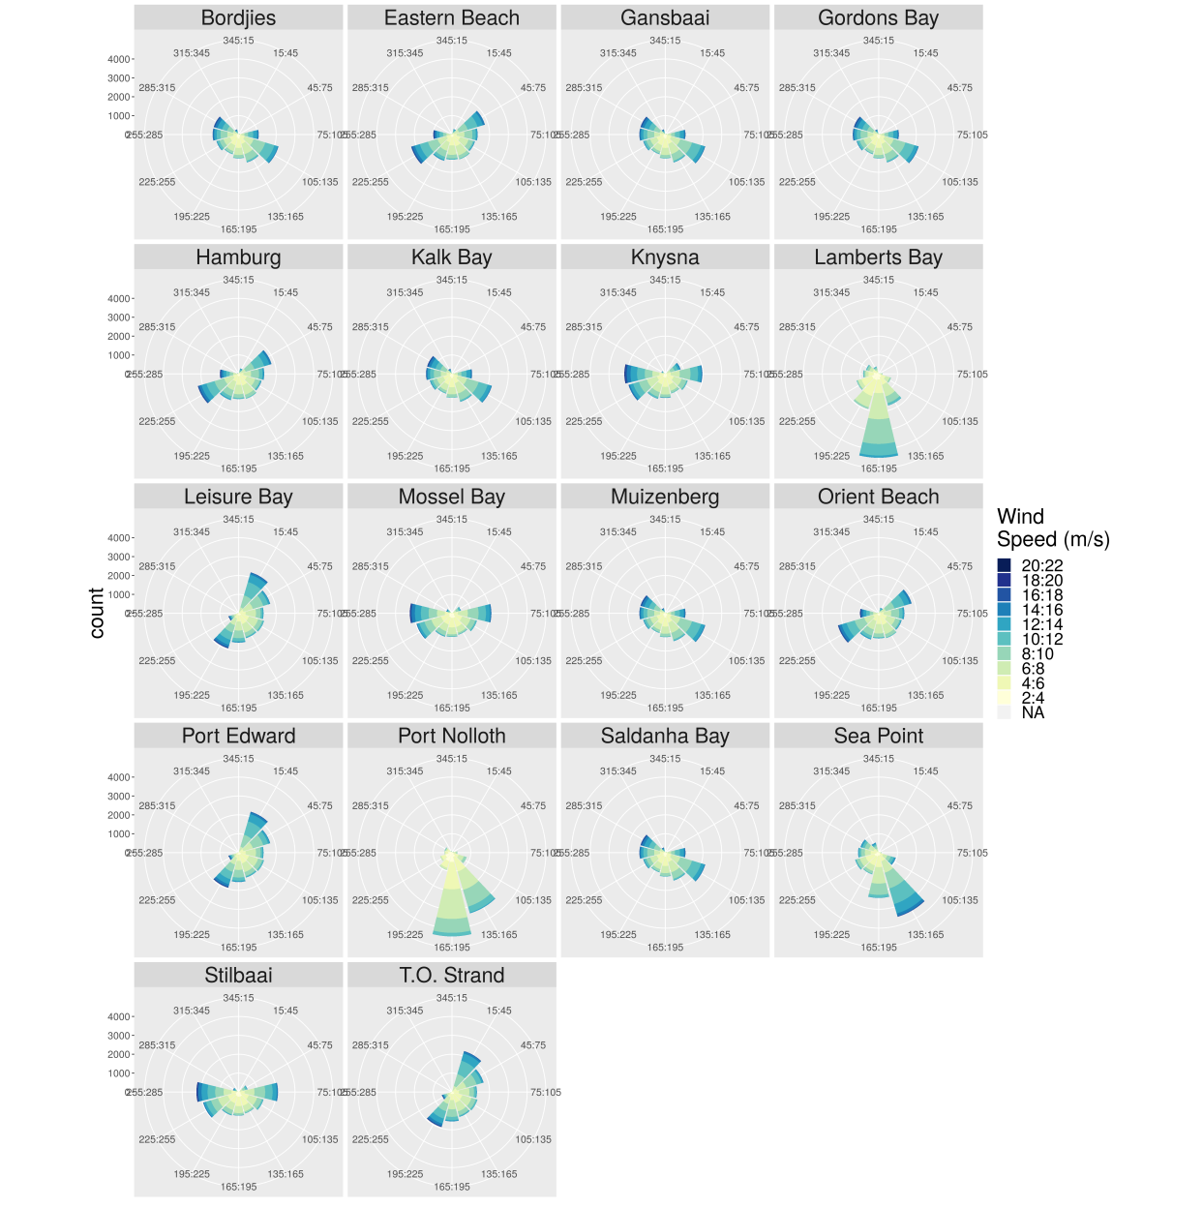
Wind and wave rose diagrams
Notes:
One year focus year was selected which is the year 2005 and three of the 8 sites were chosen. These three sites were chosen to show how the temperature varies along each coast.
Hout bay – West coast
Ballito – East coast
Mossel bay- south coast
Now inorder to test whether various temperature is affected by environmental factors we will be working with wave data, wind data, air sea temperature data
12

Slide 13
Discussion
This study aimed to investigate how broad-scale SST and wind and wave action influence variation in coastal seawater temperature along the South African coastline
Sinnett and Feddesen (2014) showed that wave energy is responsible for temperature variation within the coastal region, but this did not offer any mechanistic influence on the alongshore thermal variability
Wave energy along the South African coastline is consistently high, wind and wave action do not significantly influence seawater temperature

Slide 14
Discussion
SST data presented the broader-scale situation along the coast, and we use it here as a forcing boundary that we hypothesise influence the coastal temperatures
Broad scale properties explain 58% of the variability along the coastline

Slide 15
Conclusion
East-west thermal temperature gradient influences the nature of our findings and is caused by coastal upwelling, thermohaline circulation, solar radiation and currents
Environmental factors such as air temperature and humidity may be responsible for temperature variation
Factors such as local bathymetry, vertical mixing, internal waves, tides, local geomorphology, and diurnal solar heating may influence coastal seawater temperature
Surface layer heating is high at low wind speed
Wind and wave action may not be directly affecting ocean temperatures but has a profound influence on species distributions along the coastline.

Slide 16
Acknowledgements
I would like to thank my supervisor Prof. AJ Smit and my co-supervisors Dr. Robert Williamson and Dr. Robert Schlegel
Thanks to Team Kelp for their valuable contributions made to this project

Slide 17
References
Sinnett G, Feddersen F. 2014. The Surf Zone Heat Budget: The Effect of Wave Heating. Geophysical Research Letters 41 (20): 7217–26.
Smit AJ, Bolton JJ, Anderson RJ. 2017. Seaweeds in Two Oceans: Beta-Diversity. Frontiers in Marine Science 4: 404.

