Slide 1

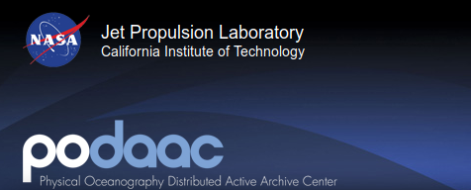
Sea Surface Temperature (SST)
Amieroh Abrahams 3559244, Kylen Brown 3540337, Kim Scholtz 3571589

Slide 2

Environmental dataset
Advanced very high resolution radiometer (AVHRR)
Global SST dataset
What is SST?
This is a measure of the energy due to the motion of molecules at the top layer of the ocean surface

Slide 3
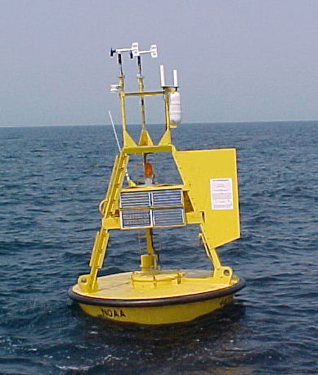
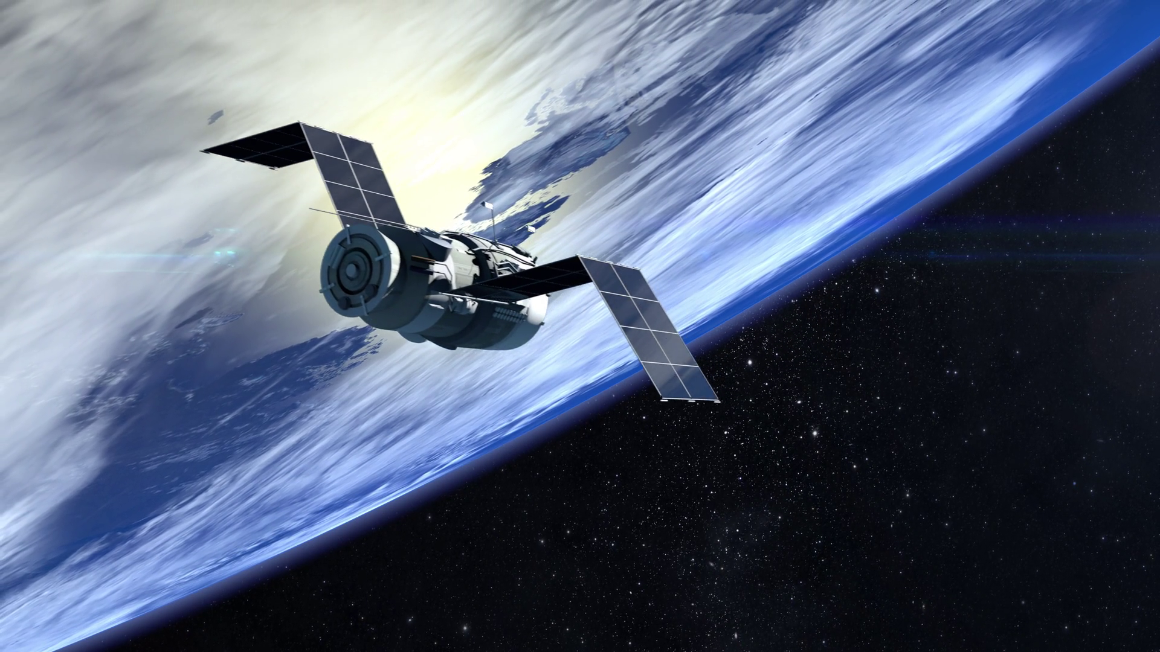
Measuring Sea Surface Temperature
Prior to the 1980’s
Instruments on shoreline, ships and buoys
First automated method of gathering SST
Since the 1980’s
Satellite observations
Moderate Resolution Imaging Spectroradiometer (MODIS)
Physics
Common questions raised

Slide 4
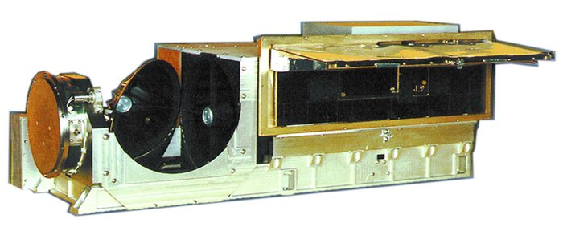
AVHRR dataset
Data availability: netCDFs (Network Common Data Form)
Class model with internal compression and chunking
Pathfinder SST time series represents the longest global ocean physical measurement from space.
AVHRR instrument
6 channel imaging system
A total of 2048 samples are obtained per channel per Earth scan

Slide 5
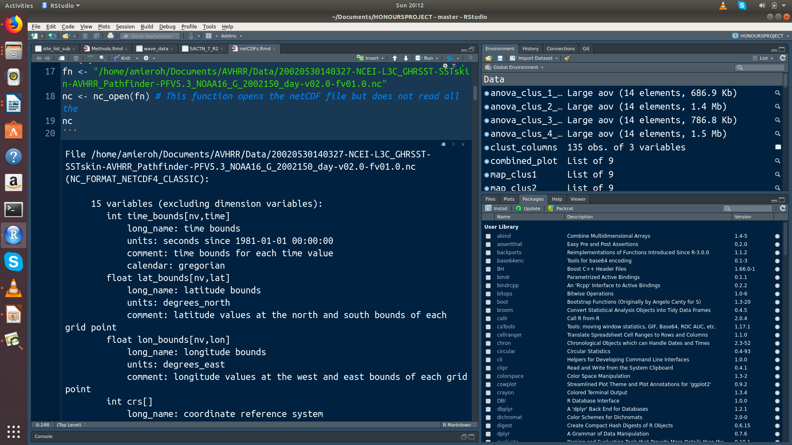
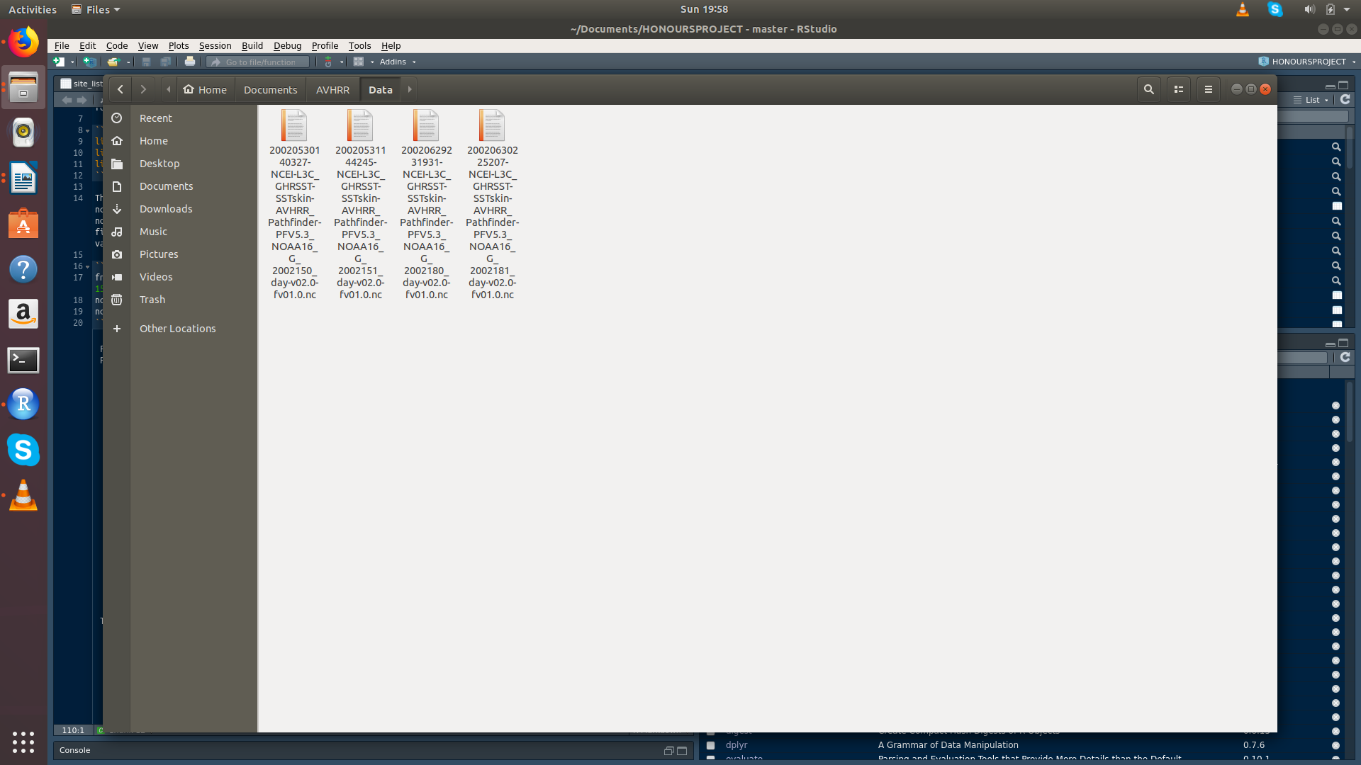

Slide 6
Importance of SST
Indicator of state of the earths climate
Climate monitoring, research and prediction
SST used as a boundary condition for weather prediction
Possible questions for this dataset

