Slide 1
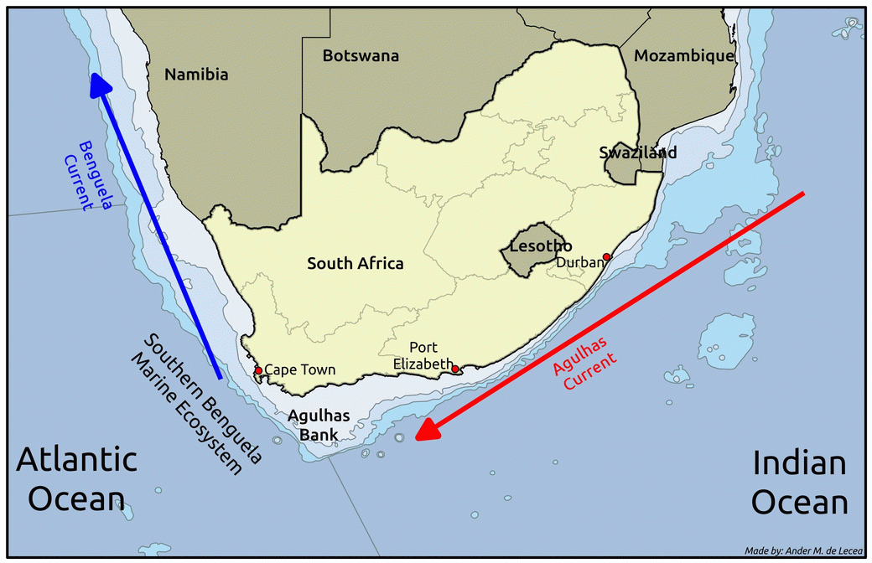
Upwelling signals: a comparison of sea surface temperature products in the Benguela
Presenter: Amieroh Abrahams
Supervisor: Prof AJ Smit
Co-supervisor: Robert Schlegel
University of the Western Cape
Department of Biodiversity and Conservation Biology
Notes:
<number>

Slide 2

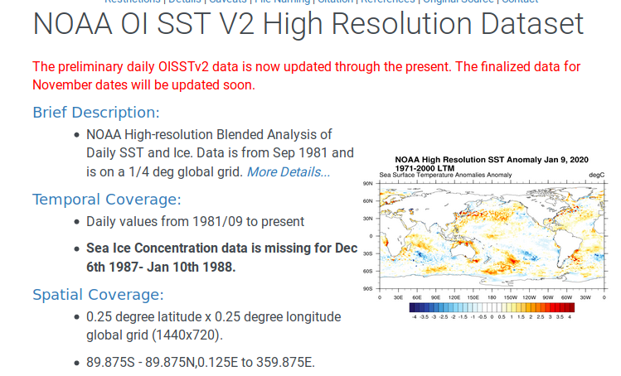
Introduction
Sea surface temperature
High resolution data
Gridded products
Notes:
<number>

Slide 3
Introduction
SST products of increasingly higher resolutions and at increasing distances from the shore were used in order to examine consistencies of upwelling signals detected in satellite products against the more reliable in situ collected SSTs.
Aims
Classify upwelling signals
Examine whether there is a difference in the number of signals detected at the various
distances.
Notes:
.
<number>

Slide 4
Introduction
It was hypothesized that the higher resolution data should have a better fidelity at detecting these upwelling signals
Notes:
<number>

Slide 5
Methods
SACTN dataset: In situ collected seawater temperature
Wind
Satellite SST
Notes:
.
<number>

Slide 6
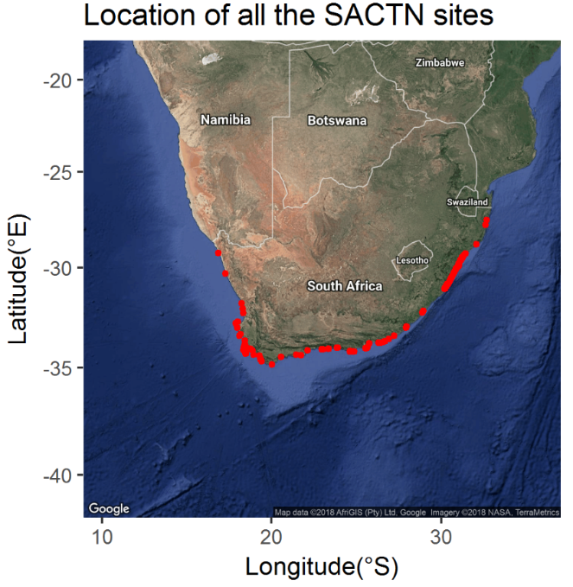
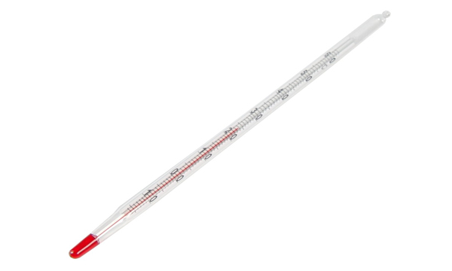
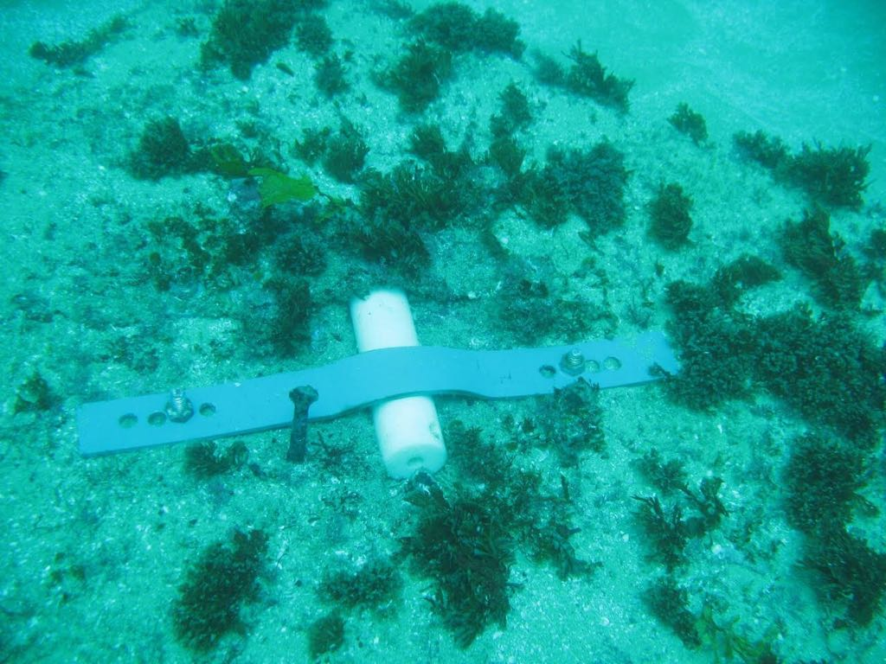
Methods
In situ temperature data
Dataset collected at 129 sites
Daily measurements: 1972 – present
Hand-held thermometers and UTRs
Notes:
.
<number>

Slide 7
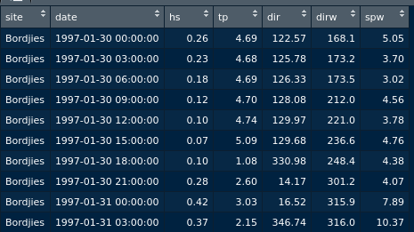
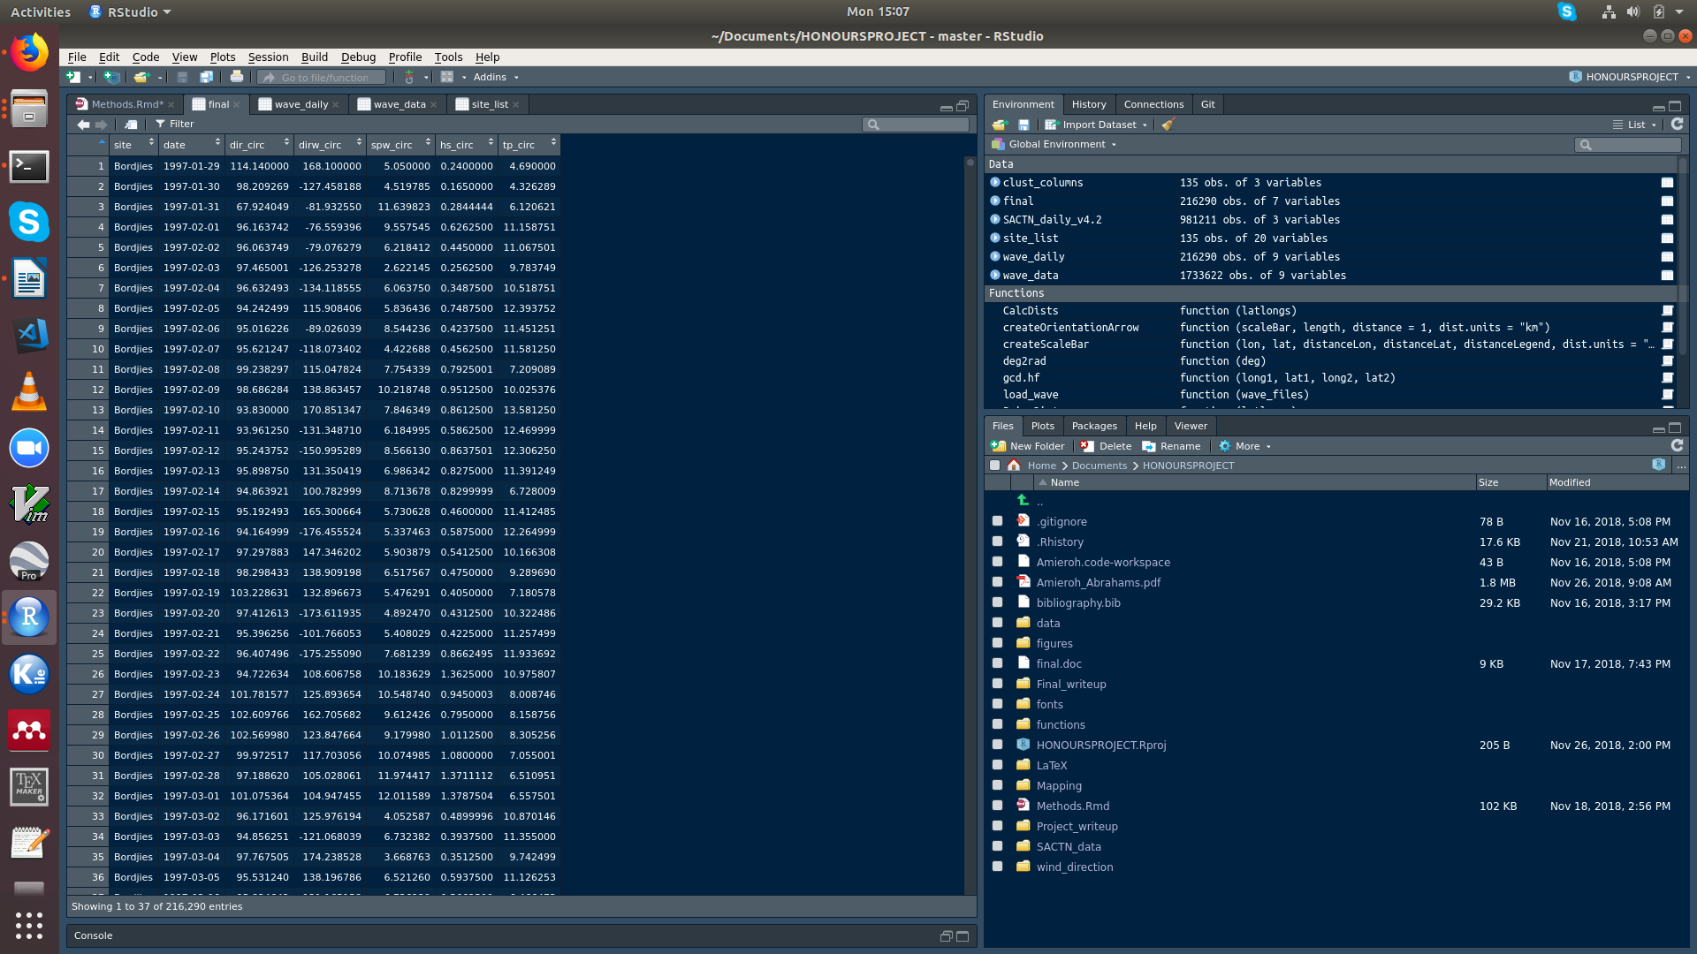
Methods
Wind data
South African Weather Service (SAWS)
Wind direction (dirw) and wind speed(spw)
Wind direction is important for upwelling
Notes:
.
<number>

Slide 8
Methods
Satellite SST datasets
The AVHRR-only Optimally-Interpolated Sea Surface Temperature (OISST)
The Multi-scale Ultra-high Resolution (MUR) Sea Surface Temperature Analysis
CMC dataset constructed by the Canadian Meteorological Centre
G1SST. A Group for High Resolution Sea Surface Temperature (GHRSST) Level 4 sea surface temperature analysis produced daily using a multi-scale two-dimensional variational
Notes:
Sactn data consist of satellite-derived SST and in situ derived sst
<number>

Slide 9


Methods
Analyses were conducted in R software version 3.6.1
The data used within this study and comprehensive script used for data analyses, and production of figures can be found at
https://github.com/AmierohAbrahams/Upwelling
Notes:
Sactn data consist of satellite-derived SST and in situ derived sst
<number>

Slide 10
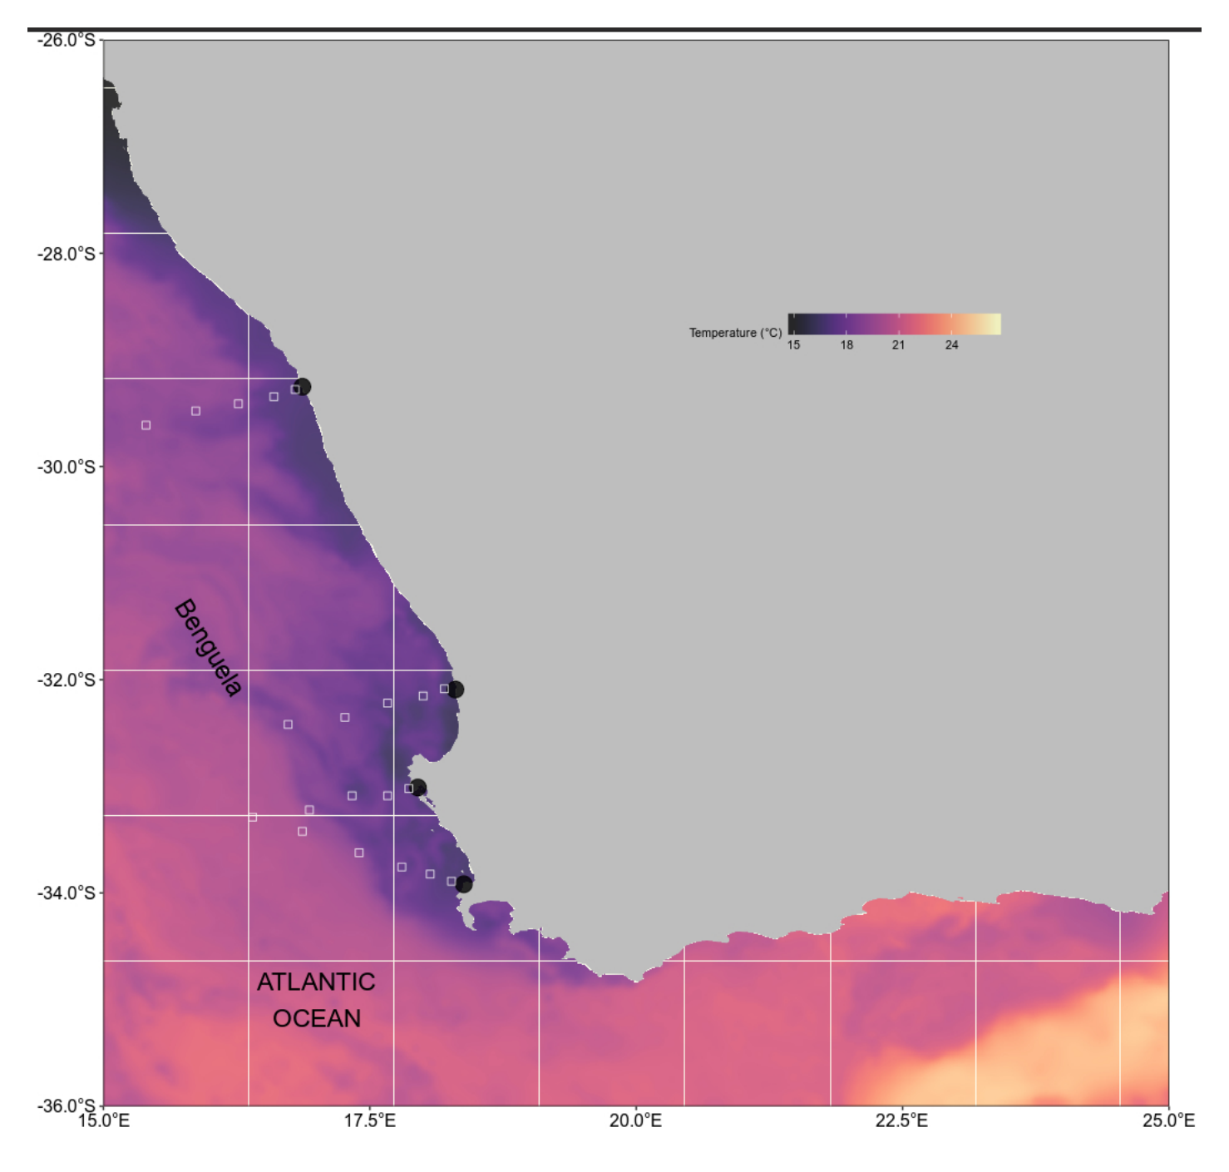
Site Selection
Temperature data were not evenly recorded at each site, only sites with a time series of longer 30 years were selected
Notes:
Sactn data consist of satellite-derived SST and in situ derived sst
<number>

Slide 11
Introduction
Why select an upwelling region for this study?
For convenience, as there are strong spatial and temporal patterns that provide a confident result when similar patterns are detected amongst vastly different kinds of data.
Shown to inject a known or expected signal into each of the data sources, which should be detectable in all data types.
Notes:
<number>

Slide 12
Classifying Upwelling
Upwelling index
Upwelling Index = μ(Cosθ − coastal angle)
exceedance() function within heatwaveR package
Determining upwelling metrics the detect_event() function
Notes:
Sactn data consist of satellite-derived SST and in situ derived sst
<number>

Slide 13
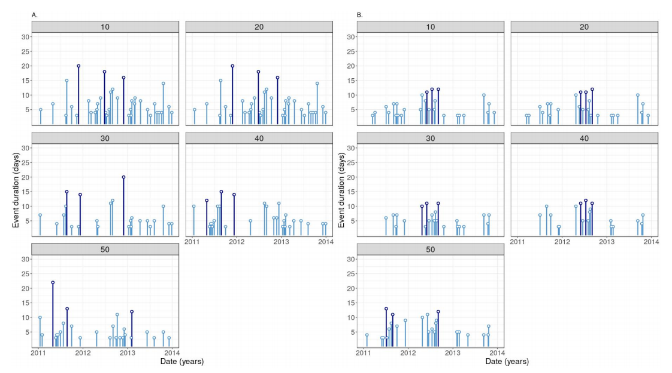
Results (OISST)
Notes:
A temperature budget was used to compare the relative roles of horizontal advection and air–sea heat flux to the upper ocean warming during the event.
The temperature tendency equation was volume averaged over a depth h and an area A defined over the SEAus domain (Fig. 1a,
box), yielding the following expression
<number>

Slide 14
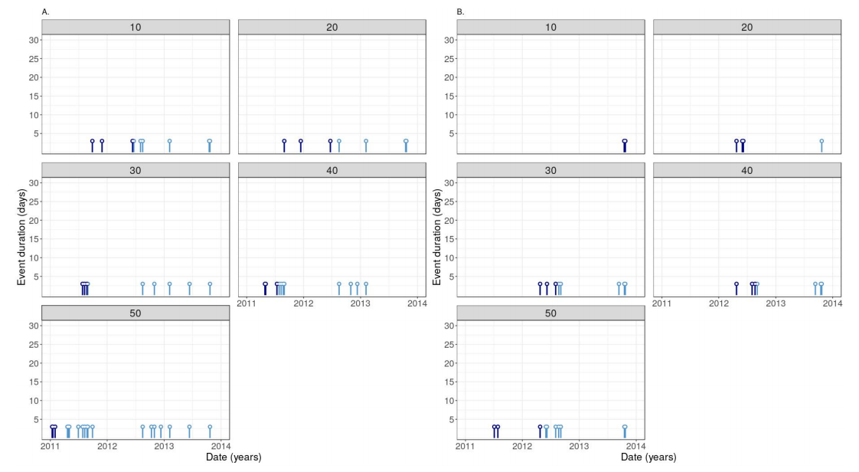
Results (CMC)
Notes:
A temperature budget was used to compare the relative roles of horizontal advection and air–sea heat flux to the upper ocean warming during the event.
The temperature tendency equation was volume averaged over a depth h and an area A defined over the SEAus domain (Fig. 1a,
box), yielding the following expression
<number>

Slide 15
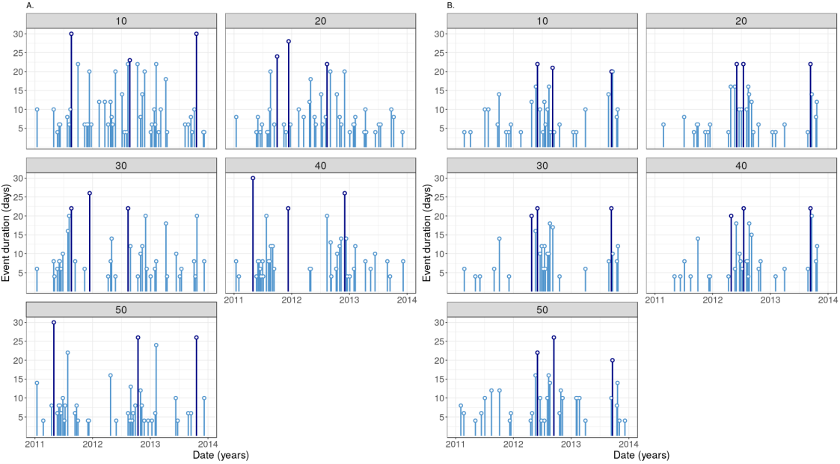
Results (MUR)
Notes:
A temperature budget was used to compare the relative roles of horizontal advection and air–sea heat flux to the upper ocean warming during the event.
The temperature tendency equation was volume averaged over a depth h and an area A defined over the SEAus domain (Fig. 1a,
box), yielding the following expression
<number>

Slide 16
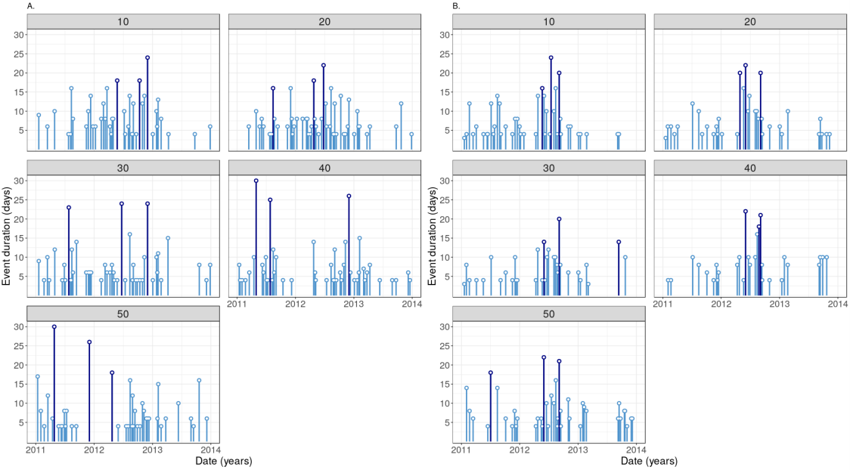
Results (G1SST)
Notes:
A temperature budget was used to compare the relative roles of horizontal advection and air–sea heat flux to the upper ocean warming during the event.
The temperature tendency equation was volume averaged over a depth h and an area A defined over the SEAus domain (Fig. 1a,
box), yielding the following expression
<number>

Slide 17
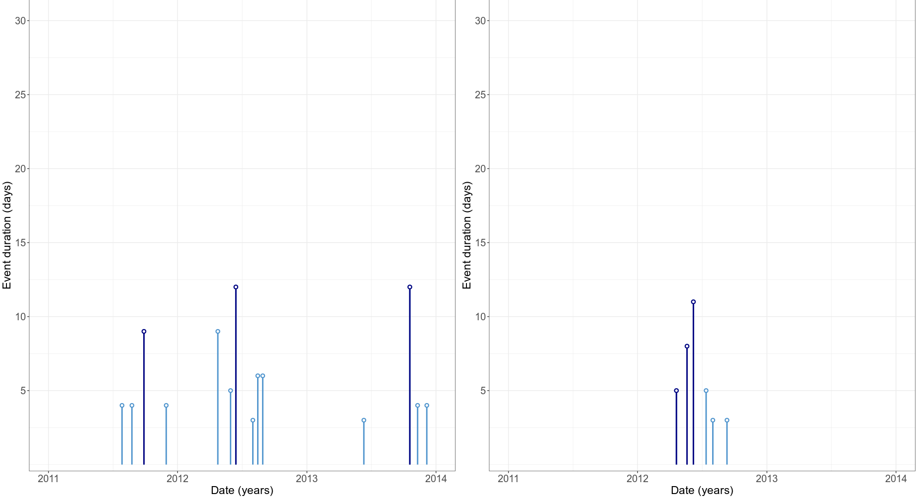
Results
Notes:
A temperature budget was used to compare the relative roles of horizontal advection and air–sea heat flux to the upper ocean warming during the event.
The temperature tendency equation was volume averaged over a depth h and an area A defined over the SEAus domain (Fig. 1a,
box), yielding the following expression
<number>

Slide 18
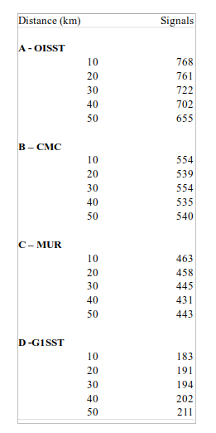
Results
More upwelling signals were present at a distances of 10km from the coastline
Notes:
A temperature budget was used to compare the relative roles of horizontal advection and air–sea heat flux to the upper ocean warming during the event.
The temperature tendency equation was volume averaged over a depth h and an area A defined over the SEAus domain (Fig. 1a,
box), yielding the following expression
<number>

Slide 19
Discussion
Often the duration of upwelling signals are longer at a greater distance from the coastline
Fewer upwelling signals were detected at a greater distance from the coastline
Similar upwelling patterns are visible at a distance of 10km and 20km
Notes:
A temperature budget was used to compare the relative roles of horizontal advection and air–sea heat flux to the upper ocean warming during the event.
The temperature tendency equation was volume averaged over a depth h and an area A defined over the SEAus domain (Fig. 1a,
box), yielding the following expression
<number>

Slide 20
Discussion
The process shows how disimilar satellite data is from in situ data
The MUR and G1SST represented a frequent detection of signals lasting for a much longer duration
The CMC signals were very moderate and closely relate to the signals detected in the SACTN dataset
Notes:
One year focus year was selected which is the year 2005 and three of the 8 sites were chosen. These three sites were chosen to show how the temperature varies along each coast.
Hout bay – West coast
Ballito – East coast
Mossel bay- south coast
Now inorder to test whether various temperature is affected by environmental factors we will be working with wave data, wind data, air sea temperature data
<number>

Slide 21
Discussion
SACTN dataset shows few signals detected in Port Nolloth similarly CMC and OISST data shows fewer signals collected at 10km
At a distance of 30km – 50km the upwelling signals differed greatly compared to those observed in the SACTN data
In the MUR and G1SST datasets the signals exhibit much longer duration (>30days)
Notes:
One year focus year was selected which is the year 2005 and three of the 8 sites were chosen. These three sites were chosen to show how the temperature varies along each coast.
Hout bay – West coast
Ballito – East coast
Mossel bay- south coast
Now inorder to test whether various temperature is affected by environmental factors we will be working with wave data, wind data, air sea temperature data
<number>

Slide 22
Discussion
Signals detected in CMC dataset never exceeded 5 days
MUR and G1SST dataset showed the similar patterns with regards to the number of signals and average duration of the signals
Weaknesses in the SACTN dataset
Notes:
One year focus year was selected which is the year 2005 and three of the 8 sites were chosen. These three sites were chosen to show how the temperature varies along each coast.
Hout bay – West coast
Ballito – East coast
Mossel bay- south coast
Now inorder to test whether various temperature is affected by environmental factors we will be working with wave data, wind data, air sea temperature data
<number>

Slide 23
Kelp and Phytoplankton
The Benguela, one of four major EBUS
Ecklonia maxima and Laminaria pallida
Optimal growing environment due to high light intensity, high nutrient concentration and contineous water movement
Nutrient concentration largely depend on the upwelling cycle
Coastal upwelling replaces water volume in kelp forests 3-7 times a day
Notes:
One year focus year was selected which is the year 2005 and three of the 8 sites were chosen. These three sites were chosen to show how the temperature varies along each coast.
Hout bay – West coast
Ballito – East coast
Mossel bay- south coast
Now inorder to test whether various temperature is affected by environmental factors we will be working with wave data, wind data, air sea temperature data
<number>

Slide 24
Conclusion
Irrespective, satellite acquired SST records are useful to modern marine scientists.
Analysis showed that offshore SSTs at a distance of 30-50km often do not match the detected signals present in the SACTN dataset
Shows that upwelling detected at a distance of 10km from the coastline does not necessary mean upwelling is occurring at 50km.
Notes:
One year focus year was selected which is the year 2005 and three of the 8 sites were chosen. These three sites were chosen to show how the temperature varies along each coast.
Hout bay – West coast
Ballito – East coast
Mossel bay- south coast
Now inorder to test whether various temperature is affected by environmental factors we will be working with wave data, wind data, air sea temperature data
<number>

Slide 25

Thank you
Any questions ?
Notes:
One year focus year was selected which is the year 2005 and three of the 8 sites were chosen. These three sites were chosen to show how the temperature varies along each coast.
Hout bay – West coast
Ballito – East coast
Mossel bay- south coast
Now inorder to test whether various temperature is affected by environmental factors we will be working with wave data, wind data, air sea temperature data
<number>

