Slide 1
DATABASES
Amine FATHALLAH
GoMyCode 20/21

Slide 2
MySQL
MySQL is an Oracle-backed open source relational database management system (RDBMS) based on Structured Query Language (SQL). MySQL runs on virtually all platforms, including Linux, UNIX and Windows. Although it can be used in a wide range of applications, MySQL is most often associated with web applications and online publishing.
MySQL is an important component of an open source enterprise stack called LAMP. LAMP is a web development platform that uses Linux as the operating system, Apache as the web server, MySQL as the relational database management system and PHP as the object-oriented scripting language. (Sometimes Perl or Python is used instead of PHP.)
Originally, conceived by the Swedish company MySQL AB, MySQL was acquired by Sun Microsystems in 2008 and then by Oracle when it bought Sun in 2010. Developers can use MySQL under the GNU General Public License (GPL), but enterprises must obtain a commercial license from Oracle.
Today, MySQL is the RDBMS behind many of the top websites in the world and countless corporate and consumer-facing web-based applications, including Facebook, Twitter and YouTube.

Slide 3
PostgreSQL
PostgreSQL also known as Postgres, is a free and open-source relational database management system (RDBMS) emphasizing extensibility and SQL compliance. It was originally named POSTGRES, referring to its origins as a successor to the Ingres database developed at the University of California, Berkeley. In 1996, the project was renamed to PostgreSQL to reflect its support for SQL. After a review in 2007, the development team decided to keep the name PostgreSQL and the alias Postgres.
PostgreSQL features transactions with Atomicity, Consistency, Isolation, Durability (ACID) properties, automatically updatable views, materialized views, triggers, foreign keys, and stored procedures.It is designed to handle a range of workloads, from single machines to data warehouses or Web services with many concurrent users. It is the default database for macOS Server, and is also available for Linux, FreeBSD, OpenBSD, and Windows.

Slide 4
SQL SERVER
Microsoft SQL Server is a relational database management system developed by Microsoft. As a database server, it is a software product with the primary function of storing and retrieving data as requested by other software applications—which may run either on the same computer or on another computer across a network (including the Internet). Microsoft markets at least a dozen different editions of Microsoft SQL Server, aimed at different audiences and for workloads ranging from small single-machine applications to large Internet-facing applications with many concurrent users.

Slide 5
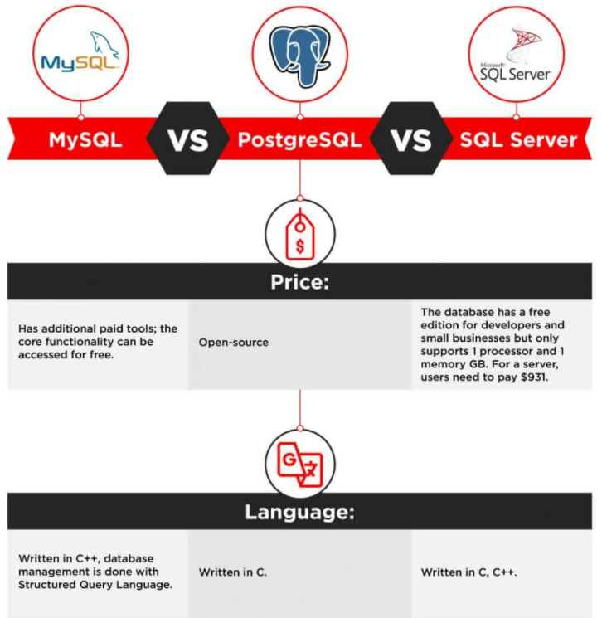
Difference between MySQL, PostgreSQL and SQL Server

Slide 6
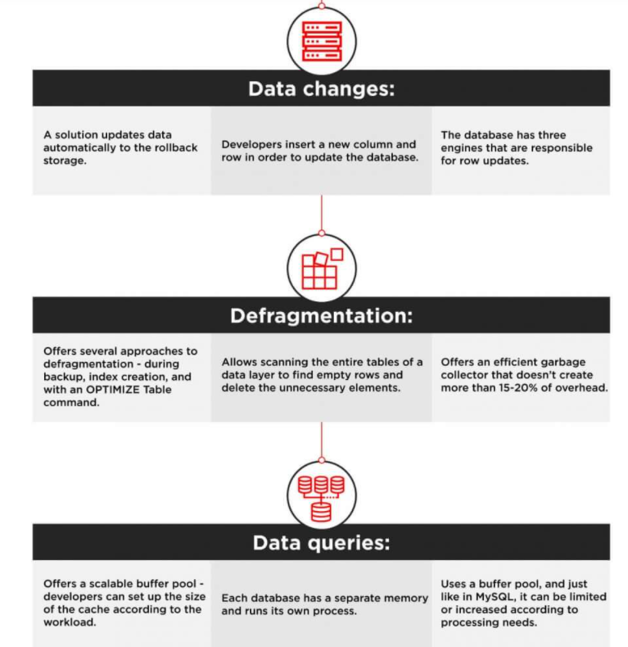

Slide 7
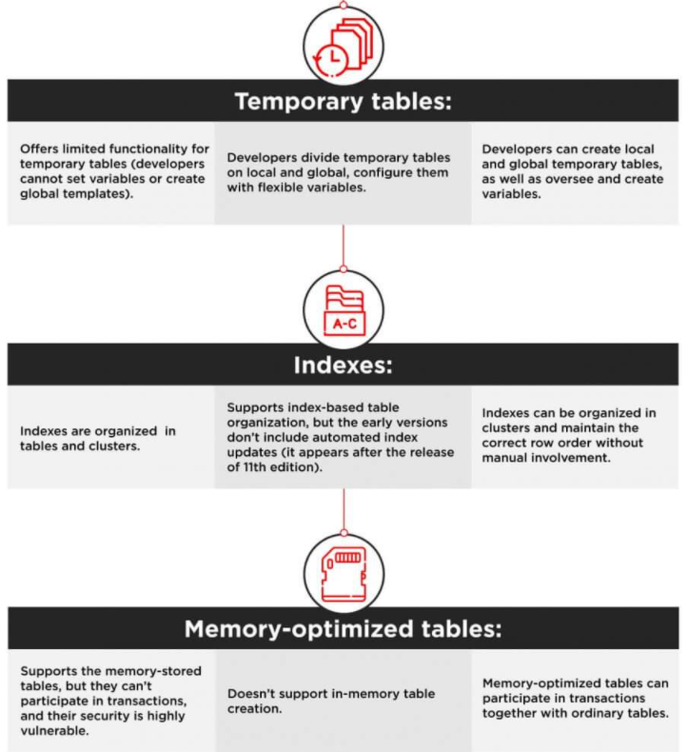

Slide 8
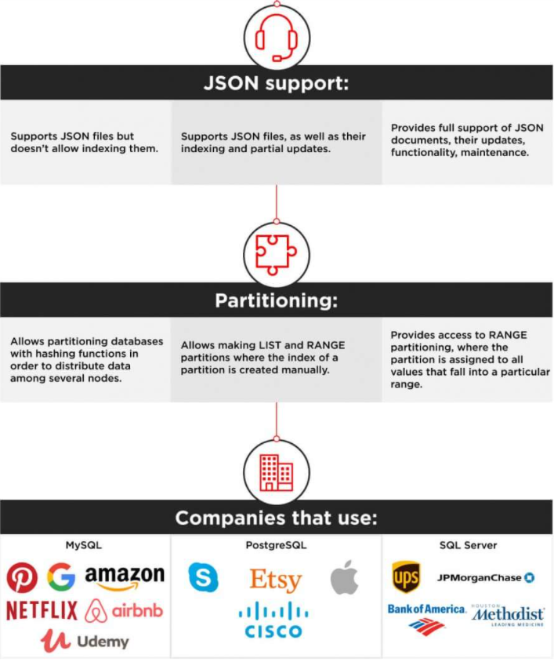

Slide 9
Conclusion
The choice between the three most popular databases ultimately boils down to the comparison of the functionality, use cases, and ecosystems. Companies that prioritize flexibility, cost-efficiency, and innovation usually choose open-source solutions. They can be integrated with multiple free add-ons, have active user communities, and are continuously updated.
For corporations that prefer traditional commercial solutions, software like SQL Server backed up by a big corporation and compatible with an extensive infrastructure, is a better bet. They have access to constant technical support, personalized assistance, and professional management tools.

