Slide 1

Home Credit Default Risk
By Amir Helmy

Slide 2
Problem Description
Many people struggle to get loans due to insufficient or non-existent credit histories.
Home Credit strives to broaden financial inclusion for the unbanked population by providing a positive and safe borrowing experience.
Our aim is to make use of alternative data to predict the probability of default of a loan application.
A typical performance measure for classification problems is the Area under the ROC Curve (AUC/ROC).

Slide 3
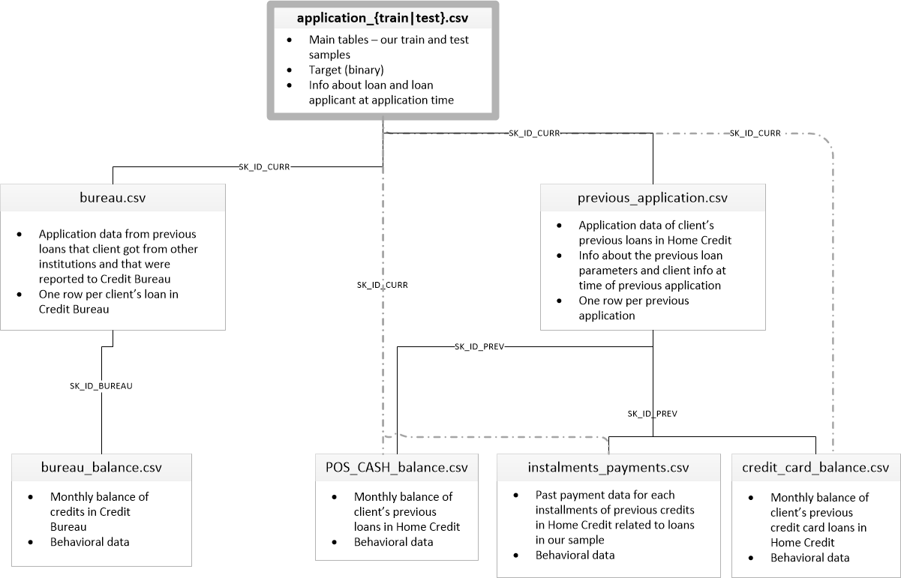
Data Description
We have different info about clients and credit applications.
The main application data file contains 122 col 307511 rows.
And0 total of 99 columns in 7 different historical data files related by foreign key.

Slide 4
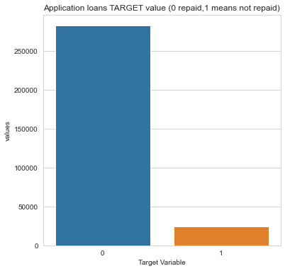
Data explorations & key findings
Target feature
92% of the loans are repaid, 8% are not repaid
Highly Imbalanced Data.
Leading to a Biased Model.
Under sampling to prevent majority class from dominating.

Slide 5
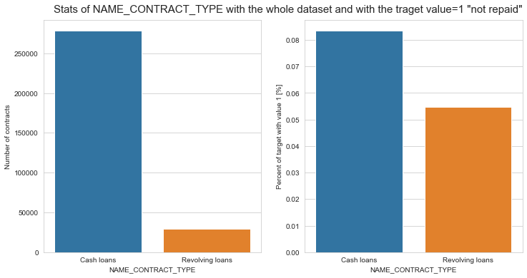
Data explorations & key findings
NAME_CONTRACT_TYPE
Contract type Revolving loans are just a small fraction (10%) from the total number of loans.
Larger amount of Revolving loans, comparing with their frequency, are not repaid.

Slide 6
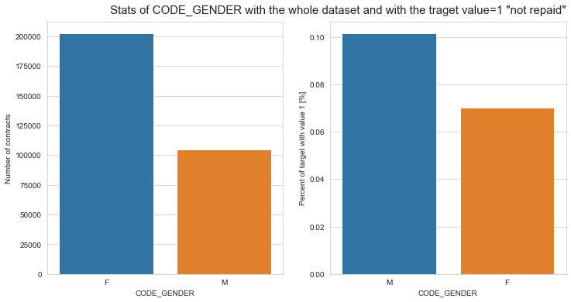
Data explorations & key findings
CODE_GENDER
The number of female clients is almost double the number of male clients
Looking to the percent of unpaid credits, males have a higher chance of not returning their loans, comparing with women.

Slide 7
Data explorations & key findings
CODE_GENDER
The number of female clients is almost double the number of male clients
Looking to the percent of unpaid credits, males have a higher chance of not returning their loans, comparing with women.

Slide 8
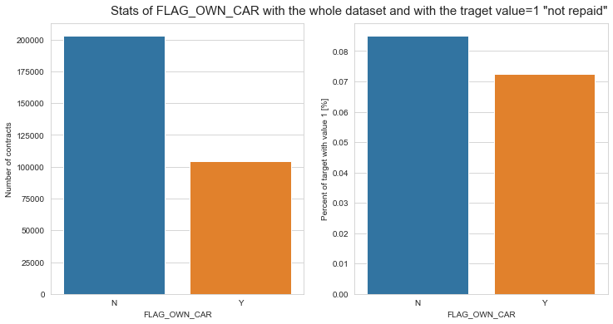
Data explorations & key findings
FLAG_OWN_CAR
The clients that owns a car are almost a half of the ones that doesn't own one.
In terms of percentage of not repayment of loan ,The clients that doesn’t own a car are more likely not to repay than who does.

Slide 9
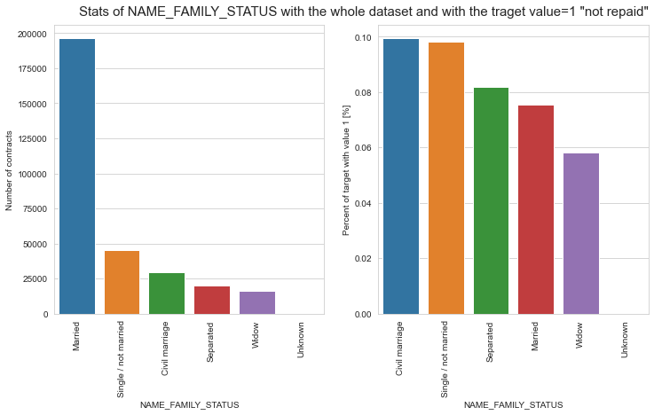
Data explorations & key findings
NAME_FAMILY_STATUS
Most of clients are married, followed by Single/not married and civil marriage.
In terms of percentage of not repayment of loan, Civil marriage has the highest percent of not repayment.
Widow being the most likely to pay.

Slide 10
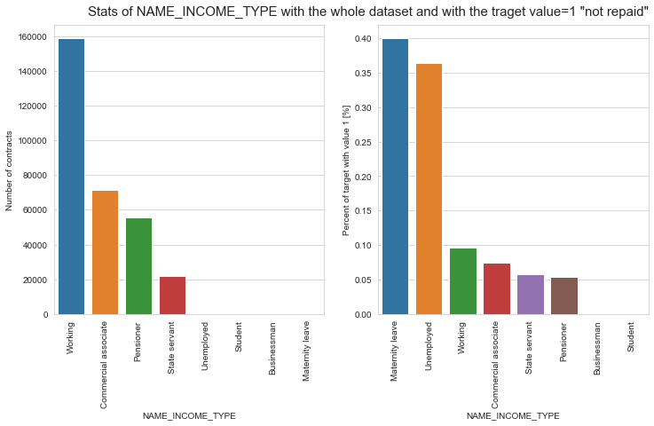
Data explorations & key findings
NAME_INCOME_TYPE
Most income is from Working, followed by Commercial associate, Pensioner,etc..
Applicants with Maternity leave income have almost 40% ratio of not returning loans, followed by Unemployed (37%).
The rest of types of incomes are under 10% for not returning loans

Slide 11
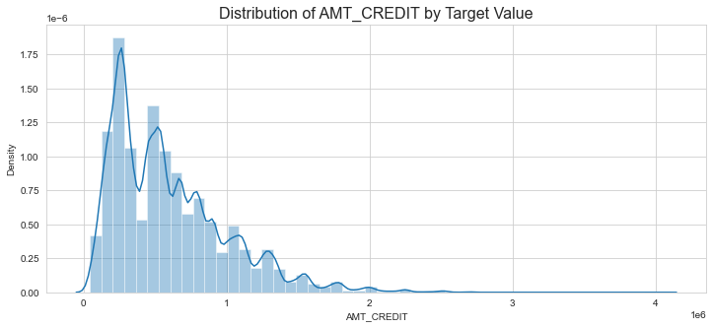
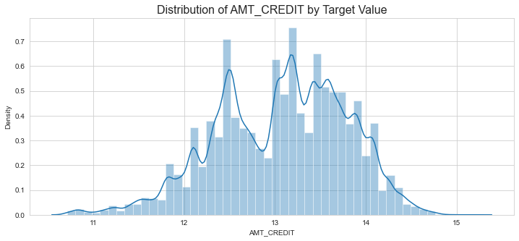
Data explorations & key findings
AMT_CREDIT
Data points are mostly centered in the left side of the plot, 'Right skewed’ (under about 1.5 million)
Certain models are sensitive to skewed data, so I applied log transform to get data close to normal distribution and correct It’s skewness.

