Slide 1
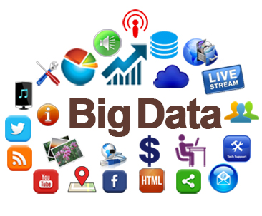
The Big Data Revolution

Slide 2
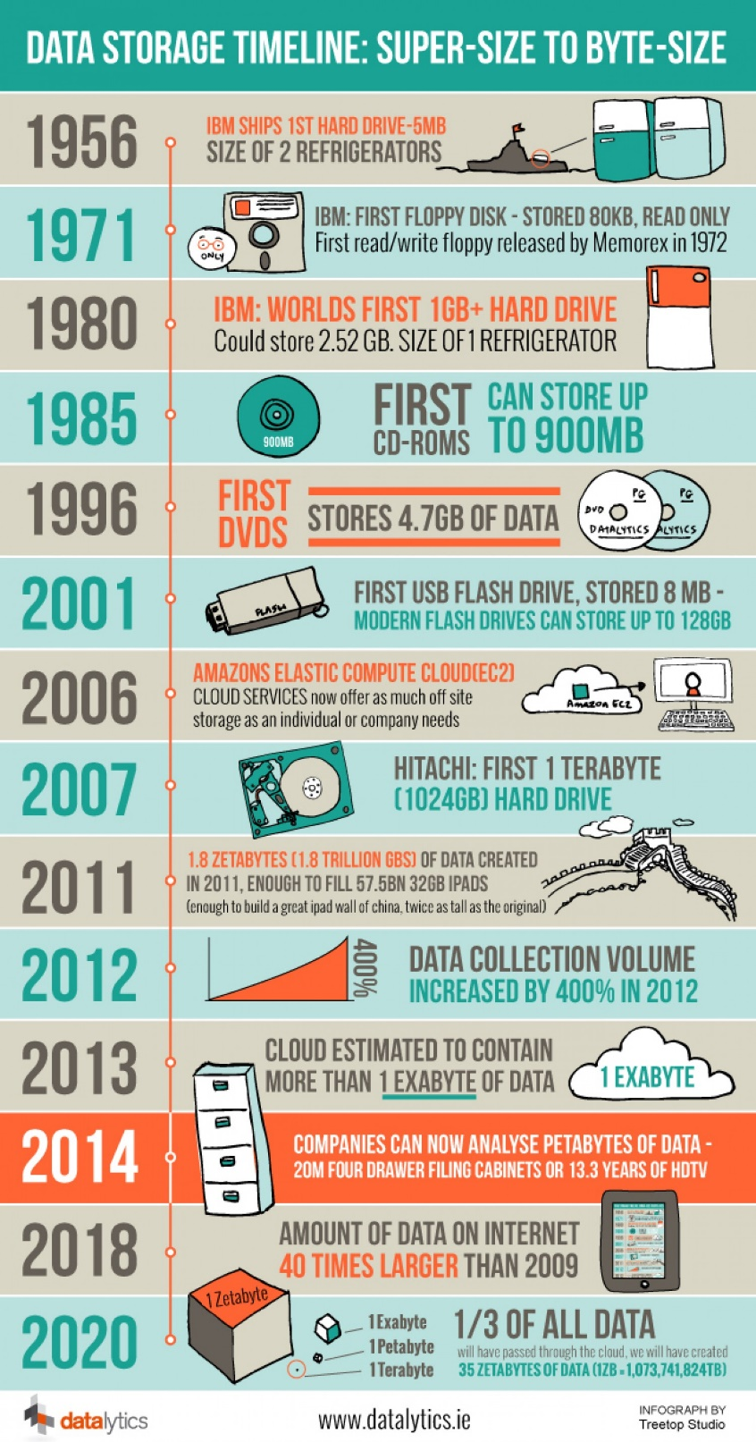
The Big Data Revolution is the result of great advancements in 4 areas:
Data generation volume
Storage capacity
Computing speed
Internet speed

Slide 3
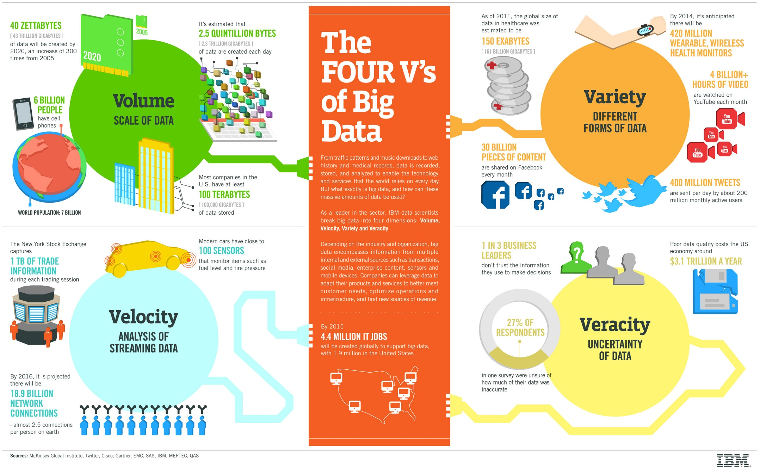

Slide 4



Lecture plan: scientific computing
Introduction to NumPy & SciPy
Plotting using MatPlotLib
Data Analysis Example

Slide 5
NumPy and SciPy
NumPy and SciPy are packages for scientific computing that provide fast pre-compiled mathematical and numerical functions.
NumPy (Numeric Python) - good for manipulating large arrays and matrices of numeric data.
SciPy (Scientific Python) - extends NumPy with many useful algorithms, e.g.:
minimization, regression, and other math techniques

Slide 6
NumPy and SciPy
NumPy and SciPy are open-source, and therefore provide a free Matlab alternative.
Matlab – widely used, but expensive
NumPy and SciPy are popular among scientists & researchers applying math to large datasets.
Read more here: http://docs.scipy.org/doc/numpy/reference/

Slide 7
Importing the required modules
Already in Anaconda.
Still, need to import at the beginning of your program
For example:
import numpy as np, matplotlib, scipy
Alias

Slide 8
NumPy’s main object is the Array
Array: It is a table of elements (usually numbers), indexed by a tuple of integers.
Rank the number of axes (=dimensions)
A vector is an array of rank 1
A 2D matrix is an array of rank 2.

Slide 9
Python list vs. NumPy’s Array
Both used to store any data type, can be indexed and iterated through
Arrays have to be declared while lists don't (part of Python's syntax)
So what are Arrays good for?
Performing arithmetic functions on the elements
Storing data more compactly and effectively

Slide 10
The Array object - Creation
List to initialize
>>> import numpy as np
>>> a = np.array([0, 1, 2]) # 1D array of size 3
>>> a
array([0,1,2])
>>> mat=np.array([[0, 1, 2], [3, 4, 5]]) # 2D array of size 2x3
>>> mat
array([[0,1,2],
[3,4,5]])
2 | 1 | 0
Nested list
2 | 1 | 0
5 | 4 | 3

Slide 11
Creating an array of zeros or ones
>>> np.zeros(7, dtype=int)
array([0, 0, 0, 0, 0, 0, 0])
>>> np.ones((2,3), dtype=float)
array([[ 1., 1., 1.],
[ 1., 1., 1.]])
Declaring types can make life easier..

Slide 12
Creating arrays containing number sequences
>>> np.arange(10)
array([0, 1, 2, 3, 4, 5, 6, 7, 8, 9])
>>> np.arange(2,7)
array([2, 3, 4, 5, 6])
>>> np.arange(2,7,2) # start, end (exclusive), step
array([2, 4, 6])
Like range(10), but
returns a numpy array object

Slide 13
More array operations
# linspace: start, end, number of elements
>>> print(np.linspace(1,5,9))
[ 1. 1.5 2. 2.5 3. 3.5 4. 4.5 5. ]
# Arrays with random values: (0 , 1)
>>> print (np.random.rand(5))
[ 0.53844313 0.3384871 0.5763536 0.29159273 0.43938366]
# slicing is similar to standard lists
>>> a=np.arange(1, 5.5, 0.5)
>>> print( a[3:1:-1] )
[ 2.5 2. ]

Slide 14
Array – Attributes & Methods
>>> mat = np.array([[0, 1, 2], [3, 4, 5]]) # Creates a 2 x 3 array
>>> mat
array([[0,1,2],
[3,4,5]])
>>> mat.ndim #number of dimensions
2
>>> mat.shape #dimension sizes
(2, 3)
>>> len(mat) # returns the size of the first dimension
2
>>> mat.T #Transpose
array([[0, 3],
[1, 4],
[2, 5]])
2 | 1 | 0
5 | 4 | 3
No parentheses
Same as lists
3 | 0
4 | 1
5 | 2

Slide 15
Reshaping an Array
>>> a = np.arrange(10.0)
>>> a
array([ 0., 1., 2., 3., 4., 5., 6., 7., 8., 9.])
>>> a = a.reshape((5, 2))
>>> a
array([[ 0., 1.],
[ 2., 3.],
[ 4., 5],
[ 6., 7.],
[ 8., 9.]])
>>> a.shape
(5, 2)
9. | 8. | 7. | 6. | 5. | 4. | 3. | 2. | 1. | 0.
Reshape
Creates a new array
1. | 0.
3. | 2.
5. | 4.
7. | 6.
9. | 8.

Slide 16
Creating an Array of a specific type
>>> a = np.array(range(10), dtype=float)
>>> a
array([ 0., 1., 2., 3., 4., 5., 6., 7., 8., 9.])
>>> a.dtype
dtype('float64')
Additional ways to create arrays in NumPy:
http://docs.scipy.org/doc/numpy-1.10.1/reference/routines.array-creation.html#routines-array-creation

Slide 17
Types of np arrays
>>> a
array([ 0., 1., 2., 3., 4., 5., 6., 7., 8., 9.])
>>> a.dtype
dtype('float64’)
>>> type(a)
numpy.ndarray

Slide 18
Indexing and slicing: similar to lists
>>> a = np.diag(np.arange(3))
array([[0, 0, 0],
[0, 1, 0],
[0, 0, 2]])
>>> a[1, 1]
1
>>> a[2, 1] = 10
>>> a[1, :] # Row at index 1 a[1] also works
array([ 0, 1, 0])
>>> a[:, 1] # Column at index 1
array([ 0, 1, 10])
>>> a[2, 1:]
array([10, 2])
Diagonal matrix:
Al non-diag elements are 0

Slide 19
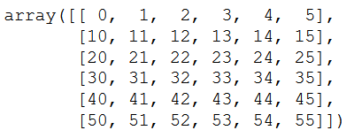
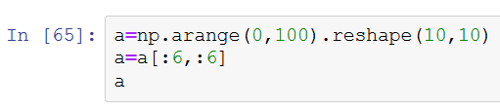
Indexing and slicing: matrices
How do we create this array?

Slide 20
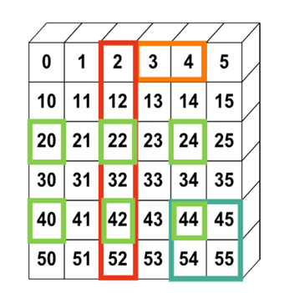

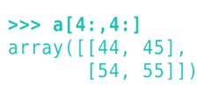

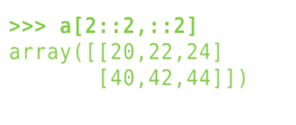

Indexing and slicing: matrices
Let’s select the colored areas
Also:

Slide 21
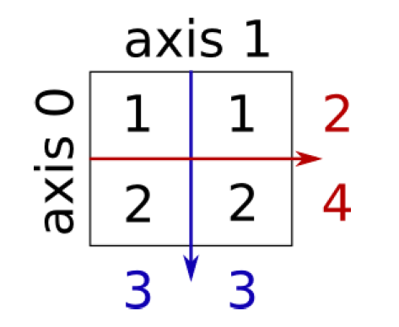
Reductions: Sum
>>> x = np.array([[1, 1], [2, 2]])
>>> x
array([[1, 1],
[2, 2]])
>>> x.sum() # ALL elements
6
>>> x.sum(axis=0) # sum the columns along axis 0
array([3, 3])
>>> x[:, 0].sum(), x[:, 1].sum()
(3, 3)
>>> x.sum(axis=1) # sum the rows along axis 1
array([2, 4])
>>> x[0, :].sum(), x[1, :].sum()
(2, 4)
Also works with x.min, x.max, x.mean etc.

Slide 22
Sorting along an axis
>>> a = np.array([[4, 3, 5], [1, 2, 1]])
>>> b = np.sort(a, axis=1)
>>> b
array([[3, 4, 5],
[1, 1, 2]])
axis 1
4 | 3 | 5
1 | 2 | 1
axis 0
>>> a.sort(axis=1)
>>> a
array([[3, 4, 5],
[1, 1, 2]])
a.sort does not return
a value

Slide 23
Array Arithmetic
Arithmetic operators on arrays apply elementwise.
A new array is created and filled with the result.
Very useful for vector calculations
>>> x = np.array([1, 5, 2])
>>> y = np.array([7, 4, 1])
>>> x + y
array([8, 9, 3])
>>> x * y # element by element multiplication! Use np.dot(x,y) for matrix multiplication.
array([ 7, 20, 2])
>>> x - y
array([-6, 1, 1])
>>> x / y
array([0, 1, 2])
>>> x % y
array([1, 1, 0])
Note that here, x and y have the same size

Slide 24
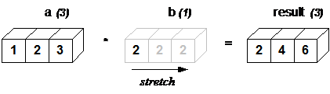
Broadcasting
NumPy operations are usually done element-by-element which requires two arrays to have exactly the same shape:
But this will also work:
>>> a = np.array([1.0,2.0,3.0])
>>> b = np.array([2.0,2.0,2.0])
>>> a * b
array([ 2., 4., 6.])
>>> a = np.array([1.0,2.0,3.0])
>>> b = 2.0
>>> a * b
array([ 2., 4., 6.])
Same result

Slide 25
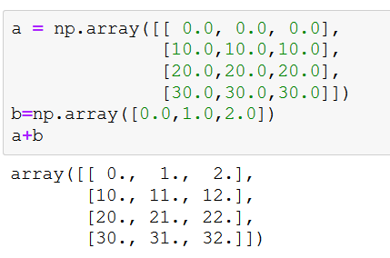
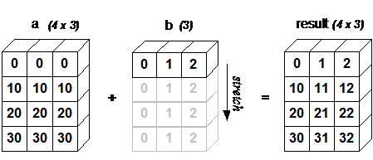
Broadcasting
One array can be “stretched” along the auxiliary axis, to fit the other

Slide 26
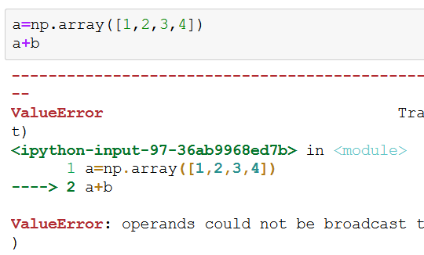
Broadcasting
Be careful of dimension mismatch

Slide 27
Comparisons and Boolean operations
>>> a = np.array([1, 4, 3, 5, 2, 3])
>>> b = np.array([1, 2, 4, 5, 2, 1])
>>> a==b
array([ True, False, False, True, True, False], dtype=bool)
>>> comp=a==b
# array of Booleans, elementwise comparison

Slide 28
Comparisons and Boolean operations
>>> comp = a==b
>>> comp
array([ True, False, False, True, True, False], dtype=bool)
>>> comp.any()
True
>>> comp.all()
False
>>> comp.nonzero()
(array([0, 3, 4], dtype=int64),)
Are any true?
Are all true?
Indices of True elements

Slide 29
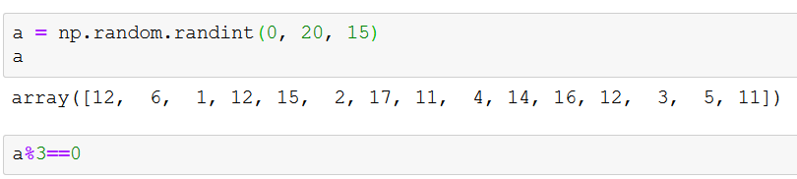
Applying a logical operation to an Array
What will be the result?
What will be the type of the new object?

Slide 30
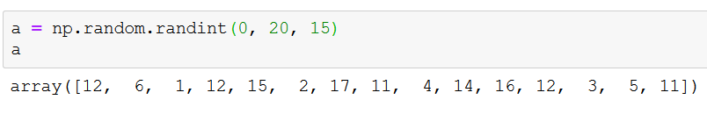

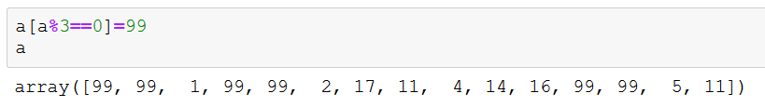
Using logic for indexing
Extremely useful –
for getting only the array elements you want
Also for assignments

Slide 31
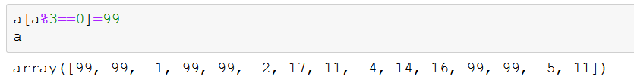

Indexing with a list
Note the [ [

Slide 32
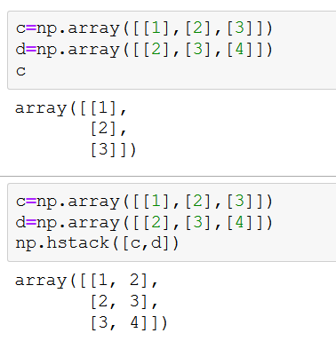
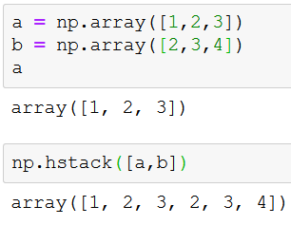
Array stacking
How to concatenate arrays?
a+b : doesn’t work…
a.append(b) : bad
Solution: hstack
Tuple or list

Slide 33
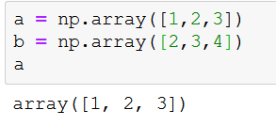
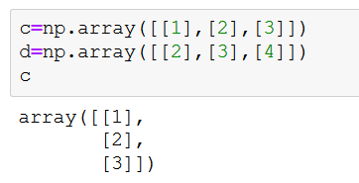
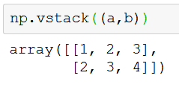
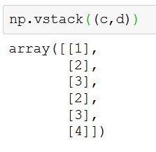
Vertical Stacking

Slide 34
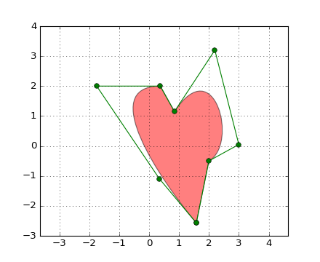
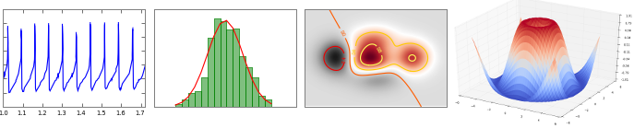
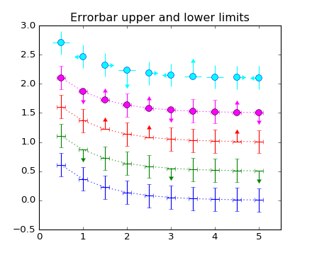

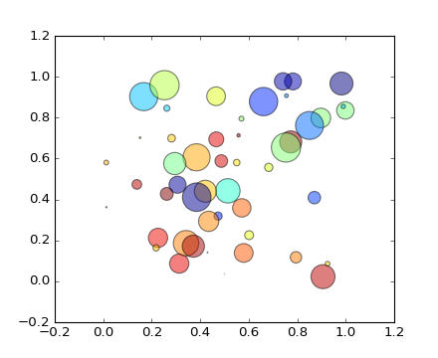
Plotting
“A plot is worth a thousand words"

Slide 35
matplotlib is a python 2D plotting library which produces publication quality figures in a variety of hardcopy formats and in an interactive manner.
You can generate plots, histograms, power spectra, bar charts, errorcharts, scatterplots, etc, with just a few lines of code.
Check this out:
http://matplotlib.org/gallery.html

Slide 36
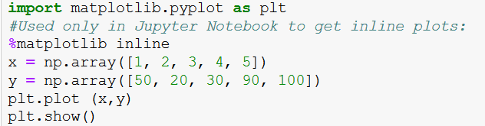
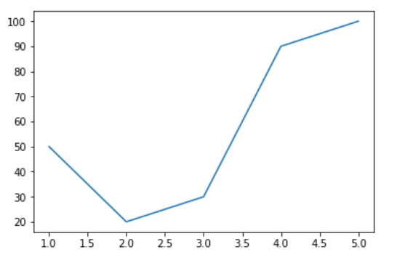
Example 1

Slide 37
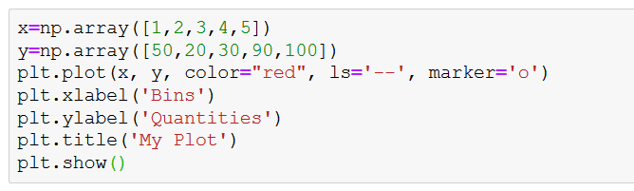
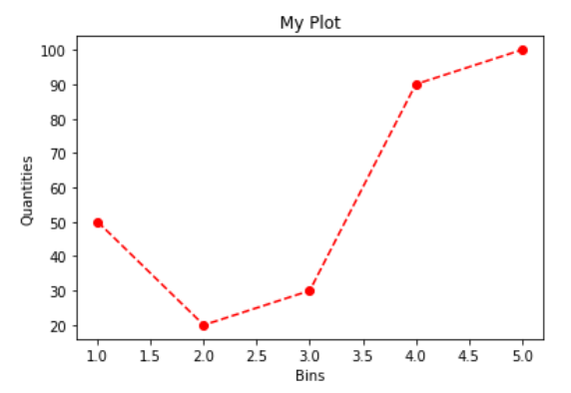
Different line styles

Slide 38
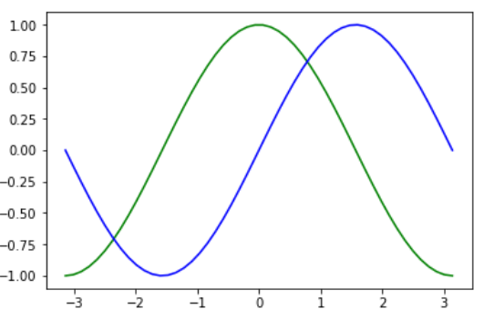
Example 2 – Sin and Cos
import matplotlib.pyplot as plt
import numpy as np
x = np.linspace(-np.pi, np.pi)
y, z = np.cos(x), np.sin(x)
plt.plot(x, y, color = 'green')
plt.plot(x, z, color = 'blue')
plt.show()

Slide 39
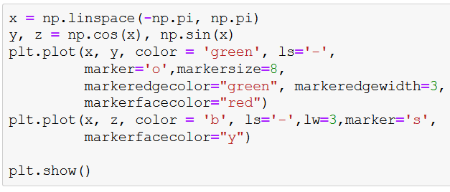
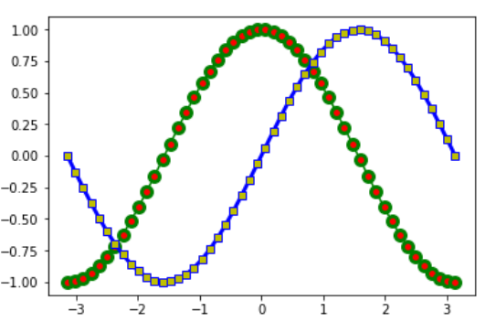
Example 2b- Sin and Cos with Style

Slide 40
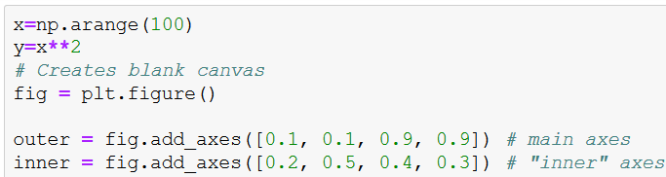
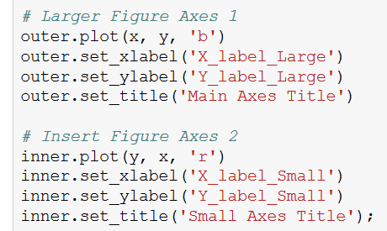
Multiple Axes in same Figure

Slide 41
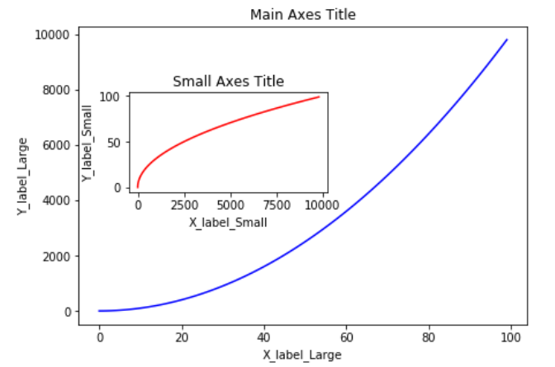
Result
X as a function
Of Y...

Slide 42
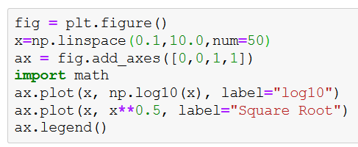
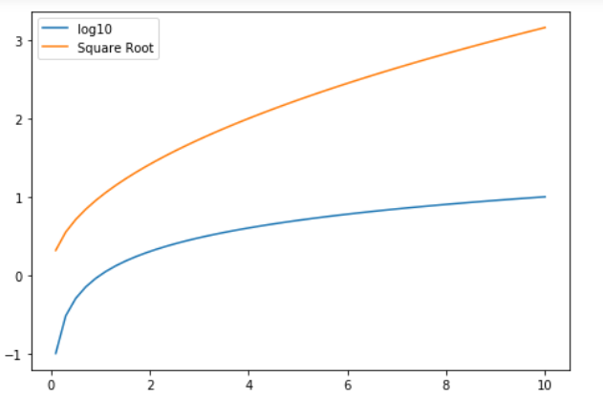
Legends & Labels

Slide 43
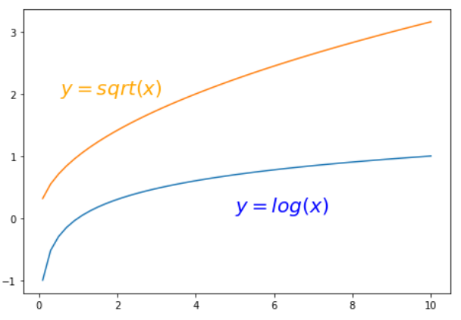
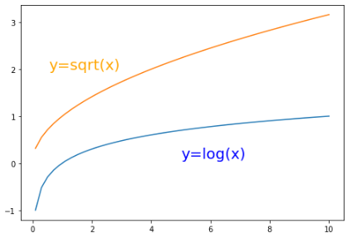
Annotating
Values on Axes

Slide 44
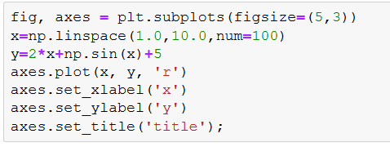
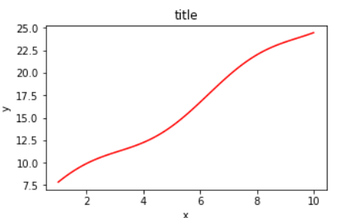
Controlling Figure size

Slide 45
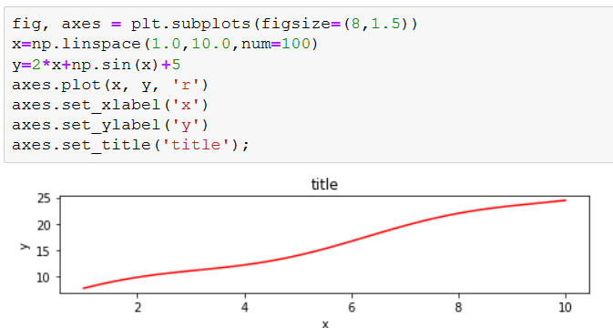
Controlling Figure size

Slide 46
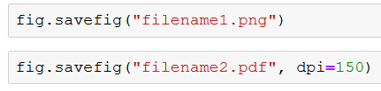
Saving Figures
Multiple picture formats supported, including PDF

Slide 47
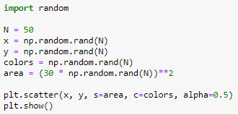
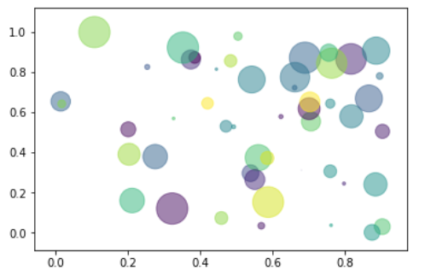
Some Useful Plots: Scatter

Slide 48
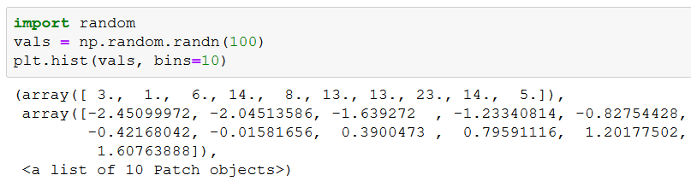
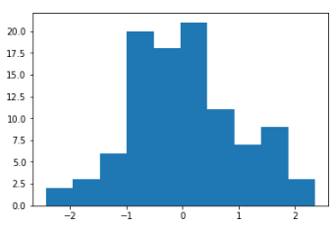
Some Useful Plots: Histogram
Generate 100 values from Normal distribution (with randn)
Insert them into 10 bins and plot
Remember
bucket sort

Slide 49

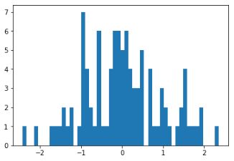
Histogram – more bins
Same values – 50 bins
50 bins
10 bins

Slide 50

3D Plots
Need to define :
Imports
Figure with 3d
X and Y, Z
Surface
Optional: Colors for surface

Slide 51


3D Plots - Data

Slide 52

3D Plots - meshgrid

Slide 53

3D Plots - meshgrid

Slide 54

3D Plots - imports

Slide 55

3D Plots - data
Z = sin ( sqrt ( x^2 + y^2) )

Slide 56

3D Plots - surface

Slide 57


3D Plots - colorbar

Slide 58
3D Plots – final plot

Slide 59

Example: Simple data analysis using Numpy Processing medical data

Slide 60

Real data analysis example
Look at the file inflammation-01.csv
(download the lecture’s code)
Tables as CSV files
Text files
Each row holds the same number of columns
Values are separated by commas

Slide 61

Real data analysis example
Look at the file inflammation-01.csv
The data: inflammation level in patients after a treatment (CSV) format
Each row holds information for a single patient
The columns represent successive days.
The first few lines in the file:
Days
Patients

Slide 62

Reading the data using NumPy

Slide 63

Properties of the data

Slide 64
Tasks
Remove the first and last 10 days
Plot the average, min, and max inflammation score per day

Slide 65

Data trimming and plots
# remove the 10 first and last days n,m = data.shape data = data[:,10:(m-9)]
How can we get the average/min/max of each day?

Slide 66

Removing first and last 10 days

Slide 67


Inflammation values per day

Slide 68
Summary: scientific computing
Numpy – library for math
Matplotlib – Library for plotting graphs
Used for data analysis
We will return to these libraries in the future

