Slide 1
Error detection and correction

Slide 2
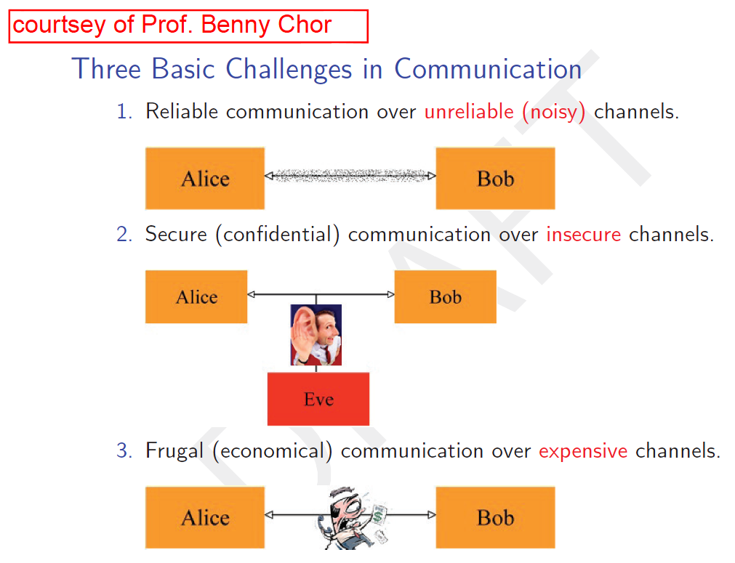
The big picture
Today

Slide 3
Plan
Error detection / error correction
Card magic
ID (ספרת ביקורת)
RAID (redundant array of independent disks)
(yet another) Spell checker
3

Slide 4
Card magic
Each card has two sides: 0 and 1
The magician arranges cards in a square, then looks away
An audience member flips one of the cards
The magician turns back, and reveals which card was flipped
0
1
0
1
0
1
1
1
0
1
1
0
0
1
1
0
0
1
0
1
0
1
0
0
1
Source: http://csu-il.blogspot.co.il/2008/03/blog-post_365.html
4

Slide 5
Mind reading card trick
Error correction / error identification
Error correcting for one card flip
What if 2 cards flip? 3? 4?
Applications:
Messages between computers
Hard disk drive
CD
Barcode
Spelling corraction
5

Slide 6
XOR – exclusive Or
Logic operator on 2 arguments
“One or the other but not both“
Returns:
True - one argument is True and other is False
False - both arguments are True or both are False
Examples (for True statements):
I’m happy XOR I’m sad
It’s raining XOR it’s not raining
http://en.wikipedia.org/wiki/Exclusive_or

Slide 7
XOR – Exclusive Or
“One or the other but not both“
Bitwise operation (Python ^):
Returns 1 if the bits are different, 0 if bits are identical
1 XOR 1 = 0
1 XOR 0 = 1
0 XOR 1 = 1
0 XOR 0 = 0
1110 XOR 1001 = 0111
Equivalent to addition without carry
Useful to calculate parity bit:
1 XOR 1 XOR 0 XOR 1 XOR 0
1 means TOTOAL odd number of ones

Slide 8
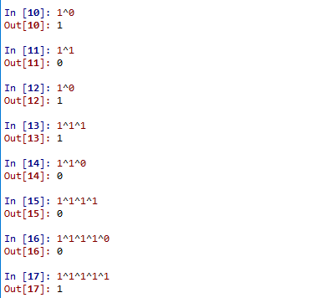
XOR Examples
A^0 = A
A^1 = not(A)
Even number
of ones
Odd number
of ones

Slide 9
XOR For Ints
What is XOR for non-binary values?
XOR all the bits, get a new integer
Present the ingeter
E.g. : 6 ^ 5 = 110 ^ 101 = 011
3
2^5 = 010 ^ 101 = 111 =(7)10

Slide 10
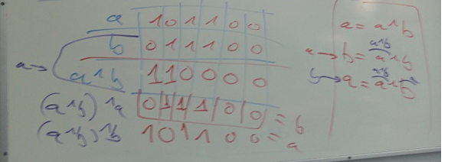
XOR Example – swap 2 vars
Problem:
Can you swap between 2 integers without using temp (or a,b=b,a) ?
a=a^b
b=a^b
a=a^b
XOR
“encodes”
the number

Slide 11
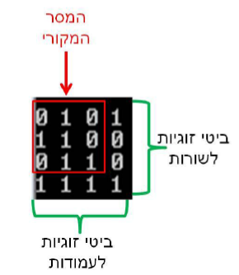
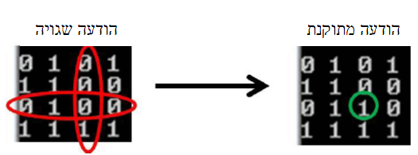
Error Correcting
A row (or column) is intact if-and-only-if its parity is 0!
11

Slide 12
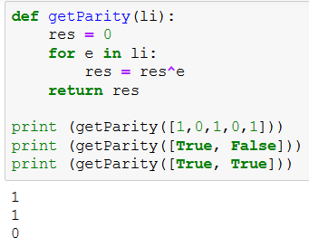
Get Parity
(Reminder: False = 0, True = 1)

Slide 13
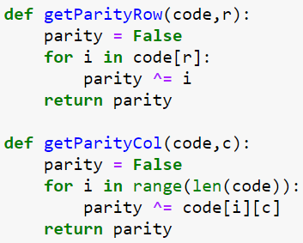
Get Parity
Code is
a nested list
(2D)
Code is
a nested list
(2D)
(Reminder: False – 0, True - 1)

Slide 14
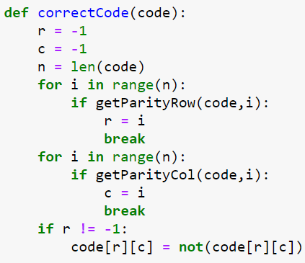
Correcting Erroneous Code (a single error)
True is returned
If there is an error!
True is returned
If there is an error!

Slide 15
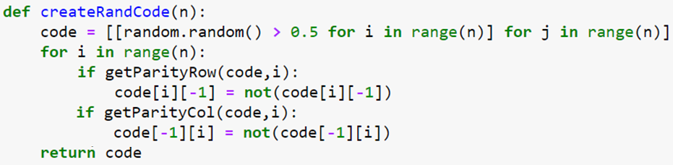
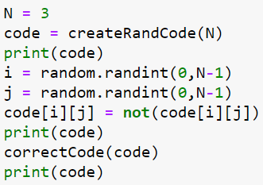
Simulation: Flip, Detect, Correct
Create random code “word”
Flip bit at random location
Detect and correct error

Slide 16
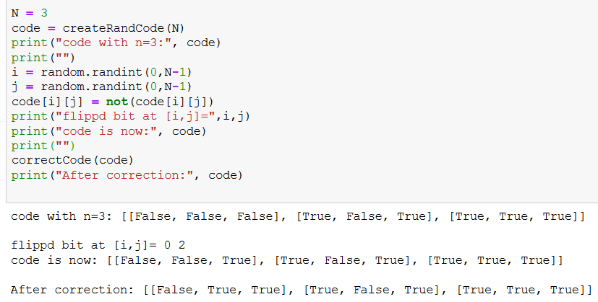
Execution Example

Slide 17

Results

Slide 18
Israeli ID Error Detection
Israeli ID: unique per person, 9 digits
Rightmost digit is control digit
How is the control digit defined/checked?
Consider first 8 ID digits
For every 2nd digit d:
d < 5 → replace d with 2*d
d ≥ 5 → replace d with 2*d + 1 – 10
Sum up all 8 digits
The control digit c is such that sum+c is a multiple of 10
Next slide: example for ID 053326187

Slide 19
Example: 053326187
0 5 3 3 2 6 1 8 7
+
+
+
+
+
+
+
0 1 3 6 2 3 1 7 = 23
(23 + control_digit) % 10 = 0
19

Slide 20
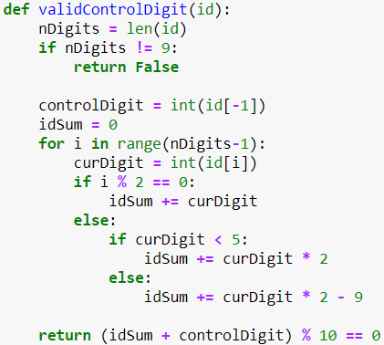

Slide 21
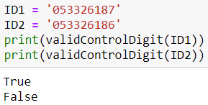
Testing..

Slide 22


RAID
Redundant array of independent disks
http://en.wikipedia.org/wiki/RAID
Add XOR disk
How to fix a flawed disk’s data?
22

Slide 23
RAID – Example
Disk 1
011 | 010 | 001 | 101 | 110 | 000 | 101 | 001 | 101 | 111
Disk 2
010 | 111 | 110 | 011 | 001 | 001 | 000 | 000 | 111 | 010
Disk 3
010 | 110 | 100 | 001 | 100 | 101 | 011 | 011 | 100 | 010
Disk 4
010 | 101 | 011 | 000 | 010 | 000 | 001 | 111 | 110 | 111
Disk 5
000 | 011 | 111 | 100 | 010 | 111 | 000 | 001 | 101 | 001

Slide 24
RAID – Control Disk
Disk 1
011 | 010 | 001 | 101 | 110 | 000 | 101 | 001 | 101 | 111
Disk 2
010 | 111 | 110 | 011 | 001 | 001 | 000 | 000 | 111 | 010
Disk 3
010 | 110 | 100 | 001 | 100 | 101 | 011 | 011 | 100 | 010
Disk 4
010 | 101 | 011 | 000 | 010 | 000 | 001 | 111 | 110 | 111
Disk 5
000 | 011 | 111 | 100 | 010 | 111 | 000 | 001 | 101 | 001
Disk 6
001 | 111 | 111 | 011 | 011 | 011 | 111 | 100 | 101 | 001
XOR on data disks

Slide 25
RAID – Set Data
Disk 1
011 | 010 | 001 | 101 | 110 | 000 | 101 | 001 | 101 | 111
Disk 2
010 | 111 | 110 | 011 | 001 | 001 | 000 | 000 | 111 | 010
Disk 3
010 | 110 | 100 | 001 | 100 | 101 | 101 | 011 | 100 | 010
Disk 4
010 | 101 | 011 | 000 | 010 | 000 | 001 | 111 | 110 | 111
Disk 5
000 | 011 | 111 | 100 | 010 | 111 | 000 | 001 | 101 | 001
Disk 6
001 | 111 | 111 | 011 | 011 | 011 | 001 | 100 | 101 | 001

Slide 26
RAID – Disk 4 is Faulty
Disk 1
011 | 010 | 001 | 101 | 110 | 000 | 101 | 001 | 101 | 111
Disk 2
010 | 111 | 110 | 011 | 001 | 001 | 000 | 000 | 111 | 010
Disk 3
010 | 110 | 100 | 001 | 100 | 101 | 101 | 011 | 100 | 010
Disk 4
000 | 000 | 000 | 000 | 000 | 000 | 000 | 000 | 000 | 000
Disk 5
000 | 011 | 111 | 100 | 010 | 111 | 000 | 001 | 101 | 001
Disk 6
001 | 111 | 111 | 011 | 011 | 011 | 001 | 100 | 101 | 001

Slide 27
RAID – Fix Disk 4
Disk 1
011 | 010 | 001 | 101 | 110 | 000 | 101 | 001 | 101 | 111
Disk 2
010 | 111 | 110 | 011 | 001 | 001 | 000 | 000 | 111 | 010
Disk 3
010 | 110 | 100 | 001 | 100 | 101 | 101 | 011 | 100 | 010
XOR on all other disks
Disk 4
010 | 101 | 011 | 000 | 010 | 000 | 001 | 111 | 110 | 111
Disk 5
000 | 011 | 111 | 100 | 010 | 111 | 000 | 001 | 101 | 001
Disk 6
001 | 111 | 111 | 011 | 011 | 011 | 001 | 100 | 101 | 001

Slide 28
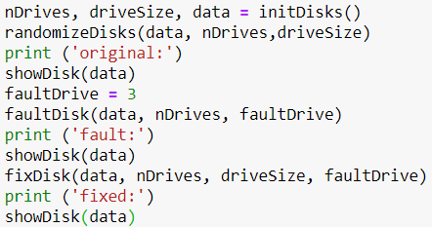
Implementation (Top-Down)

Slide 29
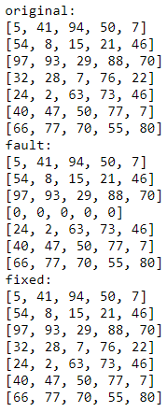
Output

Slide 30
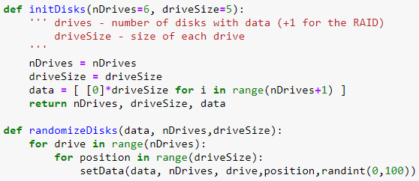
Initialization

Slide 31
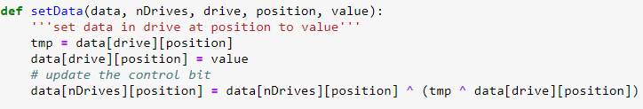
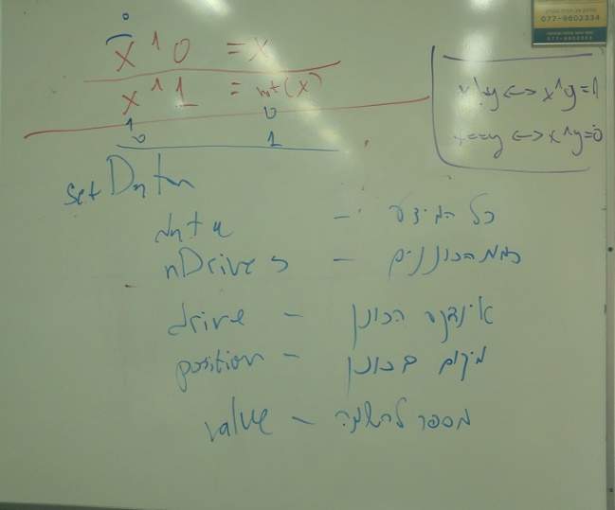
Setting Data

Slide 32
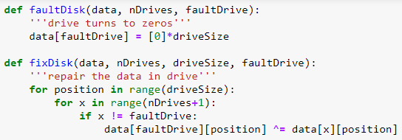
Fixing a Faulty Disk

Slide 33
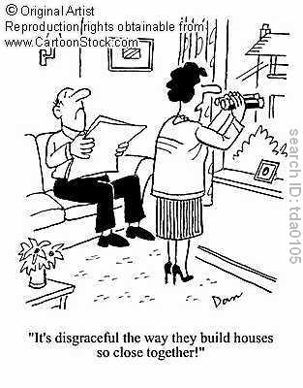
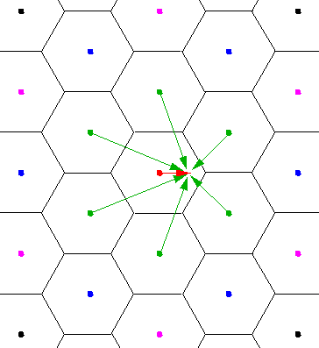
Nearest Neighbor

Slide 34
The Idea
Given a word we would like to find the closest correctly-spelled word
Correctly-spelled: predetermined list of “correct” words
Closest:
Nearest neighbor!
But how to define a distance metric?
How to do it efficiently?

Slide 35

Hamming Distance
Hamming distance, http://en.wikipedia.org/wiki/Hamming_distance
The Hamming distance between two strings of equal length is the number of positions at which the corresponding symbols are different
Examples: the Hamming distance between

Slide 36
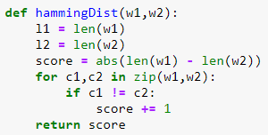
Hamming Distance Implementation

