Slide 1

Introduction to programming in Python
Fall 2018-19
Department of Software and Information Systems Engineering
Ben-Gurion University of the Negev
Lecture 21: Higher order functions continued, representing images

Slide 2
Lecture 21-22 Plan
Introduction to Digital Image representation.
Grayscale and color image
Bit depth, resolution
Class Matrix
Generating synthetic images
Basics of Digital Image Processing
Noise, and local noise reductions

Slide 3
Brief "Historical" Technological Context
transistors
speed
RAM
Hard Disk
processors
memory
5 MB
29 K
4.77 MHz
640 KB
16 GB
2 TB
1.4 G
3.7 GHz
communication
- Early 1980's
- Today (2013)
e-mail, simple text (128 ascii chars)
tons of data, inc. images (next slide)

Slide 4
A Brief Historical Context, 30 Years Later
With the proliferation of
(1) larger and faster memory,
(2) strong, inexpensive processors,
(3) faster internet,
Facebook: ~350 million photos DAILY (Sep. 2013).
Instagram: ~ 16 billion. ~55 million photos daily (Dec. 2013). (Instagram was launched on Oct. 2010!!).
This dramatic technological progress is reflected by the following saying, often attributed (apparently incorrectly) to Bill Gates, in 1981: "640KB ought to be enough for anybody".
it became possible to efficiently
(1) store,
(2) process, and
(3) transmit large digital images.

Slide 5
Basic Model of a Digital Image
A digital image is typically encoded as a n-by-m rectangle, or matrix, M, of either grey-level or color values.
m columns
x
pixel (0,m-1) |  |  |  |  | pixel (0,0)
 |  |  |  | .
 |  | pixel (x,y) |  | .
 |  |  |  | .
 |  |  |  |  | pixel (n-1,0)
n x m matrix
y
n rows

Slide 6
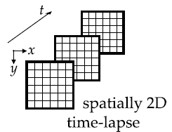
Video
A 2D image is encoded as a n-by-m matrix M
For videos (movies), there is a third dimension, "time". For each point t sampled in time, the frame at time t is nothing but a "regular" image.
6
Notes:
6

Slide 7
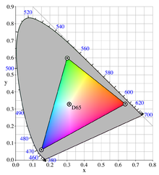
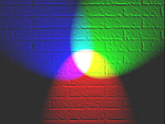
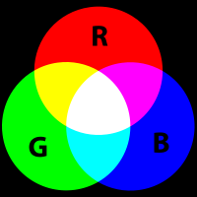
Color images (RGB)
Each element M[x, y] of the image is called a pixel, shorthand for picture element.
For grey level images, M[x, y] is a non negative real number, representing the light intensity at the pixel.
For standard (RGB) color images, M[x, y] is a triplet of values, representing the red, green, and blue components of the light intensity at the pixel.
(images from Wikipedia)

Slide 8
Gray scale images
We discuss grey scale images only (for simplicity).
Real numbers expressing grey levels have to be discretized.
A good quality photograph (human visual inspection) has 256 grey-level values (8 bits) per pixel.
The value 0 represents black, 255 represents white.
In some applications (e.g., medical imaging) 4096 grey levels (12 bits) are used.

Slide 9
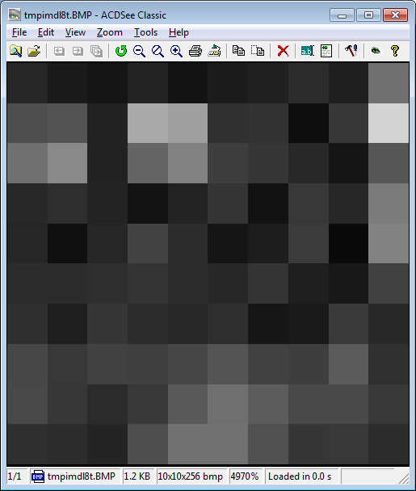
Gray scale image
8 bits per pixel (2⁸=256 gray levels): 0 = black, 255 = white
whiteish
value
38, 26, 21, 36, 19, 28, 33, 44, 31, 112,
77, 83, 34, 168, 159, 48, 50, 14, 55, 211,
112, 137, 34, 101, 129, 62, 54, 40, 21, 86,
41, 46, 35, 19, 35, 52, 18, 57, 39, 123,
38, 16, 38, 67, 45, 21, 29, 59, 10, 130,
45, 43, 46, 51, 44, 39, 53, 31, 24, 64,
47, 30, 54, 45, 40, 46, 23, 26, 58, 40,
71, 57, 66, 63, 70, 84, 65, 62, 91, 49,
72, 55, 43, 57, 90, 111, 92, 73, 74, 56,
47, 45, 36, 78, 114, 113, 81, 54, 57, 44
9
Notes:
9

Slide 10
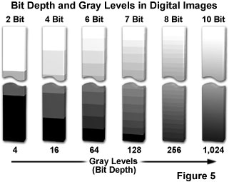
Bit Depth
Number of bits per pixel.
A human observer sees at most a few hundreds shades of gray
Higher bit depths images: typically for automated analysis by a computer.
Image from:
http://micro.magnet.fsu.edu/
Notes:
10

Slide 11
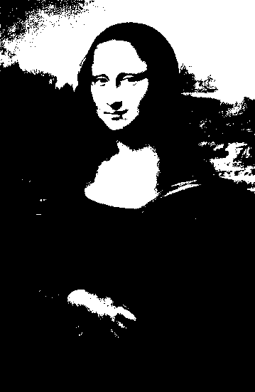
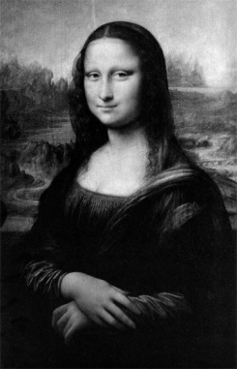
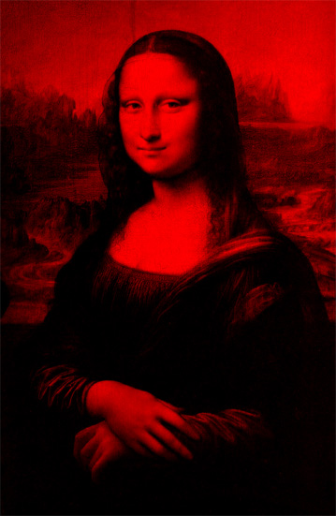
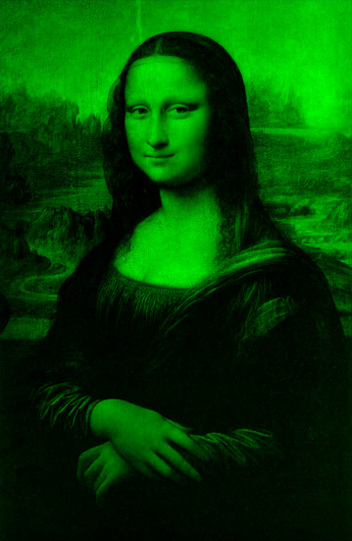
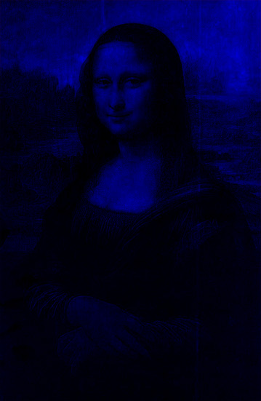
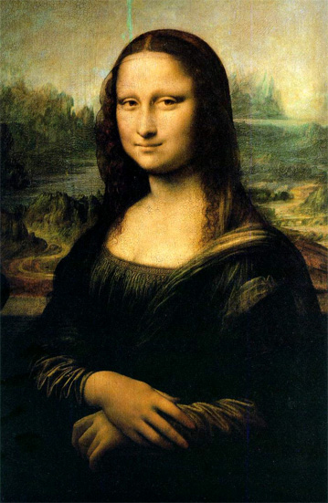
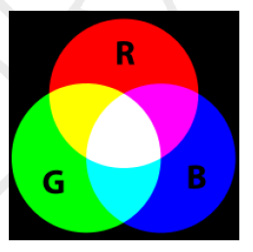
BW / Grayscale / RGB - summary
Black & white / gray-level / RGB
Black & white
(1 bpp)
256 gray level image
(8 bpp)
"true color" image
(8+8+8 = 24 bpp)
Images from: http://www.csse.uwa.edu.au/~wongt/matlab.html
11
Notes:
11

Slide 12
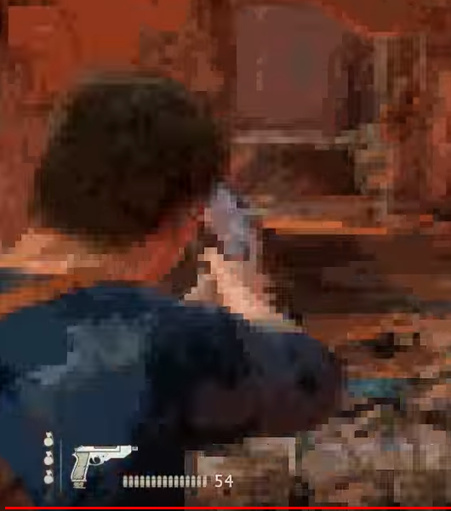
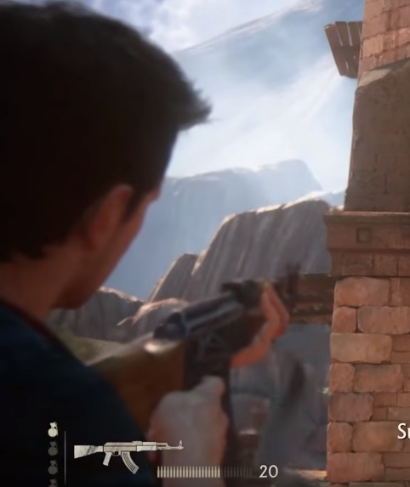
Color Bit Depth and Resolution
Notes:
12

Slide 13
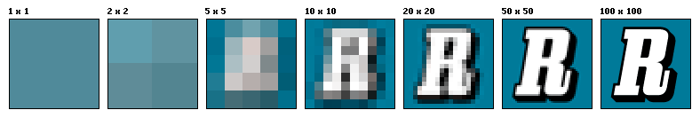
Resolution and Pixel Physical Size
Resolution is the capability of the sensor to observe or measure the smallest object clearly with distinct boundaries.
Resolution depends on the physical size of a pixel.
Higher resolution = more pixels per area = lower pixel size.
Increasing resolution
Source: wikipedia
13
Notes:
13

Slide 14
Our implementation: The Class Matrix
Class Matrix, implemented as a list of lists:
class Matrix: def __init__(self, n, m, val=0): assert n > 0 and m > 0 self.rows = [[val]*m for i in range(n)]
fill
with val

Slide 15
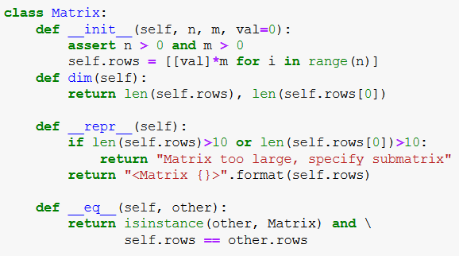
The Class Matrix (2)
calls eq
of class list

Slide 16
The Class Matrix (3)
Additional methods (we will only show how to use them):
copy
Arithmetical operations, e.g., mat1 + mat2
__getitem__ : receives a tuple (i,j)
__setitem__ : receives a tuple (i,j) and val
i and j can be both integers or both slices
display: shows the image represented by a matrix, uses the Python standard (no installation needed) package tkinter
save and load: enable storing and reading images from files

Slide 17
class Matrix - item access and assignment
>>> m = Matrix(10, 10) # 10x10 matrix of zeros
>>> m[4,5] # same as m.__getitem__((4,5))
0
>>> m[4,5] = 45 # same as m.__setitem__((4,5),45)
>>> m[4,5]
45
Note: the code file contains an additional feature: accessing and assignment of a whole slice.
>>> m[3:5, 4:8] # here i and j are both slices
<Matrix [[0 , 0, 0, 0], [0, 45, 0, 0]] >

Slide 18
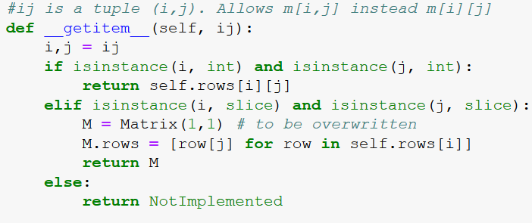
class Matrix - Indexing
# cell/sub-matrix access/assignment ####################################
both ints
both slices
int & slice

Slide 19
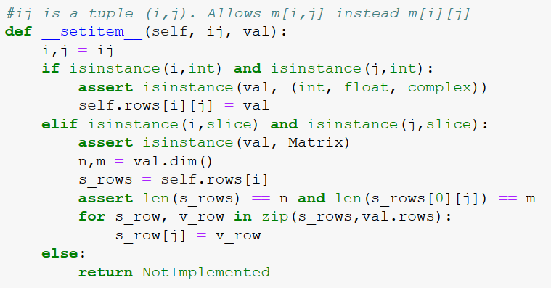
both ints
both slices

Slide 20
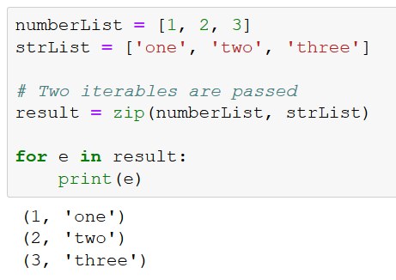
ZIP - example

Slide 21
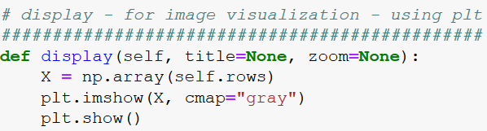
Display image

Slide 22
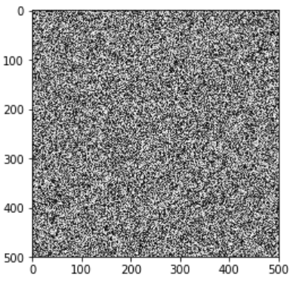
Displaying an image
n = 500
m = 500
mat = Matrix(n,m)
for i in range(n):
for j in range(m):
mat[i,j] = random.randint(0,255)
>>> mat
Matrix too large, specify submatrix
>>> mat[3:5, 4:8]
<Matrix [[216, 213, 114, 208], [2, 4, 245, 149]]>
>>> mat.display()

Slide 23
save to and load from file
>>> mat.save("./rand_image.bitmap")
A new file rand_image.bitmap will be created.
Although we gave it the extension .bitmap, this is only a text file:
>>> mat2 = Matrix.load("./rand_image.bitmap")
rand_image.bitmap
500 500
230 168 178 213 28 159 121 …
222 133 165 152 8 236 188 …
51 152 152 93 120 117 208 …
…

Slide 24
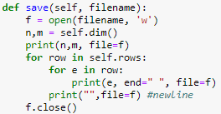
save image to file
rand_image.bitmap

Slide 25
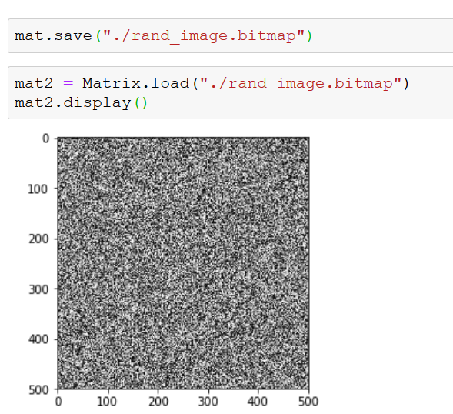
Using save to and load
same as before

Slide 26
from "real" image formats to .bitmap
we provide a way to work with "real" images in known formats such as jpg, bmp, tif etc.
The file format_conversion.py contains the transformation in both directions.
To have it work, you first need to install an external Python package called PILLOW – Python Imaging Library, from: https://pypi.python.org/pypi/Pillow
>>> image2bitmap("./an_image.jpg") #creates an_image.bitmap
>>> bitmap2image("./an_image.bitmap") #vice versa
Note: we will not need this later

Slide 27
And now for some nicer stuff

Slide 28
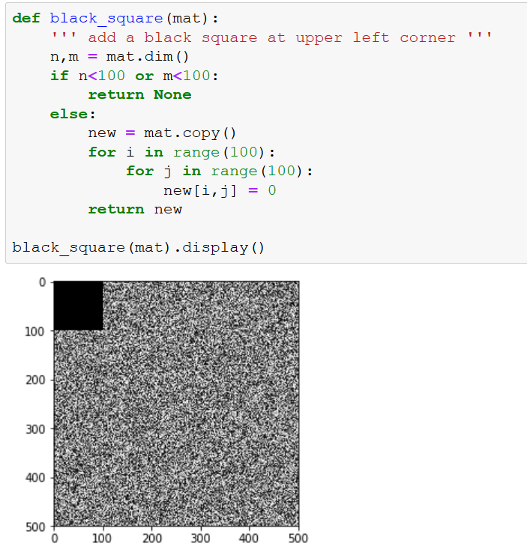

Slide 29
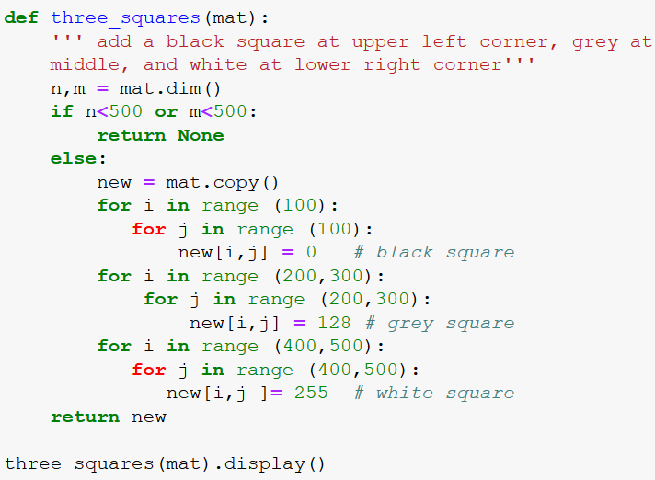
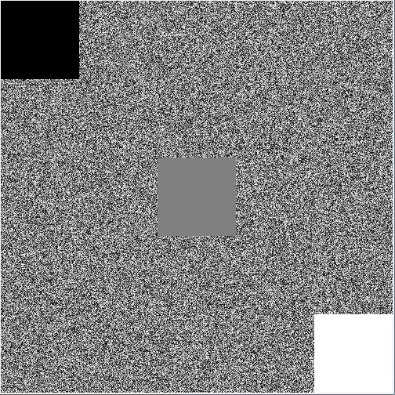

Slide 30
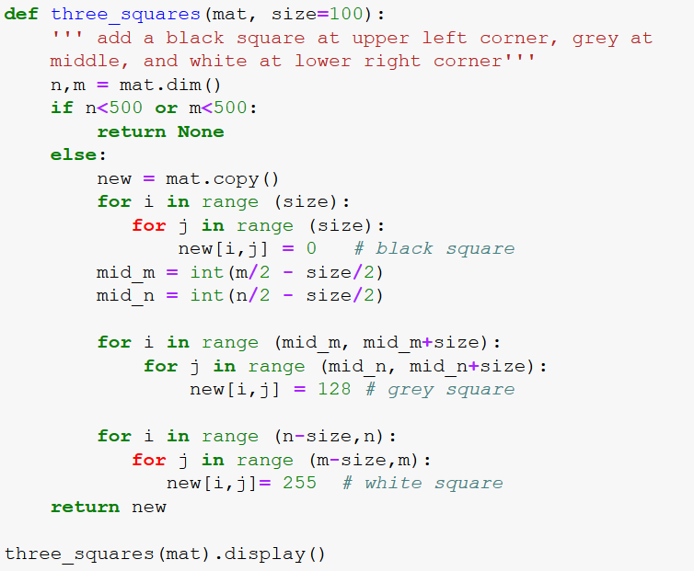
3 Squares: more generic version

Slide 31
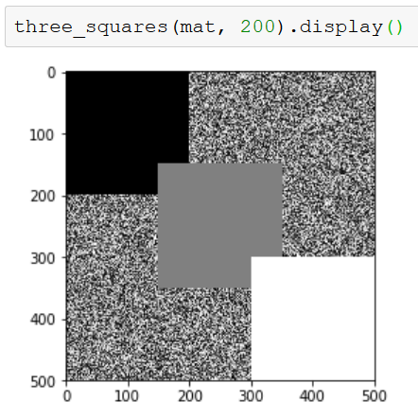
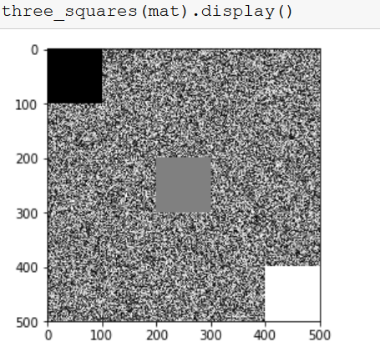
3 Squares: more generic version

Slide 32
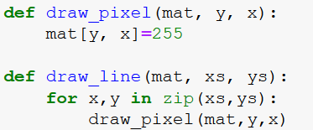
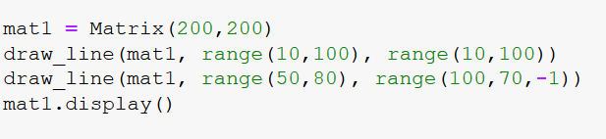
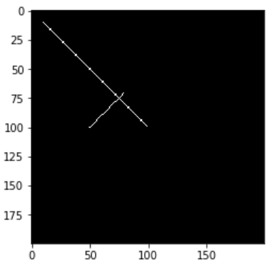
Simple Synthetic Images: Points and Lines

Slide 33
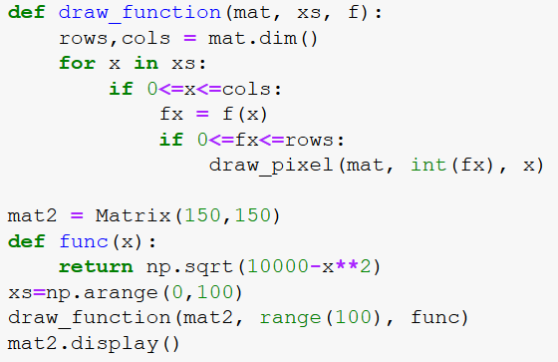
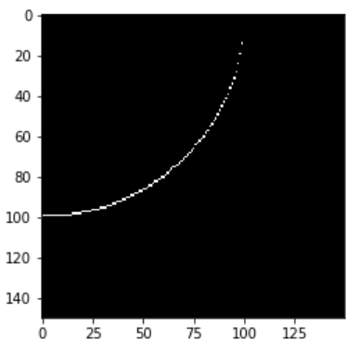
Simple Synthetic Images: Drawing Functions

Slide 34
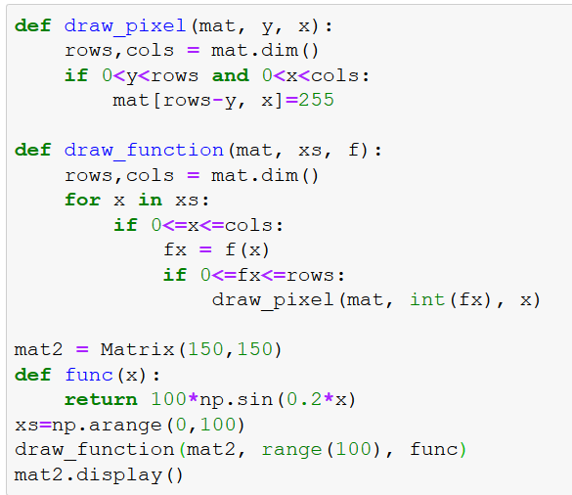
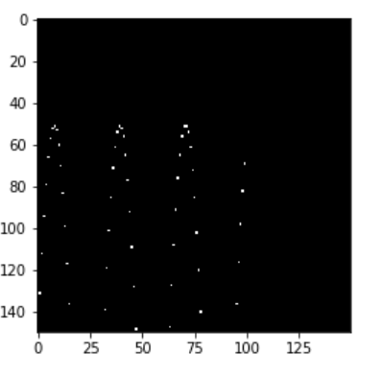
Drawing Functions where “bottom is down”

Slide 35
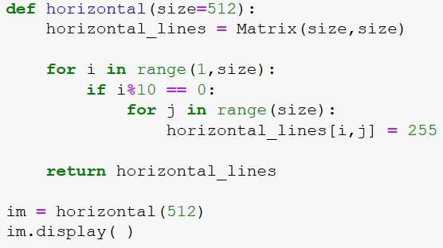
Simple Synthetic Images: Lines and More

Slide 36
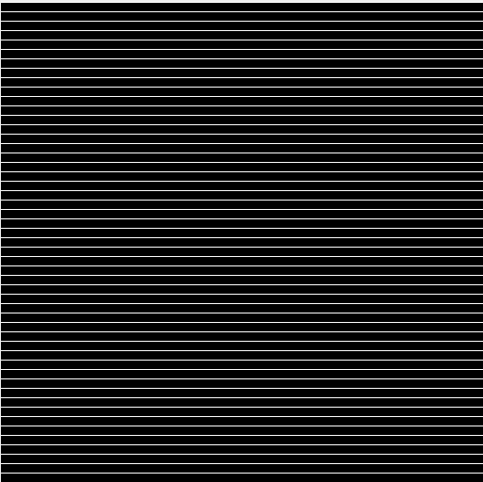
Displaying Synthetic Images: Lines and More

Slide 37
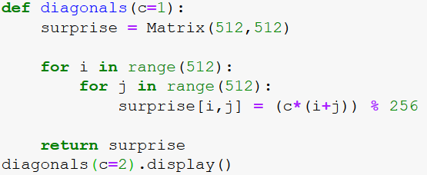
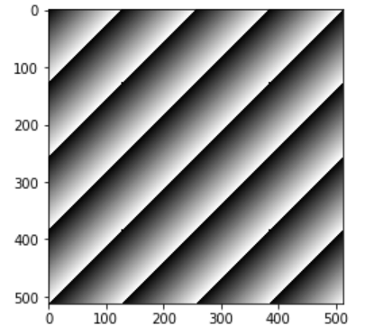
Simple Synthetic Images: Diagonal Lines

Slide 38
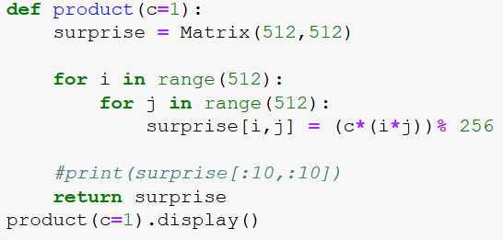
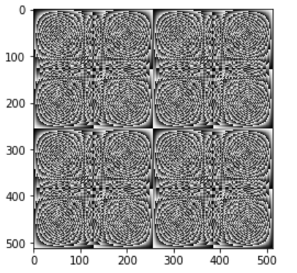
Simple Synthetic Images: Product and Circles

Slide 39
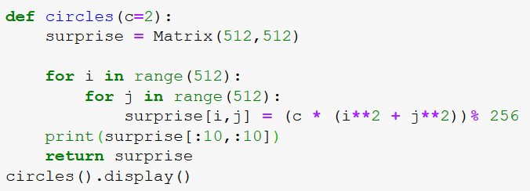
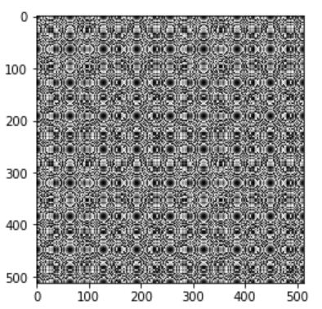
Simple Synthetic Images: Product and Circles

Slide 40
Exercises:
Go to method three squares (slide 29) and change the squares position so the white square is in the upper-left corner (and the black – in the lower right)
In the code in slide33, define func2 of x as -10*x^2 + 20x-30, and plot this function instead of func
Add a method called setColor(self, num), which sets all pixels of an image to num
For example img.setColor(0) will paint it black
Add a method called fourSquares(self, size), which draws 4 black squares at the 4 corners.

