Slide 1
Error detection and correction

Slide 2
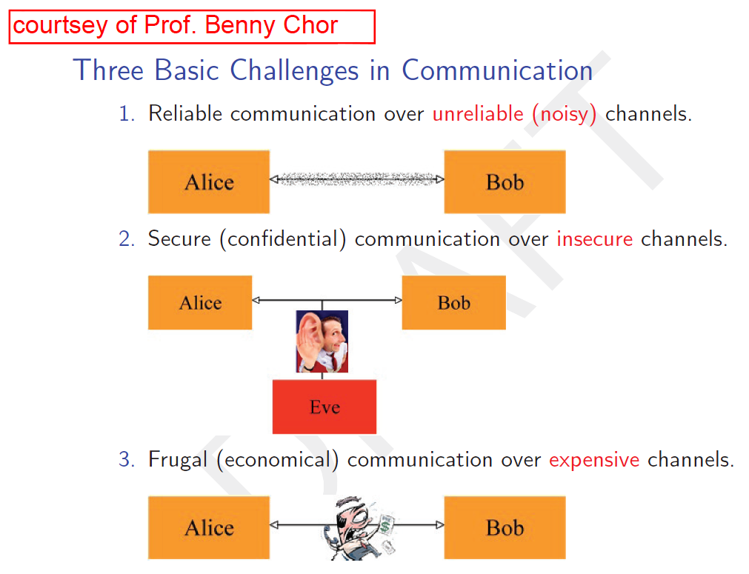
The big picture
Today

Slide 3
Plan
Error detection / error correction
Card magic
ID (ספרת ביקורת)
RAID (redundant array of independent disks)
(yet another) Spell checker
3

Slide 4
Card magic
Each card has two sides: 0 and 1
The magician arranges cards in a square, then looks away
An audience member flips one of the cards
The magician turns back, and reveals which card was flipped
0
1
0
1
0
1
1
1
0
1
1
0
0
1
1
0
0
1
0
1
0
1
0
0
1
Source: http://csu-il.blogspot.co.il/2008/03/blog-post_365.html
4

Slide 5
Mind reading card trick
Error correction / error identification
Error correcting for one card flip
What if 2 cards flip? 3? 4?
Applications:
Messages between computers
Hard disk drive
CD
Barcode
Spelling corraction
5

Slide 6
XOR – exclusive Or
Logic operator on 2 arguments
“One or the other but not both“
Returns:
True - one argument is True and other is False
False - both arguments are True or both are False
Examples (for True statements):
I’m happy XOR I’m sad
It’s raining XOR it’s not raining
http://en.wikipedia.org/wiki/Exclusive_or

Slide 7
XOR – Exclusive Or
“One or the other but not both“
Bitwise operation (Python ^):
Returns 1 if the bits are different, 0 if bits are identical
1 XOR 1 = 0
1 XOR 0 = 1
0 XOR 1 = 1
0 XOR 0 = 0
1110 XOR 1001 = 0111
Equivalent to addition without carry
Useful to calculate parity bit:
1 XOR 1 XOR 0 XOR 1 XOR 0
1 means TOTOAL odd number of ones

Slide 8
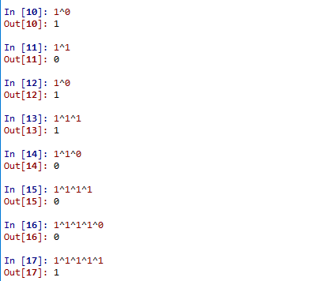
XOR Examples
A^0 = A
A^1 = not(A)
Even number
of ones
Odd number
of ones

Slide 9
XOR For Ints
What is XOR for non-binary values?
XOR all the bits, get a new integer
Present the ingeter
E.g. : 6 ^ 5 = 110 ^ 101 = 011
3
2^5 = 010 ^ 101 = 111 =(7)10

Slide 10
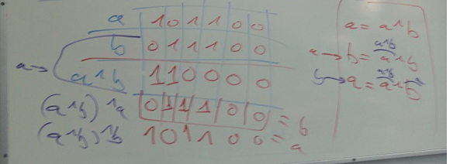
XOR Example – swap 2 vars
Problem:
Can you swap between 2 integers without using temp (or a,b=b,a) ?
a=a^b
b=a^b
a=a^b
XOR
“encodes”
the number

Slide 11
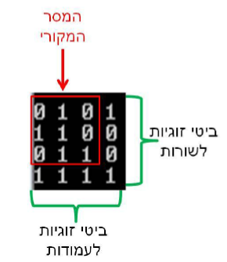
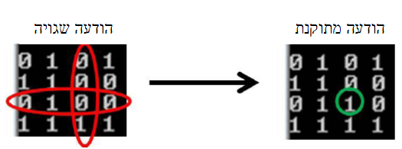
Error Correcting
A row (or column) is intact if-and-only-if its parity is 0!
11

Slide 12
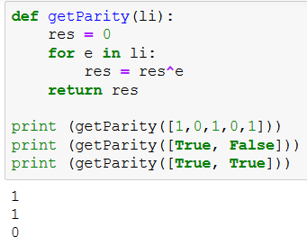
Get Parity
(Reminder: False = 0, True = 1)

Slide 13
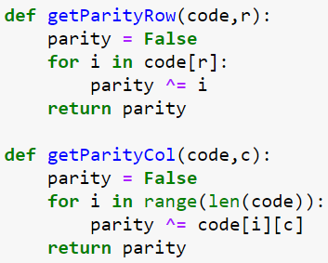
Get Parity
Code is
a nested list
(2D)
Code is
a nested list
(2D)
(Reminder: False – 0, True - 1)

Slide 14
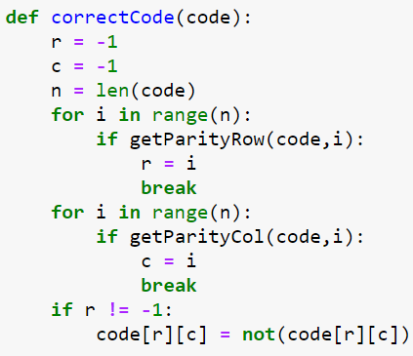
Correcting Erroneous Code (a single error)
True is returned
If there is an error!
True is returned
If there is an error!

Slide 15
Israeli ID Error Detection
Israeli ID: unique per person, 9 digits
Rightmost digit is control digit
How is the control digit defined/checked?
Consider first 8 ID digits
For every 2nd digit d:
d < 5 → replace d with 2*d
d ≥ 5 → replace d with 2*d + 1 – 10
Sum up all 8 digits
The control digit c is such that sum+c is a multiple of 10
Next slide: example for ID 053326187

Slide 16
Example: 053326187
0 5 3 3 2 6 1 8 7
+
+
+
+
+
+
+
0 1 3 6 2 3 1 7 = 23
(23 + control_digit) % 10 = 0
16

Slide 17
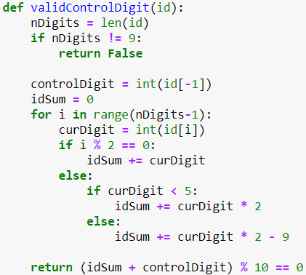

Slide 18
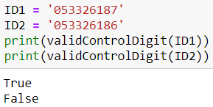
Testing..

Slide 19
Exercises
Write a function called findDigit, which receives an Israeli ID as input, without the control digit, and prints the control digit
Use validate control digit
Write a function called findAllDigits, which receives as input an array of IDs without digits, and writes all IDs

Slide 20


RAID
Redundant array of independent disks
http://en.wikipedia.org/wiki/RAID
Add XOR disk
How to fix a flawed disk’s data?
20

Slide 21
RAID – Example
Disk 1
011 | 010 | 001 | 101 | 110 | 000 | 101 | 001 | 101 | 111
Disk 2
010 | 111 | 110 | 011 | 001 | 001 | 000 | 000 | 111 | 010
Disk 3
010 | 110 | 100 | 001 | 100 | 101 | 011 | 011 | 100 | 010
Disk 4
010 | 101 | 011 | 000 | 010 | 000 | 001 | 111 | 110 | 111
Disk 5
000 | 011 | 111 | 100 | 010 | 111 | 000 | 001 | 101 | 001

Slide 22
RAID – Control Disk
Disk 1
011 | 010 | 001 | 101 | 110 | 000 | 101 | 001 | 101 | 111
Disk 2
010 | 111 | 110 | 011 | 001 | 001 | 000 | 000 | 111 | 010
Disk 3
010 | 110 | 100 | 001 | 100 | 101 | 011 | 011 | 100 | 010
Disk 4
010 | 101 | 011 | 000 | 010 | 000 | 001 | 111 | 110 | 111
Disk 5
000 | 011 | 111 | 100 | 010 | 111 | 000 | 001 | 101 | 001
Disk 6
001 | 111 | 111 | 011 | 011 | 011 | 111 | 100 | 101 | 001
XOR on data disks

Slide 23
RAID – Set Data
Disk 1
011 | 010 | 001 | 101 | 110 | 000 | 101 | 001 | 101 | 111
Disk 2
010 | 111 | 110 | 011 | 001 | 001 | 000 | 000 | 111 | 010
Disk 3
010 | 110 | 100 | 001 | 100 | 101 | 101 | 011 | 100 | 010
Disk 4
010 | 101 | 011 | 000 | 010 | 000 | 001 | 111 | 110 | 111
Disk 5
000 | 011 | 111 | 100 | 010 | 111 | 000 | 001 | 101 | 001
Disk 6
001 | 111 | 111 | 011 | 011 | 011 | 001 | 100 | 101 | 001

Slide 24
RAID – Disk 4 is Faulty
Disk 1
011 | 010 | 001 | 101 | 110 | 000 | 101 | 001 | 101 | 111
Disk 2
010 | 111 | 110 | 011 | 001 | 001 | 000 | 000 | 111 | 010
Disk 3
010 | 110 | 100 | 001 | 100 | 101 | 101 | 011 | 100 | 010
Disk 4
000 | 000 | 000 | 000 | 000 | 000 | 000 | 000 | 000 | 000
Disk 5
000 | 011 | 111 | 100 | 010 | 111 | 000 | 001 | 101 | 001
Disk 6
001 | 111 | 111 | 011 | 011 | 011 | 001 | 100 | 101 | 001

Slide 25
RAID – Fix Disk 4
Disk 1
011 | 010 | 001 | 101 | 110 | 000 | 101 | 001 | 101 | 111
Disk 2
010 | 111 | 110 | 011 | 001 | 001 | 000 | 000 | 111 | 010
Disk 3
010 | 110 | 100 | 001 | 100 | 101 | 101 | 011 | 100 | 010
XOR on all other disks
Disk 4
010 | 101 | 011 | 000 | 010 | 000 | 001 | 111 | 110 | 111
Disk 5
000 | 011 | 111 | 100 | 010 | 111 | 000 | 001 | 101 | 001
Disk 6
001 | 111 | 111 | 011 | 011 | 011 | 001 | 100 | 101 | 001

Slide 26
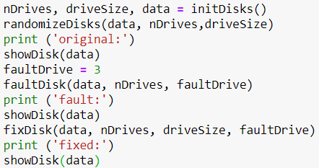
Implementation (Top-Down)

Slide 27
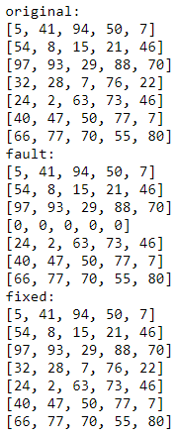
Output

Slide 28
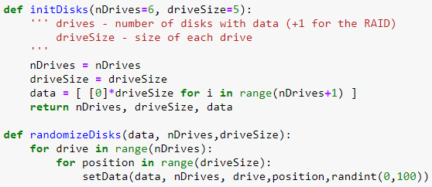
Initialization

Slide 29
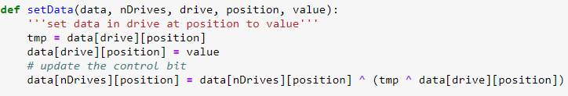
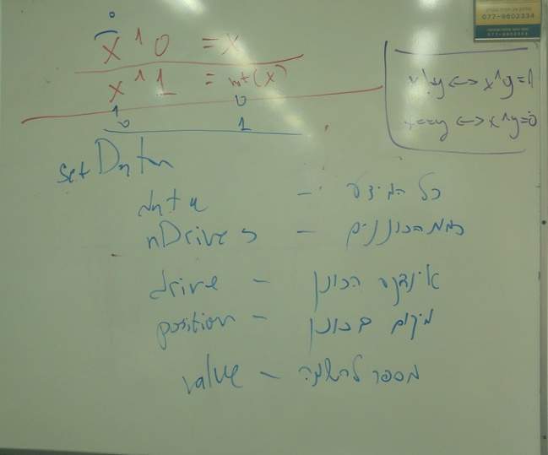
Setting Data

Slide 30
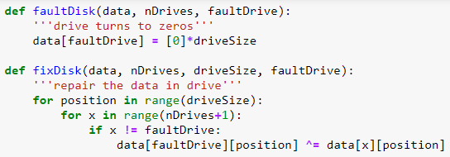
Fixing a Faulty Disk

Slide 31
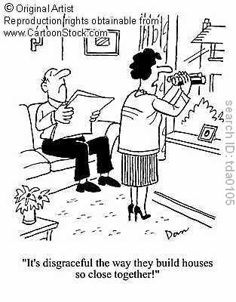
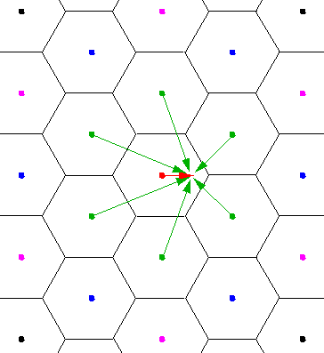
Nearest Neighbor

Slide 32
The Idea
Given a word we would like to find the closest correctly-spelled word
Correctly-spelled: predetermined list of “correct” words
Closest:
Nearest neighbor!
But how to define a distance metric?
How to do it efficiently?

Slide 33

Hamming Distance
Hamming distance, http://en.wikipedia.org/wiki/Hamming_distance
The Hamming distance between two strings of equal length is the number of positions at which the corresponding symbols are different
Examples: the Hamming distance between

Slide 34
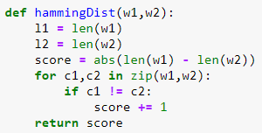
Hamming Distance Implementation

Slide 35
Exercises
Write a function names print closest:
Receive an array of strings
For each string S write: the closest to S in … (and the closest so S) the farthest from S is…

